Slide 1
Hello World Example
hello.ci file
hello.cpp file
mainmodule hello {
mainchare Main {
entry Main(CkArgMsg ∗m);
};
};
#include <stdio.h>
#include “hello.decl.h”
class Main : public CBase_Main {
public: Main(CkArgMsg∗ m) {
ckout << “Hello World!” << endl;
CkExit();
};
};
#include “hello.def.h”
Notes:
Structure of charm program
Include decl and def files, generated code
Inherit from generated chare class

Slide 2
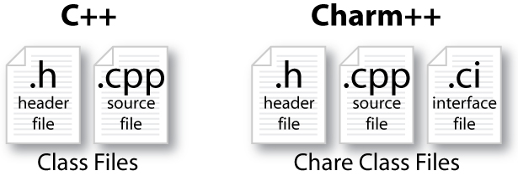
Charm++ File Structure
C++ objects (including Charm++ objects)
Defined in regular .h and .cpp files
Chare objects, entry methods (asynchronous methods)
Defined in .ci file
Implemented in the .cpp file
Hello World Example
Compiling
charmc hello.ci
charmc -c hello.cpp
charmc -o hello hello.o
Running
./charmrun +p7 ./hello
The +p7 tells the system to use seven cores

Slide 3
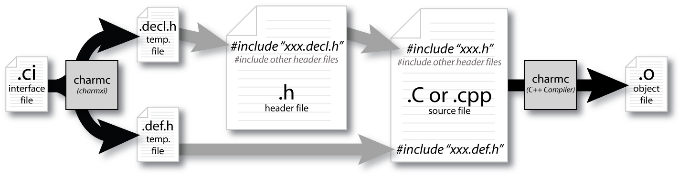
Compiling a Charm++ Program

