Slide 1
Managing Object Placement
System knows how to “find” objects efficiently:
(collection, index) → processor
Applications can specify a custom mapping or use simple runtime-provided options (e.g. blocked, round-robin)
Distribution can be static or dynamic!
Key abstraction: application logic doesn’t change, even though performance might

Slide 2
Managing Object Placement
Application logic development decoupled from any notion of processors or object mapping
Separation in time: make it work, then make it fast
Division of labor: domain specialist writes object code, CS specialist writes mapping
Portability: different mappings for different systems, scales, or configurations

Slide 3
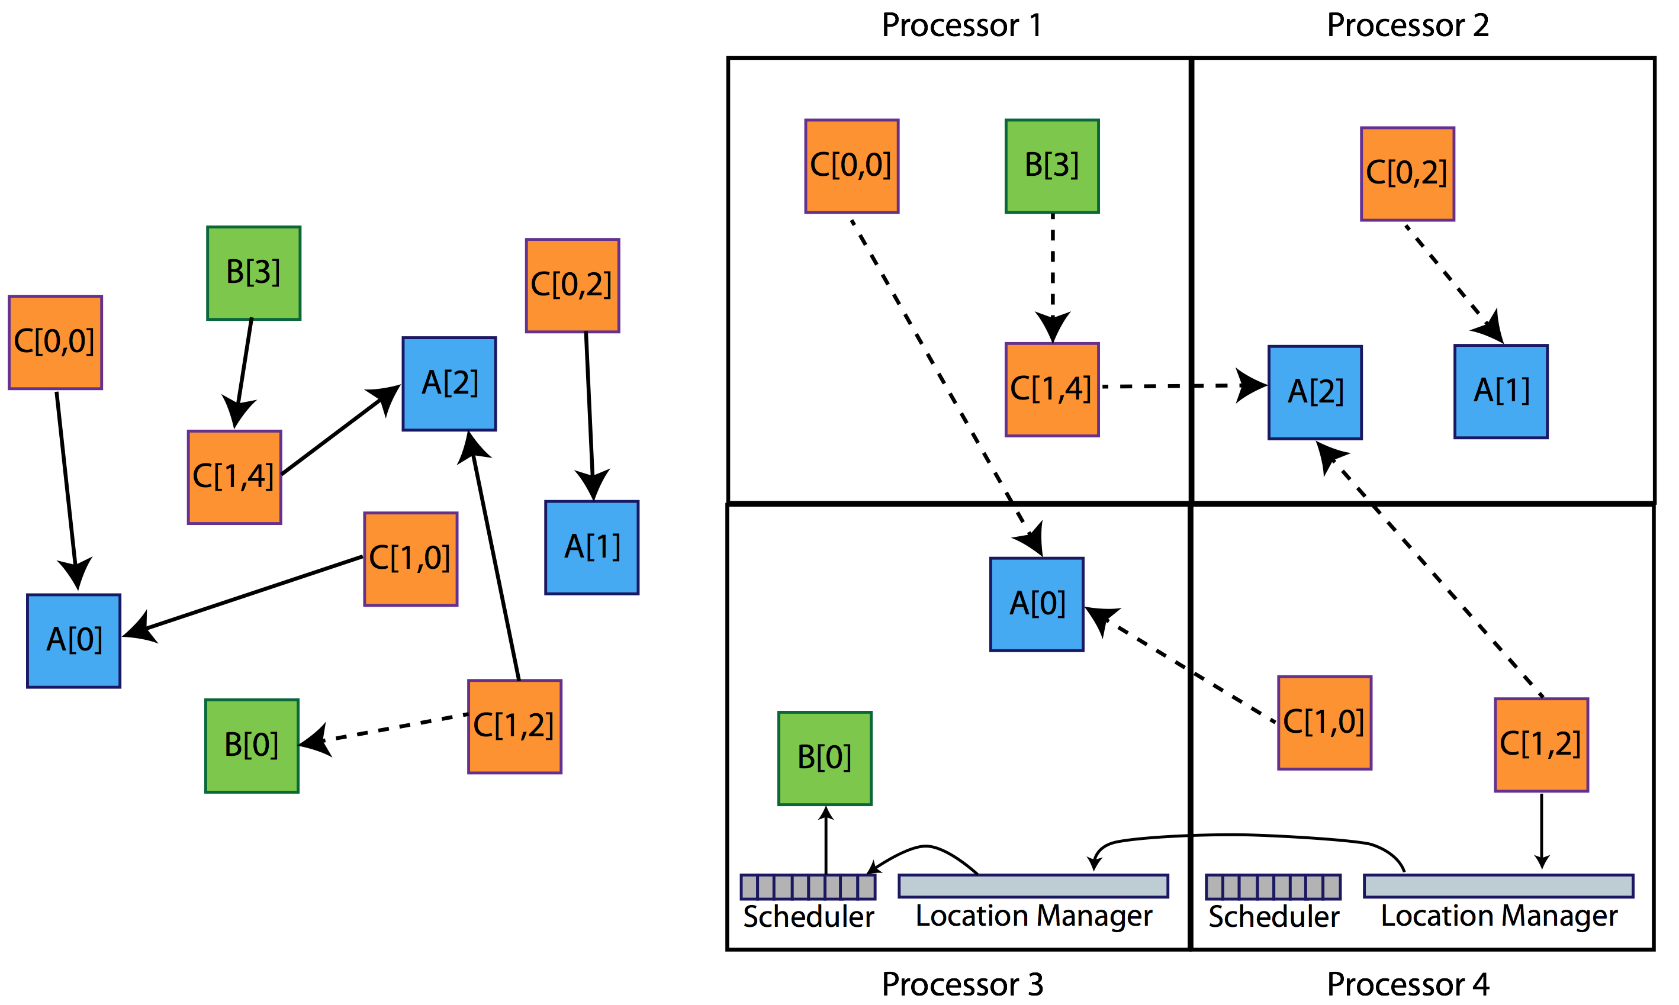
Collections of Objects

Slide 4
Broadcast
A message to each object in a collection
The chare array proxy object is used to perform a broadcast
It looks like a function call to the proxy object
From the main chare that created a chare array:
From a chare array element that is a member of the same array:
From any chare that has a proxy p to the chare array
CProxy_Hello helloArray = CProxy_Hello::ckNew(helloArraySize);
helloArray.foo();
thisProxy.foo();
p.foo();

Slide 5
Reduction
Combines a set of values: sum, max, concat, …
Usually reduces the set of values to a single value
Combination of values requires an operator
The operator must be commutative and associative
Each object calls contribute in a reduction

Slide 6
Reduction: Example
mainmodule reduction {
mainchare Main {
entry Main(CkArgMsg∗ msg);
entry [reductiontarget] void done(int value);
};
array [1D] Elem {
entry Elem(CProxy_Main mProxy);
};
}
Entry Method Attribute

Slide 7
Reduction: Example
#include “reduction.decl.h”
const int numElements = 49;
class Main : public CBase_Main {
public:
Main(CkArgMsg∗ msg) { CProxy_Elem::ckNew(thisProxy, numElements); }
void done(int value) { CkPrintf(“value: %d\n”, value); CkExit(); }
};
class Elem : public CBase_Elem {
public:
Elem(CProxy_Main mProxy) { int val = thisIndex; CkCallback cb(CkReductionTarget(Main, done), mProxy); contribute(sizeof(int), &val, CkReduction::sum_int, cb);
}
};
#include “reduction.def.h”
Output
value: 1176
Program finished.

