Slide 1
Chares Are Reactive
The way we described Charm++ so far, a chare is a reactive entity:
If it gets this method invocation, it does this action,
If it gets that method invocation then it does that action
But what does it do?
In typical programs, chares have a life-cycle
How to express the life-cycle of a chare in code?
Only when it exists
i.e. some chares may be truly reactive, and the programmer does not know the life cycle
But when it exists, its form is:
Computations depend on remote method invocations, and completion of other local computations
A DAG (Directed Acyclic Graph)!

Slide 2
Fibonacci Example
mainmodule fib {
mainchare Main {
entry Main(CkArgMsg∗ m);
};
chare Fib {
entry Fib(int n, bool isRoot, CProxy_Fib parent);
entry void result(int value);
};
};

Slide 3
Fibonacci Example
class Main : public CBase_Main {
public:
Main(CkArgMsg∗ m) {
CProxy_Fib::ckNew(atoi(m−>argv[1]), true, CProxy_Fib());
}
};
class Fib : public CBase_Fib {
public:
CProxy_Fib parent; bool isRoot; int total, count;
Fib(int n, bool isRoot_, CProxy_Fib parent_)
: parent(parent_), isRoot(isRoot_), total(0), count(2) {
if (n < THRESHOLD) {respond(seqFib(n)); }
else { CProxy_Fib::ckNew(n − 1, false, thisProxy);
CProxy_Fib::ckNew(n − 2, false, thisProxy);
}
}
};

Slide 4
Fibonacci Example
void result(int val) // when a child chare sends me its value
{total += val; if (−−count == 0) respond(); }
void respond(int val) {
if (isRoot) { CkPrintf(“Fibonacci number is: %d\n”, result);
CkExit();
}
else { parent.result(total);
delete this;
// this is unusual. Tells the system to delete this
//chare after the entry method returns.
}
}
};

Slide 5
Consider the Fibonacci Chare
The Fibonacci chare gets created
If it is not a leaf,
It fires two chares
When both children return results (by calling respond):
It can compute my result and send it up, or print it
But in our example, this logic is hidden in the flags and counters
This is simple for this simple example, but …
Lets look at how this would look with a little notational support

Slide 6
Structured Dagger: a script for a hare
Actually, its a script for an entry method
But a common pattern is to use a single “run” method for a chare as an sdag (structured dagger) entry method
You have to write this script in .ci file
Because we don’t want to parse entire C++ code.
Some entry methods are defined, rather than just declared, in the .ci file using sdag notation.
Some other entry methods get implicitly defined if they get used in “when blocks” of sdag scripts
module xyz {
chare abc {
entry abc();
entry f1();
entry run() {
sdag script here.
includes when statements
}
entry g();
entry h(..) {
second sdag entry method.
}
};
}
.ci file

Slide 7
Structured Dagger The when construct
The when construct
Declare the actions to perform when a message is received
In sequence, it acts like a blocking receive
entry void someMethod() {
when entryMethod1(parameters) { /∗ block2 ∗/ }
when entryMethod2(parameters) { /∗ block3 ∗/ }
};

Slide 8
Structured Dagger The serial construct
The serial construct
A sequential block of C++ code in the .ci file
The keyword serial means that the code block will be executed without interruption/preemption, like an entry method
Syntax: serial <optionalString> { /* C++ code */ }
The <optionalString> is used for identifying the serial for performance analysis
Serial blocks can access all members of the class they belong to
Examples (.ci file):
entry void method1(parameters) {
serial {
thisProxy.invokeMethod(10);
callSomeFunction();
}
};
entry void method2(parameters) {
serial “setValue” {
value = 10;
}
};

Slide 9
Structured Dagger The implicit sequence construct
entry void someMethod() {
serial { /∗ block1 ∗/ }
when entryMethod1(parameters) serial { /∗ block2 ∗/ }
when entryMethod2(parameters) serial { /∗ block3 ∗/ }
};
Sequence:
Sequentially execute /* block1 */
Wait for entryMethod1 to arrive, if it has not, return control back to the Charm++ scheduler, otherwise, execute /* block2 */
Wait for entryMethod2 to arrive, if it has not, return control back to the Charm++ scheduler, otherwise, execute /* block3 */

Slide 10
Structured Dagger The when construct: waiting for multiple invocations
Execute sdagScript when method1 and method2 arrive
Which is semantically the same as this:
when method1(int param1, int param2),
method2(bool param3)
{sdagScript}
when myMethod1(int param1, int param2) {
when myMethod2(bool param3) { }
}
{sdagScript}

Slide 11
Structured Dagger Boilerplate
Structured Dagger can be used in any entry method (except for a constructor)
Can be used in a mainchare, chare, or array
For any class that has Structured Dagger in it you must insert
The Structured Dagger macro: [ClassName]_SDAG_CODE

Slide 12
Structured Dagger Boilerplate
The .ci file:
The .cpp file:
[mainchare,chare,array] MyFoo {
…
entry void method(parameters) {
// … structured dagger code here …
};
…
}
class MyFoo : public CBase_MyFoo {
MyFoo_SDAG_Code /* insert SDAG macro */
public:
MyFoo() { }
};

Slide 13
Fibonacci with Structured Dagger
mainmodule fib {
mainchare Main {
entry Main(CkArgMsg∗ m);
};
chare Fib {
entry Fib(int n, bool isRoot, CProxy_Fib parent);
entry void calc(int n) {
if (n < THRESHOLD) serial { respond(seqFib(n)); }
else {
serial {
CProxy_Fib::ckNew(n − 1, false, thisProxy);
CProxy_Fib::ckNew(n − 2, false, thisProxy);
}
when result(int val), result(int val2)
serial { respond(val + val2); }
}
};
entry void result(int);
};
};

Slide 14
Fibonacci with Structured Dagger
#include “fib.decl.h”
#define THRESHOLD 10
class Main : public CBase_Main {
public: Main(CkArgMsg∗ m) {
CProxy_Fib::ckNew(atoi(m−>argv[1]), true, CProxy_Fib()); } };
class Fib : public CBase_Fib {
public:
Fib_SDAG_CODE
CProxy_Fib parent; bool isRoot;
Fib(int n, bool isRoot_, CProxy_Fib parent_):parent(parent_), isRoot(isRoot_)
{ thisProxy.calc(n); }
int seqFib(int n) { return (n < 2) ? n : seqFib(n − 1) + seqFib(n − 2); }
void respond(int val) {
if (!isRoot) { parent.response(val);
delete this; }
else { CkPrintf(”Fibonacci number is: %d\n”, val);
CkExit(); }
}
};
#include “fib.def.h”
Notes:
Just say.. The rest of the code remains the same.. (Unless we want to show the Fib_SDAG_CODE macro)

Slide 15
Structured Dagger The when construct : reference number matching
The when clause can wait on a certain reference number
If a reference number is specified for a when , the first parameter for the when must be the reference number
Semantics: the when will “block” until a message arrives with that reference number
when method1[100](int ref, bool param1)
/∗ sdag block ∗/
proxy.method1(200, false); /∗ will not be delivered to the above when ∗/
proxy.method1(100, true); /∗ will be delivered to the above when ∗/

Slide 16
Structured Dagger The if-then-else construct
The if-then-else construct:
Same as the typical C if-then-else semantics and syntax
if (thisIndex.x == 10) {
when method1[block](int ref, bool someVal) /∗ code block1 ∗/
} else {
when method2(int payload) serial {
//... some C++ code
}
}

Slide 17
Structured Dagger The for construct
The for construct:
Defines a sequenced for loop (like a sequential C for loop)
Once the body for the ith iteration completes, the i + 1 iteration is started
for (iter = 0; iter < maxIter; ++iter) {
when recvLeft[iter](int num, int len, double data[len])
serial { computeKernel(LEFT, data); }
when recvRight[iter](int num, int len, double data[len])
serial { computeKernel(RIGHT, data); }
}
iter must be defined as a class member
Because no variables are allowed to be declared inside sdag scripts
class Foo : public CBase_Foo {
public: int iter;
};

Slide 18
Structured Dagger The while construct
The while construct:
Defines a sequenced while loop (like a sequential C while loop)
while (i < numNeighbors) {
when recvData(int len, double data[len]) {
serial {
/∗ do something ∗/
}
when method1() /∗ block1 ∗/
when method2() /∗ block2 ∗/
}
serial { i++; }
}

Slide 19
Structured Dagger The overlap construct
The overlap construct:
By default, Structured Dagger defines a sequence that is followed sequentially
overlap allows multiple independent clauses to execute in any order
Any constructs in the body of an overlap can happen in any order
An overlap finishes in sequence when all the statements in it are executed
Syntax: overlap { /* sdag constructs */ }
What are the possible execution sequences?
serial { /∗ block1 ∗/ }
overlap {
serial { /∗ block2 ∗/ }
when entryMethod1[100](int ref_num, bool param1) /∗ block3 ∗/
when entryMethod2(char myChar) /∗ block4 ∗/
}
serial { /∗ block5 ∗/ }

Slide 20
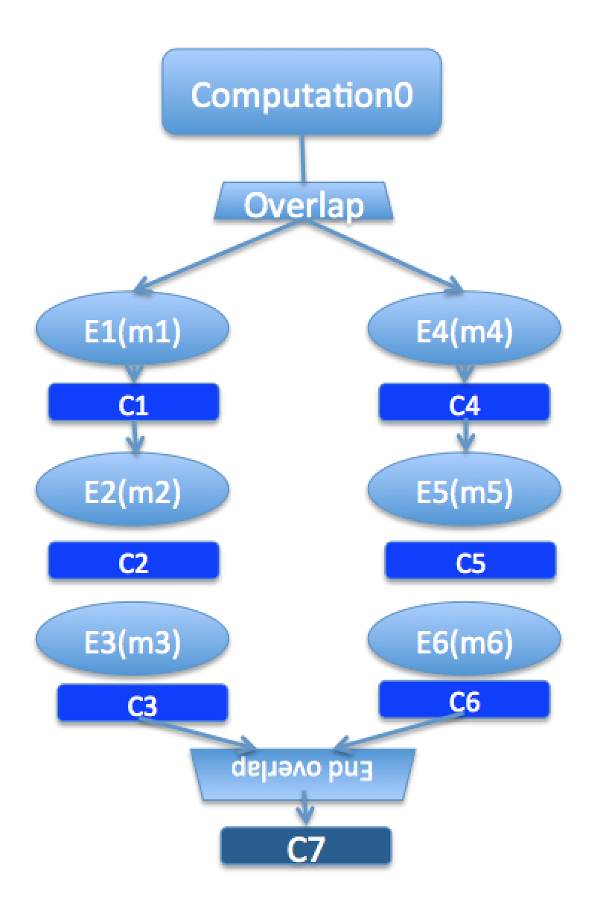
Illustration of a Long “Overlap”
Overlap can be used to get back some of the asynchrony within a chare
But it is constrained
Makes for more disciplined programming
Fewer race conditions

