Slide 1


CS598 LVK Parallel Programming with Migratable Objects
Laxmikant (Sanjay) Kale
http://charm.cs.illinois.edu
Parallel Programming Laboratory
Department of Computer Science
University of Illinois at Urbana Champaign

Slide 2
Special topics class
We have an unexpectedly (but pleasantly) large class size
No Teaching Assistants!
A lot of responsibility for learning on you
Also: it is a class where you learn by doing

Slide 3
Class Format
Lectures
Reading papers or chapters
Homeworks
Programming assignments: 5-6 tentative
Semester project: groups of 4 students
A midterm exam, but with a small fraction of grade; no final exam
Tentative breakdown:
Homework | Program. Assignments | Midterm Exam | Project
15% | 30% | 15% | 40%

Slide 4
Computers
EWS workstations to begin with
Later: Taub cluster
(Hopes for Blue Waters are dashed with expected availability being probably too late for the class).
Taub is large enough

Slide 5
Course organization
On the web:
Engineering wiki page will be set up
https://wiki.engr.illinois.edu/display/cs598lvk
Backup page:
http://courses.engr.illinois.edu/cs598lvk
Lecture notes
(always pdf, some also in ppt) will be posted online
Homework assignments, updates: online
Newsgroup: class.fa12.cs598lvk hosted at news.cs.illinois.edu
You are responsible for checking these regularly

Slide 6
The Changing Landscape in Computing
Laxmikant (Sanjay) Kale
http://charm.cs.illinois.edu
Parallel Programming Laboratory
Department of Computer Science
University of Illinois at Urbana Champaign

Slide 7
Computers
We have been able to make a “Machine” that can do complex things
Add and multiply really fast
Weather forecast, design of medicinal drugs
Speech recognition, Robotics, Artificial Intelligence..
Web browsers, internet communication protocols
What is this machine based on?

Slide 8
The Modest Switch
All these capabilities are built from an extremely simple component:
A controllable switch
The usual Electrical switch we use every day
The electric switch we use turns current on and off
But we need to turn it on and off by hand
The result of turning the switch on?
The “top end” in the figure becomes
raised to a high voltage
Which makes the current flow through the bulb
The Controllable Switch
No hands
Voltage controls if the switch is on or off
High voltage at input: switch on
Otherwise it is off

Slide 9

Lets use them creatively
Input1
Output is high if both the inputs input1 AND input2 are high
If either of the inputs is low, the output is low.
Output
This is called an AND gate
Input2
Now, can you make an OR gate with switches?

Slide 10
OR Gate
Input1
Output
Input2
Output is low iff both inputs are low
I.e. Output is high if either of the inputs (or both) are high (input1 OR input2)

Slide 11


Basic Gates
There are three basic kinds of logic gates
Operation:
AND
of two inputs
OR of two inputs
NOT
(complement)
on one input
Logic gate:
Two Questions:
How can we implement such switches?
What can we build with Gates?
Adders, controllers, memory elements, computers!

Slide 12
How to make switches?
Use mechanical power
Use hydrolic pressure
Use electromechanical switches (electromagnet turns the switch on)
Current technology:
Semiconductor transistors
A transistor can be made to conduct electricity depending on the input on the 3rd input
CMOS “gates” (actually, switches)
Two properties of Switches and Gates:
Size
Switching and Propagation delay

Slide 13
Clock Speeds
Since we can make transistors smaller
Which means smaller capacitances..
Imagine filling up “tanks” with “water” (electrons)
We can turn them on or off faster
Which means we can make our computers go faster
Clock cycle is selected so that the parts of the computer can finish basic calculations within the cycle
And indeed:

Slide 14
The Virtuous Cycle
If you can make transistors smaller,
You can fit more of them on a chip
Cost per transistor decreases
AND: propagation delays get smaller
So they can run faster!
Can you make them smaller?
Technological progress needed, but can be done
This led to:
Cheaper and faster processors every year

Slide 15
Moore’s law
Commonly (mis) stated as
“Computer Performance doubles every 18 months”
Gordon Moore observed in 1965
“The complexity… has increased roughly a factor of two per year. [It] can be expected to continue…for at least 10 years”
Its about number of transistors per chip
Funny thing is: it held true for 40+ years
And still going until 2020
“Self Fulfilling prophecy”

Slide 16
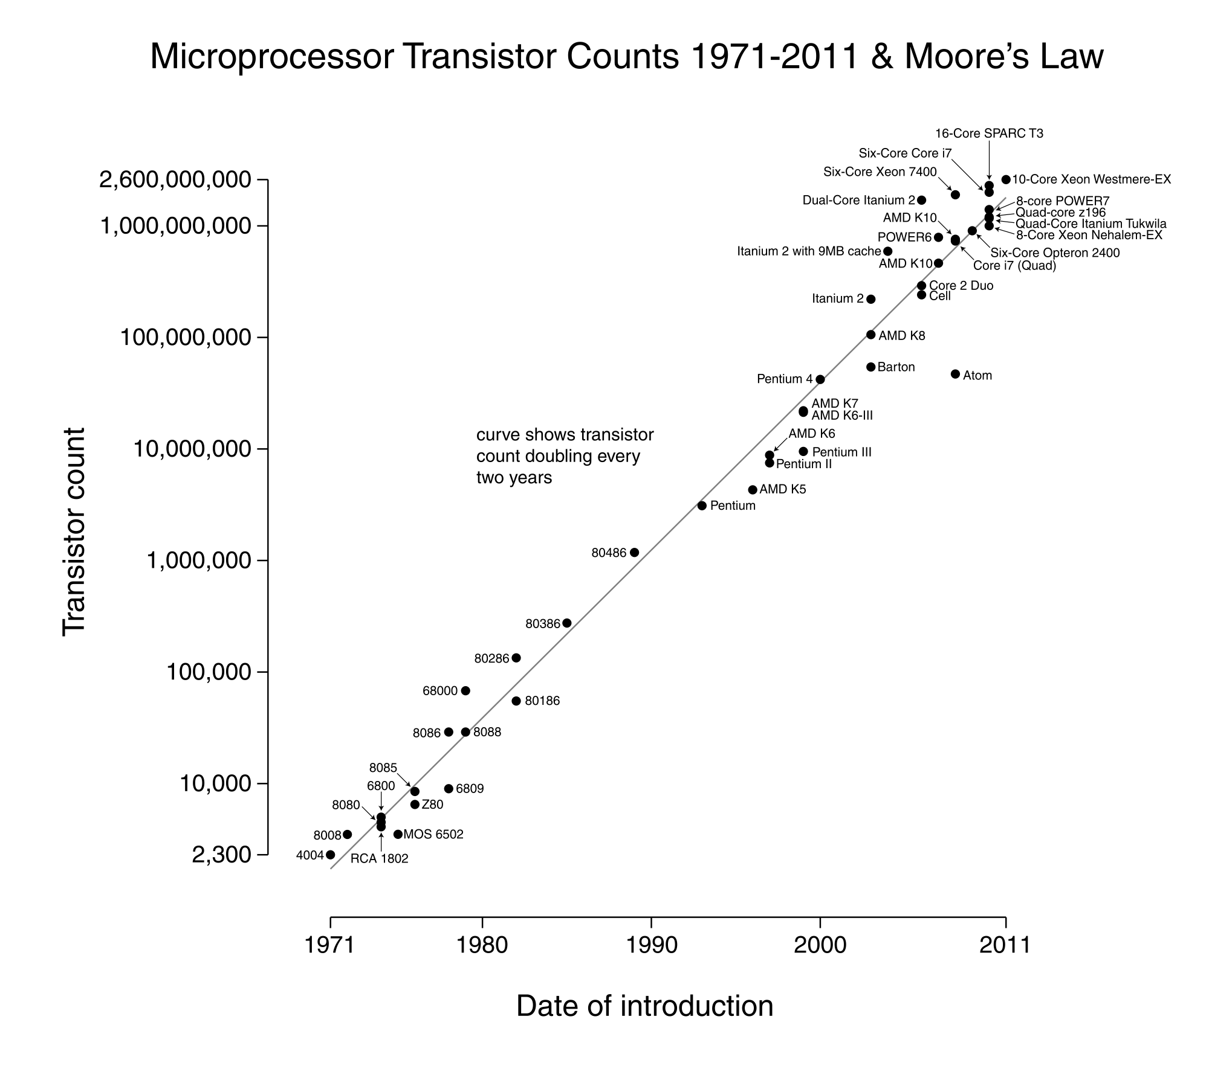

Slide 17
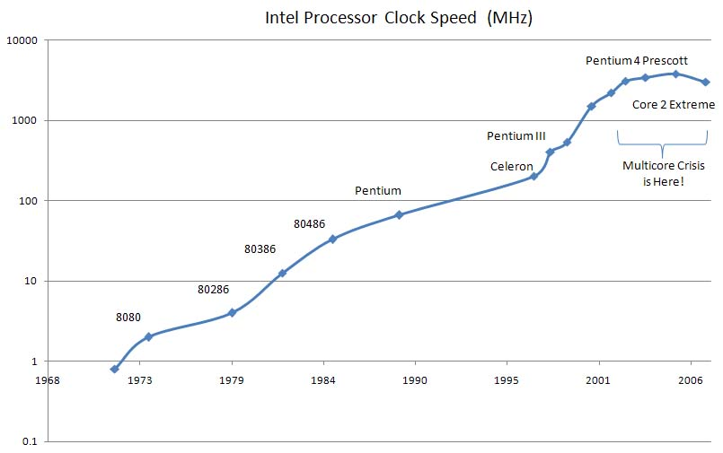
Clock Speeds Increased
Notice a little trick: x axis goes only to 2003!

Slide 18
Until they stopped increasing!
Why?

Slide 19
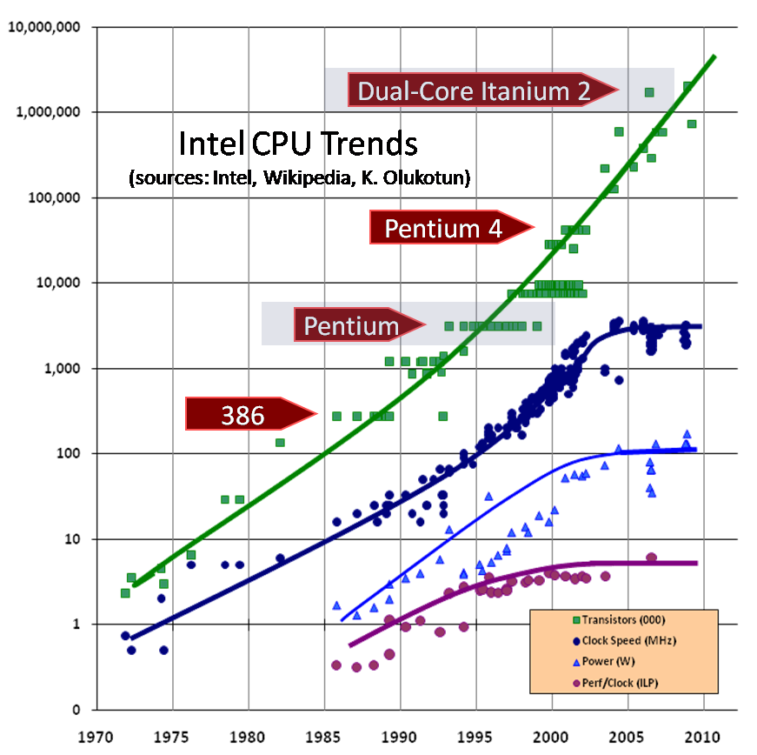
Source: Herb Sutter (orig. in DDJ)

Slide 20
Prediction in 1999
From Shekhar Borkar, Intel, at MICRO’99
So, the chips were getting too hot

Slide 21
Prediction in 1999
From Shekhar Borkar, Intel, at MICRO’99
So, the chips were getting too hot

Slide 22

Bill Wulf in 1978
William Wulf is one of the most influential computer scientist
Visited IISc Bangalore around 1978..
When I was a grad student
Talked about his parallel computing projects
C.mmp
Stated motivations: Sequential processors cannot keep getting faster forever, because of physical limitations. We need many processors working in parallel to compute faster
But engineers kept making it go faster
Until now

Slide 23
Frequency and Power
There is a cubic relationship between them!
So, if frequency doubles, dynamic power increases 8-fold!
Static power is still a significant part of the total power
So, frequencies stalled around 2-3 GHz
Which is plenty fast

Slide 24
Power vs Frequency on a given processor

Slide 25
Energy vs Frequency on a given processor

Slide 26
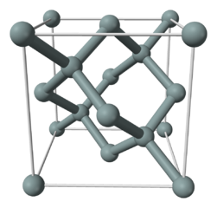
Number of Transistors/chip?
Well, they will keep on growing for the next ten years
May be a bit slowly
Current technology is 32 or 22 nanometers
We may go to 9 or 5 nanometers feature size
i.e. gap between two wires (as a simple definition)
For comparison:
Distance between a carbon and a Hydrogen atom is 1 Angstrom = 0.1 nanometer!
Silicon-Silicon bonds are longer
5 Aº lattice spacing (image: wikipedia)
i.e. 0.5 nanometer
So, we are close to atomic units!

Slide 27
Consequence
We will get to over 50 billion transistors/chip!
What to do with them?
Put more processors on a chip
Beginning of the multicore era:
Number of cores per chip doubles every X years
X= 2? 3?

Slide 28
Change is changing
To summarize:
We had been used to computers becoming faster every year.. That “change” was a constant
The change is: that the speeds are no longer changing..
So, Lets think about what happens over the next 10 years
And later:
What happens after ten years, when even the number of transistors don’t increase any more

Slide 29
Why didn’t we witness disruption?
Why haven’t we seen the effect of this disruption already?
After all the clocks stop speeding after 2003
Better integration :
Intel’s Nehalem architecture
4-way multicores could show useful performance gains for the users
Running multiple programs simultaneously
Browse, Index mail, virus scans, …
The real questions will appear in near future

Slide 30
Specialized processors
It was discovered that somewhat specialized processors can be made to compute (some things) faster, within the same technology
Vector instructions (SSE):
“Do these 4 additions” as a single instruction
IBM’s Cell processor (Toshiba, Sony)
NVIDIA GPGPU
Intel “maybe” LRB, MIC
It was assumed that people will not be willing to program specialized processors
NVIDIA proved them wrong
And time was right

Slide 31
Threat to business models
The previous were just ways in which processors can keep getting faster
But will people buy them?
Intel/AMD/.. Business model is fueled by people buying new machines every few years
Why do people buy new machines?
New apps need faster processors

Slide 32
Two problems
Maybe we have all the speed we need..
I.e. for all the apps that we need
Nyah..
Maybe 8-16 cores is all that you need
We are still seeing improvements because
We use multiple programs on the desktop
Browsers can do multiple things: get data, draw pictures, ..
But now, we have enough power.. Right?
So, unless one (or more) parallel “killer app” appears, the market will stop growing

Slide 33
What if we stop here?
Technical advantage (of Intel, AMD, NVIDIA) is no longer an advantage
Processor chips become commodity
Get manufactured wherever it is cheap
Innovation shifts elsewhere
Or more starkly stated:
Innovation in computing stops

Slide 34
Alternative: Parallelism
If we find killer apps that need all the parallel power we can bring to bear
With 50B transistors, at least 100+ processor cores on each chip
There is a tremendous competitive advantage to building such a killer app
So, given our history, we will find it
What are the enabling factors:
Finding the application areas.
Parallel programming skills

Slide 35
A few candidate areas
Some obvious ones:
Image processing:
Find all pictures of my daughter with a cat from all my albums
Already exists and will improve.. Parallelism is easy

Slide 36
More interesting areas
Speech recognition:
almost perfect already
But speaker dependent, minor training, and needs non-noisy environment
Frontier: speaker independent recognition with non-controlled environment
Broadly: Artificial intelligence
(Of course, HPC)

Slide 37
All Programming Becomes Parallel Programming

Slide 38
Parallel programming Skills
So, all machines will be (are?) parallel
So, almost all programs will be parallel
True?
There are 10 million programmers in the world
Approximate estimate
All programmers must become parallel programmers
Right? What do you think?

Slide 39
One way: Sequential-Parallel Separation
Our own example is a language called “Charisma”
or a simpler variant: structured dagger
A charisma Script captures parallel interactions
Sequential methods
consume data given to them, compute, and “publish” data
without knowing where it goes
You can decompose development into a team of parallel experts and domain experts..
No “Joe Shmoe”s

Slide 40
Another Idea
Parallel programming is difficult
in large part because of race conditions, and non-deterministic behavior
Things may be complete in different orders than we expected
Its like relativity: no notion of “simultaneity” on a parallel machine
Result: a bug that manifests itself once in 10,000 runs
So, Outlaw non-determinism
Not quite like the Indiana legislature and Pi
Develop programming models that don’t allow it
Need to interoperate with languages that do
Our Examples:
MSA (Multiphase Shared Arrays), Charisma

Slide 41
Programming Models innovations
Expect a lot of novel programming models
There is scope for new languages, unlike now
Only Java broke thru after C/C++
This is good news:
If you are a computer scientist wanting to develop new languages
Bad news:
If you are a application developer
DO NOT WAIT FOR “AutoMagic” Parallelizing compiler!

Slide 42
Digging Deeper
First law of holes:
If you in a hole, stop digging!
But we are in a hole, and we cannot help but dig!
Let me explain

Slide 43
Latency to Memory
To process data, we must bring it to the processor and take the resulting data back to memory
DRAM, the main inexpensive memory chip
Once you supply an address to it, it gets you the data after 50-ish nanoseconds
Doesn’t improve that much over time: 80 -> 30 ns
A single core clock is 2 GHz: it beats twice in a nanosecond!
So, you are working with someone who is 100 times slower..
Not just that: a single core can do 4+ additions/cycle
We are talking about putting hundreds of cores on a chip?!

Slide 44
Latency vs bandwidth
Imagine you are putting a fire out
Only buckets, no hose
100 seconds to walk with a bucket from water to fire, (and 100 to walk to walk back)
But if you form a bucket brigade
(needs people and buckets)
You can deliver a bucket every 10 seconds
So, latency is 100 or 200 seconds, but bandwidth is 0.1 buckets per second.. Much better
Whats more: you can increase bandwidth:
Just make more lines of bucket brigade

Slide 45
Bandwidth can be increased
“Only” need resources
But technology is going to help
More pins can be added to chips
3D stacking of memory can increase bandwidth further

Slide 46
Exploiting bandwidth
Need methods that translate latency problems to bandwidth problems
The difference with bucket brigade analogy:
Data dependencies
If what mixture to ask in the next bucket depends on what happened using the last one
Solution: concurrency

Slide 47
Architectural methods
For translating latency problems to bandwidth problems
Ask for nearby data: Cache hierarchies
Ask for data in bulk (prefetch) and operate on it in bulk : cell processor
OR
Every cycle: work on one problem, send its memory request out, and switch to another problem
GPGPU (and before that, MTA, ..)

Slide 48
Impact on segments
Mobile
Laptop/desktop
Small clusters
Supercomputers

Slide 49
Mobile computing
Clients will get more powerful
Within same form factors..
Of course, well connected
Your children will tell their children wistfully about text messaging..
Because speech-to-text (and may be brain-to-screen) may become the norm
Headsets will whisper the name of the person walking towards you..
Robots?

Slide 50
Laptops/Desktops
This is the big question mark
Depends on the parallel killer app
Of course, speech recognition, video processing will be there, as in mobile

Slide 51
Small Clusters
Probably some of the biggest impact
Broadening of the market
Every company/department can afford a very powerful (100 TF? PF?) cluster
All kinds of activities can be computerized
Intel’s example:
fashion designers examining how a cloth will drape over a body, and how it will move
Via simulation
Operations Research
Business Strategies via AI support

Slide 52
Supercomputers
Exascale will be reached by 2020
May be 50 MW, and 10^18 ops/s
I expect
Will create breakthroughs in Science and Engineering of great societal impact
Biomedicine, materials,
Astronomy, Physics: theories
Engineering design of better artifacts
Control Nuclear fusion (fission) may solve energy problems
Climate??
If society deems it beneficial, technology can be developed for beyond-exascale (1000 Eflops?)

Slide 53
Next Era: End of Moore’s Law
10-15 years from now
No more increase in performance from a general purpose chip!
What can we predict about this era?
First, innovation would shift to functional specialization
would have started happening already
Next, innovation will shift to application areas, and molecular sciences: biomedical (nanobots?), materials,
Another 5-10 years, you can develop CSE applications knowing that machine won’t change under your feet
Maybe

Slide 54
Caution: predicting future
Remember:
1900 or so: “End of Science” predicted
1990 or so: “End of History” predicted

Slide 55
Summary
Times are changing:
I.e. they are getting more stagnant!
Those who can “get” parallel, will have an advantage
If killer parallel app doesn’t arrive, progress will stall
Complete “stasis” after 15-20 years..
But then such things have been predicted before

