Slide 1
Modules and libraries

Slide 2
Modules and libraries
So far, our programs had one .ci file, and one module in it
Modular programming requires that we should be able to factor the program into multiple modules
The final program is a composition of multiple modules
In case of libraries, these are modules someone else wrote earlier that we want to use in our application
It may even be available as a (say, proprietary) binary
Of course, with the necessary header files
Today, we learn how to use those
Laxmikant Kalé and PPL (UIUC) – Parallel Migratable Objects

Slide 3
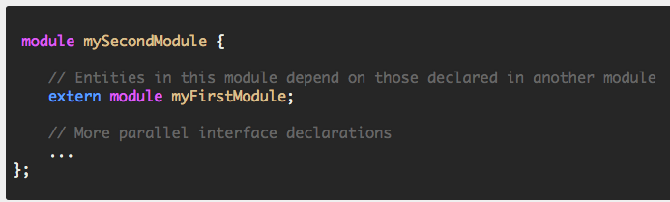
Multiple modules
A program with multiple modules
Can be in a single .ci file, but typically, each module has its own .ci file
You have to include in your .ci file, as extern, the module you plan to use

Slide 4
Reachability
Every module that you want to use must:
Either : be included via a chain of “extern module” commands starting from the mainmodule
Or: be listed in a “–module modulename” phrase as a link-time option.

Slide 5
Separately compiled libraries
The decl.h file of the imported (library) module must be provided by the library writer to the application (i.e. importing module)
Along with a .h file, as usual in sequential programs
But the .C file doesn’t need to be provided.

Slide 6
Matching size of the library array
Suppose you want to use a library for sorting elements in a chare array
The client (your application) has a 1D chare array App of size N
You want the library to also have a 1D array of the same size
You also want the correspondng elements to be on the same processor
So: you can hand over your elements to the corresponding element of the library array locally, and get back the sorted result from it

Slide 7
Bound arrays
You can bind one chare array to another
That means: the corresponding elements of the 2 arrays live on the same processor.
If the “parent” array elements migrates, any array element bound to it also migrates with it
You can make regular (without proxy) sequential method calls between the corresponding elements (via ckLocal() call)

Slide 8
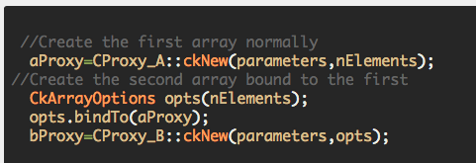
Syntax for creating a bound array
We use the “options” we learned before
The bound array (sometimes called the shadow array) is created *after* the parent array is created.
The chare types of the two arrays can be different
Typically, they are different

Slide 9
Using bound arrays in libraries
To use a parallel “sort” library,
you create your 1D chare array,
Pass its proxy (in your main chare) to the initialization call of the sort library
Which will create its array bound to your array

Slide 10
ckLocal()
If a chare is on the same processor as you,
you can get a (regular, C++) pointer to it, and
invoke methods on it directly
(or even access its public data members)
How?
x = A[i].ckLocal()
A is a proxy to a 1D chare array
x gets pointer to a C++ object
What if the A[i] is not on your processor?
This call returns NULL

