Slide 1
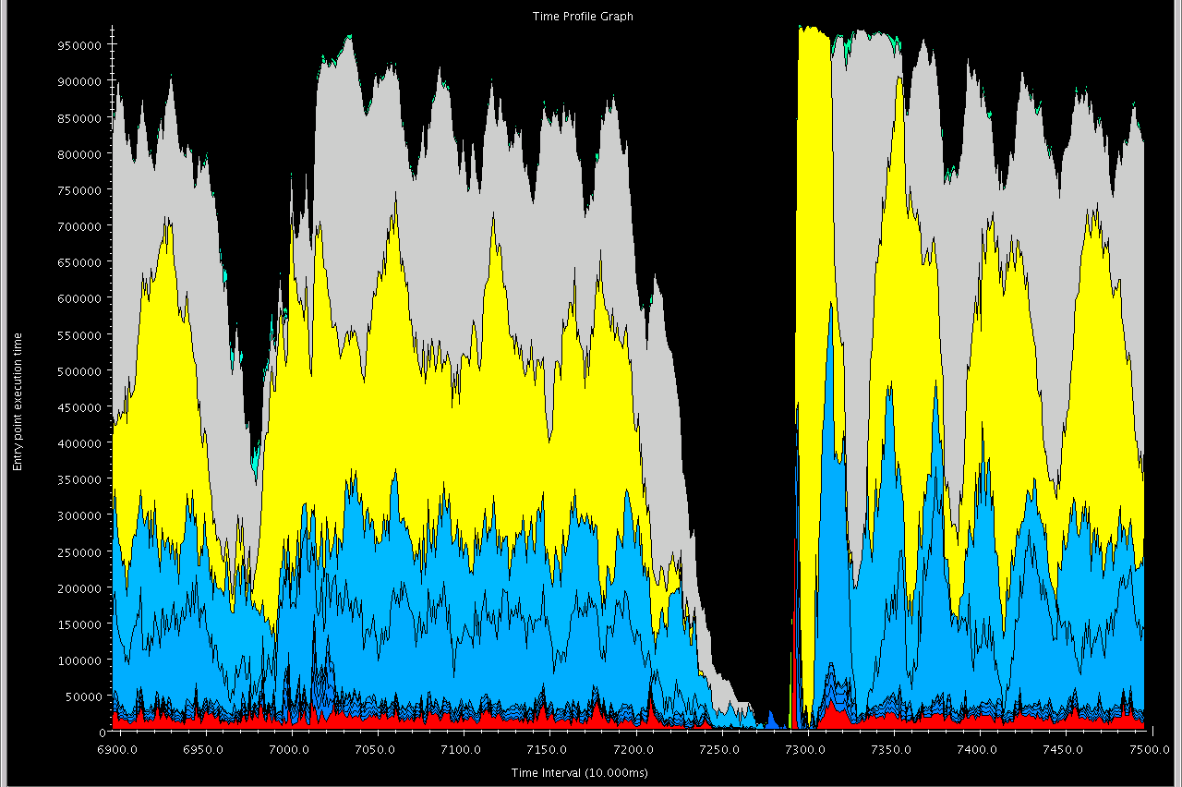
Time Profile

Slide 2
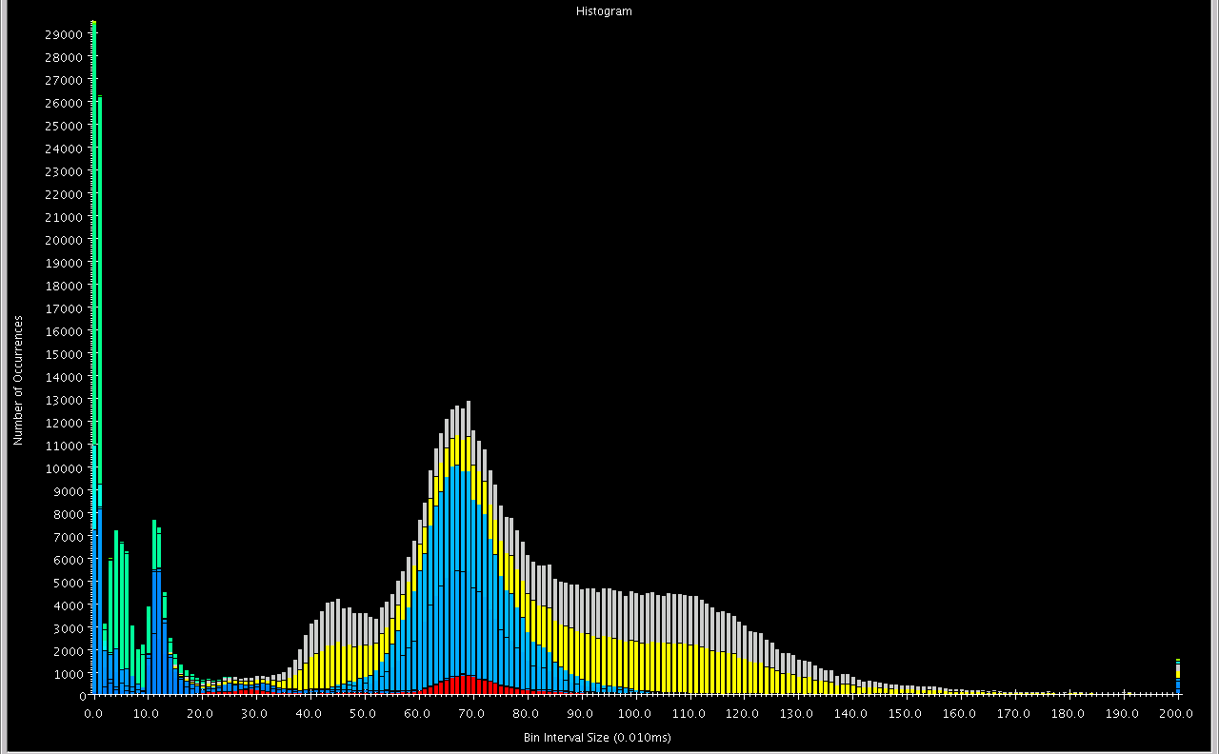
Histogram

Slide 3
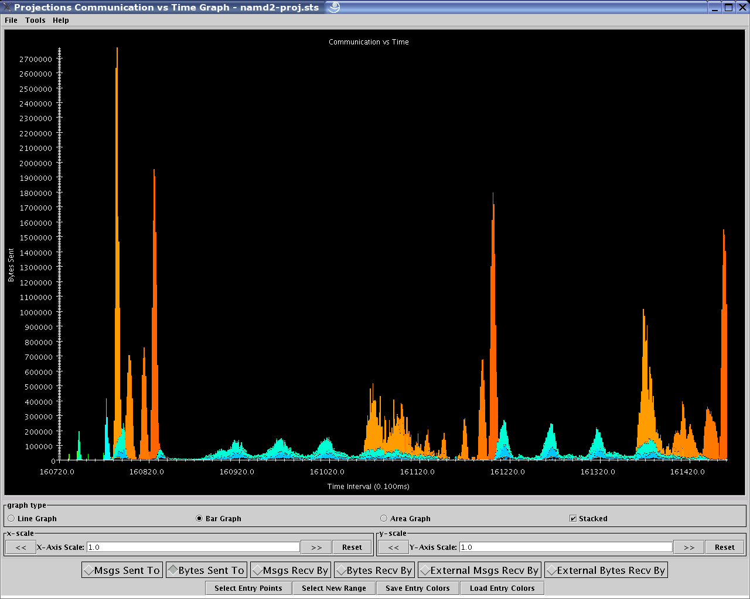
Communication vs. Time

Slide 4
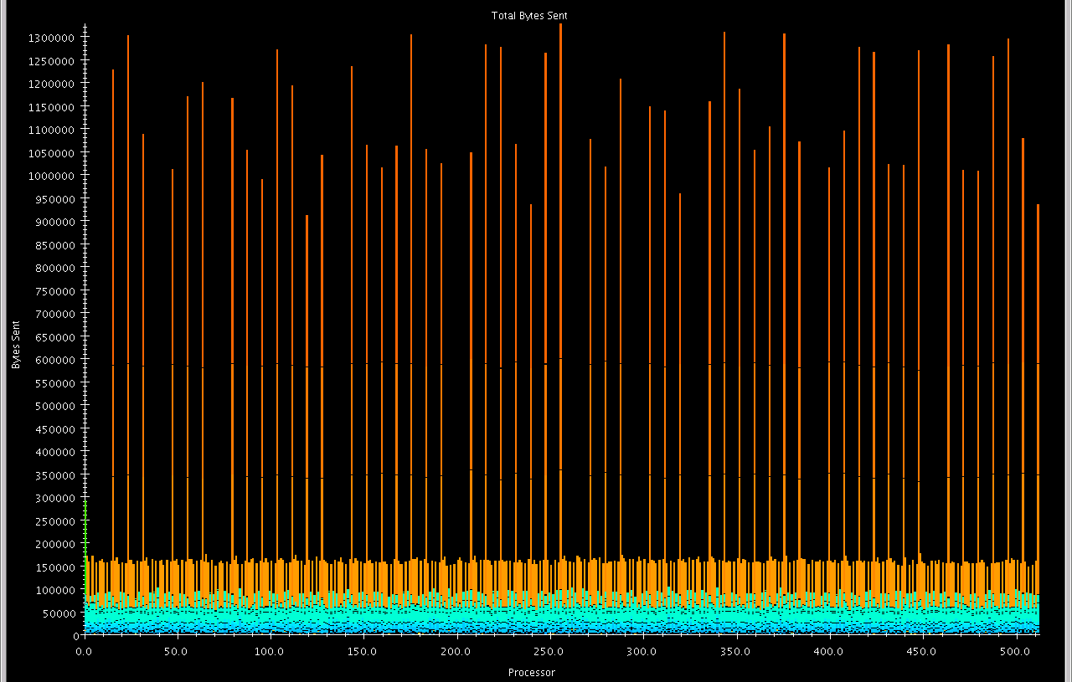
Communication per Processor

Slide 5
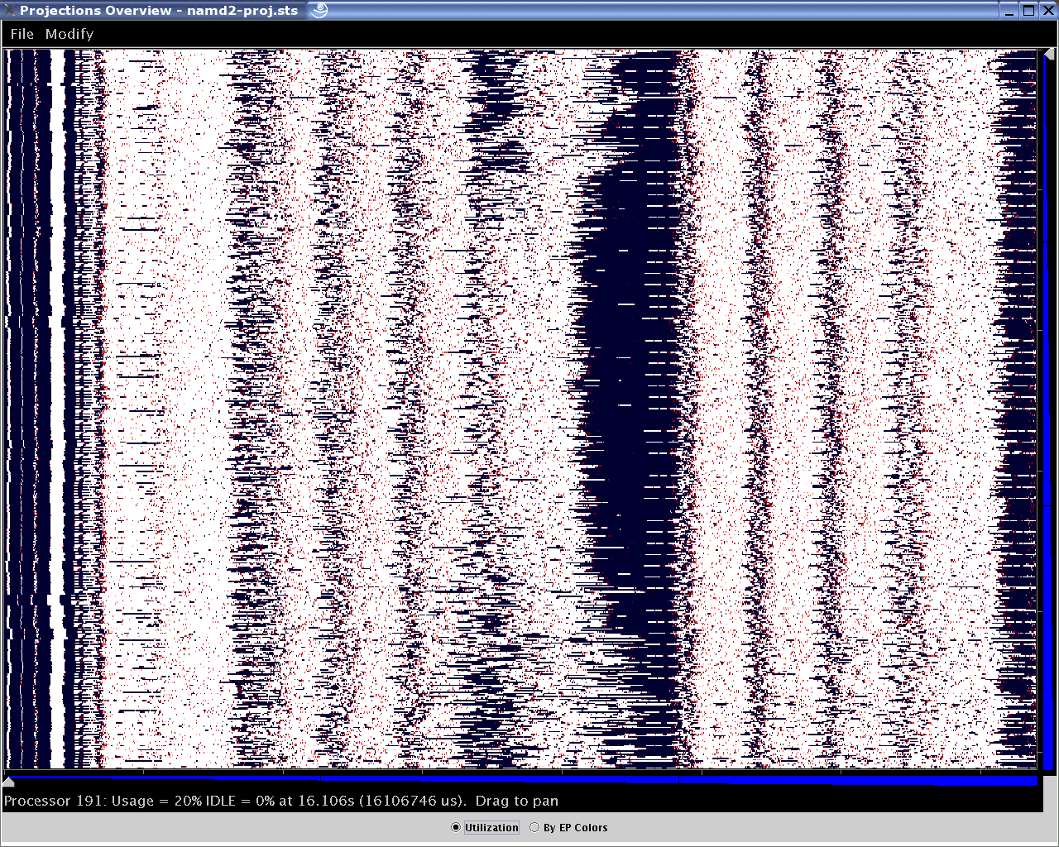
Intensity of plot represents PE’s utilization at that time

Slide 6
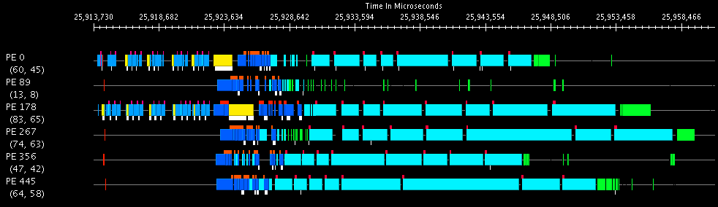
Timeline

Slide 7
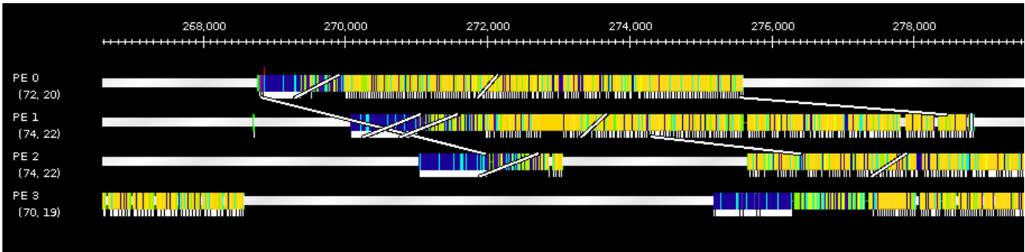
Clicking on EPs traces messages, mouseover shows EP details.

Slide 8
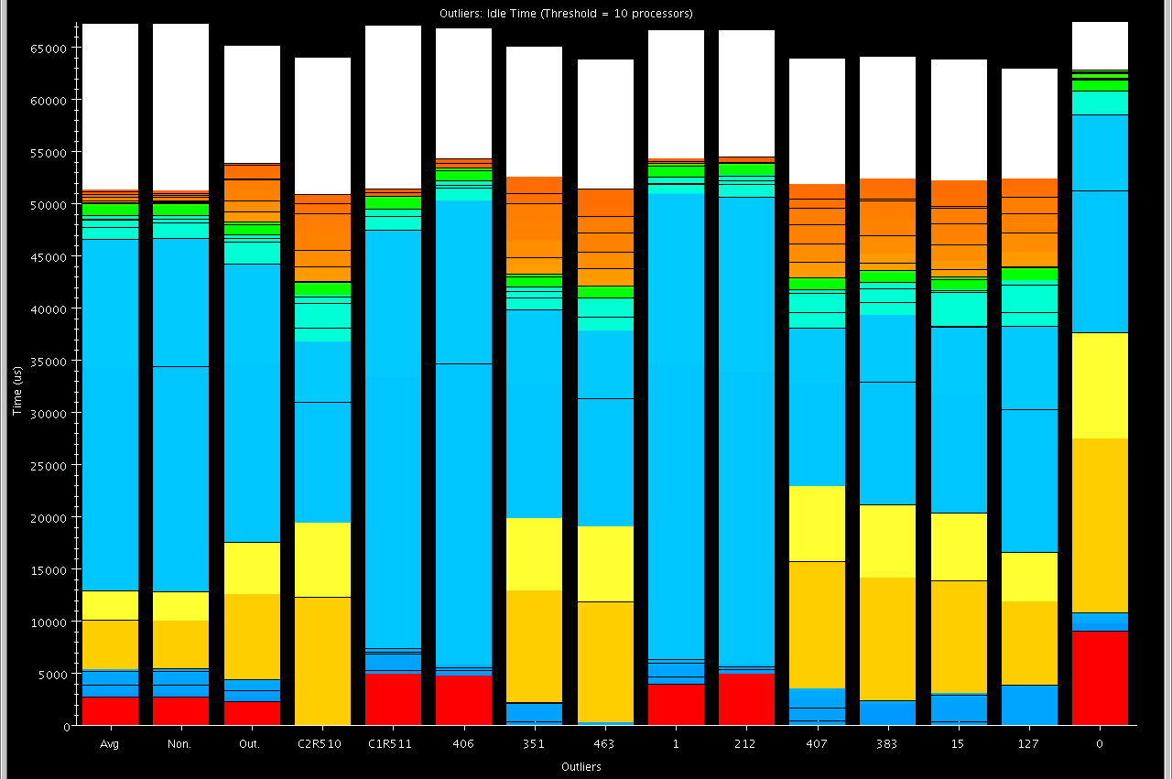
Outlier Analysis

Slide 9
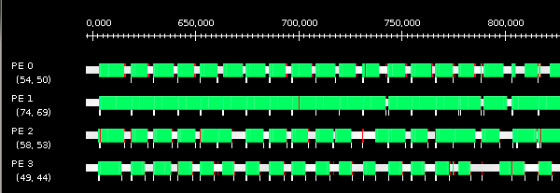
No Load Balancing

Slide 10
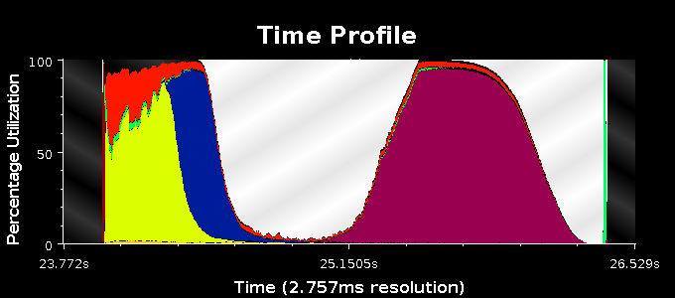
Original Time Profile

Slide 11
Original Time Profile
Why is utilization so low here?

Slide 12
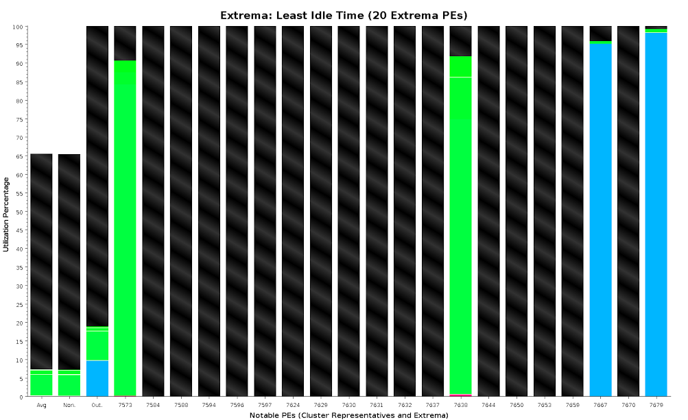
Outlier Analysis

Slide 13
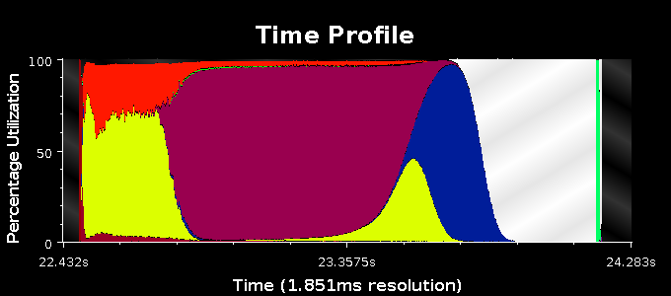
Final Time Profile

