Slide 1
Charm4Py

Slide 2
Productive Parallel Programming
Recent interest in productivity in parallel programming
Especially as compute nodes become more heterogeneous
Kokkos, Raja, DPC++, …

Slide 3
Python
Massive success in data science, ML
Recent attention by HPC community
Productive language to glue together hot code paths
Written in C/C++, JIT-compiled to heterogeneous devices

Slide 4
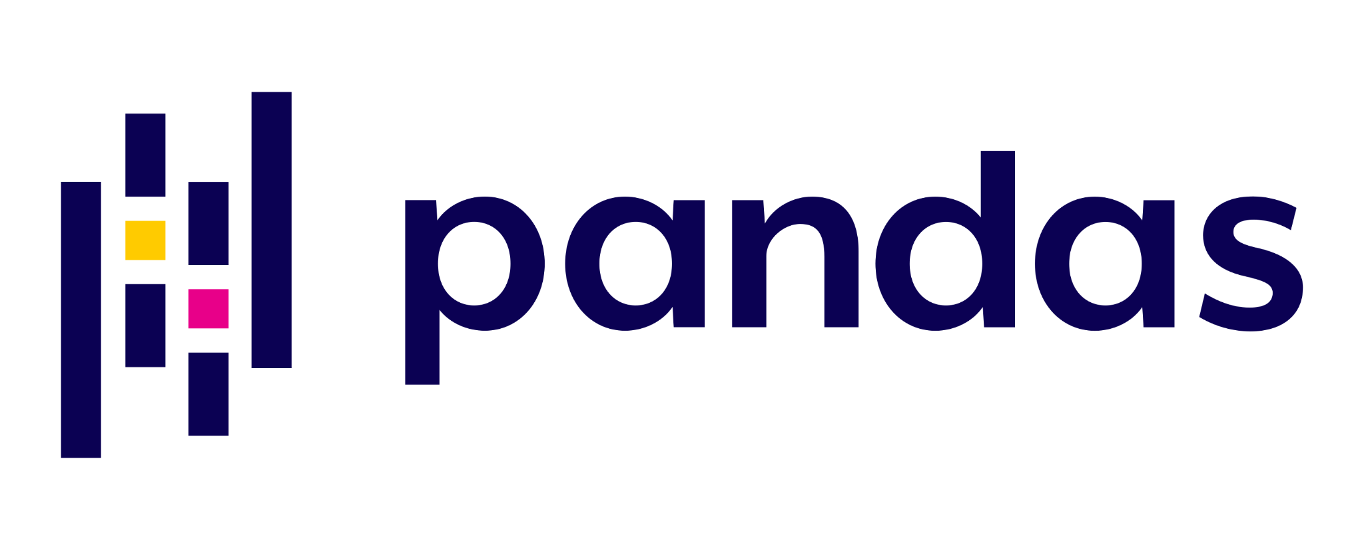


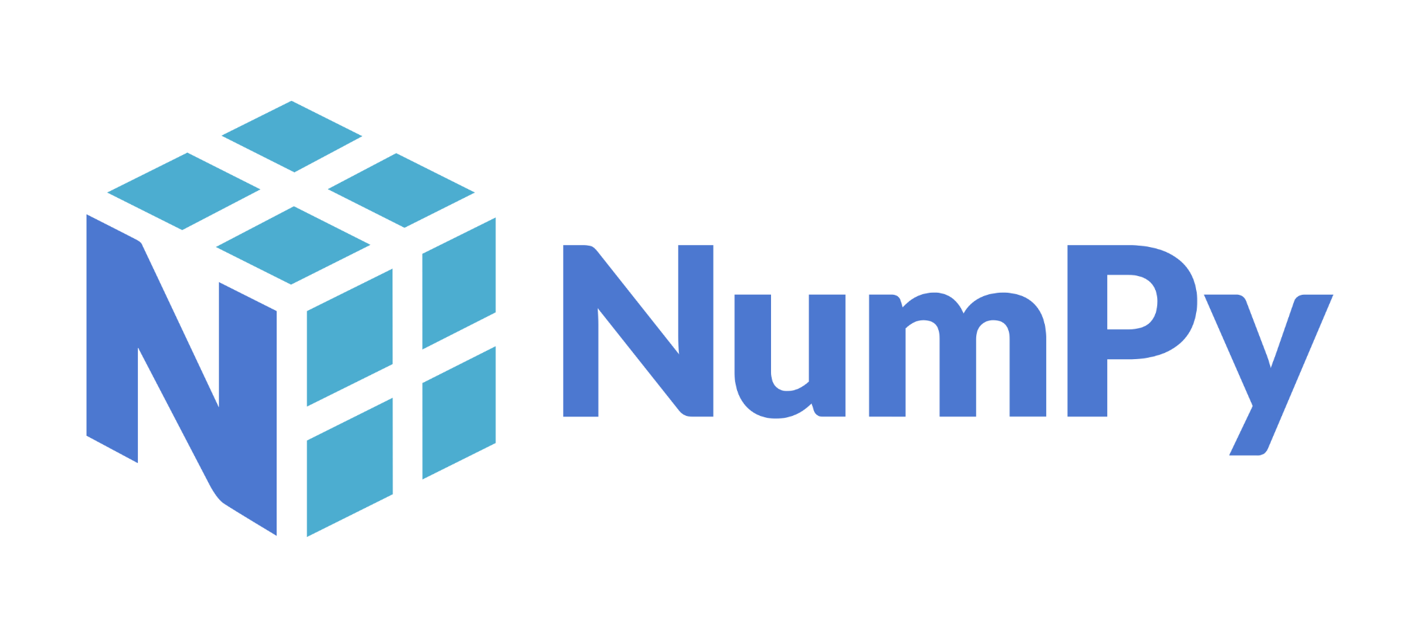

Charm4Py
Productivity + performance:
Distributed execution of Charm++ with rich software ecosystem of Python

Slide 5
Charm4Py Basics
Define chare classes in Python
Create a main driver that creates chares, begins execution.
That’s it!
No opaque compile errors, no additional files required

Slide 6
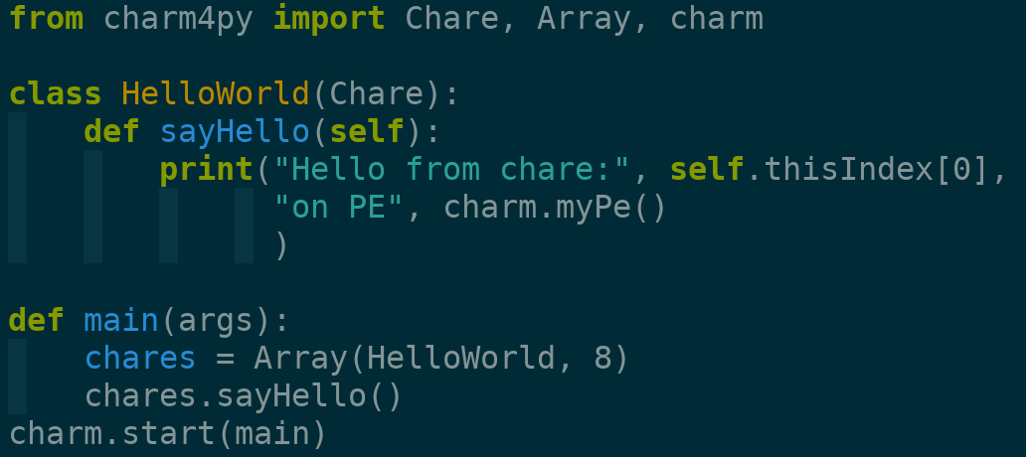
Charm4Py Basics

Slide 7
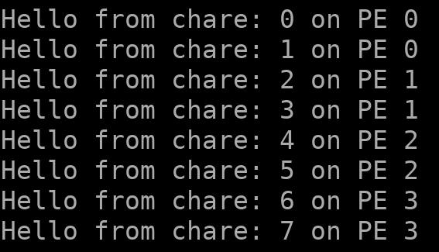
Charm4Py Basics

Slide 8
Overview
Numpy, Pandas, Scipy
Numba, PyCUDA
User Code
Runtime
Python/C Interaction
Charm++ Runtime

Slide 9
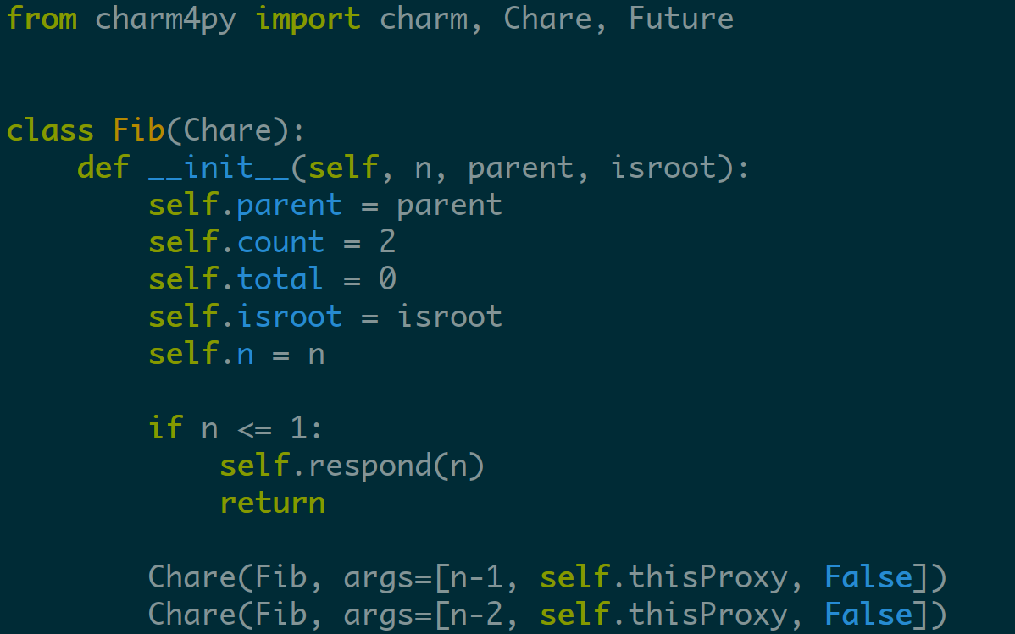
Charm4Py: Fibonacci

Slide 10
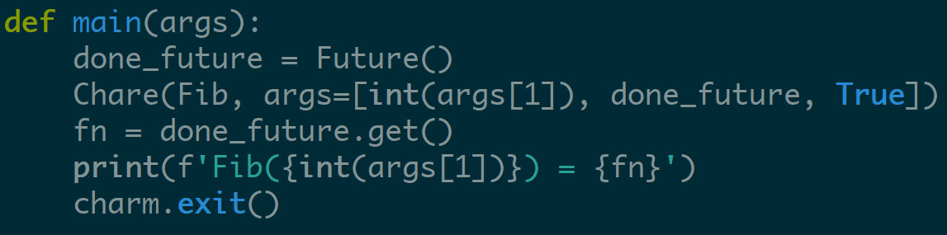
Charm4Py: Fibonacci

Slide 11
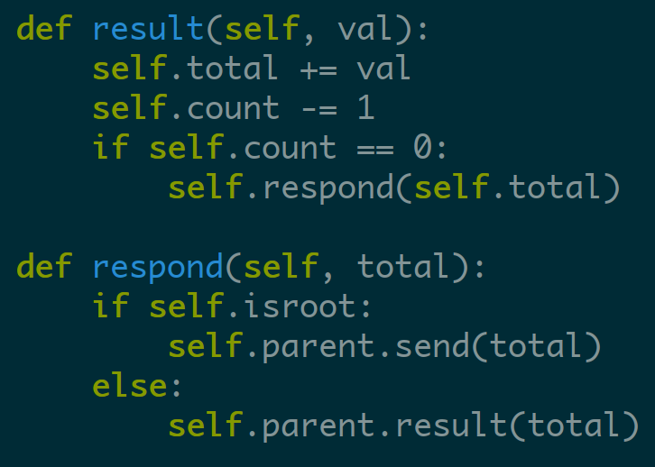
Charm4Py: Fibonacci

Slide 12
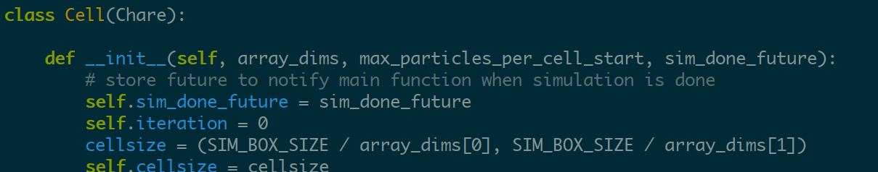
Array Creation

Slide 13
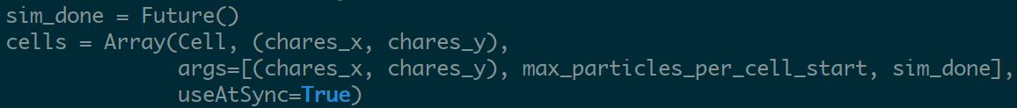
Array Creation

Slide 14
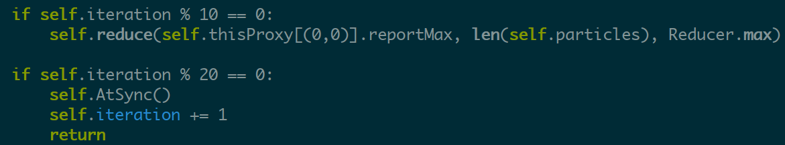
Arrays: Reductions, Load Balancing

Slide 15
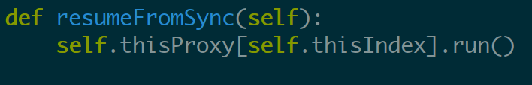
Arrays: Reductions, Load Balancing

Slide 16
Arrays: Reductions, Load Balancing
No need to define a PUP! Pickle is used

Slide 17
Channels
Point-to-point communication channel between chares

Slide 18
Channels
Point-to-point communication channel between chares

Slide 19
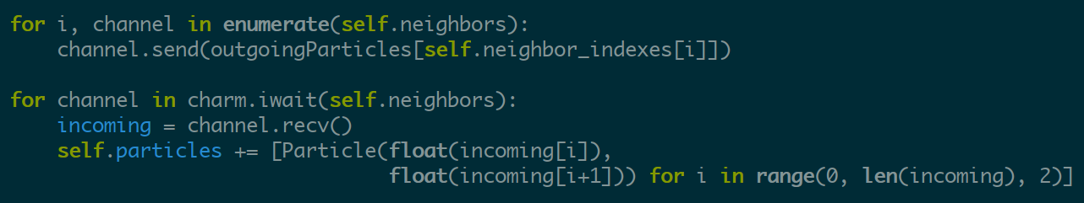
Channels
Point-to-point communication channel between chares

Slide 20
Reductions: Targeting Futures

Slide 21
Reductions: Targeting Futures

Slide 22
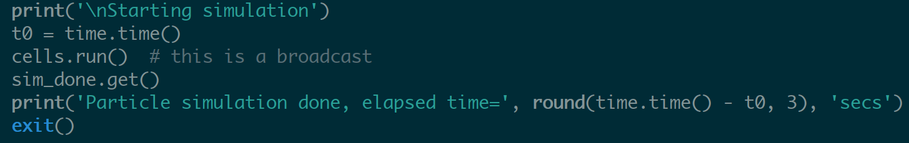
Reductions: Targeting Futures
Main chare:

Slide 23
Running Programs
On your local machine

Slide 24
Running Programs
On your local machine

Slide 25
Running Programs
On your local machine
On a cluster

Slide 26
Running Programs
On your local machine
On a cluster

Slide 27
More Information
Source: https://github.com/UIUC-PPL/charm4py
Docs: https://charm4py.readthedocs.io/en/latest/

