Slide 1
Chare Array Sections

Slide 2
Chare Array Review
Arbitrarily-sized collection of chares
Every item in the collection has a unique index and proxy
Can be indexed like an array or by an arbitrary object
Can be sparse or dense
Elements may be dynamically inserted and deleted
Elements can be migrated

Slide 3
Motivation
It is often convenient to define subcollections of elements within a chare array
Example: rows or columns of a 2D chare array
One may wish to perform collective operations on the subcollection (e.g. broadcast, reduction)
Sections are the standard subcollection construct in Charm++
A section is a subset of a Chare Array

Slide 4
Section Creation
Through explicit enumeration:
CkVec<CkArrayIndex3D> elems; // add array indices for (int i=0; i<10; i++) for (int j=0; j<20; j+=2) for (int k=0; k<30; k+=2) elems.push_back(CkArrayIndex3D(i, j, k));
CProxySection_Hello proxy =
CProxySection_Hello::ckNew(helloArrayID, elems.getVec(), elems.size());

Slide 5
Section Creation
Through index range specification:
Specify array ID of the base chare array and the inidvidual chare array elements of the array participating in the section
CProxySection_Hello proxy = CProxySection_Hello::ckNew(helloArrayID,
0, 9, 1, 0, 19, 2, 0, 29, 2);

Slide 6
Section Class Generation
Section proxy classes are automatically generated for each chare and group defined in the .ci file
Placed into decl.h and def.h files

Slide 7
Using Sections
CProxySection_Hello proxy;
// section broadcast
proxy.someEntry(...)
//sections are unranked, not allowed proxy[0].someEntry(...)
For example implementations, see
$(CHARM)/examples/charm++/arraysection
https://charmplusplus.org/miniApps/#leanmd

Slide 8
Spanning Trees
CkMulticast implements tree algorithms for multicasts and reductions
Messages are routed over a spanning tree of the section elements
Default branching factor is 2,
but a different number can be specified while creating a section
Add branching factor as a last integer parameter

Slide 9
CkMulticast Messages
To use CkMulticast library, all multicast messages must inherit from CkMcastBaseMsg
CkMcastBaseMsg must be inherited from first
No parameter marshalling is allowed in entry methods used as targets of multicast
class HiMsg : public CkMcastBaseMsg, public CMessage_HiMsg { public: int *data;
.. };

Slide 10
Reductions: setReductionClient
An array element can be a member of multiple array sections
It is necessary to disambiguate which array section reduction it is participating in each time it contributes to one
The reduction callback should be set at the time of creation.
This callback will be invoked after each reduction is complete
CkCallback *cb = new CkCallback(
CkReductionTarget (Cell, reduceForces),
thisProxy(thisIndex.x,thisIndex.y,thisIndex.z)));
mySecProxy.setReductionClient(cb);

Slide 11
Reductions: CkSectionInfo
A data structure called ''CkSectionInfo'' is created by CkMulticastMgr for each array section that the array element belongs to
During a section reduction, the array element must pass the CkSectionInfo as a parameter in the contribute()
This CkSectionInfo “cookie” can be retrieved from a previous message that was sent through CkMulticastMgr
Therefore, you can contribute into a reduction only following a broadcast to the same section.

Slide 12
Reductions with CkMulticast
CkSectionInfo cookie;
void SayHi(HiMsg *msg) { // this is a broadcast to SayHi using
// the section we want to to contribute to
//update section cookie every time CkGetSectionInfo(cookie, msg); int data = thisIndex; mcastGrp->contribute(sizeof(int),&data,
CkReduction::sum_int, cookie); }

Slide 13
Callbacks
As with array reductions, a callback needs to be specified with each contribute
OR a default callback should be specified using setReductionClient

Slide 14
Example: Matrix Multiplication
Inputs: 2D chare arrays A, B of matrix blocks
Output: 2D chare array C of matrix blocks
Elements of A and B multicast their blocks to a section comprising a row or column of C
Exercise: implement algorithm

Slide 15
Example: LeanMD
Lennart-Jones Dynamics
We have a 3D array of Cells
And a 6D array of cell-pairs
(also called “compute” objects in the leanmd miniApp at https://charmplusplus.org/miniApps/#leanmd )

Slide 16
Object Based Parallelization for MD:
Force Decomposition + Spatial Decomposition
Now, we have many objects to load balance:
Each diamond can be assigned to any proc.
Number of diamonds (3D):
14·Number of Patches
2-away variation:
Half-size cubes
5x5x5 interactions
3-away interactions: 7x7x7

Slide 17
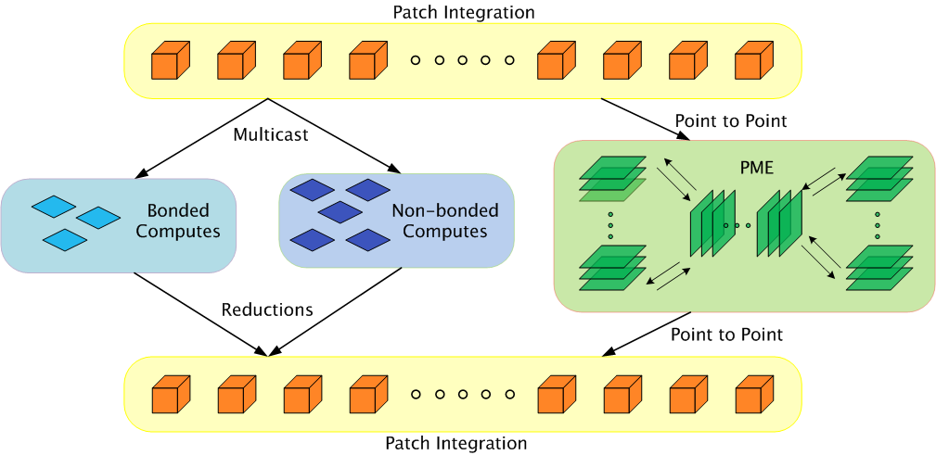
Parallelization Using Charm++
The computation is decomposed into “natural” objects of the application, which are assigned to processors by Charm++ RTS

Slide 18
LJdynamics - Cell
entry void run() {
for(stepCount = 1; stepCount <= finalStepCount; stepCount++) {
atomic { sendPositions(); }
for(forceCount=0; forceCount < inbrs; forceCount++)
when receiveForces[stepCount](int iter, vec3 forces[n], int n)
atomic { addForces(forces); }
atomic { updateProperties(); }
if ((stepCount % MIGRATE_STEPCOUNT) == 0) {
atomic { sendParticles(); }
when statements for receiving particles from neighbors
}
}//end of for loop
atomic {
contribute(0, CkReduction::NULL,
CkCallback(CkReductionTarget(Main,done),mainProxy));
}
}//end of run

Slide 19
LJdynamics - Pair
entry void run() {
for(stepCount = 1; stepCount <= finalStepCount; stepCount++) {
if (thisIndex.x1==thisIndex.x2 && thisIndex.y1==thisIndex.y2 &&
thisIndex.z1==thisIndex.z2)
when calculateForces[stepCount](ParticleData *data)
atomic { selfInteract(data); }
else {
when calculateForces[stepCount] (ParticleData *data)
atomic { bufferedData = data; }
when calculateForces[stepCount](ParticleData *data)
atomic { interact(data); }
}
// contribute/send forces to the cells involved
}//enf of for loop
};//end of run

Slide 20
Using section in sendPositions
Especially useful if you are using a 2-away formulation:
There are 5x5x5 = 125 pairs to which each cell must send its coordinates
Same data to everyone, so it is a Multicast
This happens repeatedly, every iteration
At load balancing time the locations of pairs may change, but the set is the same
So, each cell sets up its own section of pairs
Each pair is a member of two [or one] sections

Slide 21
Expressing in Charm++
Two chare arrays:
Cells: a 3D array of chares
Pairs: one object for each “neighboring” chare
What is the dimensionality of “pairs”?
Idea 1: make it a 3D array.. Does it work?
Idea 2: Make it a 1D array,
Explicitly assign indices to chares: the pair object between Cells[2,3,4] and Cells[2,3,5] is Pairs[someIndex].
Idea 3: Make it a 6D array
Pairs[2,3,4,2,3,5]
But: (a) it is sparse and
(b) symmetry? Do we also have Pairs[2,3,5,2,3,4]
Use only one of them.. (say “smaller” in dictionary order)

Slide 22
Object Based Parallelization for MD (with sections)
All pairs in the box constitute a section for the central proc:
Central chare uses CkMulticast for optimized broadcasts to this section
Without CkMulticast, it would have been point-to-point sends for all
Reductions are used across the section to aggregate results for force calculation

