Slide 1


Messages, Entry methods that return values, and Threaded entry methods
Laxmikant (Sanjay) Kale
http://charm.cs.illinois.edu
Parallel Programming Laboratory
Department of Computer Science
University of Illinois at Urbana Champaign

Slide 2
Relaxing a restriction
Earlier we said that:
Entry methods, once started, do not pause. They return control to the charm++ scheduler only after they’ve finished execution
Today, we will describe constructs that relax this restriction
Also, we will define a special class of entry methods that have return values
i.e. regular entry methods, rather than “asynchronous” ones
The baseline model, with the original restrictions:
Is a conceptually simpler model, and
Is adequate: powerful enough for most situations
Especially when extended with structured dagger
You should continue to use that whenever possible

Slide 3
sync methods
Synchronous as opposed to asynchronous
They return a value - always a “message” type
Always a pointer to a message, MsgType *
Other than that, just like any other entry method:
In interface file:
entry [sync] MsgData * f(double A[2*m], int m );
In C++ file:
MsgData * f(double X[], int size) {
…..
m = new MsgData(..);
…..
return m;
}

Slide 4
How to invoke a sync method
We might invoke a sync method just like any other method:
MsgData * m = A[i].foo(.. parameters..);
Do you see any problem with this?

Slide 5
Threaded methods
Any method that calls a sync method must be able to suspend
Need to be declared as a “threaded” method.
A threaded method of a chare C
Can suspend, without blocking the processor
Other chares can then be executed
Even other methods of chare C can be executed

Slide 6
A complete example
A chare array A of N elements, and each element holds a single number
Check if the numbers are already in a sorted order?
Each chare checks with its right neighbor, in parallel, and combine there results via a reduction

Slide 7
Interface File - .ci
mainmodule arrayRing {
message MsgData;
readonly int numElements;
mainchare Main {
entry Main(CkArgMsg *msg);
entry [reductiontarget] void allDone(CkReductionMsg *m);
};
array [1D] SimpleArray {
entry SimpleArray();
entry [threaded] void run();
entry [sync] MsgData * blockingGetValue();
};
}

Slide 8
Class Main - .C
class Main : public CBase_Main {
public:
Main(CkArgMsg* msg) {
numElements = 10;
if (msg->argc > 1) numElements = atoi(msg->argv[1]);
delete msg;
CProxy_SimpleArray elems =
CProxy_SimpleArray::ckNew(numElements);
CkCallback *cb = new CkCallback(
CkIndex_Main::allDone(NULL), thisProxy);
elems.ckSetReductionClient(cb);
elems.run();
}

Slide 9
Class Main - .C
class Main : public CBase_Main….contd
public:
void allDone(CkReductionMsg *m) {
int *sorted = (int *) m->getData();
if( *sorted == numElements) {
printf(“ Elements were sorted \n”);
} else {
printf(“ Elements were not sorted \n”);
}
CkExit();
}
};

Slide 10
.C contd.
class MsgData: public CMessage_MsgData {
public:
double value;
};
class SimpleArray : public CBase_SimpleArray {
private:
double myValue;
public:
SimpleArray() {
myValue = drand48();
}

Slide 11
.C contd.
void run() { // threaded method
int contrib = 1;
if(thisIndex < numElements - 1) {
MsgData *m = thisProxy(thisIndex+1).blockingGetValue();
if(myValue > m->value) contrib = 0;
}
contribute(sizeof(int), &contrib, CkReduction::sum_int);
}
MsgData* blockingGetValue() { // blocking method
MsgData * m = new MsgData();
m->value = myValue;
return m;
}
};

Slide 12
Discussion
How can you write the same code without threaded methods:
Without sdag? (structured dagger)
With sdag?
Which way is better?
Which way is more efficient?
What can you say about other situations beyond this simple example?
Can you write doubly recursive Fibonacci code with sync methods?

Slide 13
Once you have threaded methods…
You can make them suspend in multiple ways ways:
Futures (CkFuture)
Suspend and Awaken

Slide 14
Fibonacci with Futures - .ci
mainmodule fib {
message ValueMsg;
mainchare Main {
entry Main(CkArgMsg *m);
entry [threaded] void run(int n);
};
chare Fib {
entry Fib(int n, CkFuture f);
entry [threaded] void run(int n, CkFuture f);
};
};

Slide 15
Fibonacci with Futures - main
class Main : public CBase_Main {
public:
Main(CkMigrateMessage *m) {};
Main(CkArgMsg* m) {
thisProxy.run(atoi(m->argv[1]));
}
void run(int n) {
CkFuture f = CkCreateFuture();
CProxy_Fib::ckNew(n, f);
ValueMsg *m = (ValueMsg*)CkWaitFuture(f);
CkPrintf("The requested Fibonacci number is : %d\n", m->value);
CkExit();
}
};

Slide 16
Fibonacci with Futures - fib
class Fib : public CBase_Fib {
public:
int result;
Fib(CkMigrateMessage *m) {};
Fib(int n, CkFuture f) { thisProxy.run(n, f); }
void run(int n, CkFuture f) {
if (n < THRESHOLD) result = seqFib(n);
else {
CkFuture f1 = CkCreateFuture(); CkFuture f2 = CkCreateFuture();
CProxy_Fib::ckNew(n-1, f1); CProxy_Fib::ckNew(n-2, f2);
ValueMsg* m1 = (ValueMsg*)CkWaitFuture(f1);
ValueMsg* m2 = (ValueMsg*)CkWaitFuture(f2);
result = m1->value + m2->value;
delete m1; delete m2;
}
ValueMsg *m = new ValueMsg();
m->value = result; CkSendToFuture(f, m);
}
};

Slide 17
Fibonacci with Futures - continued
int seqFib(int n) {
if (n<2) return n;
else return (seqFib(n-1) + seqFib(n-2));
}
class ValueMsg : public CMessage_ValueMsg {
public: int value;
};

Slide 18
Fibonacci with explicit thread calls
All synchronization constructs, such as futures, are implemented using these basic thread library calls
CthThread tid = CthSelf();
CthSuspend();
CthAwaken(tid);

Slide 19
mainmodule fib_threads {
mainchare Main {
entry Main(CkArgMsg *m);
};
chare fib {
entry fib(int amIroot, int n, CProxy_fib parent);
entry [threaded] void run(int n);
entry void response(int);
};
};
class Main : public CBase_Main
{
public:
Main(CkMigrateMessage *m) {}
Main(CkArgMsg * m) {
if(m->argc < 2) CmiAbort("./fib_threads N");
int n = atoi(m->argv[1]);
CProxy_fib::ckNew(1, n, NULL);
}
};
class fib : public CBase_fib
{
private:
int result, count, IamRoot;
CthThread tid; CProxy_fib parent;
public:
fib(CkMigrateMessage *m) {}
fib(int amIRoot, int n, CProxy_fib _parent) {
IamRoot = amIRoot;
parent = _parent;
thisProxy.run(n);
}

Slide 20
void run(int n) {
tid = CthSelf();
if (n< THRESHOLD) { result = seqFib(n);
} else { CProxy_fib::ckNew(0,n-1, thisProxy);
CProxy_fib::ckNew(0,n-2, thisProxy);
result = 0; count = 2;
CthSuspend(); }
if (IamRoot) {
CkPrintf("The requested Fibonacci number is : %d\n", result);
CkExit();
} else parent.response(result);
}
void response(int fibValue) {
result += fibValue;
count--;
if(!count) CthAwaken(tid);
}

Slide 21
Finding Approximate Median
You are given K*num_chares numbers spread across num_chares chares of a chare array
Find the approxmiate median of those numbers
i.e. approximately half numbers are smaller and half are larger
Approximate, so that a small percentage difference is tolerated
E.g. a number with 49.5% smaller and 51.5% larger than it is acceptable as approximate median
This tolerance is allowed so as to make it converge faster

Slide 22
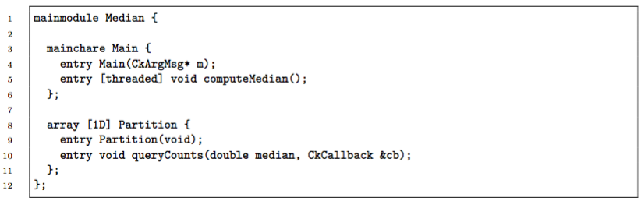
the interface file median.ci

Slide 23
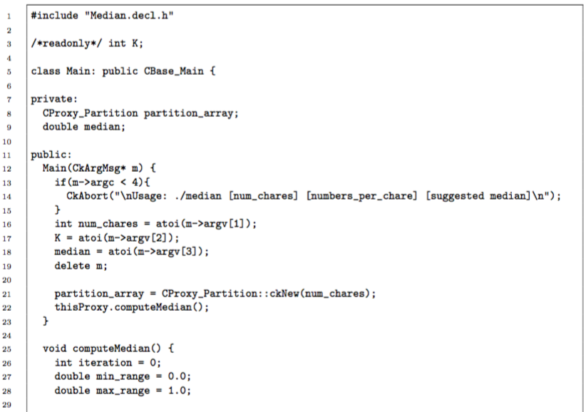
class Main in the C++ file median.C

Slide 24
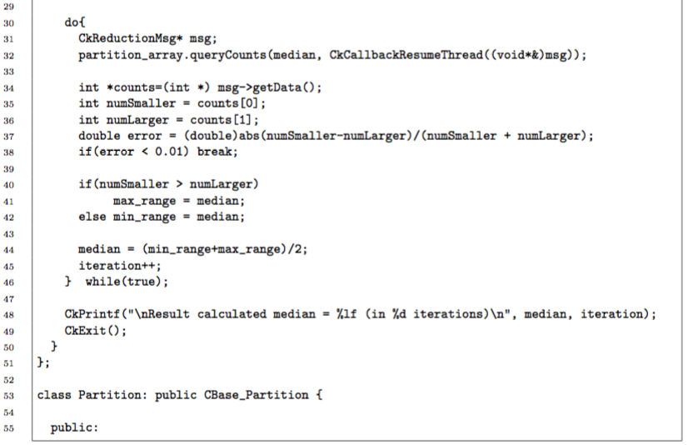
class Main in the C++ file median.C

Slide 25
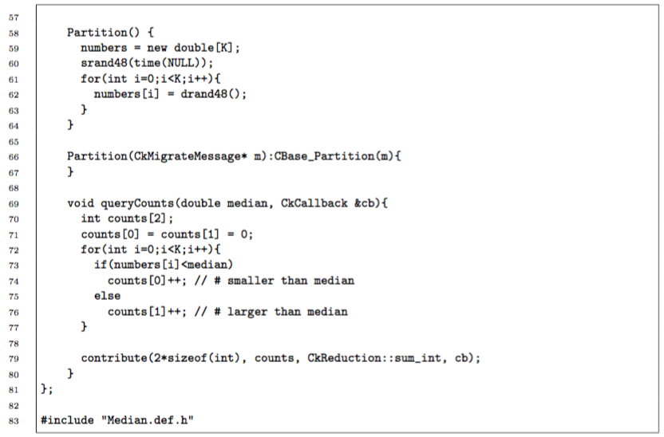
class Partition in the C++ file median.C

