Slide 1



598LVK Chare Array Sections, CkMulticast
Laxmikant (Sanjay) Kale
http://charm.cs.illinois.edu
Parallel Programming Laboratory
Department of Computer Science
University of Illinois at Urbana Champaign

Slide 2
Chare Array Review
Arbitrarily-sized collection of chares
Every item in the collection has a unique index and proxy
Can be indexed like an array or by an arbitrary object
Can be sparse or dense
Elements may be dynamically inserted and deleted
Elements can be migrated

Slide 3
Motivation
It is often convenient to define subcollections of elements within a chare array
Example: rows or columns of a 2D chare array
One may wish to perform collective operations on the subcollection (e.g. broadcast, reduction)
Sections are the standard subcollection construct in Charm++

Slide 4
Section Creation
Through explicit enumeration:
CkVec<CkArrayIndex3D> elems; // add array indices for (int i=0; i<10; i++) for (int j=0; j<20; j+=2) for (int k=0; k<30; k+=2) elems.push_back(CkArrayIndex3D(i, j, k));
CProxySection_Hello proxy =
CProxySection_Hello::ckNew(helloArrayID, elems.getVec(), elems.size());

Slide 5
Section Creation
Through index range specification:
CProxySection_Hello proxy = CProxySection_Hello::ckNew(helloArrayID, 0, 9, 1, 0,
19, 2, 0, 29, 2);

Slide 6
Section Class Generation
Section proxy classes are automatically generated for each chare and group defined in the ci file
Placed into decl.h and def.h files
Take a look at the CProxySection classes and their member functions in the decl.h and def.h for your MPs

Slide 7
Using Sections
CProxySection_Hello proxy;
// section broadcast
proxy.someEntry(...)
// send to the first element in the section proxy[0].someEntry(...)

Slide 8
CkMulticast
Charm++ library for high performance broadcasts and reductions over sections
# compile and install the CkMulticast library cd charm/tmp make multicast # link CkMulticast library using -module charmc -o hello hello.o -module CkMulticast -language charm++

Slide 9
Delegation
A way to customize Charm++ send and receive behavior
CkDelegateMgr
“interface” class with virtual functions for sending messages to chares, groups, nodegroups, arrays, sections
Delegation Manager
Any group which inherits from CkDelegateMgr
Specifies communication behavior by overriding one or more of the default communication functions

Slide 10
Delegation
Achieved by associating a delegation manager to a proxy
Different proxies for the same array or section may be associated with different delegation managers with distinct implementations of communication functions

Slide 11
CkMulticastMgr
A delegation manager which implements section broadcasts and reductions
Overrides CkDelegateMgr::ArraySectionSend
CProxySection_Hello sectProxy = CProxySection_Hello::ckNew(...); CkGroupID mCastGrpId = CProxy_CkMulticastMgr::ckNew(); CkMulticastMgr *mCastGrp = CProxy_CkMulticastMgr(mCastGrpId).ckLocalBranch();
// initialize section proxy sectProxy.ckSectionDelegate(mCastGrp); //multicast via delegation library as before
sectProxy.someEntry(...);

Slide 12
Spanning Trees
CkMulticast implements tree algorithms for multicasts and reductions
Messages are routed over a spanning tree of the section elements
Default branching factor is 2
Modifying branching factor:
CkGroupID mCastGrpId =
CProxy_CkMulticastMgr::ckNew(3); // factor is 3

Slide 13
CkMulticast Messages
To use CkMulticast library, all multicast messages must inherit from CkMcastBaseMsg
CkMcastBaseMsg must be inherited from first
No parameter marshalling is allowed in entry methods used as targets of multicast
class HiMsg : public CkMcastBaseMsg, public CMessage_HiMsg { public: int *data; };

Slide 14
Reductions: CkSectionInfo
An array element can be a member of multiple array sections
It is necessary to disambiguate which array section reduction it is participating in each time it contributes to one
A data structure called ''CkSectionInfo'' is created by CkMulticastMgr for each array section that the array element belongs to
During a section reduction, the array element must pass the CkSectionInfo as a parameter in the contribute()

Slide 15
Reductions with CkMulticast
CkSectionInfo cookie; void SayHi(HiMsg *msg) {
// update section cookie every time CkGetSectionInfo(cookie, msg); int data = thisIndex; mcastGrp->contribute(sizeof(int), &data,
CkReduction::sum_int, cookie);
}

Slide 16
Callbacks
As with array reductions, a callback needs to be specified with each contribute
OR a default callback should be specified using setReductionClient

Slide 17
Example: Matrix Multiplication
Inputs: 2D chare arrays A, B of matrix blocks
Output: 2D chare array C of matrix blocks
Elements of A and B multicast their blocks to a section comprising a row or column of C
Exercise: implement algorithm

Slide 18
Example: LeanMD
Lennart-Jones Dynamics (Lecture on 9/18)
Remember we had a 3D array of Cells
And a 6D array of

Slide 19
Object Based Parallelization for MD:
Force Decomposition + Spatial Decomposition
Now, we have many objects to load balance:
Each diamond can be assigned to any proc.
Number of diamonds (3D):
14·Number of Patches
2-away variation:
Half-size cubes
5x5x5 interactions
3-away interactions: 7x7x7

Slide 20
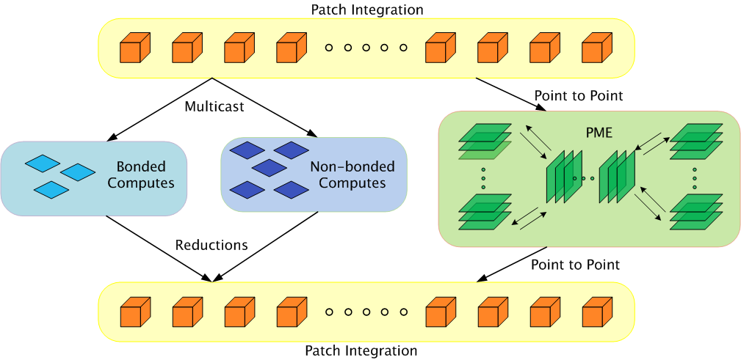
Parallelization Using Charm++
The computation is decomposed into “natural” objects of the application, which are assigned to processors by Charm++ RTS

Slide 21
Expressing in Charm++
Two chare arrays:
Cells: a 3D array of chares
Pairs: one object for each “neighboring” chare
What is the dimensionality of “pairs”?
Idea 1: make it a 3D array.. Does it work?
Idea 2: Make it a 1D array,
Explicitly assign indices to chares: the pair object between Cells[2,3,4] and Cells[2,3,5] is Pairs[someIndex].
Idea 3: Make it a 6D array
Pairs[2,3,4,2,3,5]
But: (a) it is sparse and
(b) symmetry? Do we also have Pairs[2,3,5,2,3,4]
Use only one of them.. (say “smaller” in dictionary order)

Slide 22
LJdynamics - Cell
entry void run() {
for(stepCount = 1; stepCount <= finalStepCount; stepCount++) {
atomic { sendPositions(); }
for(forceCount=0; forceCount < inbrs; forceCount++)
when receiveForces[stepCount](int iter, vec3 forces[n], int n)
atomic { addForces(forces); }
atomic { updateProperties(); }
if ((stepCount % MIGRATE_STEPCOUNT) == 0) {
atomic { sendParticles(); }
when statements for receiving particles from neighbors
}
}
atomic {
contribute(0, CkReduction::NULL,
CkCallback(CkReductionTarget(Main,done),mainProxy));
}

Slide 23
LJdynamics - Pair
entry void run() {
for(stepCount = 1; stepCount <= finalStepCount; stepCount++) {
if ( thisIndex.x1==thisIndex.x2 && thisIndex.y1==thisIndex.y2 &&
thisIndex.z1==thisIndex.z2)
when calculateForces[stepCount](ParticleData *data)
atomic { selfInteract(data); }
else {
when calculateForces[stepCount] (ParticleData *data)
atomic { bufferedData = data; }
when calculateForces[stepCount](ParticleData *data)
atomic { interact(data); }
}
}
};

Slide 24
Using section in sendPositions
Especially useful if you are using a 2-away formulation:
There are 5x5x5 = 125 pairs to which each cell must send its coordinates
Same data to everyone, so it is a Multicast
This happens repeatedly, every iteration
At load balancing time the locations of pairs may change, but the set is the same
So, each cell sets up its own section of pairs
Each pair is a member of two [or one] sections

