Slide 1
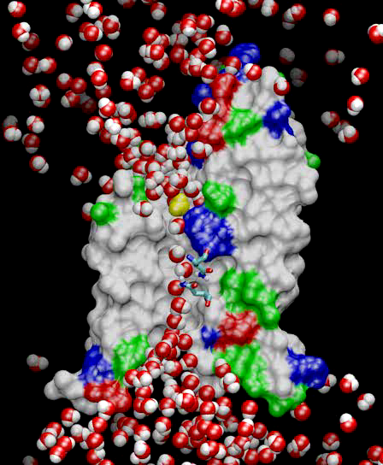
Molecular Dynamics
Collection of [charged] atoms, with bonds
Newtonian mechanics
Relatively small #of atoms (100K – 10M)
At each time-step
Calculate forces on each atom
Bonds:
Non-bonded: electrostatic and van der Waal’s
Short-distance: every timestep
Long-distance: using PME (3D FFT)
Multiple Time Stepping : PME every 4 timesteps
Calculate velocities and advance positions
Challenge: femtosecond time-step, millions needed!
Collaboration with K. Schulten, R. Skeel, and coworkers

Slide 2
Lennart-Jones Dynamics
We will look at a simpler problem:
Gas atoms moving around
Temperature tells you the average velocity
The only forces acting on them are van der Waals
Basically, if they come too close, they are repelled,
Otherwise, there is a small attractive force between all atoms
Algorithm: simulate each time step
Each atom has a mass, coordinates, and initial velocity
Calculate forces on each atom due to nearby atoms
Using forces, and Newton’s laws of motion, calculate acceleration, velocity, and update coordinates

Slide 3
Spatial Decomposition Via Charm
Atoms distributed to cubes based on their location
Size of each cube :
Just a bit larger than cut-off radius
Communicate only with neighbors
Work: for each pair of nbr objects
C/C ratio: O(1)
However:
Load Imbalance
Limited Parallelism
Charm++ is useful to handle this
Cells, Cubes or“Patches”

Slide 4
Object Based Parallelization for MD:
Force Decomposition + Spatial Decomposition
Now, we have many objects to load balance:
Each diamond can be assigned to any proc.
Number of diamonds (3D):
14·Number of Patches
2-away variation:
Half-size cubes
5x5x5 interactions
3-away interactions: 7x7x7

Slide 5
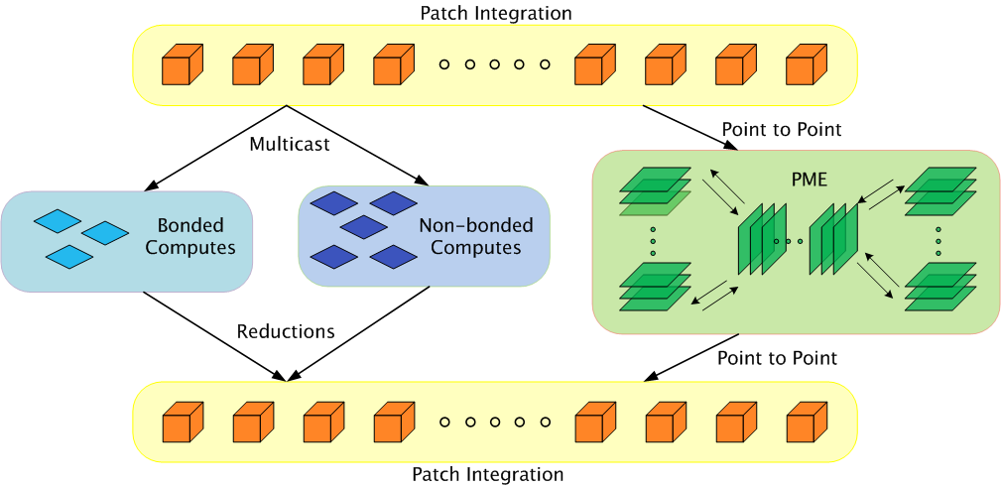
Parallelization Using Charm++
The computation is decomposed into “natural” objects of the application, which are assigned to processors by Charm++ RTS

Slide 6
Expressing in Charm++
Two chare arrays:
Cells: a 3D array of chares
Pairs: one object for each “neighboring” chare
What is the dimensionality of “pairs”?
Idea 1: make it a 3D array.. Does it work?
Idea 2: Make it a 1D array,
Explicitly assign indices to chares: the pair object between Cells[2,3,4] and Cells[2,3,5] is Pairs[someIndex].
Idea 3: Make it a 6D array
Pairs[2,3,4,2,3,5]
But: (a) it is sparse and
(b) symmetry? Do we also have Pairs[2,3,5,2,3,4]
Use only one of them.. (say “smaller” in dictionary order)

Slide 7
LJdynamics – Main chare
entry void run() {
when computesCreated() atomic {
computeArray.doneInserting();
cellArray.run();
computeArray.run();
}
when done()
atomic { CkExit(); }
}; //end of run

Slide 8
LJdynamics - Cell
entry void run() {
for(stepCount = 1; stepCount <= finalStepCount; stepCount++) {
atomic { sendPositions(); }
for(forceCount=0; forceCount < inbrs; forceCount++)
when receiveForces[stepCount](int iter, vec3 forces[n], int n)
atomic { addForces(forces); }
atomic { updateProperties(); }
if ((stepCount % MIGRATE_STEPCOUNT) == 0) {
atomic { sendParticles(); }
when statements for receiving particles from neighbors
}
}
atomic { contribute(0, CkReduction::NULL,
CkCallback(CkReductionTarget(Main,done),mainProxy));
}

Slide 9
LJdynamics - Pair
entry void run() {
for(stepCount = 1; stepCount <= finalStepCount; stepCount++) {
if ( thisIndex.x1==thisIndex.x2 && thisIndex.y1==thisIndex.y2 &&
thisIndex.z1==thisIndex.z2)
when calculateForces[stepCount](ParticleData *data)
atomic { selfInteract(data); }
else {
when calculateForces[stepCount] (ParticleData *data)
atomic { bufferedData = data; }
when calculateForces[stepCount](ParticleData *data)
atomic { interact(data); }
}
}
};

