Slide 1




Milli-Arcsecond (MAS) Imaging with SmallSat Enabled Super-resolution Monthly Progress Report August 2018
Cooperative Agreement (CA) Partnerships with Universities and NASA Centers
Grant/Cooperative Agreement Number: 80NSSC18M0052
Farzad Kamalabadi; University of Illinois at Urbana-Champaign
Douglas Rabin; NASA Goddard Space Flight Center

Slide 2
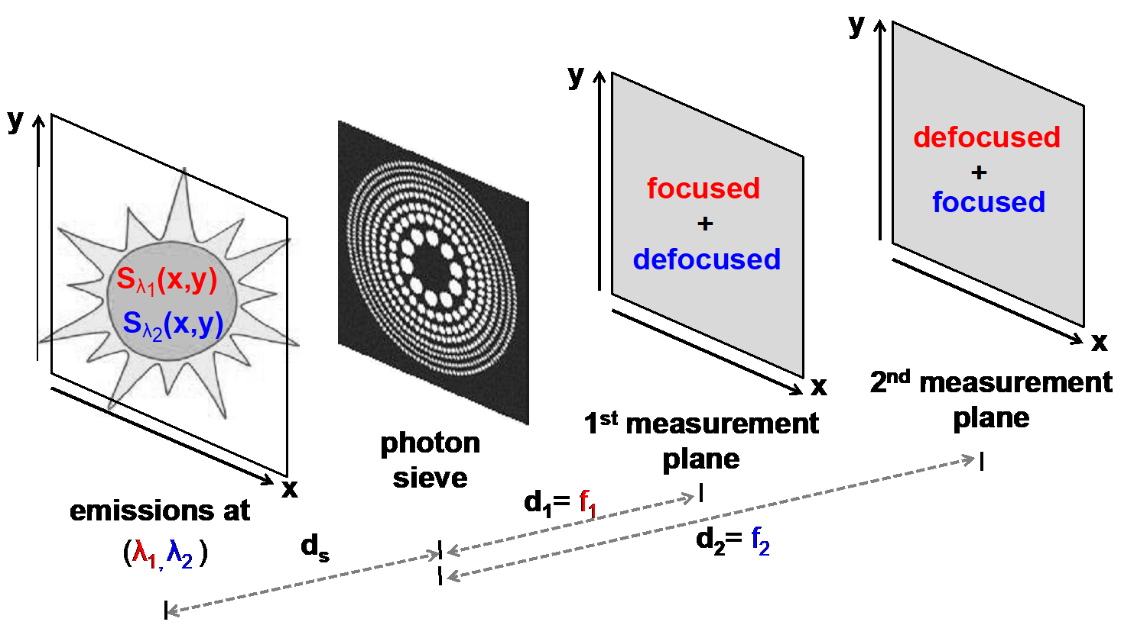
Univ. PI: Farzad Kamalabadi, UIUC
NASA POC: Douglas Rabin, GSFC CA 80NSSC18M0052
MAS Monthly Progress Report
Project Summary
PI: Farzad Kamalabadi, UIUC
NASA Center: Doug Rabin, GSFC
Summary: The objective of this project is to demonstrate a new imaging technology with unprecedented capabilities for scientific exploration.
Relevance and Impact: The technology is based on a unique combination of novel diffractive optical sensing (photon sieve), advanced image processing, and small satellite formation flying.
Technical Approach: The project will develop optimal strategies for the solution of the inherent inverse problem of photon sieve image deconvolution, and apply them to a laboratory simulator that will characterize the performance of the deconvolution process and demonstrate (beyond) diffraction-limited imaging capability.
FOMs: <As in proposal Relevance and Impact)>
Starting TRL: 3 Planned Year 2 Ending TRL: 6
Key:
Completed Milestone
Planned Milestone
August
2018
2019
Develop Reconstruction Algorithm
Develop optimal measurement
plane selection algorithm
Completed Analysis of
Algorithms in context of
physical problems
Project completion. Technology demonstration in laboratory.
Plans for publications
Nothing to report.
Note: NF 1679 Disclosure of Invention and New Technology form to be filed for each invention and new technology.
Project Photos (Publicly Releasable)

Slide 3
Univ. PI: Farzad Kamalabadi, UIUC
NASA POC: Douglas Rabin, GSFC CA 80NSSC18M0052
MAS Monthly Progress Report
Contacts
PI: Farzad Kamalabadi, UIUC
NASA Center: Doug Rabin, GSFC
Concerns, Risks
Lack of communication with Goddard team. Don't understand how to design an optics experiment. What are we expected to deliver for this milestone? (Oct. 2018)
UIUC Accomplishments
Planned Accomplishments This Month
Finish entropy tracking test
Finish migrating Matlab code
Actual Accomplishments This Month
Migrated forward model to Python
Implemented caching for PSF generation, forward model, and reconstruction stages
Planned Accomplishment for Next Month
Learn about CCDs - what data format do they produce, sample rate, noise, etc.
Compare results from 3D sparsifying transform reconstructions vs separate 2D sparsifying transform reconstructions
Discussion of Actual vs. Planned Accomplishments
(Refer to Milestones on Project Schedule)
Implemented deconvolution algorithm for reconstruction of simulated measurements
Implemented iterative algorithm for determining nearly optimal measurement selection

