Slide 1


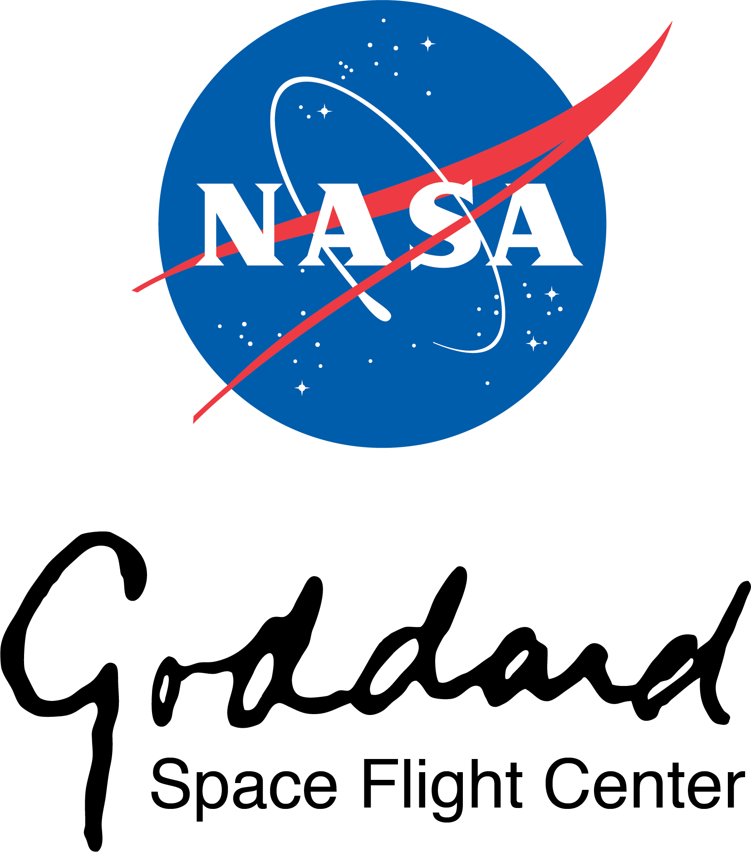

Milli-Arcsecond (MAS) Imaging with SmallSat Enabled Super-resolution Monthly Progress Report July 2018
Cooperative Agreement (CA) Partnerships with Universities and NASA Centers
Grant/Cooperative Agreement Number: 80NSSC18M0052
Farzad Kamalabadi; University of Illinois at Urbana-Champaign
Douglas Rabin; NASA Goddard Space Flight Center

Slide 2
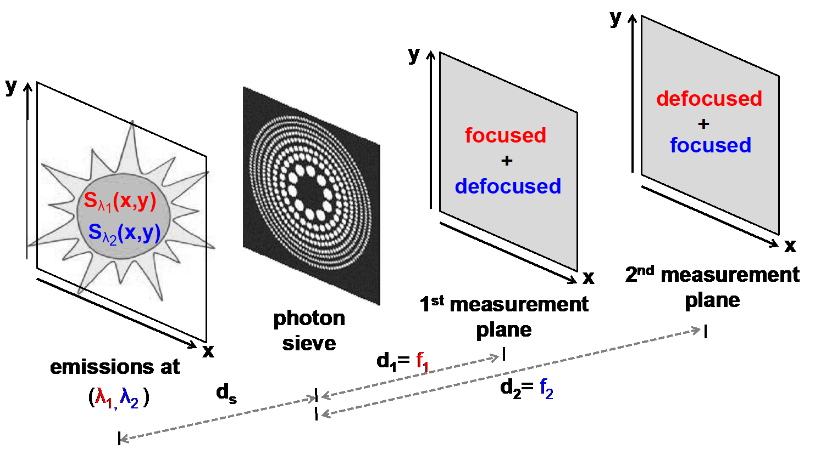
Univ. PI: Farzad Kamalabadi, UIUC
NASA POC: Douglas Rabin, GSFC CA 80NSSC18M0052
MAS Monthly Progress Report
Project Summary
PI: Farzad Kamalabadi, UIUC
NASA Center: Doug Rabin, GSFC
Summary: The objective of this project is to demonstrate a new imaging technology with unprecedented capabilities for scientific exploration.
Relevance and Impact: The technology is based on a unique combination of novel diffractive optical sensing (photon sieve), advanced image processing, and small satellite formation flying.
Technical Approach: The project will develop optimal strategies for the solution of the inherent inverse problem of photon sieve image deconvolution, and apply them to a laboratory simulator that will characterize the performance of the deconvolution process and demonstrate (beyond) diffraction-limited imaging capability.
FOMs: <As in proposal Relevance and Impact)>
Starting TRL: 3 Planned Year 2 Ending TRL: 6
Key:
Completed Milestone
Planned Milestone
June
2018
2019
Develop Reconstruction Algorithm
Develop optimal measurement
plane selection algorithm
Completed Analysis of
Algorithms in context of
physical problems
Project completion. Technology demonstration in laboratory.
Plans for publications
Nothing to report.
Note: NF 1679 Disclosure of Invention and New Technology form to be filed for each invention and new technology.
Project Photos (Publicly Releasable)

Slide 3
Univ. PI: Farzad Kamalabadi, UIUC
NASA POC: Douglas Rabin, GSFC CA 80NSSC18M0052
MAS Monthly Progress Report
Contacts
PI: Farzad Kamalabadi, UIUC
NASA Center: Doug Rabin, GSFC
Concerns, Risks
Nothing to report
UIUC Accomplishments
Planned Accomplishments This Month
Investigate image registration problem with regards to determining satellite formation drift
Test deconvolution algorithm with various parameters and images
Actual Accomplishments This Month
Came up with simple entropy based image tracking method
Updated legacy photon sieve generation code and bundled into Python project
Began moving Matlab code into Python project
Planned Accomplishment for Next Month
Finish entropy tracking test
Finish migrating Matlab code
Discussion of Actual vs. Planned Accomplishments
(Refer to Milestones on Project Schedule)
Implemented deconvolution algorithm for reconstruction of simulated measurements
Implemented iterative algorithm for determining nearly optimal measurement selection

