Slide 1




Milli-Arcsecond (MAS) Imaging with SmallSat Enabled Super-resolution
Monthly Progress Report
May 2018
Cooperative Agreement (CA) Partnerships with Universities and NASA Centers
Grant/Cooperative Agreement Number: 80NSSC18M0052
Farzad Kamalabadi; University of Illinois at Urbana-Champaign
Douglas Rabin; NASA Goddard Space Flight Center

Slide 2
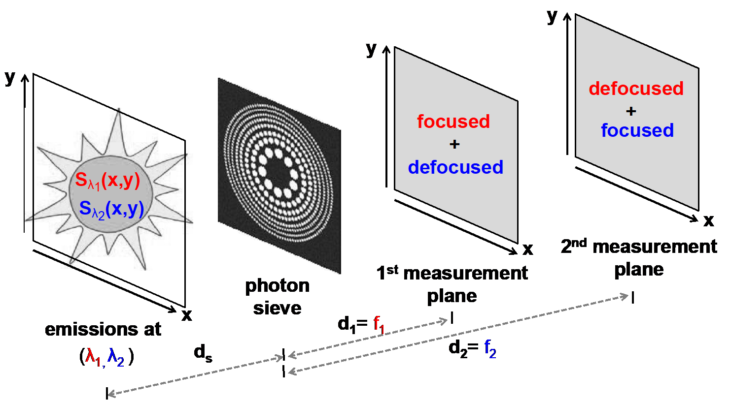
Univ. PI: Farzad Kamalabadi; UIUC
POC: Douglas Rabin, GSFC
CA 80NSSC18M0052
MAS Imaging with SmallSat Enabled Super-resolution Monthly Progress Report
Project Summary
PI: Farzad Kamalabadi, University of Illinois at Urbana-Champaign
NASA Center: Douglas Rabin, GSFC
Summary: The objective of this project is to demonstrate a new imaging technology with unprecedented capabilities for scientific exploration.
Relevance and Impact: The technology is based on a unique combination of novel diffractive optical sensing (photon sieve), advanced image processing, and small satellite formation flying.
Technical Approach: The project will develop optimal strategies for the solution of the inherent inverse problem of photon sieve image deconvolution, and apply them to a laboratory simulator that will characterize the performance of the deconvolution process and demonstrate (beyond) diffraction-limited imaging capability.
FOMs: <As in proposal Relevance and Impact)>
Starting TRL: 3 Planned Year 2 Ending TRL: 6
Master Project Schedule
Key:
Completed Milestone
Planned Milestone
May
2018
2019
Develop Reconstruction Algorithm
Develop optimal measurement
plane selection algorithm
Completed Analysis of
Algorithms in context of
physical problems
Project completion. Technology demonstration in laboratory.
Plans for publications
Nothing to report.
Note: NF 1679 Disclosure of Invention and New Technology form to be filed for each invention and new technology.
Project Photos (Publicly Releasable)

Slide 3
Univ. PI: Farzad Kamalabadi; UIUC
POC: Douglas Rabin, GSFC
CA 80NSSC18M0052
University Monthly Progress Report
Contacts
PI: Farzad Kamalabadi, UIUC
Co-Is: <Co-I Name>, <Affiliation>
NASA Center: Douglas Rabin, GSFC
Discussion of Actual vs. Planned Accomplishments
(Refer to Milestones on Master Project Schedule)
With the actual accomplishments and the planned accomplishments for next month, we will be able to determine the optimal number of measurements and the focal length spacing to maximize resolution (which is our next milestone).
UIUC Accomplishments
Planned Accomplishments This Month
  Implement USE (uniform squared error) cost
  Begin considering optimum plane problem in context of physical constraints (focal length drift, maximum exposure time, etc.)
Actual Accomplishments This Month
  Partially tested and verified the implemented measurement plane selection algorithm (with SSE cost) for certain scenarios
  Began developing a formalism for the trade-off space in the mission (high SNR – scene dynamics – measurement diversity)
Planned Accomplishment for Next Month
  Explore learning based image reconstruction algorithms for high fidelity reconstructions
  Test the developed measurement plane selection algorithm for further verification
Concerns, Risks
Concerns
  None
Risks
  None

