Slide 1




Milli-Arcsecond (MAS) Imaging with SmallSat Enabled Super-resolution
Quarterly Progress Report
2018Q2
Cooperative Agreement (CA) Partnerships with Universities and NASA Centers
Grant/Cooperative Agreement Number: 80NSSC18M0052
Farzad Kamalabadi; University of Illinois at Urbana-Champaign
Douglas Rabin; NASA Goddard Space Flight Center

Slide 2
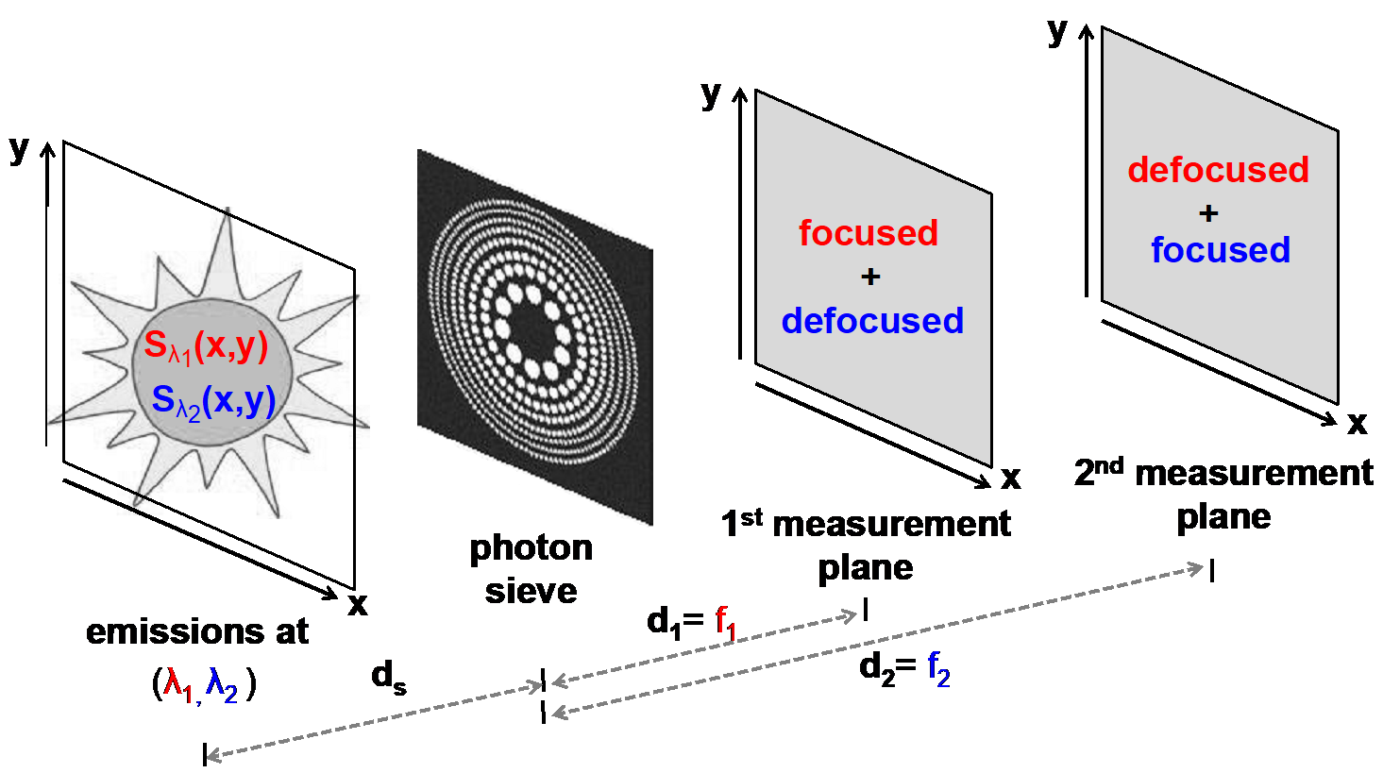
Univ. PI: Farzad Kamalabadi, UIUC
NASA POC: Douglas Rabin, GSFC
CA 80NSSC18M0052
MAS Quarterly Progress Report
Project Summary
PI: Farzad Kamalabadi, UIUC
NASA Center: Doug Rabin, GSFC
Summary: The objective of this project is to demonstrate a new imaging technology with unprecedented capabilities for scientific exploration.
Relevance and Impact: The technology is based on a unique combination of novel diffractive optical sensing (photon sieve), advanced image processing, and small satellite formation flying.
Technical Approach: The project will develop optimal strategies for the solution of the inherent inverse problem of photon sieve image deconvolution, and apply them to a laboratory simulator that will characterize the performance of the deconvolution process and demonstrate (beyond) diffraction-limited imaging capability.
FOMs: <As in proposal Relevance and Impact)>
Starting TRL: 3 Planned Year 2 Ending TRL: 6
Project Photos (Publicly Releasable)
Plans for publications
Nothing to report.
Note: NF 1679 Disclosure of Invention and New Technology form to be filed for each invention and new technology.
Concerns, Risks
Concerns:
  None
Risks:
  None

Slide 3
Univ. PI: Farzad Kamalabadi, UIUC
NASA POC: Douglas Rabin, GSFC
CA 80NSSC18M0052
UIUC Quarterly Progress Report
Cost
University Budget, as shown on proposal
<what is the University plan for spending Year 1 funds?>
<are actual costs / purchases going according to plan?>
Contacts
PI: Farzad Kamalabadi, UIUC
NASA Center: Doug Rabin, GSFC
Discussion of Actual vs. Planned Accomplishments
(Refer to Milestones on Project Schedule)
Implemented deconvolution algorithm for reconstruction of simulated measurements
Implemented iterative algorithm for determining nearly optimal measurement selection
Planned vs Actual Costs, $
Q1 Q2 Q2 Q4
Planned vs Actual Costs
University Project Schedule
Key:
Completed Milestone
UIUC Accomplishments
Planned Accomplishments This Month
  Test developed measurement plane selection algorithm for further verification
Actual Accomplishments This Month
  Verified iterative algorithm converges on a reasonable result
Planned Accomplishment for Next Month
  Investigate image registration problem with regards to determining satellite formation drift
  Test deconvolution algorithm with various parameters and images
Planned Milestone
June
2018
2019
Develop Reconstruction Algorithm
Develop optimal measurement
plane selection algorithm
Completed Analysis of
Algorithms in context of
physical problems
Project completion. Technology demonstration in laboratory.

Slide 4
Univ. PI: Farzad Kamalabadi, UIUC
NASA POC: Douglas Rabin, GSFC
CA 80NSSC18M0052
Measurement Plane Selection Algorithm
Motivation
We desire to image L wavelengths, but the object under study is dynamically changing and there is only enough time to make K measurements.
Intuitive solution when L = K:
Measure once at focal plane for each wavelength.
How can this be validated numerically?
What if K < L? (underdetermined system)
What if K > L? (overdetermined system)

Slide 5
Univ. PI: Farzad Kamalabadi, UIUC
NASA POC: Douglas Rabin, GSFC
CA 80NSSC18M0052
Measurement Plane Selection Algorithm
Overview
Algorithm Input
Initialize with N linearly-spaced candidate measurement planes with K measurements at each plane (N*K measurements)
Delete the measurement whose removal incurs the smallest increase in reconstruction error
Repeat step 2 until K measurements remain
Algorithm Output

Slide 6
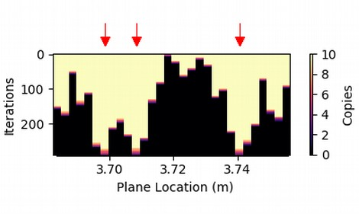
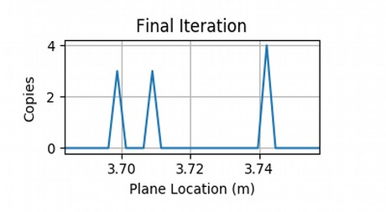
Univ. PI: Farzad Kamalabadi, UIUC
NASA POC: Douglas Rabin, GSFC
CA 80NSSC18M0052
Measurement Plane Selection Algorithm
Results for Overdetermined System
L=3 sources
K=10 selected measurements
The algorithm converges on the focal planes of the three sources.

Slide 7

Univ. PI: Farzad Kamalabadi, UIUC
NASA POC: Douglas Rabin, GSFC
CA 80NSSC18M0052
MAS Deconvolution Algorithm
Task: Develop image deconvolution algorithm to reconstruct the spectral images from the noisy, blurred, and superimposed measurements.
Cost Function
General
Form
t : measurements
H : system matrix
s : spectral images
: regularization functional
λ : regularization parameter
Data fidelity
Regularizer
Regularization | Optimization Problem
Total Variation
DCT Transform
Transform Learning
L : discrete gradient matrix
D : discrete cosine transform

Slide 8
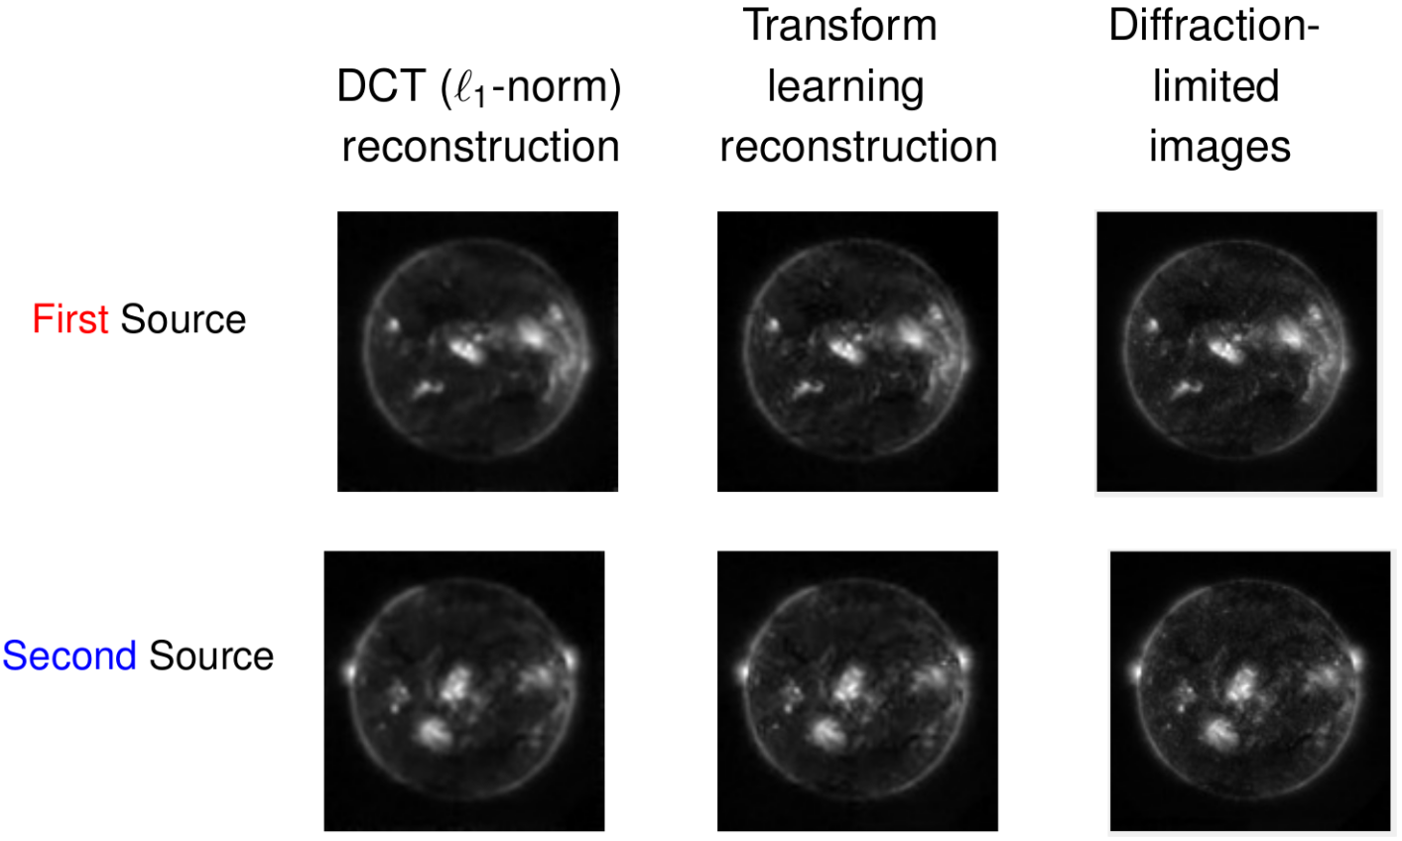
Univ. PI: Farzad Kamalabadi, UIUC
NASA POC: Douglas Rabin, GSFC
CA 80NSSC18M0052
Deconvolution Algorithm
Reconstruction Results

Slide 9
Univ. PI: Farzad Kamalabadi, UIUC
NASA POC: Douglas Rabin, GSFC
CA 80NSSC18M0052
NASA Center Quarterly Progress Report
Summary
PI: Farzad Kamalabadi, UIUC
NASA Center: Doug Rabin, GSFC
Summary:
Cost
NASA FTE amount (and year-2 procurement), as shown on proposal
<what is the NASA plan for labor?>
<are labor / purchases going according to plan?>
Discussion of Actual vs. Planned Accomplishments
(Refer to Milestones on Project Schedule)
<Explanation of significantly accelerated accomplishments>
<Explanation for significant delays>
<Unplanned work>
<New or deleted scope of work>
For NASA / JPL partner, SSTP Resource Manager will provide table: Planned FTE vs Actual FTE / $
Q1 Q2 Q2 Q4
Planned vs Actual FTE
NASA Project Schedule
Key:
Completed Milestone
<NASA Center> Accomplishments
Planned Accomplishments This Month
  <Planned Accomplishment 1>
  <Planned Accomplishment 2>
  <Planned Accomplishment 3>
Actual Accomplishments This Month
  <Actual Accomplishment 1>
  <Actual Accomplishment 2>
Planned Accomplishment for Next Month
  <Planned Accomplishment 1>
  <Planned Accomplishment 2>
  <Planned Accomplishment 3>
Planned Milestone
<This Month>
2018
2019
<Milestone 1>
<Milestone 2>
<Year 1 Final Milestone>
Year 2 Milestone 1>
Year 2 Milestone 2>

