Slide 1

Viewing
CS 418: Interactive Computer Graphics
UNIVERSITY OF ILLINOIS AT URBANA-CHAMPAIGN
Eric Shaffer

Slide 2
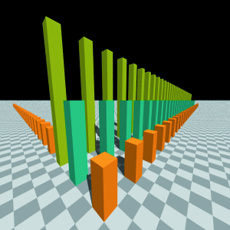
Viewing
What we’ve seen so far is restrictive
…let’s lift the restrictions
Let’s implement a virtual pinhole camera

Slide 3
Virtual Pinhole Camera
We have the following parameters
eyepoint
view direction
orientation around the view direction
distance to the view plane

Slide 4
Compare with a Real Pinhole Camera
What is the difference?

Slide 5
Setting up a Viewing Coordinate System
We need to find ray directions through the view plane
We’ll look at the viewplane from a frame
Based at the eyepoint
Defined by the viewing parameters
eye point e
look-at point l
up vector up
view plane distance d
(x_{v},y_{v},z_{v}) are points in this frame
Think of the frame as a local coordinate system

Slide 6
Computing the ONB
ONB= orthonormal basis

Slide 7
Primary Ray Calculation
Direction u is parallel to pixel rows
Direction v is parallel to pixel columns
x_{v}=s(c-h_{res}/2 +p_{x})
y_{v} = s(r-v_{res}/2+p_{y})
What are p_{x} and p_{y}?
Notes:
for a pixel center it would 0.5 and 0.5
offsets inside the pixel
0,0 lower left pixel corner

Slide 8
Primary Ray Direction
We have (x_{v},y_{v}) in view coordinates
What is the view coordinate in the w direction?
What is the direction vector in world coordinates?
Notes:
-d distance down the view vector to the view plane

Slide 9
Primary Ray Direction
We have (x_{v},y_{v}) in view coordinates
What is the view coordinate in the w direction?
What is the direction vector in world coordinates?
In local frame, eyepoint is origin, so d_{v}=(x_{v}-0,y_{v}-0,-d-0)
u,v,w are in world coordinates
we have d = x_{v}u+y_{v}v-dw
…need to normalize d
Notes:
-d distance down the view vector to the view plane

Slide 10
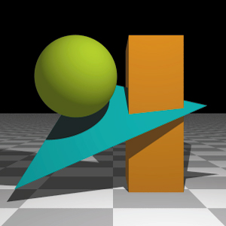
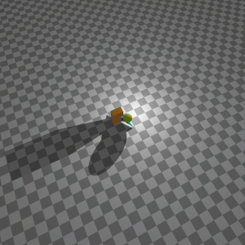
Example

