Slide 1

Bounding Volume Hierarchies
CS 418: Interactive Computer Graphics
UNIVERSITY OF ILLINOIS AT URBANA-CHAMPAIGN
Eric Shaffer

Slide 2
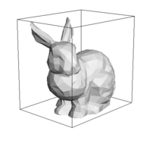
Bounding Boxes
Complex geometric models require expensive tests for ray intersections
Boxes are fast to test for ray intersection
Can implement a “quick rejection” test on the bounding box of a complex object
Usually, lots of rays will miss an object

Slide 3
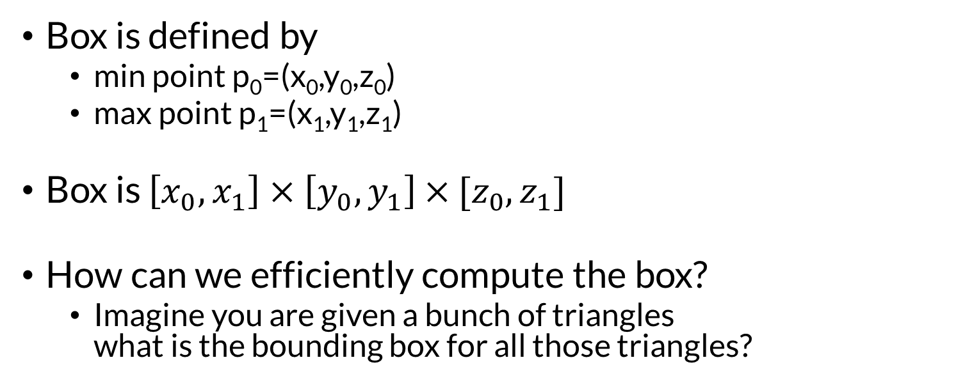
Axis-Aligned Bounding Box
Box is defined by
min point p₀=(x₀,y₀,z₀)
max point p₁=(x₁,y₁,z₁)
Box is $\left[x_{0},x_{1}\right]×$ $\left[y_{0},y_{1}\right]$ $×$ ${[z}_{0},z_{1}]$
How can we efficiently compute the box?
Imagine you are given a bunch of triangles what is the bounding box for all those triangles?

Slide 4
Box-Ray Intersection Test
Box is defined by slabs along each axis
We will look at 2D case and generalize to 3D
Ray misses the box when the slab intersection intervals do not overlap
How would you test this?

Slide 5
Box-Ray Intersection Test
Check if largest entering t value is less than smallest exiting t value

Slide 6
Box-Ray Intersection Test
But ray can also miss if smallest exiting t value is negative

Slide 7
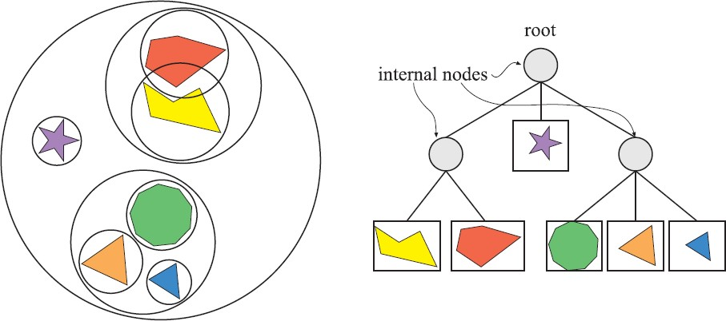
Bounding Volume Hierarchies (BVHs)
Three stages to construction:
Bound each primitive
Build a tree using recursive splitting
Convert tree to pointerless structure…more compact

Slide 8
Bounding Volume Hierarchies (BVHs)
BVH nodes store BV extent plus centroid
Leaves store primitives
Each primitive appears in only one node
If bounding boxes overlap, must traverse more than one subtree
Make internal nodes compact
8 byte representation means 4 fit in 32 byte cache line
In PBR, moving from 16 bytes to 8 resulted in 20% speedup

Slide 9
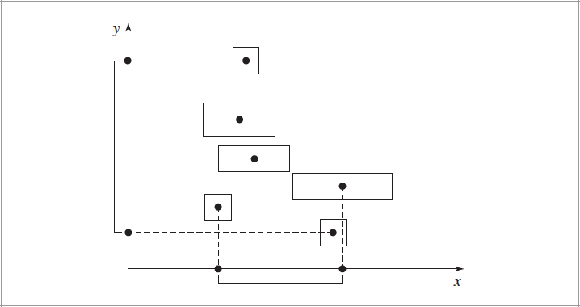
Which Axis to Split?

Slide 10
How to Split? Some Simple Heuristics…
Mid-point
Compute mid-point of the primitive centroids
Split along a principal axis
Split-equal
Partition primitive into 2 sets
n/2 objects with smallest coordinate centroids
n/2 objects with largest coordinate centroids

Slide 11
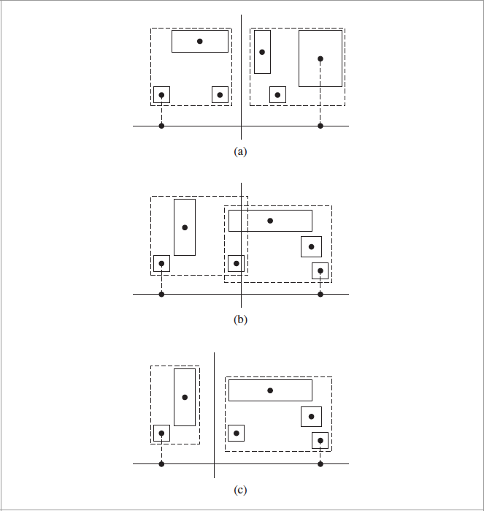
Problems with Simple Solutions
Midpoint works well
Midpoint and Equal are suboptimal
A better split …achieved by the Surface Area Heuristic …but that’s a topic for a different course

Slide 12
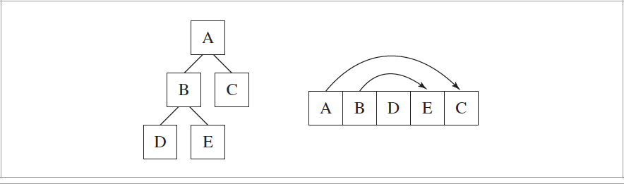
Compact Layout
Stored in depth-first order
First child immediately after parent node Offset to second child stored explicitly

Slide 13
Traversal of BVHs for Ray Tracing
Test ray against root BV for intersection…
Recurse (but not really…)
For a leaf, test against primitives
For a parent, test 2 children….

