Slide 1

Geometric Modeling with Meshes
CS 418: Interactive Computer Graphics
UNIVERSITY OF ILLINOIS AT URBANA-CHAMPAIGN
Eric Shaffer

Slide 2


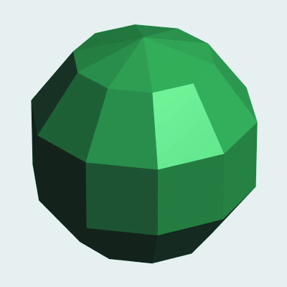
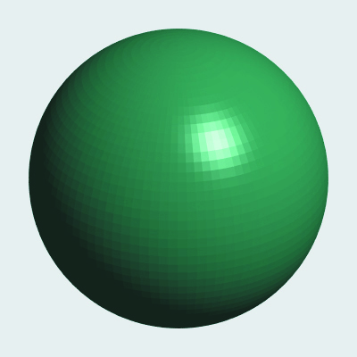
Objectives
Understand how meshes are used to model surfaces
Become familiar with basic mesh data structures

Slide 3
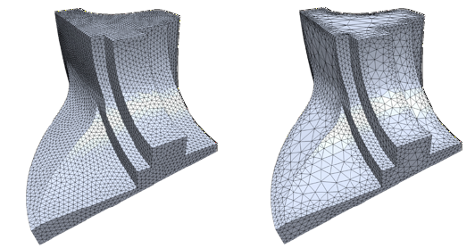
What is a Mesh?
Polygonal meshes define a surface using a collection of polygons
Just as curve can be approximated by connected linear segments…
…a smooth surface can be approximated by polygons
Lots of useful properties
Can model arbitrary topology
Can model surface discontinuities easily
Can be adaptively refined/coarsened

Slide 4
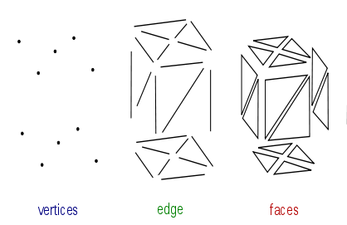
Triangle Meshes
We will focus on triangle meshes
Any polygon can be triangulated
Triangles can tile a surface
Modern graphics hardware is optimized to render triangles
Elements of a triangle mesh
Vertices specified using 3D coordinates describe the geometry
Edges specify the connectivity
Faces are the triangles…three connected edges forming a loop

Slide 5
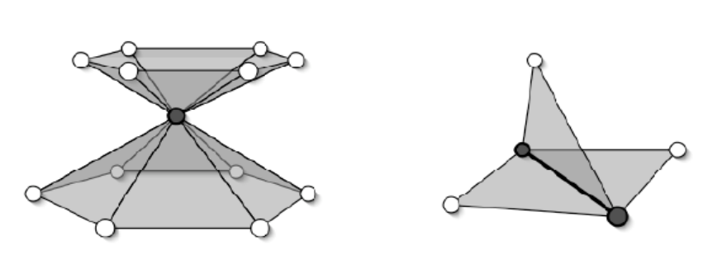
Mesh Properties
Manifold
Every edge is shared by exactly two faces
Every vertex neighborhood is like a disk
Orientable
Normals are consistent
Watertight
Orientable and manifold
Boundary
Some edges appear on only one face
Ordering
Vertices typically given in CCW order
Outward normal is then (v1-v0) ✕ (v2-v0)
Non-manifolds

Slide 6
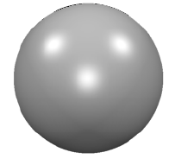
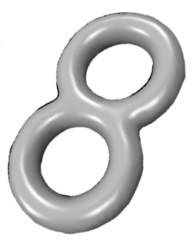
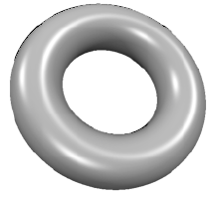
Euler Characteristic
Derived by Leonhard Euler (1707-1783) for polyhedra
Can also be applied to planar graphs
…and manifold polygonal surfaces without boundaries
For triangle meshes
F≈2V…can you prove it?
E≈3V…can you prove it?
Average valence is 6….why?

Slide 7
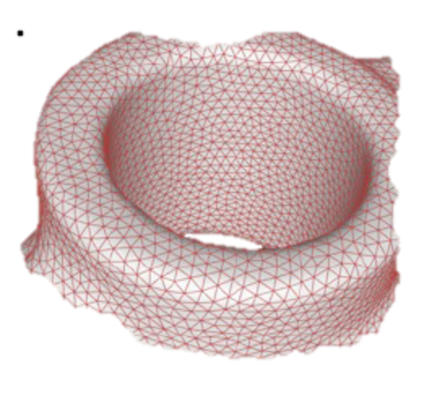
Mesh Data Structures
Must store the geometry and connectivity
Tradeoffs are made between
Amount of storage
Time required to determine information
What are the coordinates of a vertex?
What are the neighbors of a vertex?
What faces are incident on an edge?
Choice of data structure
determined by what operations need to be supported

Slide 8
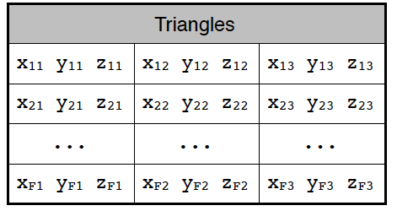
Face Set Data Structure
Each triangle stored explicitly using coordinates of the vertices
STL file format is an example
Assuming 4 bytes per floating point number (IEEE single precision)
How much storage is needed as a function of V?
What can you do fast?
What kind of operation is difficult?

Slide 9
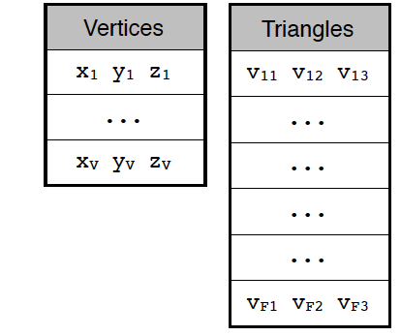
Indexed Face Set
OBJ and PLY file formats are examples
Each vertex stored as 3 coordinates
Each face stored as 3 integer indices into into vertex set
Assuming 4-byte integers, home many bytes per vertex?
What benefits does this structure have
What kind of operation is difficult?

Slide 10
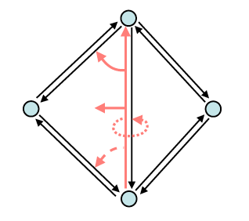
Half-Edge Data Structure
Designed to facilitate neighborhood queries
Each vertex has coordinates and a half-edge reference
Each face has a reference to a half-edge
Each half-edge has
Reference to end vertex
Reference to left face
Reference to next half-edge…maybe others
Around 144 B/v

Slide 11
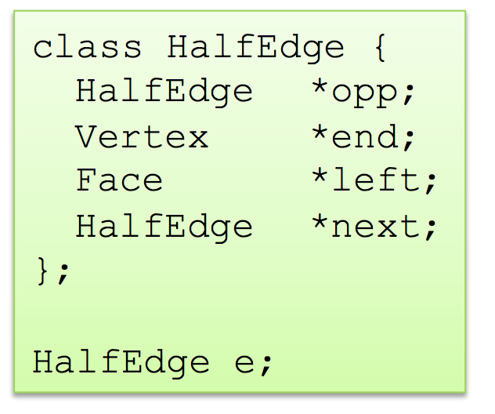
Half-edge Data Structure
How would you find the start vertex?
How would you find the right face ?
How would you find the 3 vertices of the left face?

Slide 12
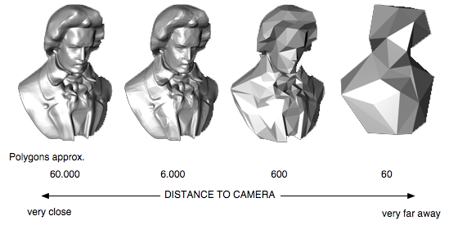
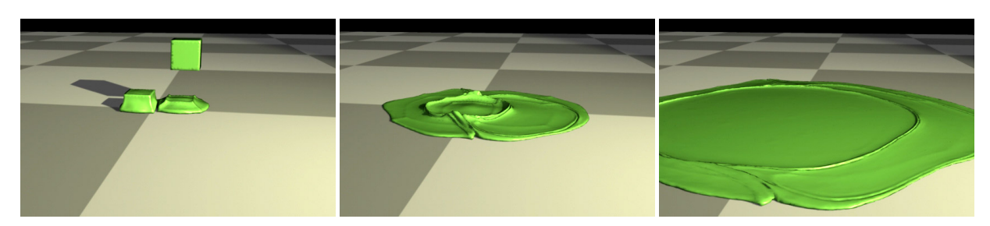
Mesh Processing
Lots of interesting operations
Mesh Generation
Mesh Smoothing
Generating Levels-of-Detail
Mesh Refinement
Mesh Coarsening
Remeshing
Mesh Deformation

Slide 13
Shading Considerations
Need a normal vector for the surface at a hit point Assume triangle is given by v₁ v₂ v₃
Flat Shading
Single normal per triangle
Compute (v₂ – v₁ ) ✕ (v₃ – v₁) and normalize
Smooth Shading
Compute interpolated normal for a hit point
Compute a normal at each vertex that averages the face normals Note: weighting by face area is best
Compute interpolated normal using barycentric coordinates n = b₁n₁ + b₂n₂ + b₃n₃

Slide 14
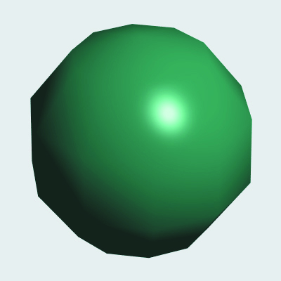
Shading Considerations

