Slide 1

Affine Transformations
CS 418: Interactive Computer Graphics
UNIVERSITY OF ILLINOIS AT URBANA-CHAMPAIGN
Eric Shaffer

Slide 2
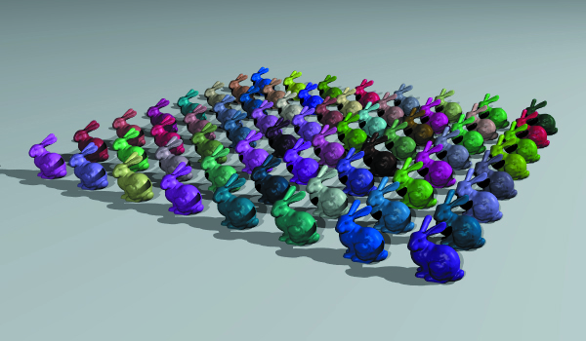
Objectives
Understand what affine transformations are
…and why they are not linear transformations
Review how to represent an affine transformation as a matrix
…and composite transformations
…and inverse transformations
Understand the use of homogenous coordinates
Understand how to intersect transformed objects
Know how to use instancing

Slide 3
Affine Transformations
We will review:
Rotation
Scaling
Translation
Reflection
All linear functions are affine functions
Linear functions keep the origin fixed
Affine functions need not do so
So…to include translation we use affine transformations
…and we’re going to use homogenous coordinates…

Slide 4

Homogenous Coordinates
Cartesian coordinates are used in Euclidean Geometry
Homogenous coordinates are used in Projective Geometry
Map between a 2D Cartesian point and a homogenous point
w=0 corresponds to a point at infinity
Generalizes directly to 3D Cartesian points
What does (wX,wY,w) form in projective space?

Slide 5
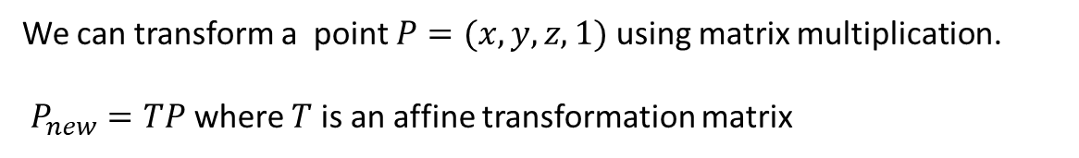
3D Translation
We can transform a point $P=(x,y,z,1)$ using matrix multiplication. $P_{new}=TP$ where $T$ is an affine transformation matrix

Slide 6
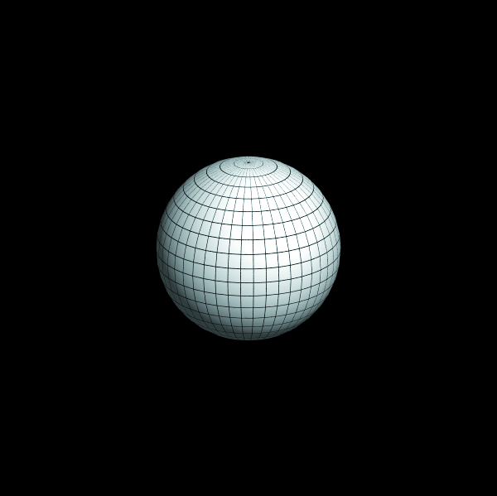
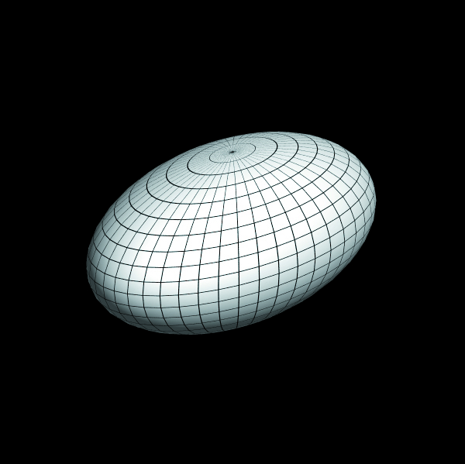
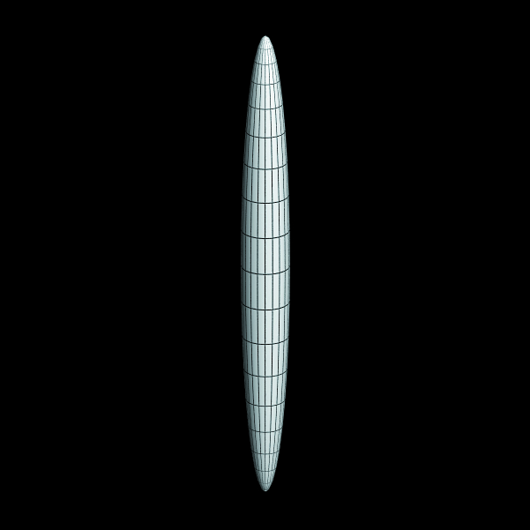
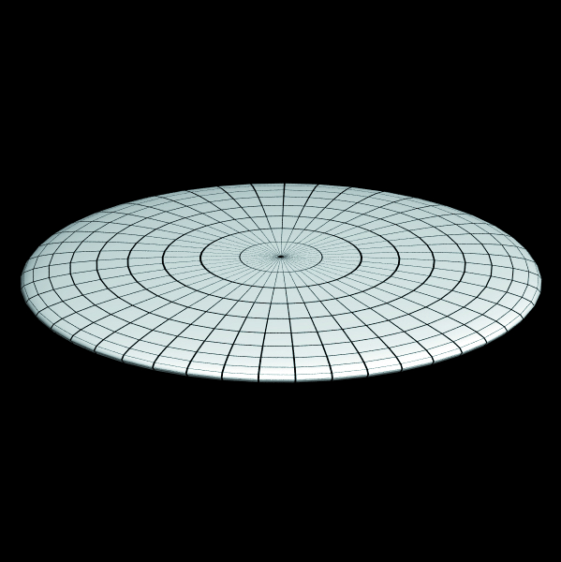
3D Scaling

Slide 7
3D Rotation
Pick an axis to rotate around (x, y, or z)
Looking along the negative axis , the rotation is counter-clockwise

Slide 8
3D Rotation
Pick an axis to rotate around (x, y, or z)
Looking along the negative axis , the rotation is counter-clockwise

Slide 9
3D Reflection

Slide 10
Composing Transformations
Non-uniform scaling and rotation do not commute

Slide 11
Composing Transformations
Rotation and translation do not commute

Slide 12
Composing Transformations
Rotations do not commute

Slide 13
Inverse Transformations
Generally easy to construct
For translation and rotation → just negate the terms in the matrix
For scaling → transform diagonal entries to their reciprocals
If we have Tv = T_{n}T_{n-1}…T₁v then T⁻¹=T₁⁻¹…T⁻¹_{n-1}T⁻¹_{n} T⁻¹Tv=v

Slide 14
Intersecting Transformed Objects
Apply inverse set of transformations to the ray
Intersect inverse transformed ray with untransformed object
Compute the normal at the hit point
Use hit point to compute hit point on transformed object
Use normal to compute normal on transformed object

Slide 15
Intersecting Transformed Objects

Slide 16
Intersecting Transformed Objects
To transform the ray
Assume matrix T transforms the object
Assume original ray is o + td
The inverse transformed ray is then T⁻¹o+tT⁻¹d
Note that d is a vector
It should be unaffected by translation
Use a homogenous coordinate of 0 in d

Slide 17
Finding the Hit Point
p = hit point for transformed ray and untransformed object
p’ = hit point for original ray and transformed object
If the hit point p occurs at t₀ then the hit point p’ occurs at t₀
Just calculate the point p’ using t₀ and the original ray
Proof:

Slide 18
Transforming Normals
Let n be the normal on the untransformed object
Found at hit point with inverse transformed ray
Let n’ be the normal on the transformed object: n’ = (T⁻¹)^{T}n
If you only use uniform scaling and rotations (T⁻¹)^{T}=T
Use homogenous coordinate of 0
Normalize n’ after you find it

Slide 19
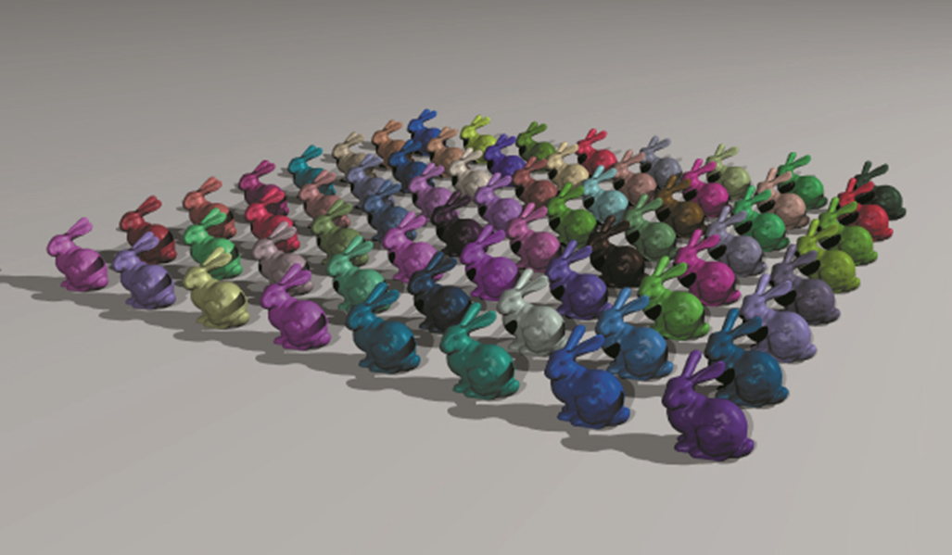
Instancing
Keep a single original geometric model
Create instance models which consist of
Reference to original model
Inverse transformation matrix
Material

Slide 20
BVHs and Transformed Objects
Store references to instances just as you would normal objects
For a mesh this would be references to individual triangles
…and references to a material and inverse transformation matrix
How can you compute the bounding box for the instances?
Why do you need the bounding box?
What information do you need to compute it?

Slide 21
Bounding Boxes and Transformed Objects

