Slide 1

Aliasing
CS 296: Data Structures Honors Section Geometric Data Structures for Computer Graphics
UNIVERSITY OF ILLINOIS AT URBANA-CHAMPAIGN
Eric Shaffer

Slide 2
Aliasing
Aliasing is an effect caused by discrete sampling
With digital images
We have a finite number of pixels
We have a finite number of colors
…which will not always be able to render a scene accurately
Some common aliasing phenomena are
jaggies
moire patterns
loss of small details in textures

Slide 3
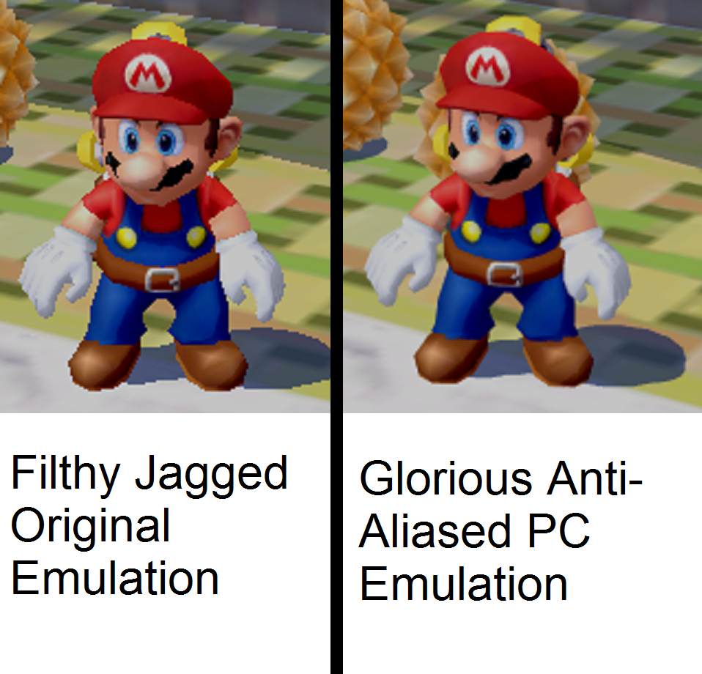
Mario…

Slide 4
Aliasing in Ray Tracing
Imagine a yellow polygon in a scene.
We have a 5x7 array of pixels and shoot rays through the pixel centers
We get a jagged edge….
How could we generate a better approximation?
Notes:
Shooting through the center of the pixels…in pixels that should be bi-colored we get mono-color. Jaggies.
What are some obvious steps to take: More pixels….
Alternatively…more colors…we could make the pixel an area-weighted average of the 2 colors in it…

Slide 5
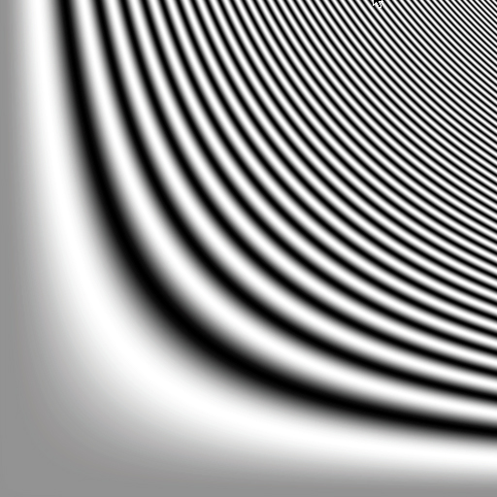
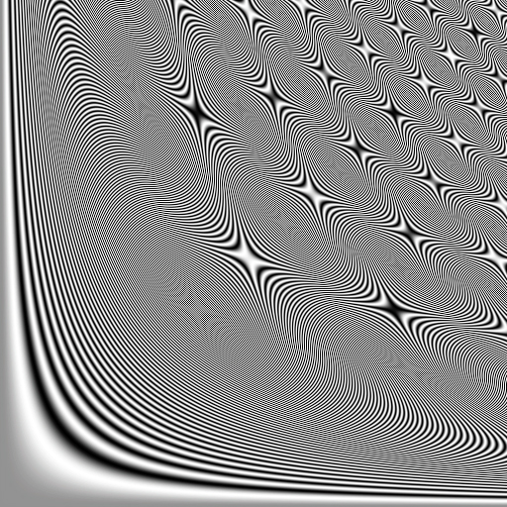
Moire patterns
Second images show what happens when we try to squeeze a bigger domain into the same 512x512 pixels
As an aside….how do you ray cast f(x,y) ?
Notes:
First picture is x,y in [0,3.79] and bands are all more than two pixels wide
Second is [0, 10.83] and we get moire patterns in which we “see” two superimposed signals
mwar

Slide 6
Anti-aliasing
One remedy to aliasing is to shoot more rays per-pixel
Sampling pattern Pixel on the edge Final color on a single pixel
REGULAR SAMPLING
We use an n by n regular sub-grid and shoot through the sub-pixels
Color is the average color returned by the sub-samples
Image shows one pixel with 25 sub-samples

Slide 7
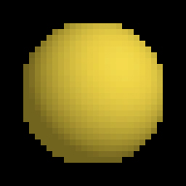
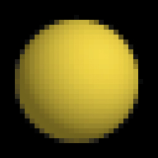
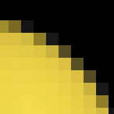
A Ray Tracing Example
One ray per pixel 16 rays per pixel Enlarged view

Slide 8
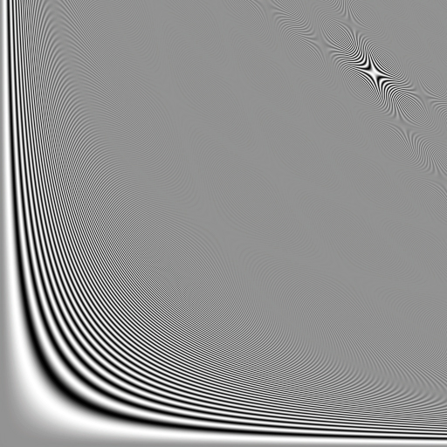
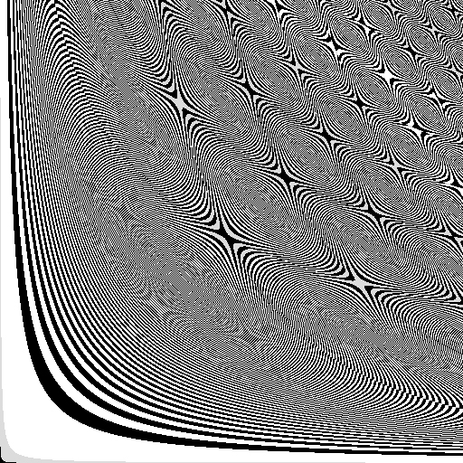
Problems with Regular Sampling
Still often leads to “regular” artifacts
Humans are great at perceiving induced regular patterns
Notes:
Moire patterns persist even with 5x5 subsampling….second image enhances contrast and the moire patterns pop….

Slide 9
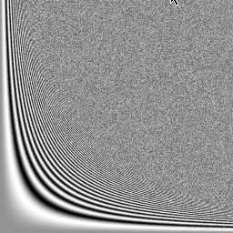
Random Sampling
Could use N random locations in the pixel
Often makes things look noisy, but…
…people prefer noise to aliasing visually
Notes:
What is the obvious problem…can have clumping

Slide 10
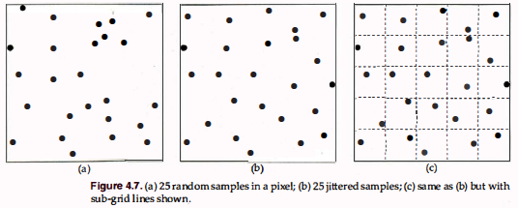
Jittered Sampling
Use a regular grid of n by n subpixels
Use random location within each subpixel

Slide 11
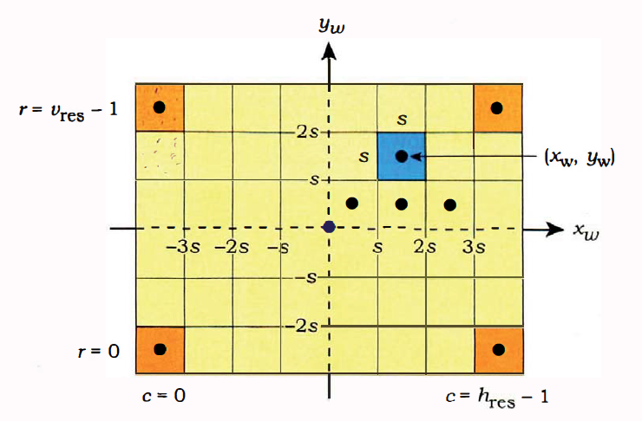
Computing Jittered Pixel Coordinates
Generate multiple positions inside the pixel (4?)
Don’t use the same pattern inside every pixel What implementation would do this?

Slide 12
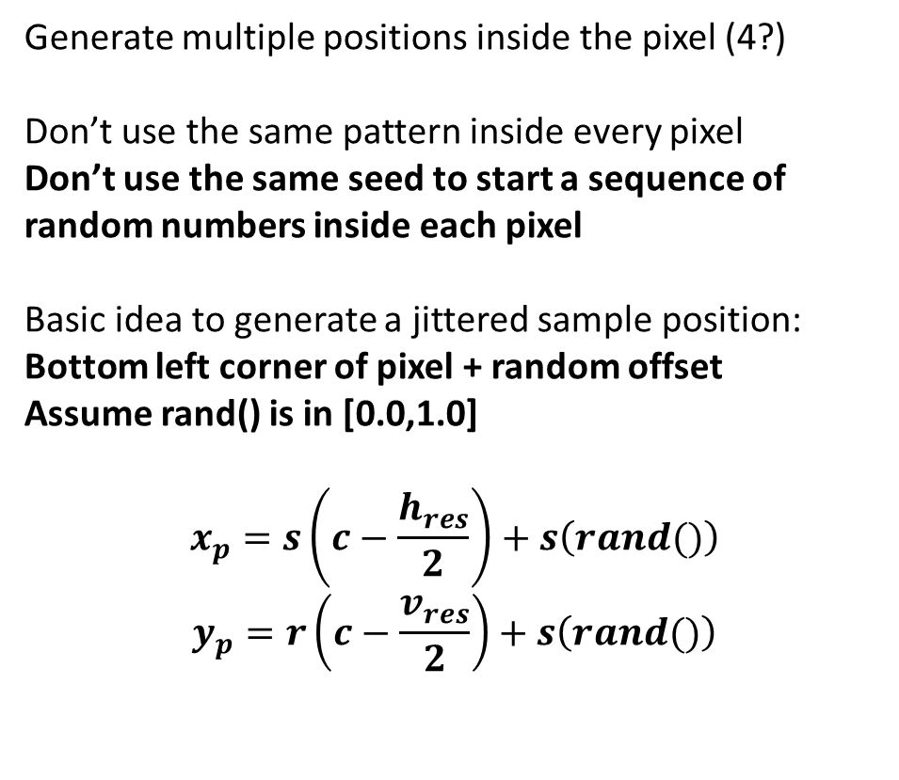
Computing Jittered Pixel Coordinates
Generate multiple positions inside the pixel (4?)
Don’t use the same pattern inside every pixel Don’t use the same seed to start a sequence of random numbers inside each pixel
Basic idea to generate a jittered sample position:
Bottom left corner of pixel + random offset Assume rand() is in [0.0,1.0]
$$x_{p}=s\left(c−\frac{h_{res}}{2}\right)+s\left(rand()\right)$$
$$y_{p}=r\left(c−\frac{v_{res}}{2}\right)+s\left(rand()\right)$$

