Slide 1

The OBJ File Format
CS 296
UNIVERSITY OF ILLINOIS AT URBANA-CHAMPAIGN
Eric Shaffer

Slide 2
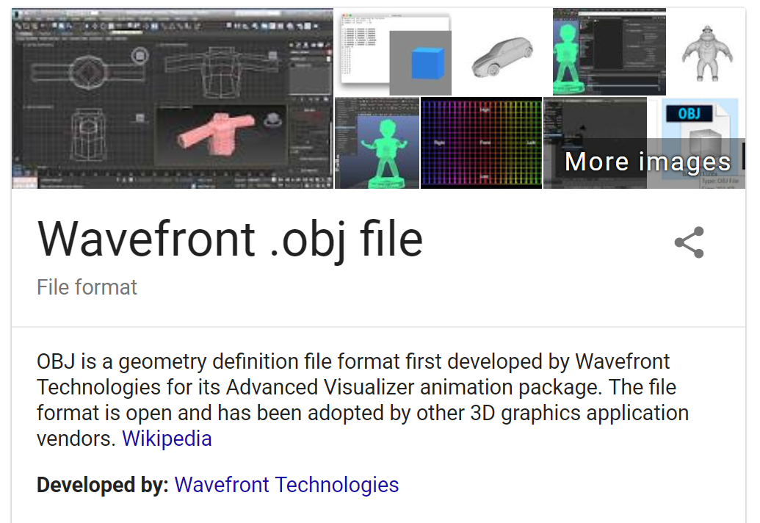
OBJ File Format
It is a text (ASCII) file format for 3D surface models
You will implement a parser for a subset of the format
For details on the file format: https://en.wikipedia.org/wiki/Wavefront_.obj_file

Slide 3


Parsing the OBJ File
You just need to parse a subset of the OBJ file format…
Lines starting with # are comments…log these to the console
Lines staring with v are vertex coordinates
Lines starting with f are triangles
NOTE..obj vertex indices start at 1…you need to subtract one if your arrays will start at 0
To make things easier: -->assume faces have only 3 numbers in each record…not true for full OBJ format

Slide 4
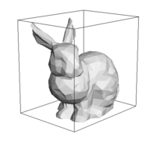
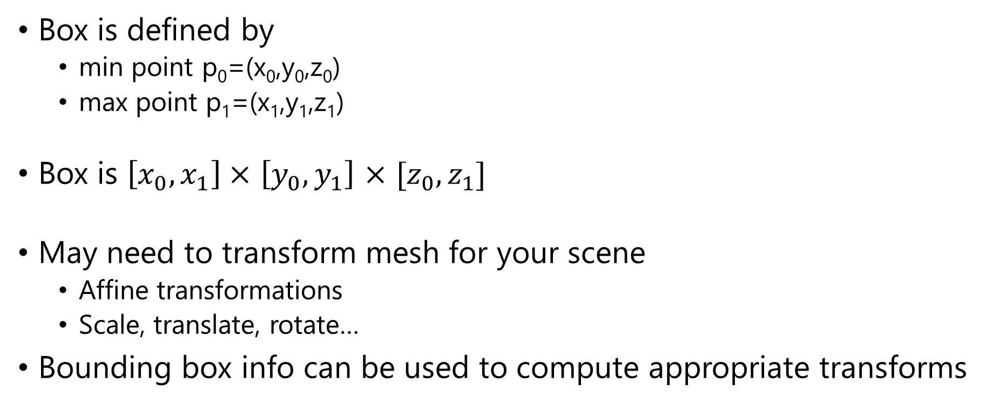
Axis Aligned Bounding Box
Box is defined by
min point p₀=(x₀,y₀,z₀)
max point p₁=(x₁,y₁,z₁)
Box is $\left[x_{0},x_{1}\right]×$ $\left[y_{0},y_{1}\right]$ $×$ ${[z}_{0},z_{1}]$
May need to transform mesh for your scene
Affine transformations
Scale, translate, rotate…
Bounding box info can be used to compute appropriate transforms

Slide 5
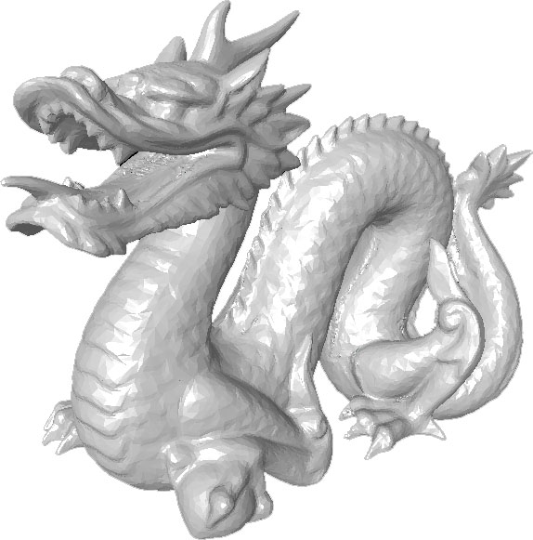
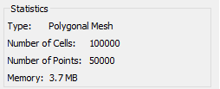
Dragon.obj

Slide 6
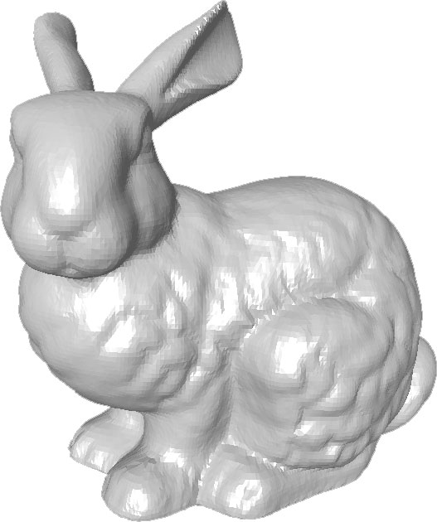
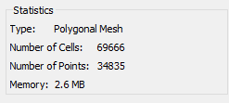
Bunny.obj

Slide 7

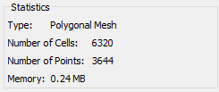
Teapot.obj

Slide 8
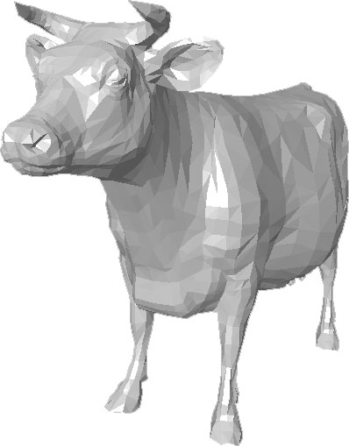
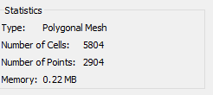
Cow.obj

