Slide 1

Modeling with Constructive Solid Geometry (CSG)
CS 296
UNIVERSITY OF ILLINOIS AT URBANA-CHAMPAIGN
Eric Shaffer

Slide 2
Implicit Surfaces
Real-valued function f(x,y,z)
Classifies points in space
Inside solid object: f<0
Outside solid object: f>0
Surface f=0

Slide 3
Why Use Implicits
Versus polygonal meshes?
Smoother
Compact (in terms of storage)

Slide 4
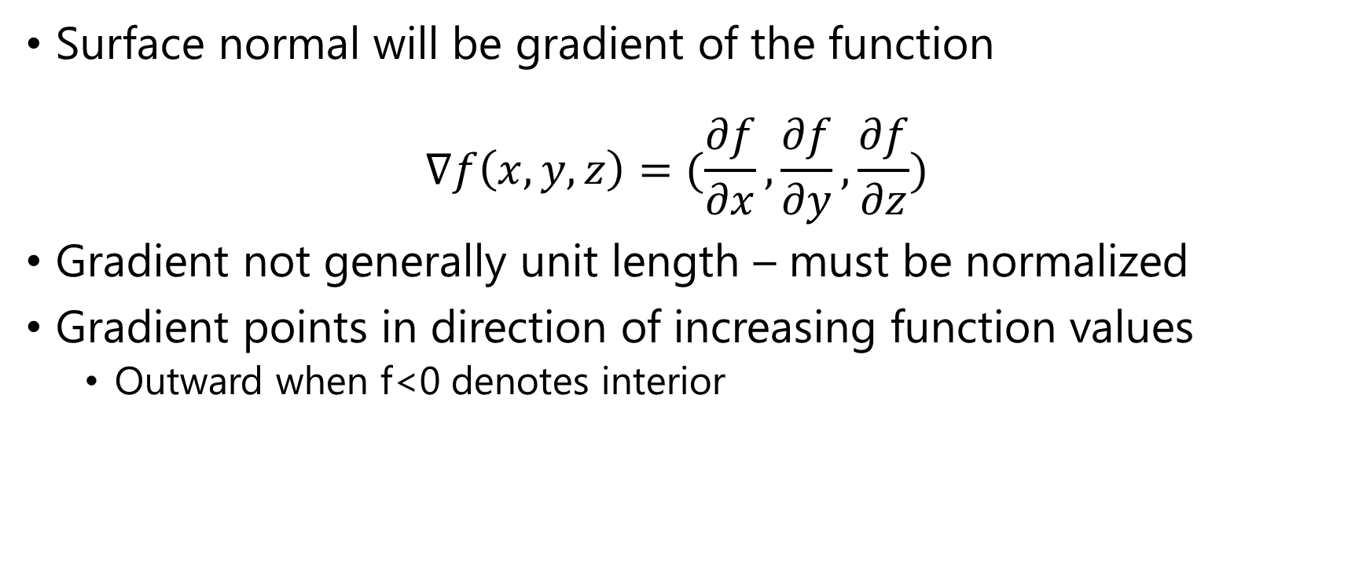
Surface Normals
Surface normal will be gradient of the function $∇f\left(x,y,z\right)=(\frac{∂f}{∂x},\frac{∂f}{∂y},\frac{∂f}{∂z})$
Gradient not generally unit length – must be normalized
Gradient points in direction of increasing function values
Outward when f<0 denotes interior

Slide 5
CSG: Constructive Solid Geometry
CGS performs Boolean operations on shapes
Union : min(f,g)
Intersection : max(f,g)
Complement: -f
Subtraction: max(f,-g)

Slide 6
Ray Tracing CSG Objects
Intersect ray with each basic object
Each intersection generates an interval on the ray
Perform the Boolean operations on the ray
Work in the parametric space with t

