Slide 1

Lab 8
CS 418: Interactive Computer Graphics
UNIVERSITY OF ILLINOIS AT URBANA-CHAMPAIGN
Eric Shaffer

Slide 2
Goals
In this lab you will implement code to read a mesh from an OBJ file
Things you will need to do include:
Learn how to asynchronously fetch a server side file
Handle a asynchronous event
So you don’t try to draw before you have the mesh ready
Parse the OBJ text file using JavaScript
So you can populate the vertex and face buffers for the mesh
All of this code will be used in MP3

Slide 3
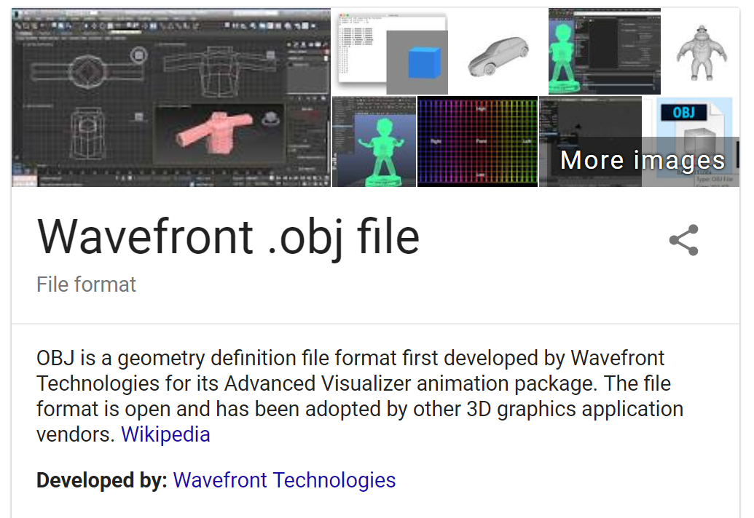
OBJ File Format
It is a text (ASCII) file format for 3D surface models
You will implement a parser for a subset of the format
…and render a cow
For details on the file format: https://en.wikipedia.org/wiki/Wavefront_.obj_file

Slide 4
Asynchronously Read a File
It would probably be more useful to read and render a file on the client side…but for this MP, grading will be e easier if we read a server side
file…
To start, we need to be able to read a text file
We will write code to fetch an obj file kept on the server side
The only slightly tricky part is that the fetch is done asynchronously
Since the file read is asynchronous…
We need to not try to draw the mesh before the data is ready

Slide 5
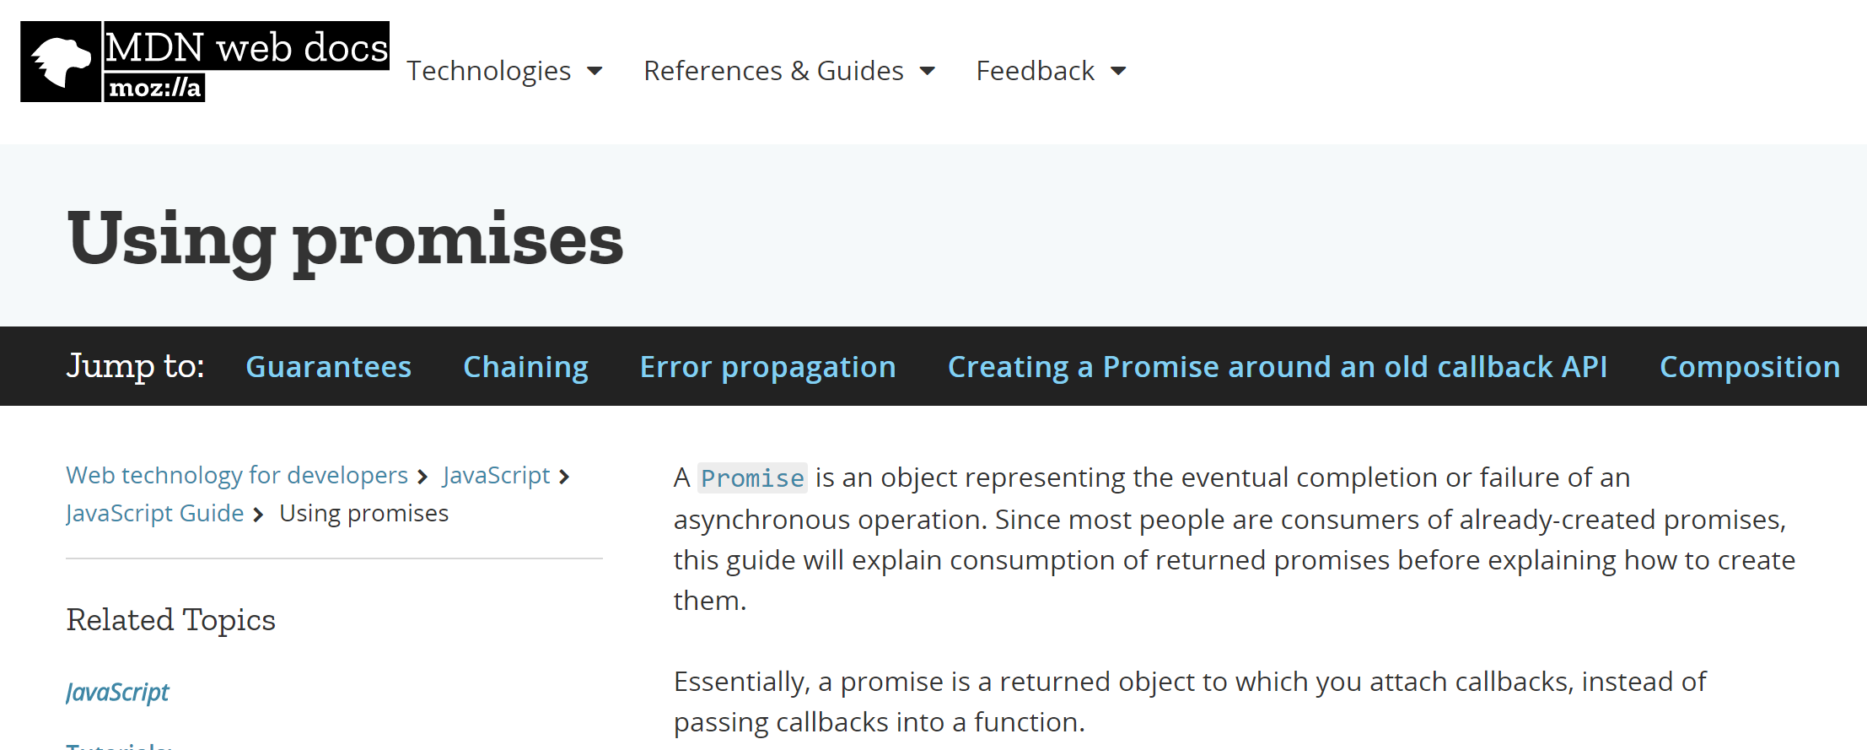
function setupMesh(filename)
To get the text asynchronously from the server we will use a JavaScript promise You can read about them: https://developer.mozilla.org/en-US/docs/Web/JavaScript/Guide/Using_promises

Slide 6
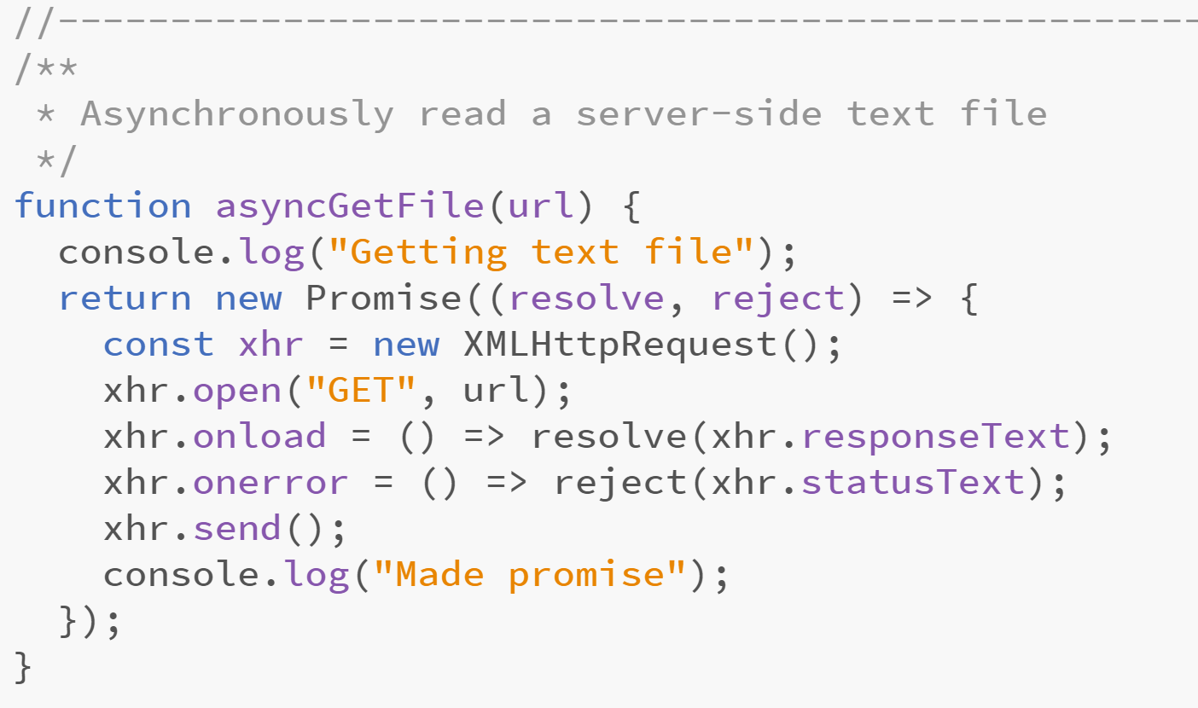
function asyncGetFile(url) in HelloMesh.js
Add this code:

Slide 7
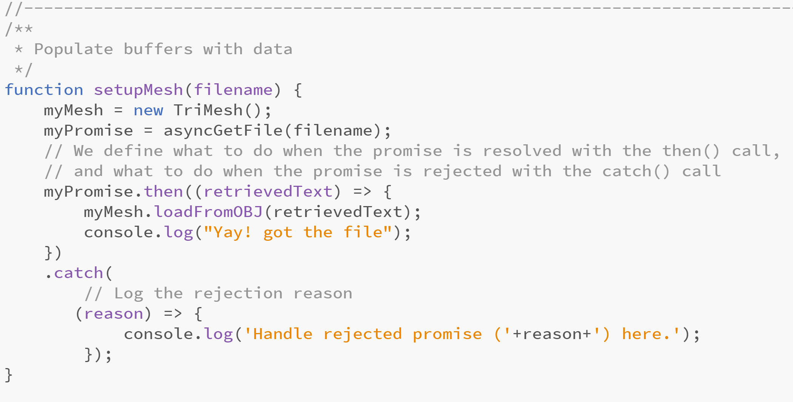
Function setupMesh in HelloMesh.js
Now use that asyncGetFile function you wrote to fetch the cow.obj file
…and give it to the TriMesh object to be parsed…

Slide 8
function draw() in HelloMesh.js
Stop myMesh from being drawn before it is ready
…add an if statement to prevent this
Which TriMesh function will be useful?

Slide 9
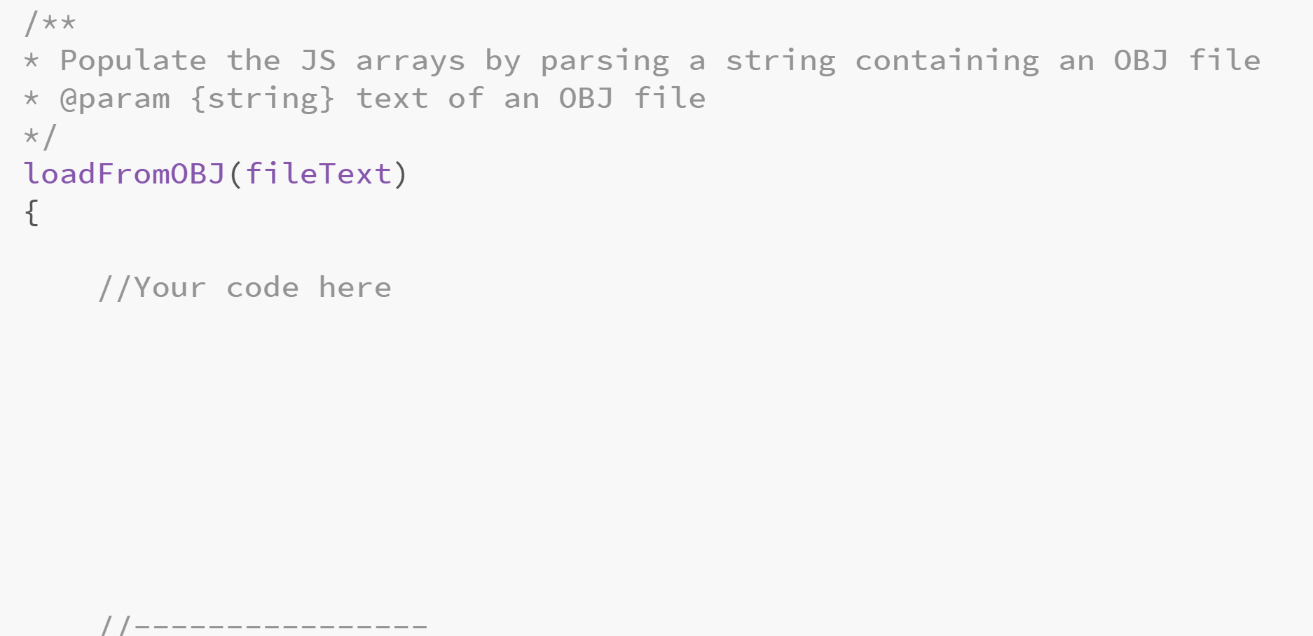
loadFromOBJ(fileText) in TriMesh.js
Finally…write code toparse the text file….

Slide 10


Parsing the OBJ File
You just need to parse a subset of the OBJ file format…
Lines starting with # are comments…log these to the console
Lines staring with v are vertex coordinates
Lines starting with f are triangles
NOTE..obj vertex indices start at 1…you need to subtract one if your arrays will start at 0
To make things easier, assume faces have only 3 numbers in each record …not true for full OBJ format
Read those lines and fill this.vBuffer and this.fBuffer

Slide 11
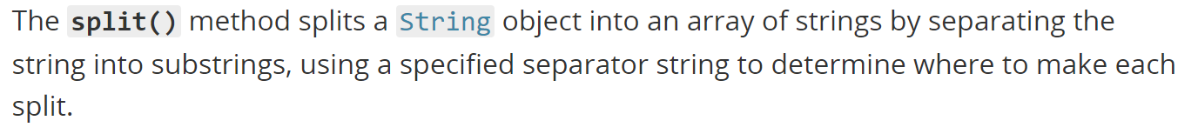
Useful JS functions
String method split() https://developer.mozilla.org/en-US/docs/Web/JavaScript/Reference/Global_Objects/String/split
parseFloat https://developer.mozilla.org/en-US/docs/Web/JavaScript/Reference/Global_Objects/parseFloat
parseInt
https://developer.mozilla.org/en-US/docs/Web/JavaScript/Reference/Global_Objects/parseInt

Slide 12
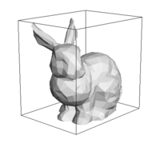
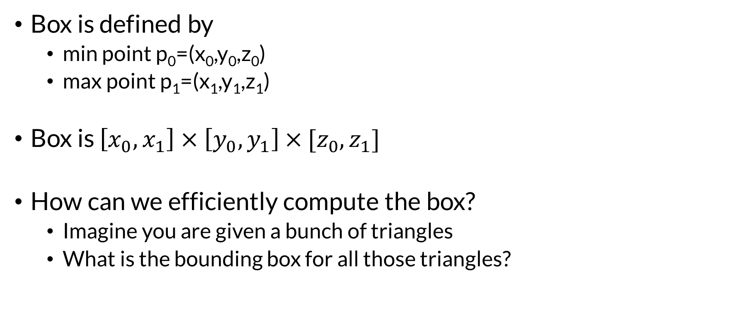
Axis Aligned Bounding Box
Box is defined by
min point p₀=(x₀,y₀,z₀)
max point p₁=(x₁,y₁,z₁)
Box is $\left[x_{0},x_{1}\right]×$ $\left[y_{0},y_{1}\right]$ $×$ ${[z}_{0},z_{1}]$
How can we efficiently compute the box?
Imagine you are given a bunch of triangles
What is the bounding box for all those triangles?

Slide 13
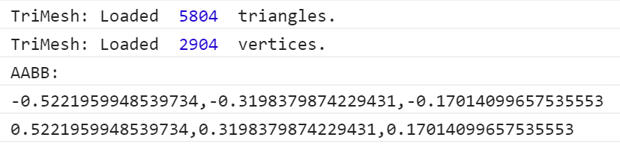
Model Size and Position
The cow mesh AABB:
The view and projection matrices are set up to see that geometry
Other meshes might not naturally be located in your view volume
May need to be translated and scaled
In TriMesh.js complete the functions shown here …you can use that information to determine how a mesh should be transformed

Slide 14
TriMesh.js: Complete computeAABB() and getAABB(minXYZ,maxXYZ)
You can then use these functions in code that
Determines if the geometry should be scaled
Determines if the geometry should be translated
You would apply those tranformations to the MVMatrix before drawing

Slide 15
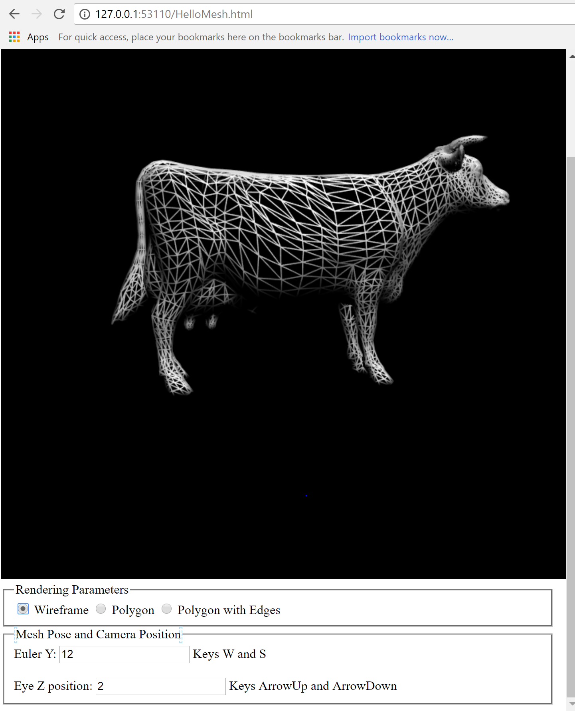
Final Result

