Slide 1
冒險故事(VTube Studio)

Slide 2
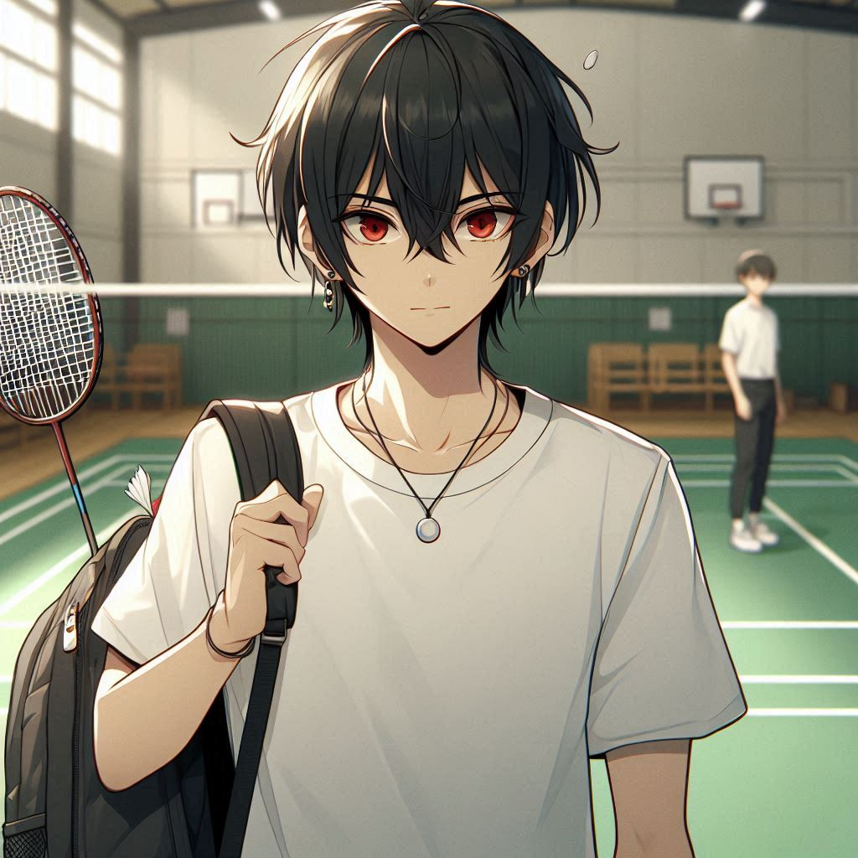
Notes:
Build a Japanese anime style scene. You are an anime high school boy with black hair, a round hairstyle, hair down to your shoulders, red eyes, wearing a white shirt.In the drawing, you're about to represent your school in an interschool badminton match. You're standing on the badminton court with a backpack carrying your badminton racket.
我是一名剛入選校隊的高中羽球選手，正在準備代表學校參加全國比賽。

Slide 3
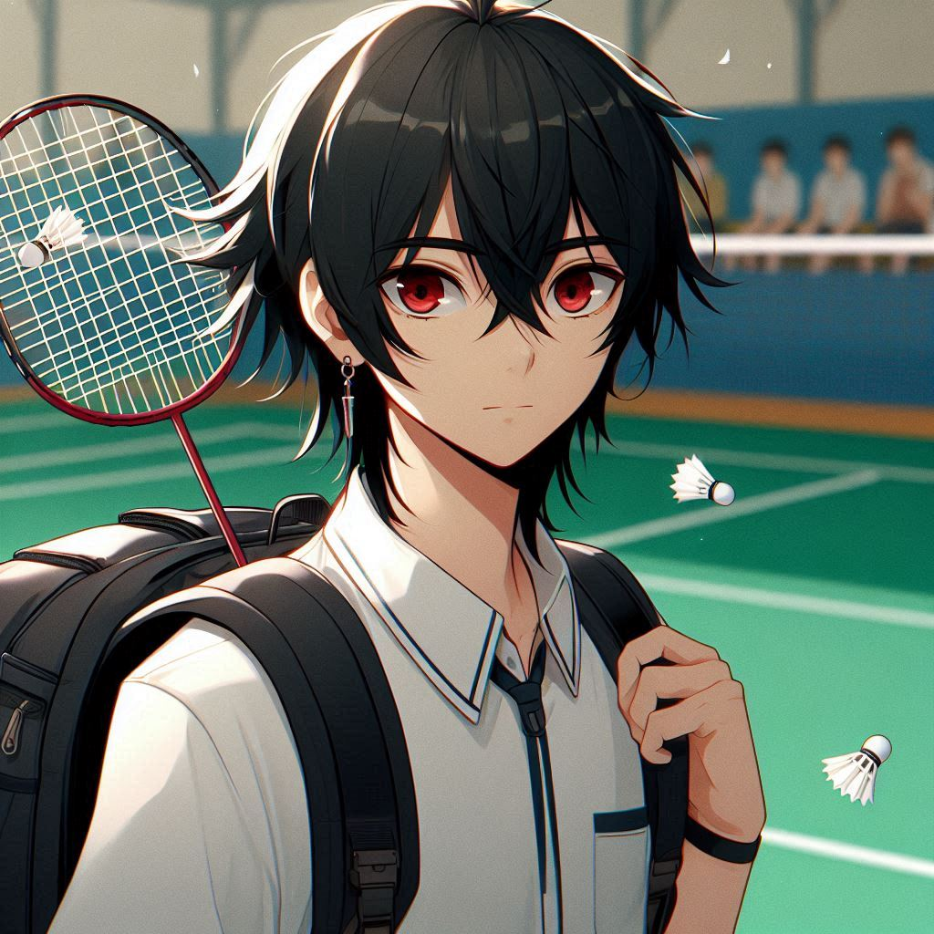

Notes:
Build a Japanese anime style scene. You are an anime high school boy with black hair, a round hairstyle, hair down to your shoulders, red eyes, wearing a white shirt.In the drawing, you're about to represent your school in an interschool badminton match. You're standing on the badminton court with a backpack carrying your badminton racket.
這是我一直以來的夢想，能夠和全國最強的選手同場競技對我來說意義重大。每天的訓練讓我更加自信，但我也知道這次比賽會充滿挑戰。

Slide 4
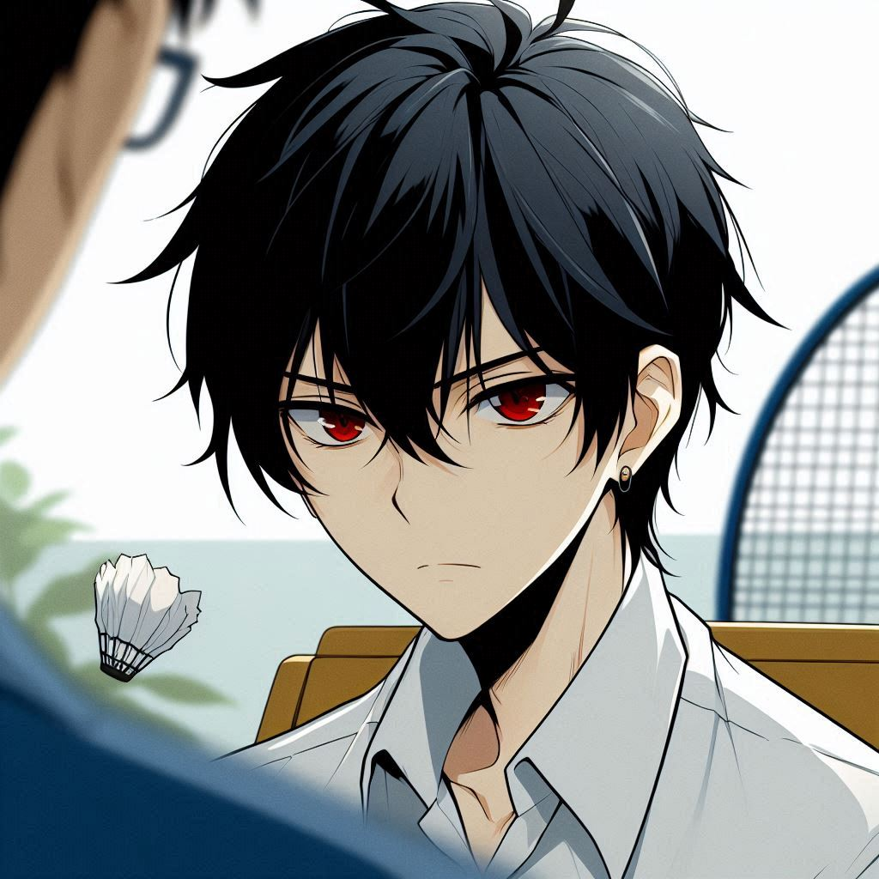
Notes:
Build a Japanese anime style scene. You are an anime high school boy with black hair, a round hairstyle, hair down to your shoulders, red eyes, wearing a white shirt. You look like you're under a lot of pressure.you are thinking about the badminton match. You are talking to the coach.
比賽前，校隊內部的壓力逐漸增加，大家都很期待能在全國賽上取得好成績。教練把我放在單打的位置，這意味著我要面對全隊的重要對手。我雖然努力準備，但心裡一直覺得自己的經驗不如其他選手，有點擔心是否能夠勝任這個角色。

Slide 5
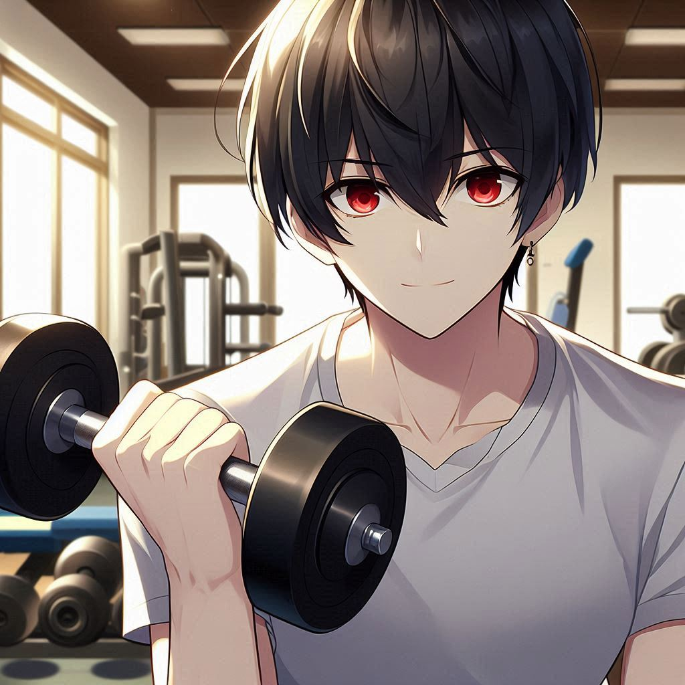
Notes:
Build a Japanese anime style scene. You are an anime high school boy with black hair, a round hairstyle, hair down to your shoulders, red eyes, wearing a white shirt. You look confident.You're working on your physical fitness in the gym. You're holding a dumbbell, working out.
為了讓自己在比賽中發揮最佳狀態，我每天加強訓練，對自己的體能進行加強

Slide 6
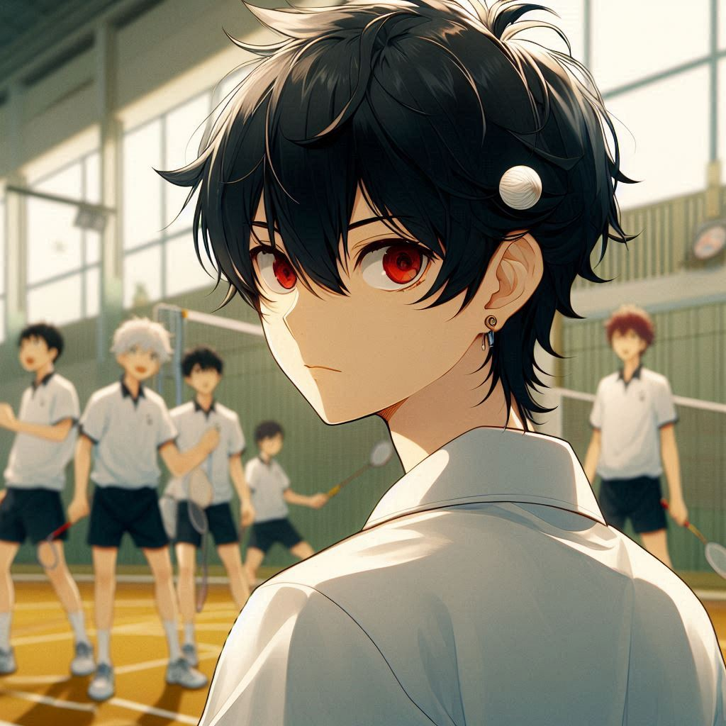
Notes:
Build a Japanese anime style scene. You are an anime high school boy with black hair, a round hairstyle, hair down to your shoulders, red eyes, wearing a white shirt. You look confident.You're working on your physical fitness in the gym. You're holding a dumbbell, working out.
並和隊友進行高強度的實戰模擬。除了技術上的提升，我也努力學習如何在關鍵時刻保持冷靜和專注。教練經常提醒我，比賽不僅是體力和技術的較量，更是心態的比拼。

Slide 7
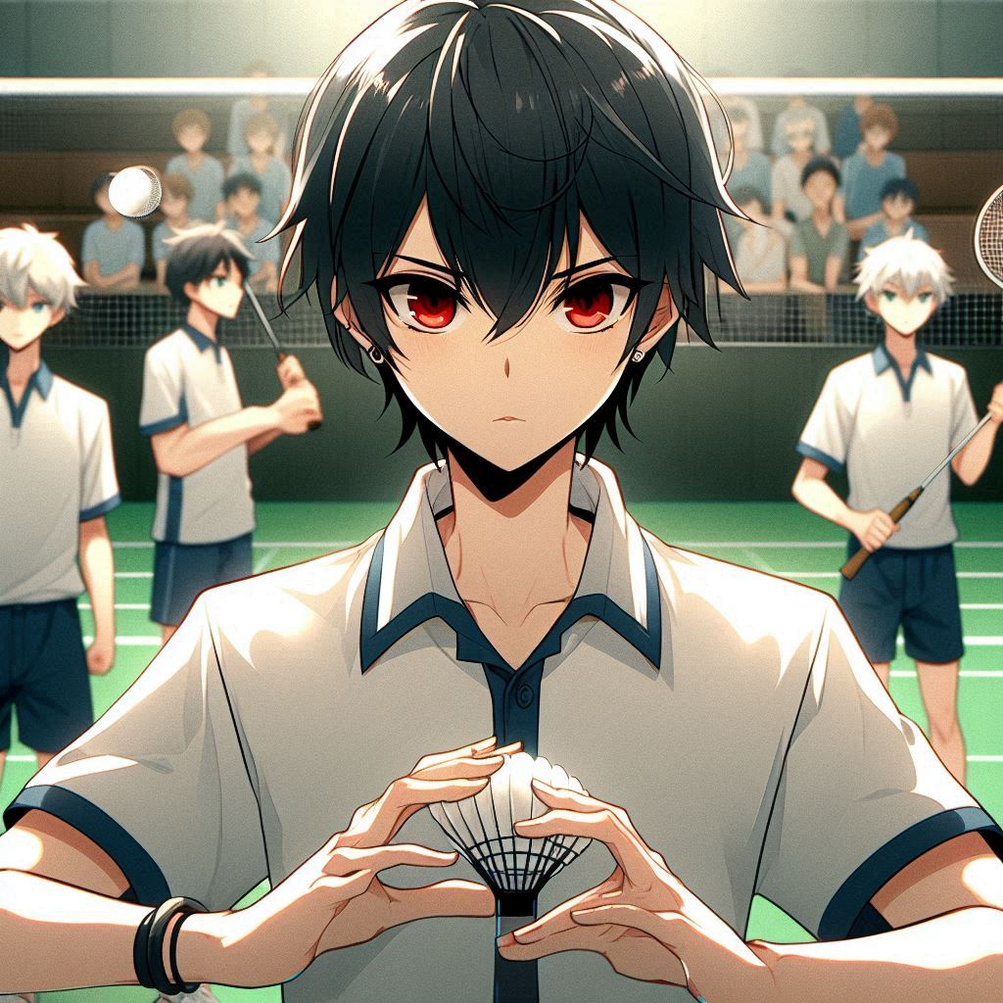
Notes:
Build a Japanese anime style scene. You are an anime high school boy with black hair, a round hairstyle, hair down to your shoulders, red eyes, wearing a white shirt. You're practicing match drills with your badminton teammates.
比賽當天，體育館裡充滿了觀眾的歡呼聲和緊張的氣氛。

Slide 8
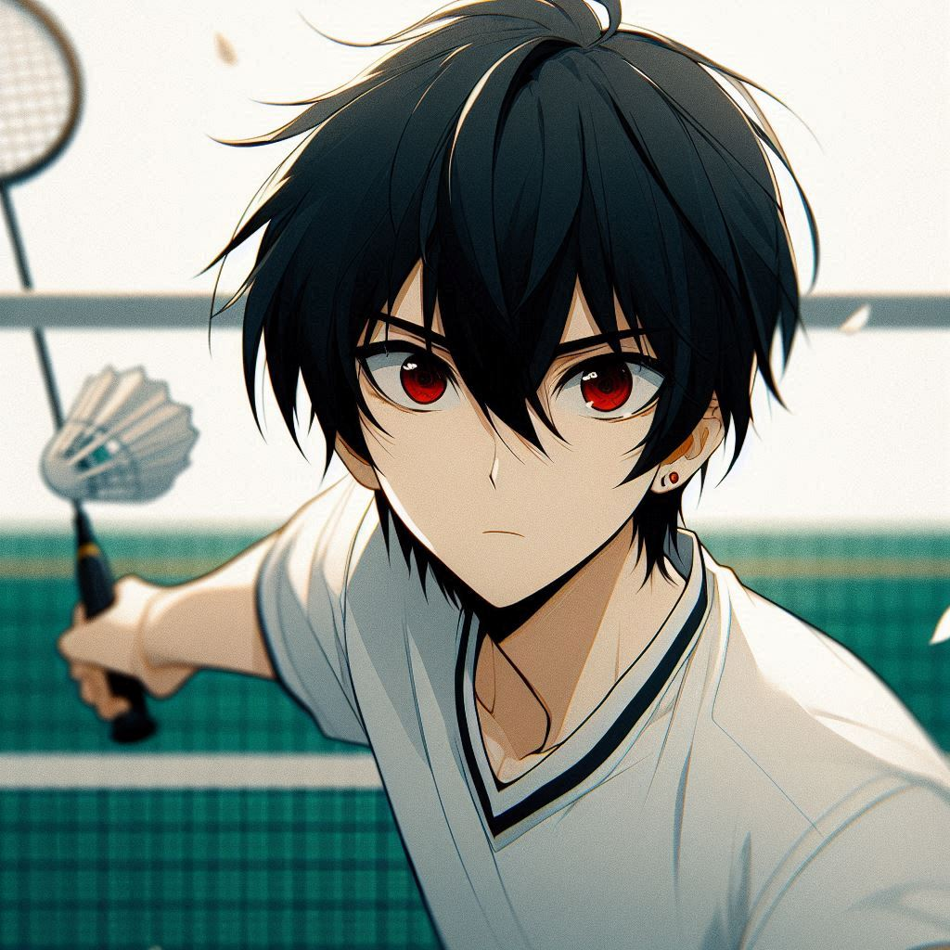
Notes:
You're competing against your opponent in a badminton match, and you made a mistake. There's only one opponent.You are an anime high school boy with black hair, a round hairstyle, hair down to your shoulders, red eyes, wearing a white shirt.You are at a badminton match.
上場的那一刻，我感覺自己既興奮又有些不安，幾次擊球失誤讓我感到壓力倍增。可是，我很快穩住了情緒，開始回到平時訓練時的節奏，逐漸恢復了信心。

Slide 9
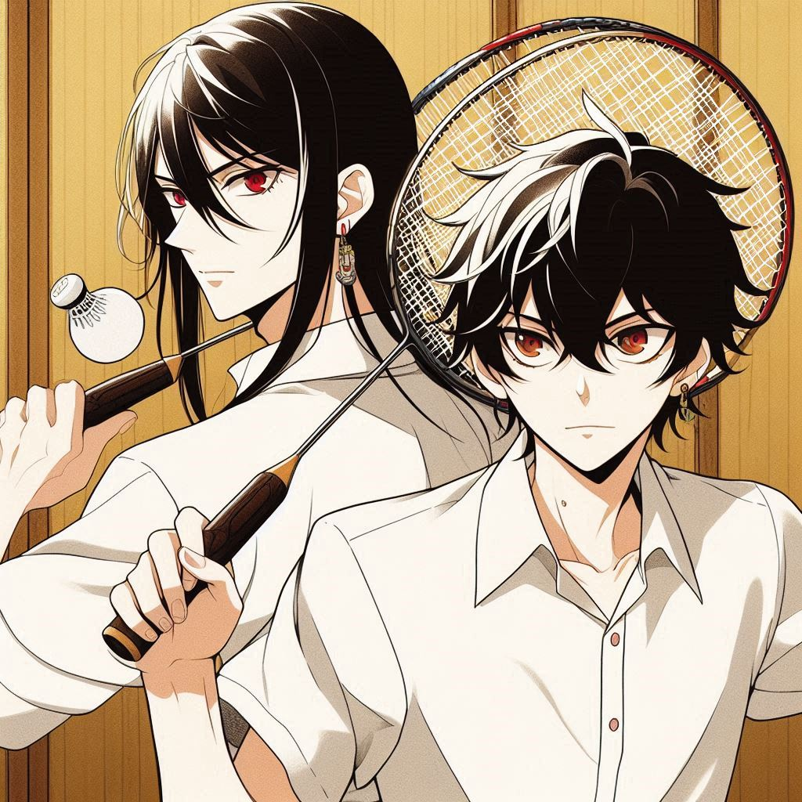
Notes:
You're competing against your opponent in a badminton match, and you made a mistake. There's only one opponent.You are an anime high school boy with black hair, a round hairstyle, hair down to your shoulders, red eyes, wearing a white shirt.You are at a badminton match.
上場的那一刻，我感覺自己既興奮又有些不安，幾次擊球失誤讓我感到壓力倍增。可是，我很快穩住了情緒，開始回到平時訓練時的節奏，逐漸恢復了信心。

Slide 10
Notes:
Build a Japanese anime style scene. there are two men playing against each others in a badminton match. The one person's appearance is with black hair, a round hairstyle, hair down to your shoulders, red eyes, wearing a white shirt.
對手的實力比我想像的更強，他的擊球速度和球路變化讓我一時難以應對。比分一度被拉開，我開始擔心自己無法逆轉局勢。就在這時，我告訴自己不能慌張，專注於每一個來球，並觀察對方的弱點。

Slide 11
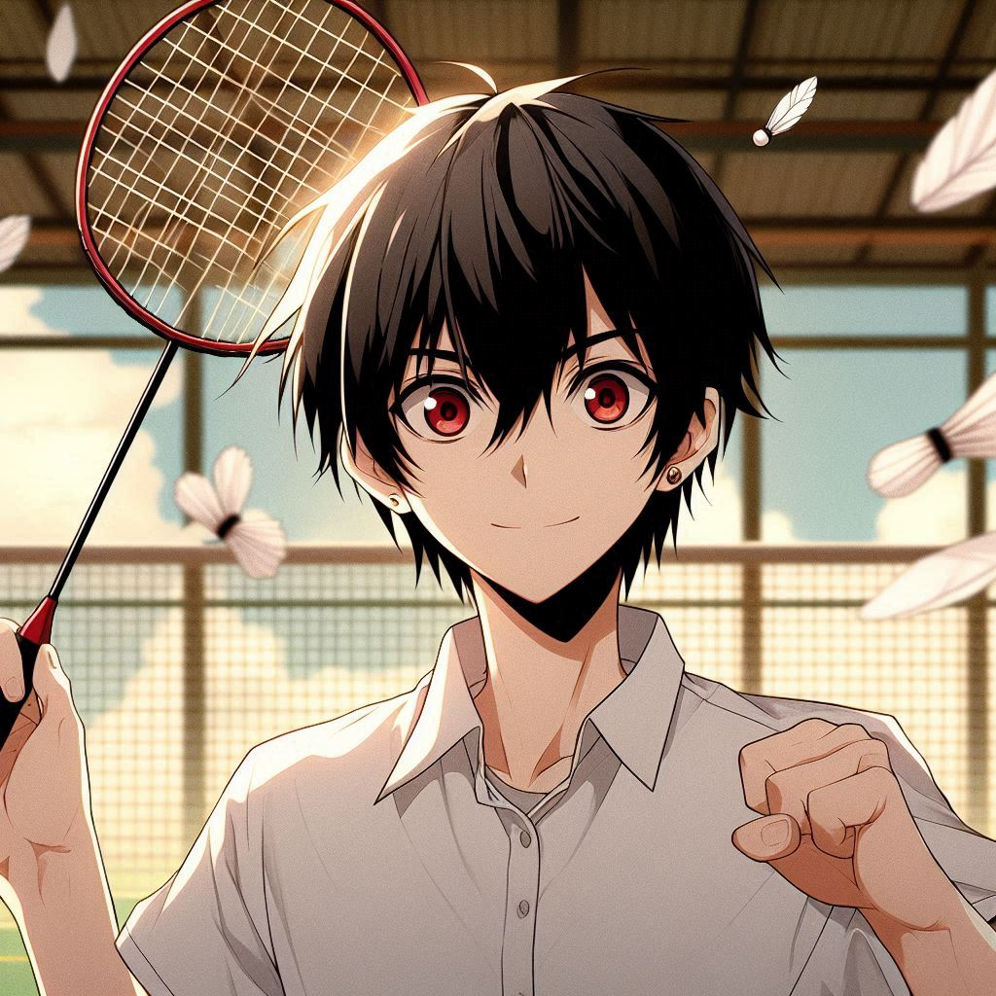
Notes:
Build a Japanese anime style scene. You are an anime high school boy with black hair, a round hairstyle, hair down to your shoulders, red eyes, wearing a white shirt.You are at a badminton match. You're competing against your opponent in a badminton match, you are winning the match
我決定改變戰術，放慢節奏，增加更多變化球，讓對手無法輕易預測我的動作。這樣的調整讓我逐漸打亂了對手的節奏，並且抓住了他幾次失誤的機會。隨著我的穩定發揮，比分慢慢被拉近，我開始掌握比賽的主導權。

Slide 12
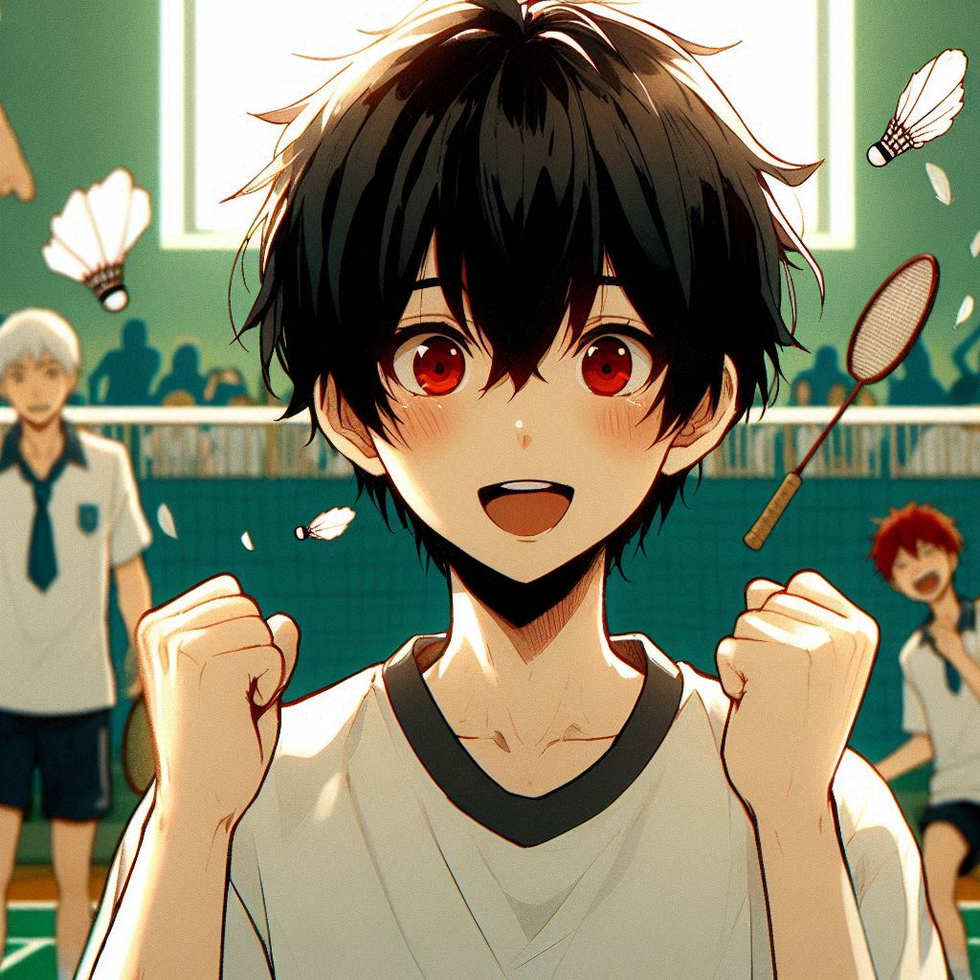
Notes:
Build a Japanese anime style scene. You are an anime high school boy with black hair, a round hairstyle, hair down to your shoulders, red eyes, wearing a white shirt.You are at a badminton match. You're competing against your opponent in a badminton match. you win the match. you look happy, and your opponent looks sad
最終，我以一記漂亮的吊球結束了比賽，為我們校隊贏得了關鍵的一分，順利挺進下一輪。整個隊伍士氣大振，而我也因這次表現得到了教練和隊友的認可。

Slide 13
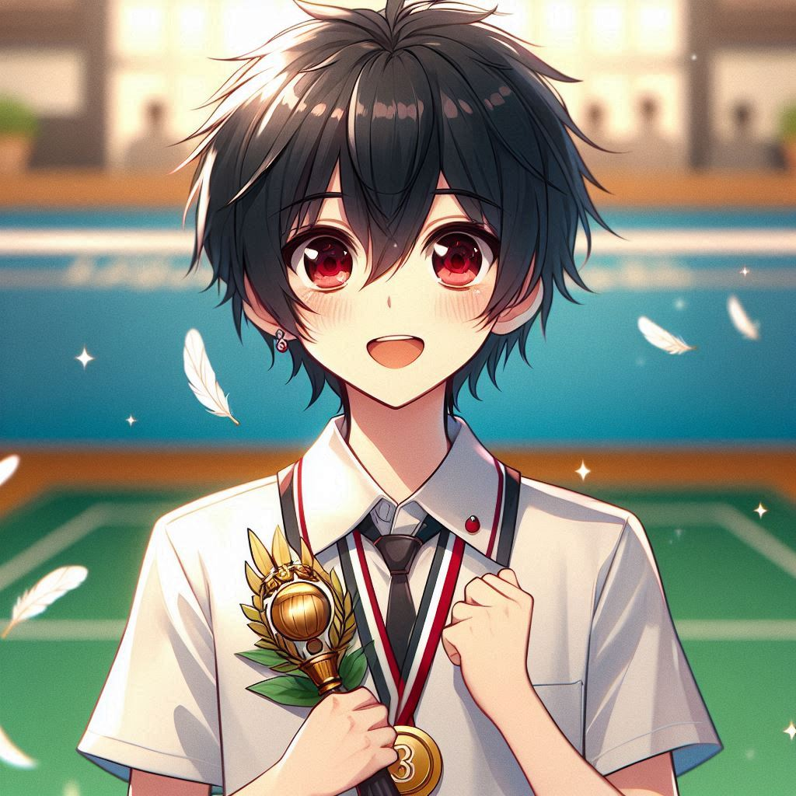
Notes:
Build a Japanese anime style scene. You are an anime high school boy with black hair, a round hairstyle, hair down to your shoulders, red eyes, wearing a white shirt.You are at a badminton match. You're competing against your opponent in a badminton match. you win the match. you look happy,You're holding the third-place trophy and looking very happy.
我們最終在全國賽中取得了第三名，而這次經歷讓我學會了如何面對壓力，同時更加相信自己的實力。

