Slide 1
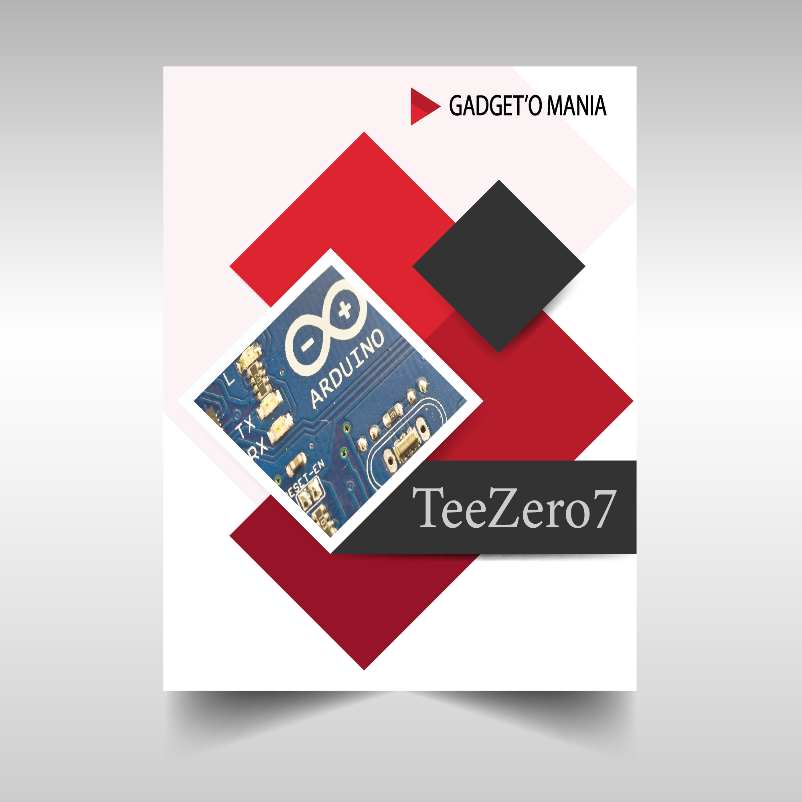

Slide 2
INTRODUCTION
Team Name : TeeZero7
Members :-
(i) Ankit Chauhan (2115039)
(ii) Ujjwal Saxena (2115063)
(iii) Mukul Tiwari (2115065)
Problem Statement Selected : Problem 1
Problem : In the most recent times, you must have seen many burglaries/accidents happening so in order to overcome this problem and make people stay in a safe environment. Design and build a home security system using suitable sensors in the most efficient way.

Slide 3


Technology Used
Arduino :
Arduino is an embedded system i.e. in which the software is part of the hardware. It is an open-source electronics platform based on easy-to-use hardware and software.
Sensors :
Sensor is a device which detects or measures a physical property and records, indicates, or otherwise responds to it.
Sensors used in our project
PIR Sensor :
PIR stands for passive infrared. A passive infrared sensor is an electronic sensor that measures infrared light radiating from objects in its field of view. It is mainly used to detect human movements.
Ultrasonic Sensor :
An ultrasonic sensor is an electronic device that measures the distance of a target object by emitting ultrasonic sound waves, and converts the reflected sound into an electrical signal.

Slide 4
WORKING
We have used two sensors in our home security model. There is a motion sensor used to detect human motion and if presence is detected by PIR sensor then it will trigger the buzzer.
There remains a risk of theft even if the people are in the house but are either busy some where or sleeping, in that case it happens that the workers/servants of the house may attempt to burgle important things like jewellery or money from their house (mostly the important things are kept in the bedroom). So we have used and ultrasonic sensor embedded in the wall near the door side and functioned it to trigger the buzzer when the door is opened.
Both the sensors will have one switch each to switch them on or off. The control of the switches will be inside the bedroom. In case anyone wants to go out then the sensors can be turned off for that while and turned back on on return.
This keeps our house safe from theft whether we are out or inside our house.

Slide 5

PIR Sensor

Slide 6
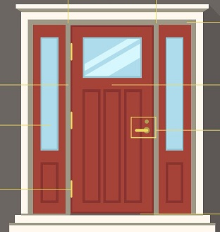
Sensor

Slide 7
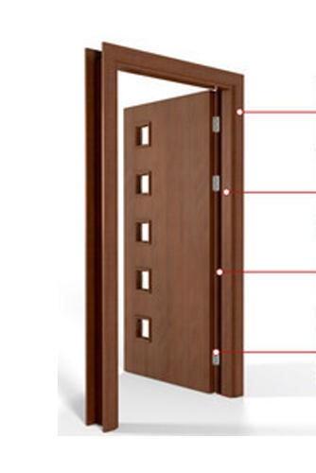
Sensor

Slide 8
Efficiency
The home security model proposed by our team is quite efficient in keeping our home safe from thefts when we are out of our house and even when we are inside our house. During day time when we are at home, the PIR sensor will be turned off but in that case the other sensor will still be in work and if anyone tries to enter the bedroom, where important things are kept, the ultrasonic sensor will trigger the buzzer. Both the sensors work independently and can be independently turned on and off as well.
Even if there is unwanted movements during the night time the buzzer will be triggered.

Slide 9
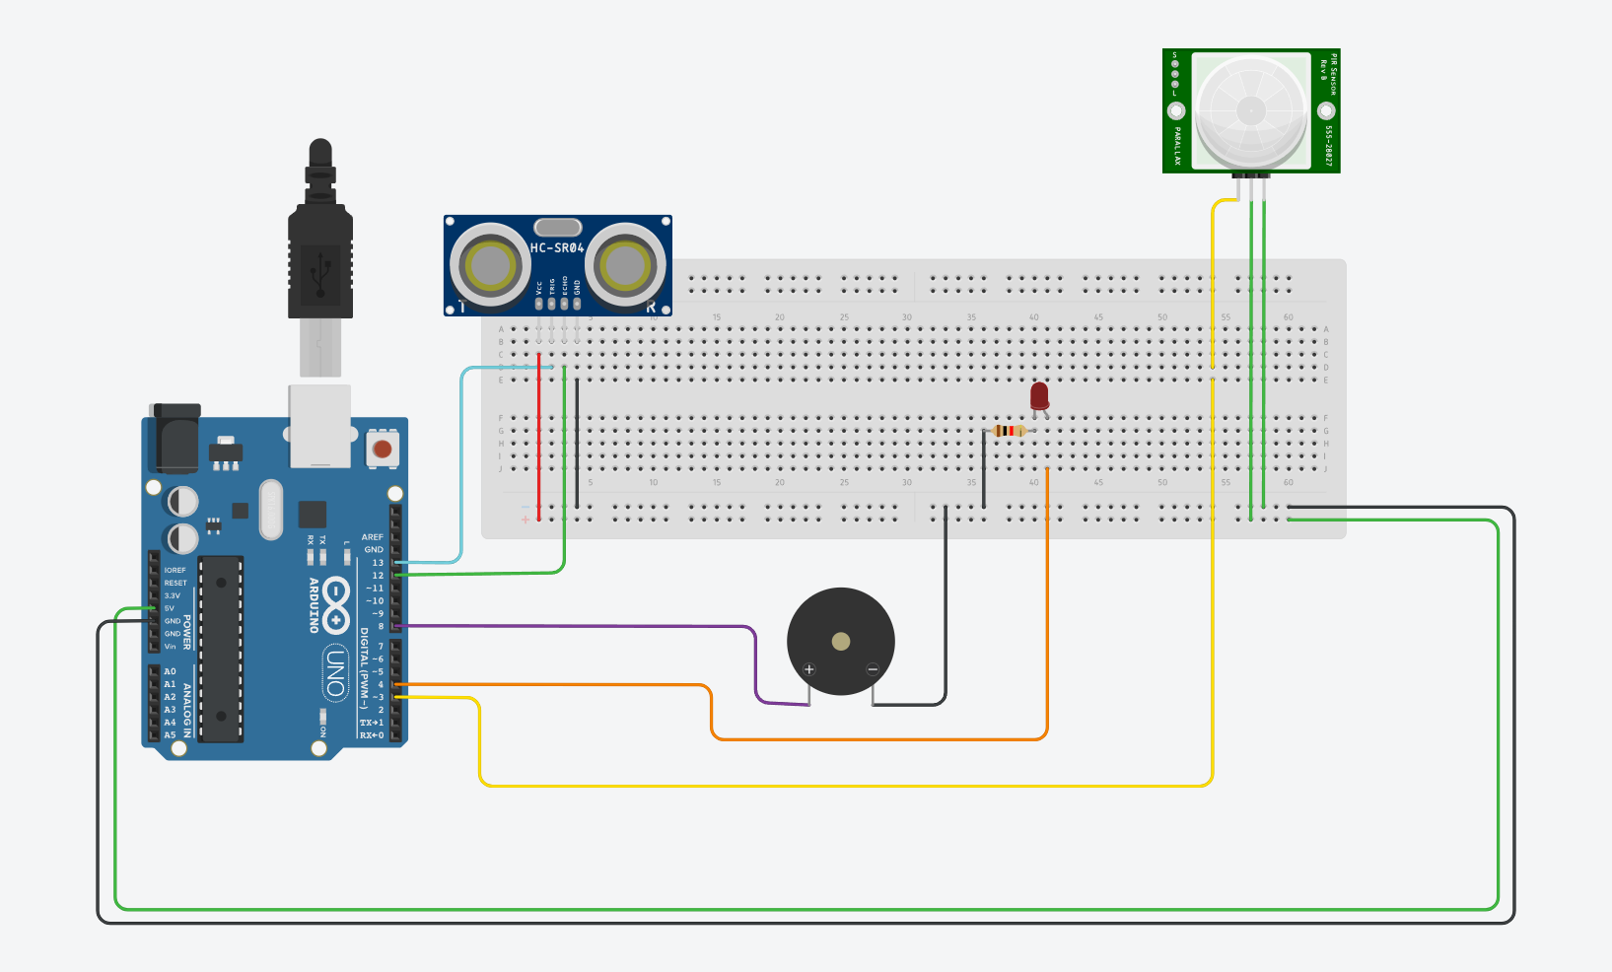
TINKER CAD CIRCUIT DESIGN
https://www.tinkercad.com/things/gevhRBtGZqk-daring-kasi/editel?sharecode=qqa8aM9A-K-W_UgHio_OaV7NoNBw69vuX0ci4Cxg1pk

Slide 10
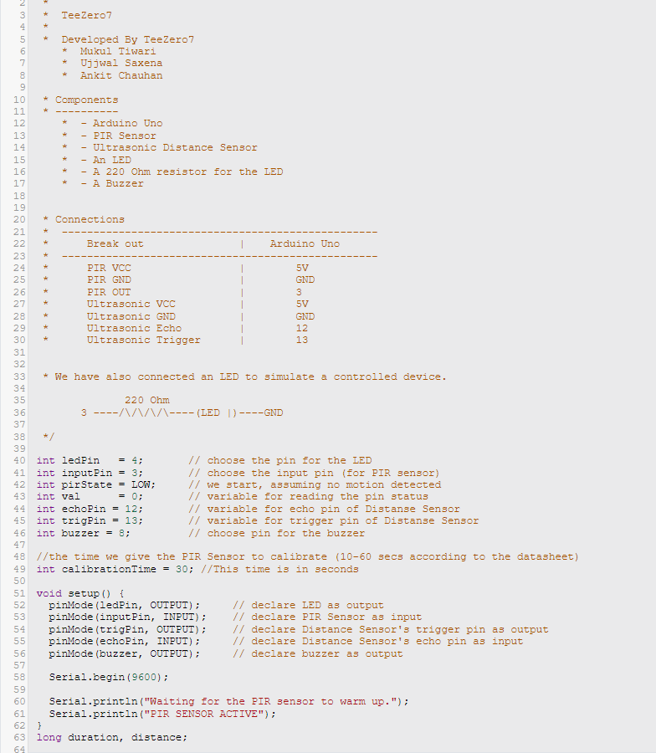
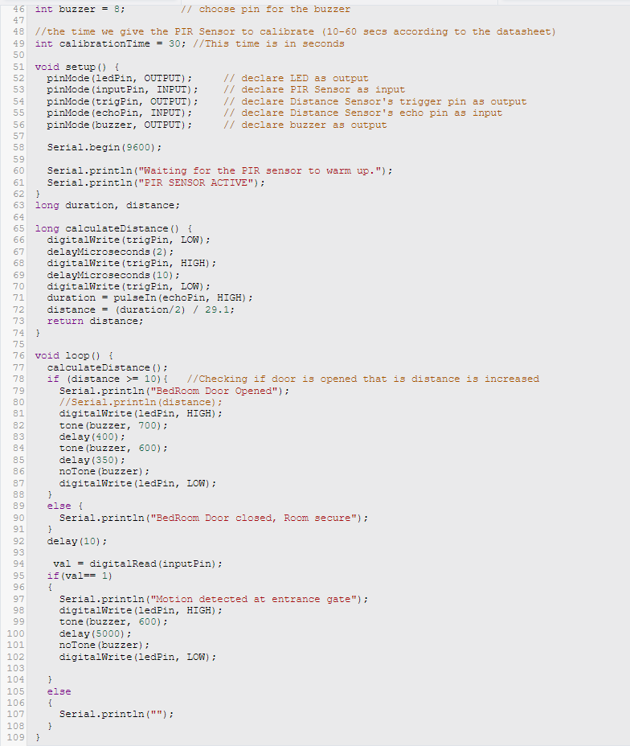
CODE

Slide 11
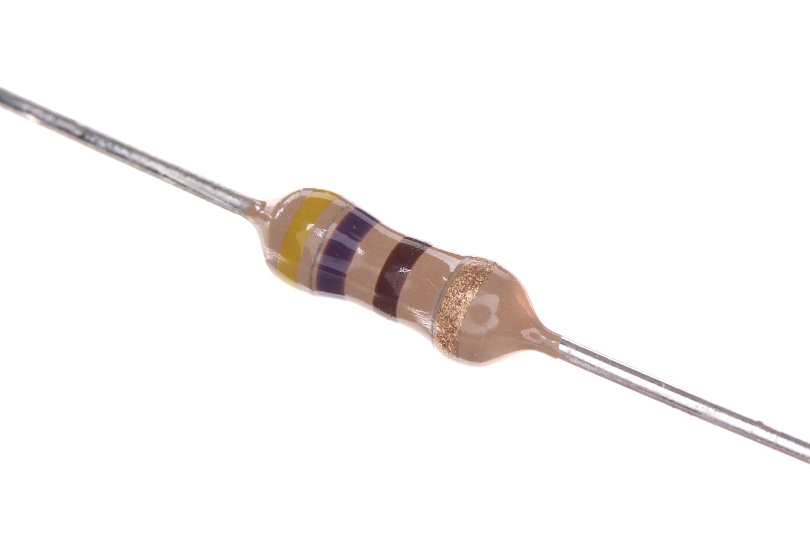
ADVANTAGES AND DISADVANTAGES
Advantage of our model is that both the sensors work independently and can be switched on and off independently. When in house the PIR sensor can be turned off and when out of the house it can be switched back on.
Disadvantage of our model is that the PIR motion sensor cannot differentiate between a animal and a human. If the pet of the house wanders near the sensor range and gets detected by it, it will lead to unwanted triggering of the buzzer.

Slide 12
EXTRA FEATURES THAT CAN BE ADDED IN THE FUTURE
We can use a GSM module in the system so that if we are not in our house and the sensors pick up something the system will send a call or message to notify us about it.
We can create a fingerprint door lock.
We can use a Camera and program the system in a way that if motion is detected it will capture the image from where the motion was detected and can also make it send us on our E-mail or Smartphone.
We can add a laser tripwire setup in our system.
We can use AI/ML to improve our system and can also make an app to control the system wirelessly.
We can control the sensor (switch on and off) using a numeric keypad and led display and setup a security pin to deactivate and activate them.

