Slide 1
Decision Tree - Classification
Decision tree builds classification or regression models in the form of a tree structure.
It breaks down a dataset into smaller and smaller subsets while at the same time an associated decision tree is incrementally developed.
The final result is a tree with decision nodes and leaf nodes.
A decision node (e.g., Outlook) has two or more branches (e.g., Sunny, Overcast and Rainy).
Leaf node (e.g., Play) represents a classification or decision.
The topmost decision node in a tree which corresponds to the best predictor called root node.
Decision trees can handle both categorical and numerical data.

Slide 3
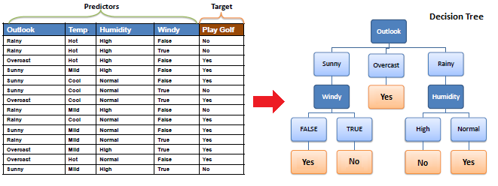
Example:

Slide 4
Key Terms:
Decision tree induction is the learning of decision trees from class-labeled training tuples.
A decision tree is a flowchart-like tree structure,
internal node (non-leaf node) denotes a test on an attribute,
branch represents an outcome of the test,
leaf node (or terminal node) holds a class label.
The topmost node in a tree is the root node.

Slide 5
Decision Tree Algorithm
Decision trees are constructed in a top-down recursive divide-and-conquer manner.
top-down approach, which starts with a training set of tuples and their associated class labels.
The training set is recursively partitioned into smaller subsets as the tree is being built.
Input:
Data partition, D, which is a set of training tuples and their associated class labels;
attribute list, the set of candidate attributes;
Attribute selection method, a procedure to determine the splitting criterion that “best” partitions the data tuples into individual classes. This criterion consists of a
splitting attribute and, possibly, either a split-point or splitting subset.
Output: A decision tree.

Slide 6
It begins with the original set D as the root node.
On each iteration of the algorithm, it iterates through the very unused attribute of the set D and calculates Information gain(IG) of this attribute.
It then selects the attribute which has the Largest Information gain.
The set D is then split by the selected attribute to produce a subset of the data.
The algorithm continues to recur on each subset, considering only attributes never selected before.

Slide 7

Attribute Selection Method
An attribute selection measure is a heuristic for selecting the splitting criterion that “best” separates a given data partition, D, of class-labeled training tuples into individual classes.
The attribute selection measure provides a ranking for each attribute describing the given training tuples. The attribute having the best score for the measure is chosen as the splitting attribute for the given tuples.
The tree node created for partition D is labeled with the splitting criterion, branches are grown for each outcome of the criterion, and the tuples are partitioned accordingly.
Information Gain
Let node N represent or hold the tuples of partition D. The attribute with the highest information gain is chosen as the splitting attribute for node N.
1) The expected information needed to classify a tuple in D is given by

Slide 8


2) Attribute information can be calculated using the following formula:
Information gain is defined as the difference between the original information requirement (i.e., based on just the proportion of classes) and the new requirement (i.e., obtained after partitioning on A). That is,
Gain(A), is chosen as the splitting attribute at node N

Slide 9
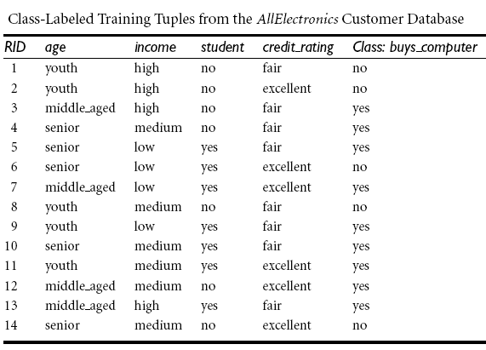
Transaction Database

Slide 10





The expected information needed to classify a tuple in D:
Next, we need to compute the expected information requirement for each attribute.
Let’s start with the attribute age, We need to look at the distribution of yes and no tuples for each category of age.
For the age category “youth,” there are two yes tuples and three no tuples.
For the category “middle aged,” there are four yes tuples and zero no tuples.
For the category “senior,” there are three yes tuples and two no tuples.
The expected information needed to classify a tuple in D if the tuples are partitioned according to age is

Slide 11
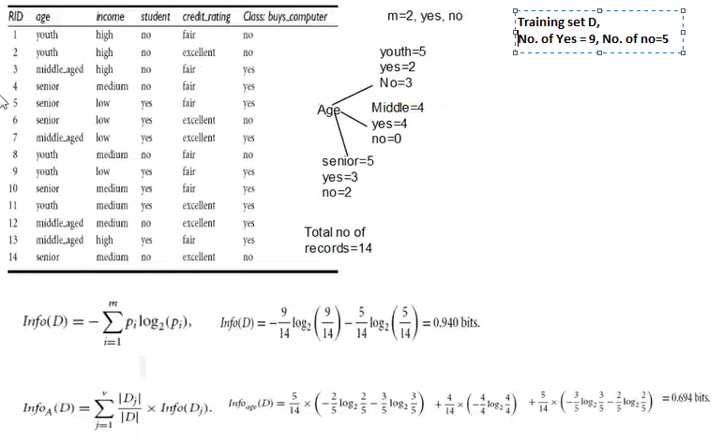
Table presents a training set, D, of class-labeled tuples randomly selected from the AllElectronics customer database.
In this example, each attribute is discretevalued.
The class label attribute, buys computer, has two distinct values (namely, yes, no); therefore, there are two distinct classes (i.e., m =2).
Let class C1 correspond to yes and class C2 correspond to no.
There are nine tuples of class yes and five tuples of class no.
A (root) node N is created for the tuples in D. To find the splitting criterion for these tuples, we must compute the information gain of each attribute.
A
Absolute value of D

Slide 12
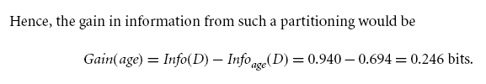
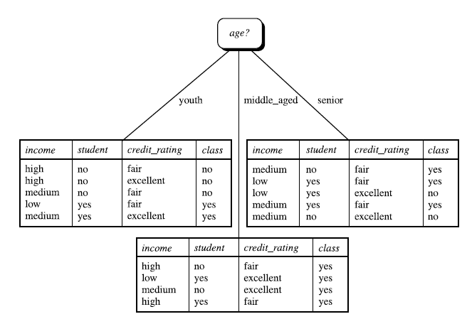
Similarly, we can compute Gain.income/ D 0.029 bits, Gain.student/ D 0.151 bits, and Gain.credit rating/ D 0.048 bits. Because age has the highest information gain among the attributes, it is selected as the splitting attribute. Node N is labeled with age, and branches are grown for each of the attribute’s values. The tuples are then partitioned accordingly, as shown in Figure.

