Slide 1
Hadoop Framework
Hadoop is an open-source framework that allows to store and process big data in a distributed environment across clusters of computers using simple programming models. It is designed to scale up from single servers to thousands of machines, each offering local computation and storage.
It is provided by Apache to process and analyze very huge volume of data. It is written in Java and currently used by Google, Facebook, LinkedIn, Yahoo, Twitter etc.

Slide 2
Big Data & Hadoop – Restaurant Analogy
Let us take an analogy of a restaurant to understand the problems associated with Big Data and how Hadoop solved that problem.
Bob is a businessman who has opened a small restaurant. Initially, in his restaurant, he used to receive two orders per hour, and he had one chef with one food shelf in his restaurant which was sufficient to handle all the orders.
Now let us compare the restaurant example with the traditional scenario where data was getting generated at a steady rate and our traditional systems like RDBMS is capable enough to handle it, just like Bob’s chef. Here, you can relate the data storage with the restaurant’s food shelf and the traditional processing unit with the chef as shown in the figure.

Slide 3
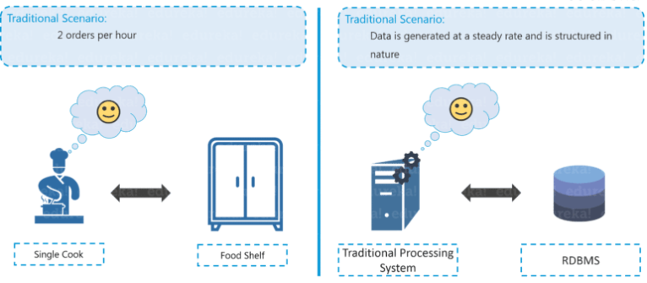
Hadoop Tutorial – Traditional Restaurant Scenario

Slide 4
After a few months, Bob thought of expanding his business and therefore, he started taking online orders and added few more foods to the restaurant’s menu in order to engage a larger audience.
Because of this transition, the rate at which they were receiving orders rose to an alarming figure of 10 orders per hour and it became quite difficult for a single cook to cope up with the current situation. Aware of the situation in processing the orders, Bob started thinking about the solution.

Slide 5
Similarly, in Big Data scenario, the data started getting generated at an alarming rate because of the introduction of various data growth drivers such as social media, smartphones etc.
Now, the traditional system, just like the cook in Bob’s restaurant, was not efficient enough to handle this sudden change. Thus, there was a need for a different kind of solutions strategy to cope up with this problem.
After a lot of research, Bob came up with a solution where he hired 4 more chefs to tackle the huge rate of orders being received. Everything was going quite well, but this solution led to one more problem. Since four chefs were sharing the same food shelf, the very food shelf was becoming the bottleneck of the whole process. Hence, the solution was not that efficient as Bob thought.

Slide 6
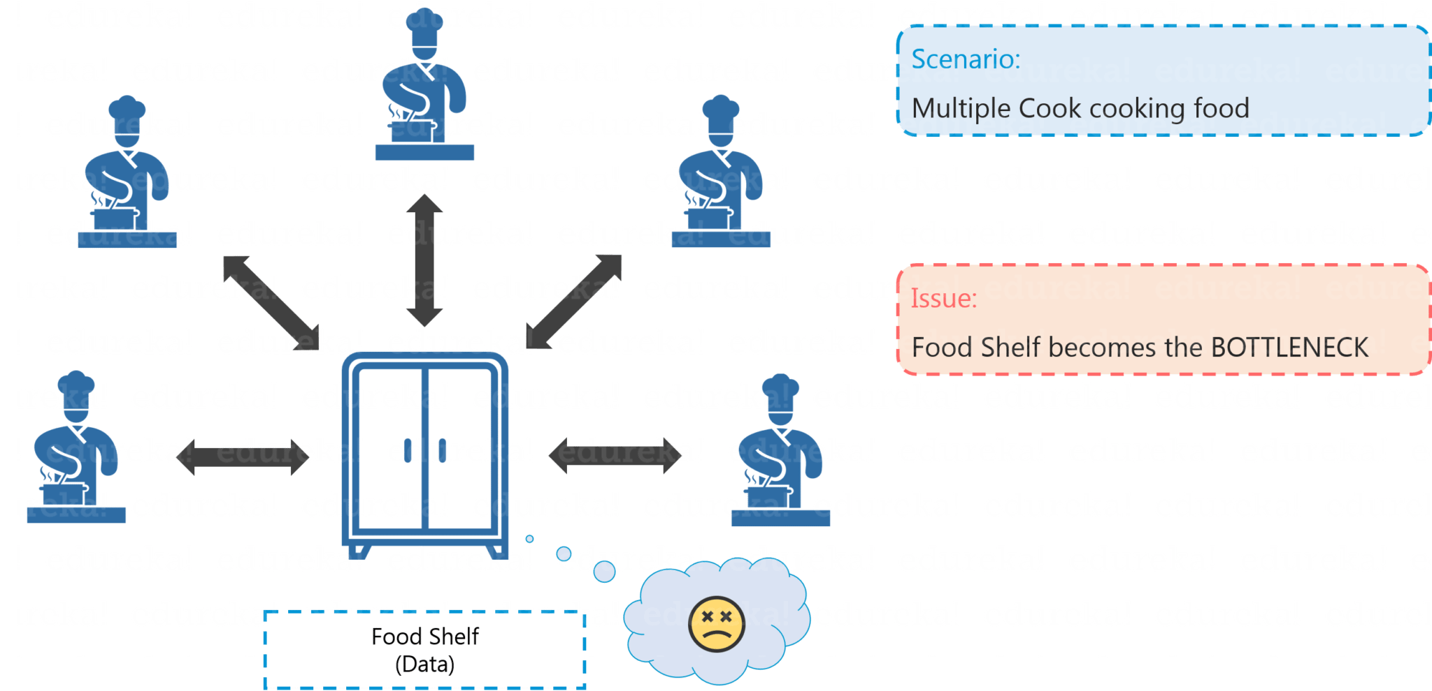
Hadoop Tutorial – Distributed Processing Scenario

Slide 7
Similarly, to tackle the problem of processing huge data sets, multiple processing units were installed so as to process the data in parallel (just like Bob hired 4 chefs). But even in this case, bringing multiple processing units was not an effective solution because the centralized storage unit became the bottleneck.
In other words, the performance of the whole system is driven by the performance of the central storage unit. Therefore, the moment our central storage goes down, the whole system gets compromised. Hence, again there was a need to resolve this single point of failure.

Slide 8
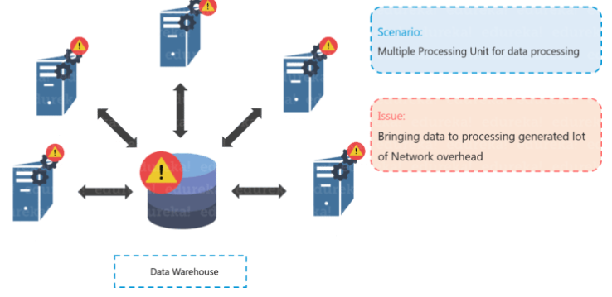
Hadoop Tutorial – Distributed Processing Scenario Failure

Slide 9
Bob came up with another efficient solution, he divided all the chefs into two hierarchies, that is a Junior and a Head chef and assigned each junior chef with a food shelf.
Let us assume that the dish is Meat Sauce. Now, according to Bob’s plan, one junior chef will prepare meat and the other junior chef will prepare the sauce. Moving ahead they will transfer both meat and sauce to the head chef, where the head chef will prepare the meat sauce after combining both the ingredients, which then will be delivered as the final order.

Slide 10
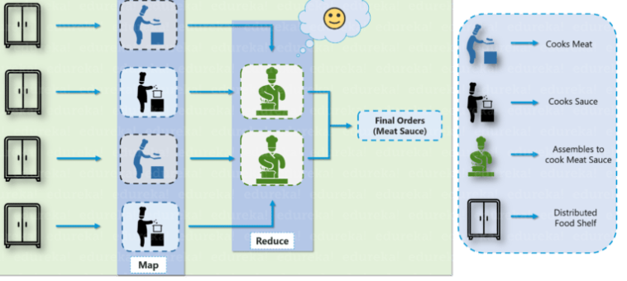
Hadoop Tutorial – Solution to Restaurant Problem

Slide 11
Hadoop functions in a similar fashion as Bob’s restaurant. As the food shelf is distributed in Bob’s restaurant, similarly, in Hadoop, the data is stored in a distributed fashion with replications, to provide fault tolerance.
For parallel processing, first the data is processed by the slaves where it is stored for some intermediate results and then those intermediate results are merged by master node to send the final result.

Slide 12
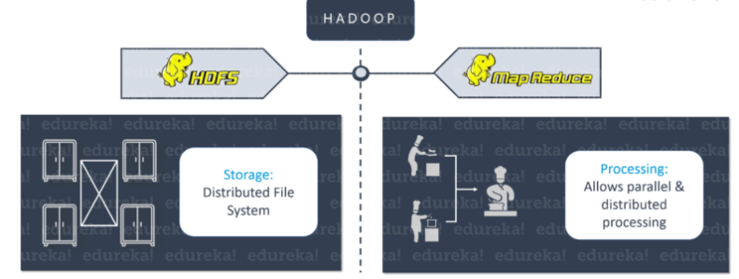

Slide 13

Three major challenges with Big Data
The first problem is storing the huge amount of data
Storing huge data in a traditional system is not possible. The reason is obvious, the storage will be limited to one system and the data is increasing at a tremendous rate.

Slide 14
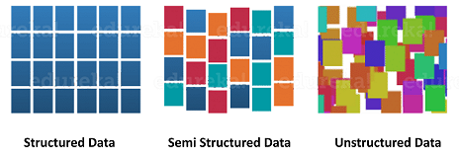
The second problem is storing heterogeneous data
The data is not only huge, but it is also present in various formats i.e. unstructured, semi-structured and structured. So, you need to make sure that you have a system to store different types of data that is generated from various sources.

Slide 15

Finally let’s focus on the third problem, which is the processing speed
Now the time taken to process this huge amount of data is quite high as the data to be processed is too large.

Slide 16
To solve the storage issue and processing issue, two core components were created in Hadoop – HDFS and YARN. HDFS solves the storage issue as it stores the data in a distributed fashion and is easily scalable, and YARN solves the processing issue by reducing the processing time drastically.

Slide 17

What is Hadoop?
Hadoop is an open-source software framework used for storing and processing Big Data in a distributed manner on large clusters of commodity hardware. Hadoop is licensed under the Apache v2 license.
Hadoop was developed, based on the paper written by Google on the MapReduce system and it applies concepts of functional programming.
Hadoop is written in the Java programming language and ranks among the highest-level Apache projects. Hadoop was developed by Doug Cutting and Michael J. Cafarella.

Slide 18
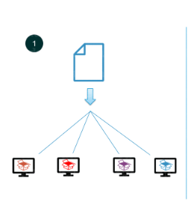
Hadoop-as-a-Solution Let’s understand how Hadoop provides a solution to the Big Data problems
The first problem is storing huge amount of data.
As you can see in the image, HDFS provides a distributed way to store Big Data. Your data is stored in blocks in DataNodes and you specify the size of each block. Suppose you have 512 MB of data and you have configured HDFS such that it will create 128 MB of data blocks. Now, HDFS will divide data into 4 blocks as 512/128=4 and stores it across different DataNodes. While storing these data blocks into DataNodes, data blocks are replicated on different DataNodes to provide fault tolerance.
Hadoop follows horizontal scaling instead of vertical scaling. In horizontal scaling, you can add new nodes to HDFS cluster on the run as per requirement, instead of increasing the hardware stack present in each node.

Slide 19
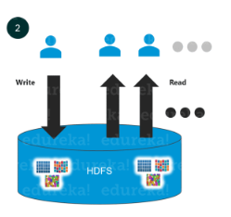
Next problem was storing a variety of data.
As you can see in the above image, in HDFS you can store all kinds of data whether it is structured, semi-structured or unstructured. In HDFS, there is no pre-dumping schema validation. It also follows write once and read many models. Due to this, you can just write any kind of data once and you can read it multiple times for finding insights.

Slide 20
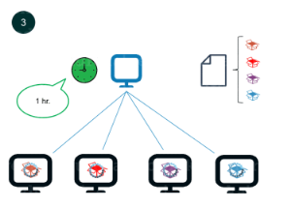
The third challenge was about processing the data faster.
In order to solve this, we move the processing unit to data instead of moving data to the processing unit.
So, what does it mean by moving the computation unit to data?
It means that instead of moving data from different nodes to a single master node for processing, the processing logic is sent to the nodes where data is stored so as that each node can process a part of data in parallel. Finally, all of the intermediary output produced by each node is merged together and the final response is sent back to the client.

Slide 21
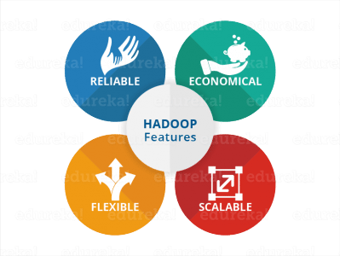
Features of Hadoop

Slide 22
Reliability
When machines are working as a single unit, if one of the machines fails, another machine will take over the responsibility and work in a reliable and fault-tolerant fashion. Hadoop infrastructure has inbuilt fault tolerance features and hence, Hadoop is highly reliable.
Economical
Hadoop uses commodity hardware (like your PC, laptop). For example, in a small Hadoop cluster, all your DataNodes can have normal configurations like 8-16 GB RAM with 5-10 TB hard disk and Xeon processors.
But if I would have used hardware-based RAID with Oracle for the same purpose, I would end up spending 5x times more at least. So, the cost of ownership of a Hadoop-based project is minimized. It is easier to maintain a Hadoop environment and is economical as well. Also, Hadoop is open-source software and hence there is no licensing cost.

Slide 23
Scalability
Hadoop has the inbuilt capability of integrating seamlessly with cloud-based services. So, if you are installing Hadoop on a cloud, you don’t need to worry about the scalability factor because you can go ahead and procure more hardware and expand your set up within minutes whenever required.
Flexibility
Hadoop is very flexible in terms of the ability to deal with all kinds of data. Data can be of any kind and Hadoop can store and process them all, whether it is structured, semi-structured or unstructured data.
These 4 characteristics make Hadoop a front-runner as a solution to Big Data challenges.

Slide 24
Hadoop Core Components
While setting up a Hadoop cluster, you have an option of choosing a lot of services as part of Hadoop platform, but there are two services which are always mandatory for setting up Hadoop.
One is HDFS (storage) and the other is YARN (processing).
HDFS stands for Hadoop Distributed File System, which is a scalable storage unit of Hadoop whereas YARN is used to process the data i.e. stored in the HDFS in a distributed and parallel fashion.

Slide 25
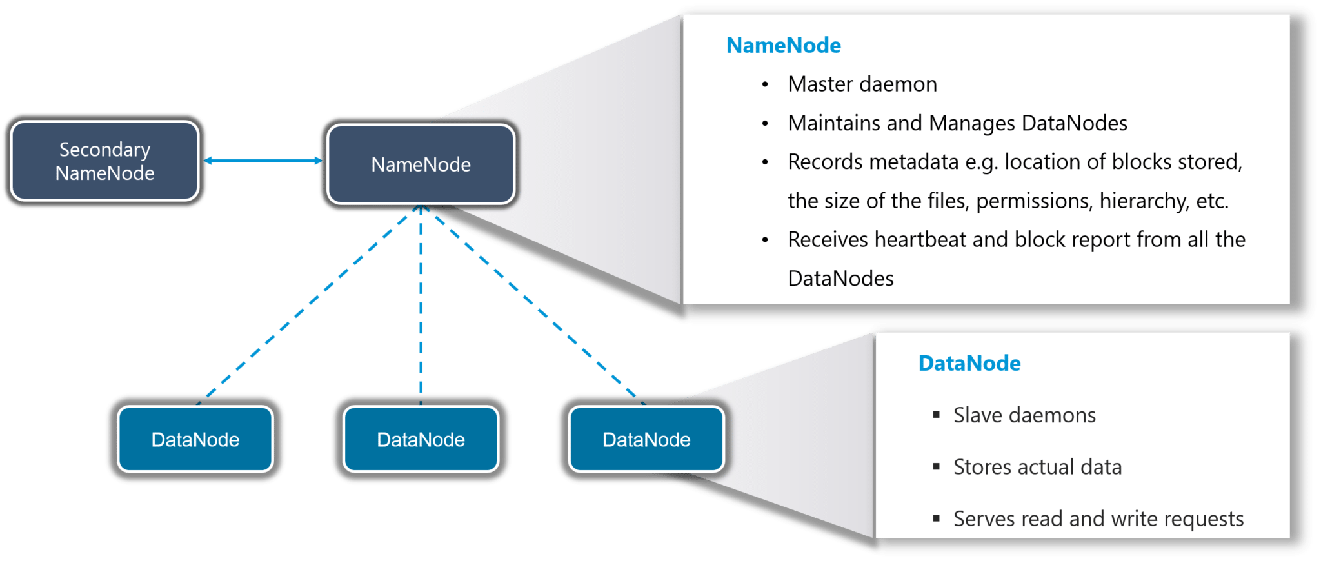
HDFS - Hadoop Distributed file system
The main components of HDFS are the NameNode and the DataNode.

Slide 26
NameNode
It is the master daemon that maintains and manages the DataNodes (slave nodes)
It records the metadata of all the blocks stored in the cluster, e.g. location of blocks stored, size of the files, permissions, hierarchy, etc.
It records each and every change that takes place to the file system metadata
If a file is deleted in HDFS, the NameNode will immediately record this in the EditLog
It regularly receives a Heartbeat and a block report from all the DataNodes in the cluster to ensure that the DataNodes are alive
It keeps a record of all the blocks in the HDFS and DataNode in which they are stored

Slide 27
DataNode
It is the slave daemon which runs on each slave machine
The actual data is stored on DataNodes
It is responsible for serving read and write requests from the clients
It is also responsible for creating blocks, deleting blocks and replicating the same based on the decisions taken by the NameNode
It sends heartbeats to the NameNode periodically to report the overall health of HDFS, by default, this frequency is set to 3 seconds

Slide 28
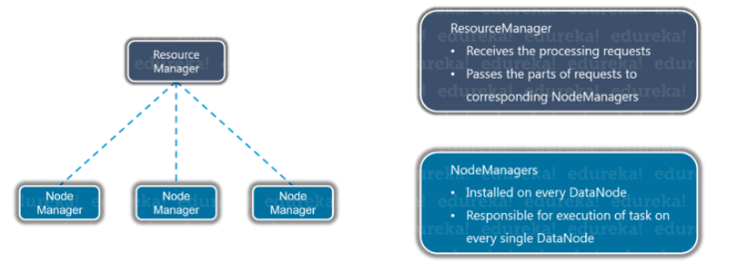
YARN
YARN comprises of two major components: ResourceManager and NodeManager.

Slide 29
ResourceManager
It is a cluster-level (one for each cluster) component and runs on the master machine
It manages resources and schedules applications running on top of YARN
It has two components: Scheduler & ApplicationManager
The Scheduler is responsible for allocating resources to the various running applications
The ApplicationManager is responsible for accepting job submissions and negotiating the first container for executing the application
It keeps a track of the heartbeats from the Node Manager

Slide 30
NodeManager
It is a node-level component (one on each node) and runs on each slave machine
It is responsible for managing containers and monitoring resource utilization in each container
It also keeps track of node health and log management
It continuously communicates with ResourceManager to remain up-to-date

