Slide 1
Data analytics
Data analytics—the practice of examining data to answer questions, identify trends, and extract insights—can provide you with the information necessary to strategize and make impactful business decisions.
A data analyst collects, cleans, and interprets data sets in order to answer a question or solve a problem. They work in many industries, including business, finance, criminal justice, science, medicine, and government.
What is the role of data analytics?
Data analytics helps individuals and organizations make sense of data. Data analysts typically analyze raw data for insights and trends. They use various tools and techniques to help organizations make decisions and succeed.

Slide 2
Skills For Data Analysts
Structured Query Language (SQL)
Microsoft Excel.
Critical Thinking.
R or Python-Statistical Programming.
Data Visualization.
Presentation Skills.
Machine Learning.

Slide 3
PREDICTIVE ANALYTICS
Predictive analytics is the use of data to predict future trends and events. It uses historical data to forecast potential scenarios that can help drive strategic decisions.
Predictive analytics is a form of technology that makes predictions about certain unknowns in the future. It draws on a series of techniques to make these determinations, including artificial intelligence (AI), data mining, machine learning, modeling, and statistics.

Slide 4
One predictive analytics tool is regression analysis, which can determine the relationship between two variables (single linear regression) or three or more variables (multiple regression). The relationships between variables are written as a mathematical equation that can help predict the outcome should one variable change.

Slide 5
EXAMPLES OF PREDICTIVE ANALYTICS IN ACTION
Finance: Forecasting Future Cash Flow
Entertainment & Hospitality: Determining Staffing Needs
Marketing: Behavioral Targeting
Manufacturing: Preventing Malfunction
Health Care: Early Detection of Allergic Reactions

Slide 6
Regression Analysis
It consists of a set of machine learning methods that allow us to predict a continuous outcome variable (y) based on the value of one or multiple independent variables (x).
It predicts continuous/real values such as temperature, age, salary, price, etc.

Slide 7
Terminologies
Dependent Variable: The main factor in Regression analysis which we want to predict or understand is called the dependent variable. It is also called target variable.
Independent Variable: The factors which are used to predict the values of the dependent variables are called independent variable, also called as a predictor.
Outliers: Outlier is an observation which contains either very low value or very high value in comparison to other observed values. An outlier may hamper the result, so it should be avoided.
Underfitting and Overfitting: If our algorithm works well with the training dataset but not well with test dataset, then such problem is called Overfitting. And if our algorithm does not perform well even with training dataset, then such problem is called underfitting.

Slide 8
Types of Regression
Simple Linear Regression
One dependent variable (interval or ratio)
One independent variable (interval or ratio or dichotomous)
Multiple Linear Regression
One dependent variable (interval or ratio)
Two or more independent variables (interval or ratio or dichotomous)
Logistic Regression
One dependent variable (binary)
Two or more independent variable(s) (interval or ratio or dichotomous)

Slide 9
Linear Regression
Linear regression is a statistical regression method which is used for predictive analysis.
It is one of the very simple and easy algorithms which works on regression and shows the relationship between the continuous variables.
It is used for solving the regression problem in machine learning.
Linear regression shows the linear relationship between the independent variable (X-axis) and the dependent variable (Y-axis), hence called linear regression.
If there is only one input variable (x), then such linear regression is called simple linear regression. And if there is more than one input variable, then such linear regression is called multiple linear regression.

Slide 10
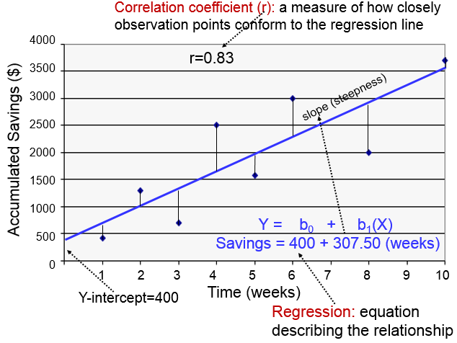
The mathematical equation for Linear regression:
Y= a+bX
Here, Y = dependent variables (target variables), X= Independent variables (predictor variables), a and b are the linear coefficients

Slide 11
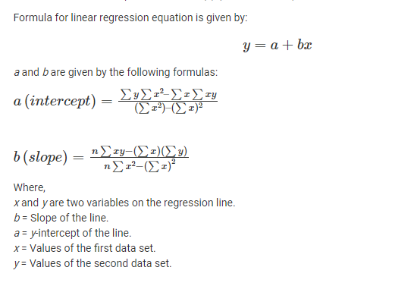

Slide 12
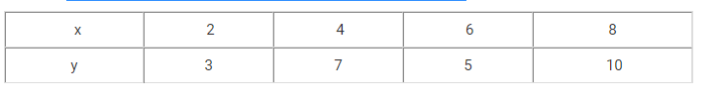
Find linear regression equation for the following two sets of data: Also find the value of Y for x=12

Slide 13
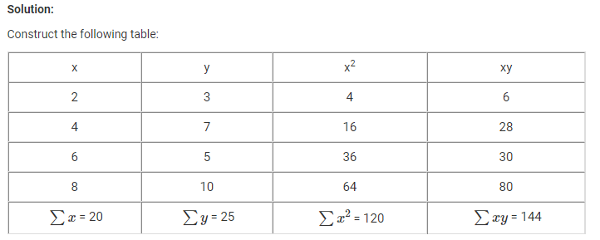
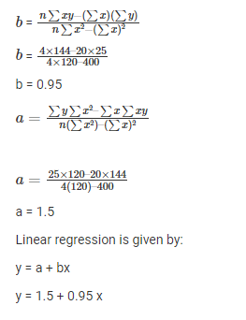
find the value of Y for x=12
Y=1.5 + (0.95 * 12)
Y= 12.5

Slide 14
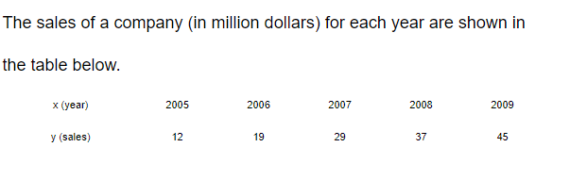
Problem
Find the regression line y=a+bx
b) Use the regression line as a model to estimate the sales of the company in 2012.

Slide 15
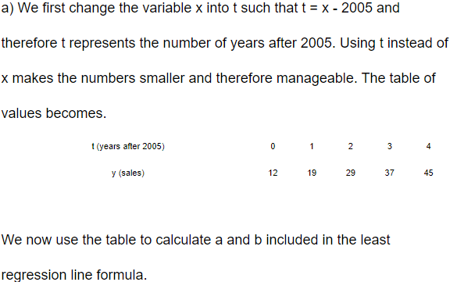
Solution

Slide 16
The following data are math aptitude test and statistics score for five students.
Maths | 95 | 85 | 80 | 70 | 60
Statistics | 85 | 95 | 70 | 65 | 70
1. What linear regression equation best predicts statistics performance, based on math aptitude scores?
2. If a student made a 75 on the math aptitude test, what grade would we expect her to make in statistics?

Slide 17
Multiple Linear Regression
Multiple Linear Regression is one of the important regression algorithms which models the linear relationship between a single dependent continuous variable and more than one independent variable.
Y= a+b₁x₁+b₂x₂
Here, Y = dependent variables (target variables), x_{1,} x₂ = Independent variables (predictor variables), a and b₁, b₂ are the linear coefficients

Slide 18
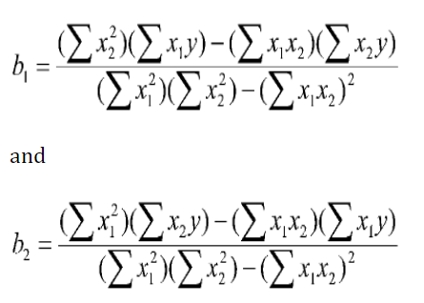
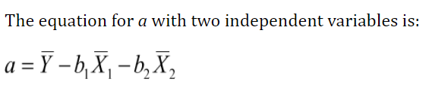
Y= a+b₁x₁+b₂x₂ Calculate b1, b2 and a using the following formula

Slide 19
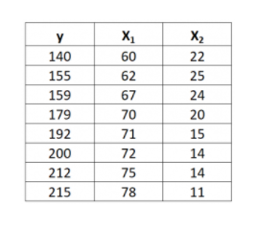
Problem: The following dataset with one response variable y and two predictor variables X1 and X2. Find the regression equation..

Slide 20
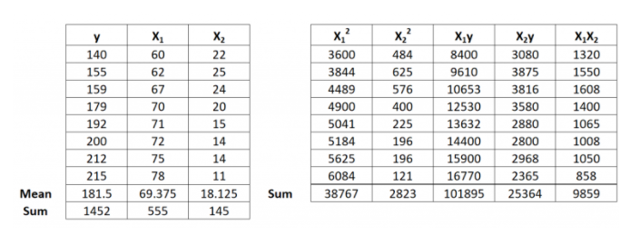
Step 1: Calcúlate X₁², X₂², X₁y, X₂y and X₁X₂.

Slide 21
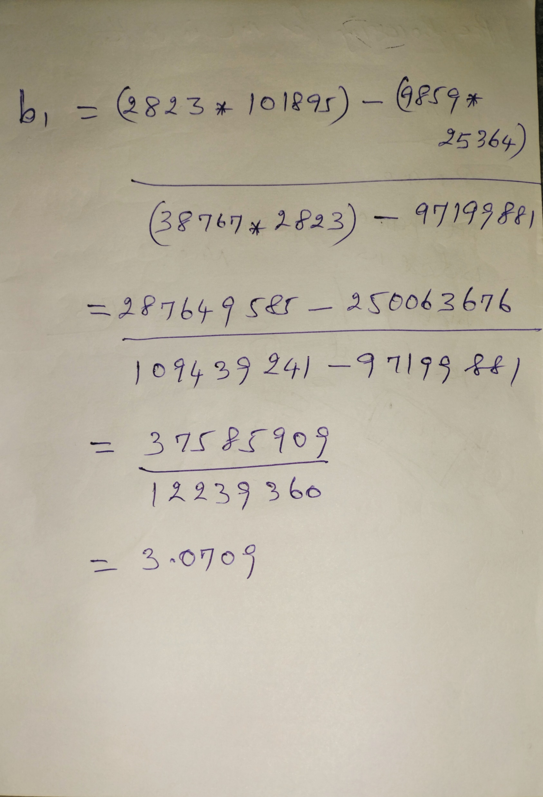
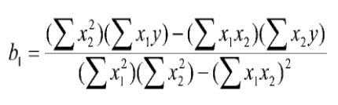

Slide 22
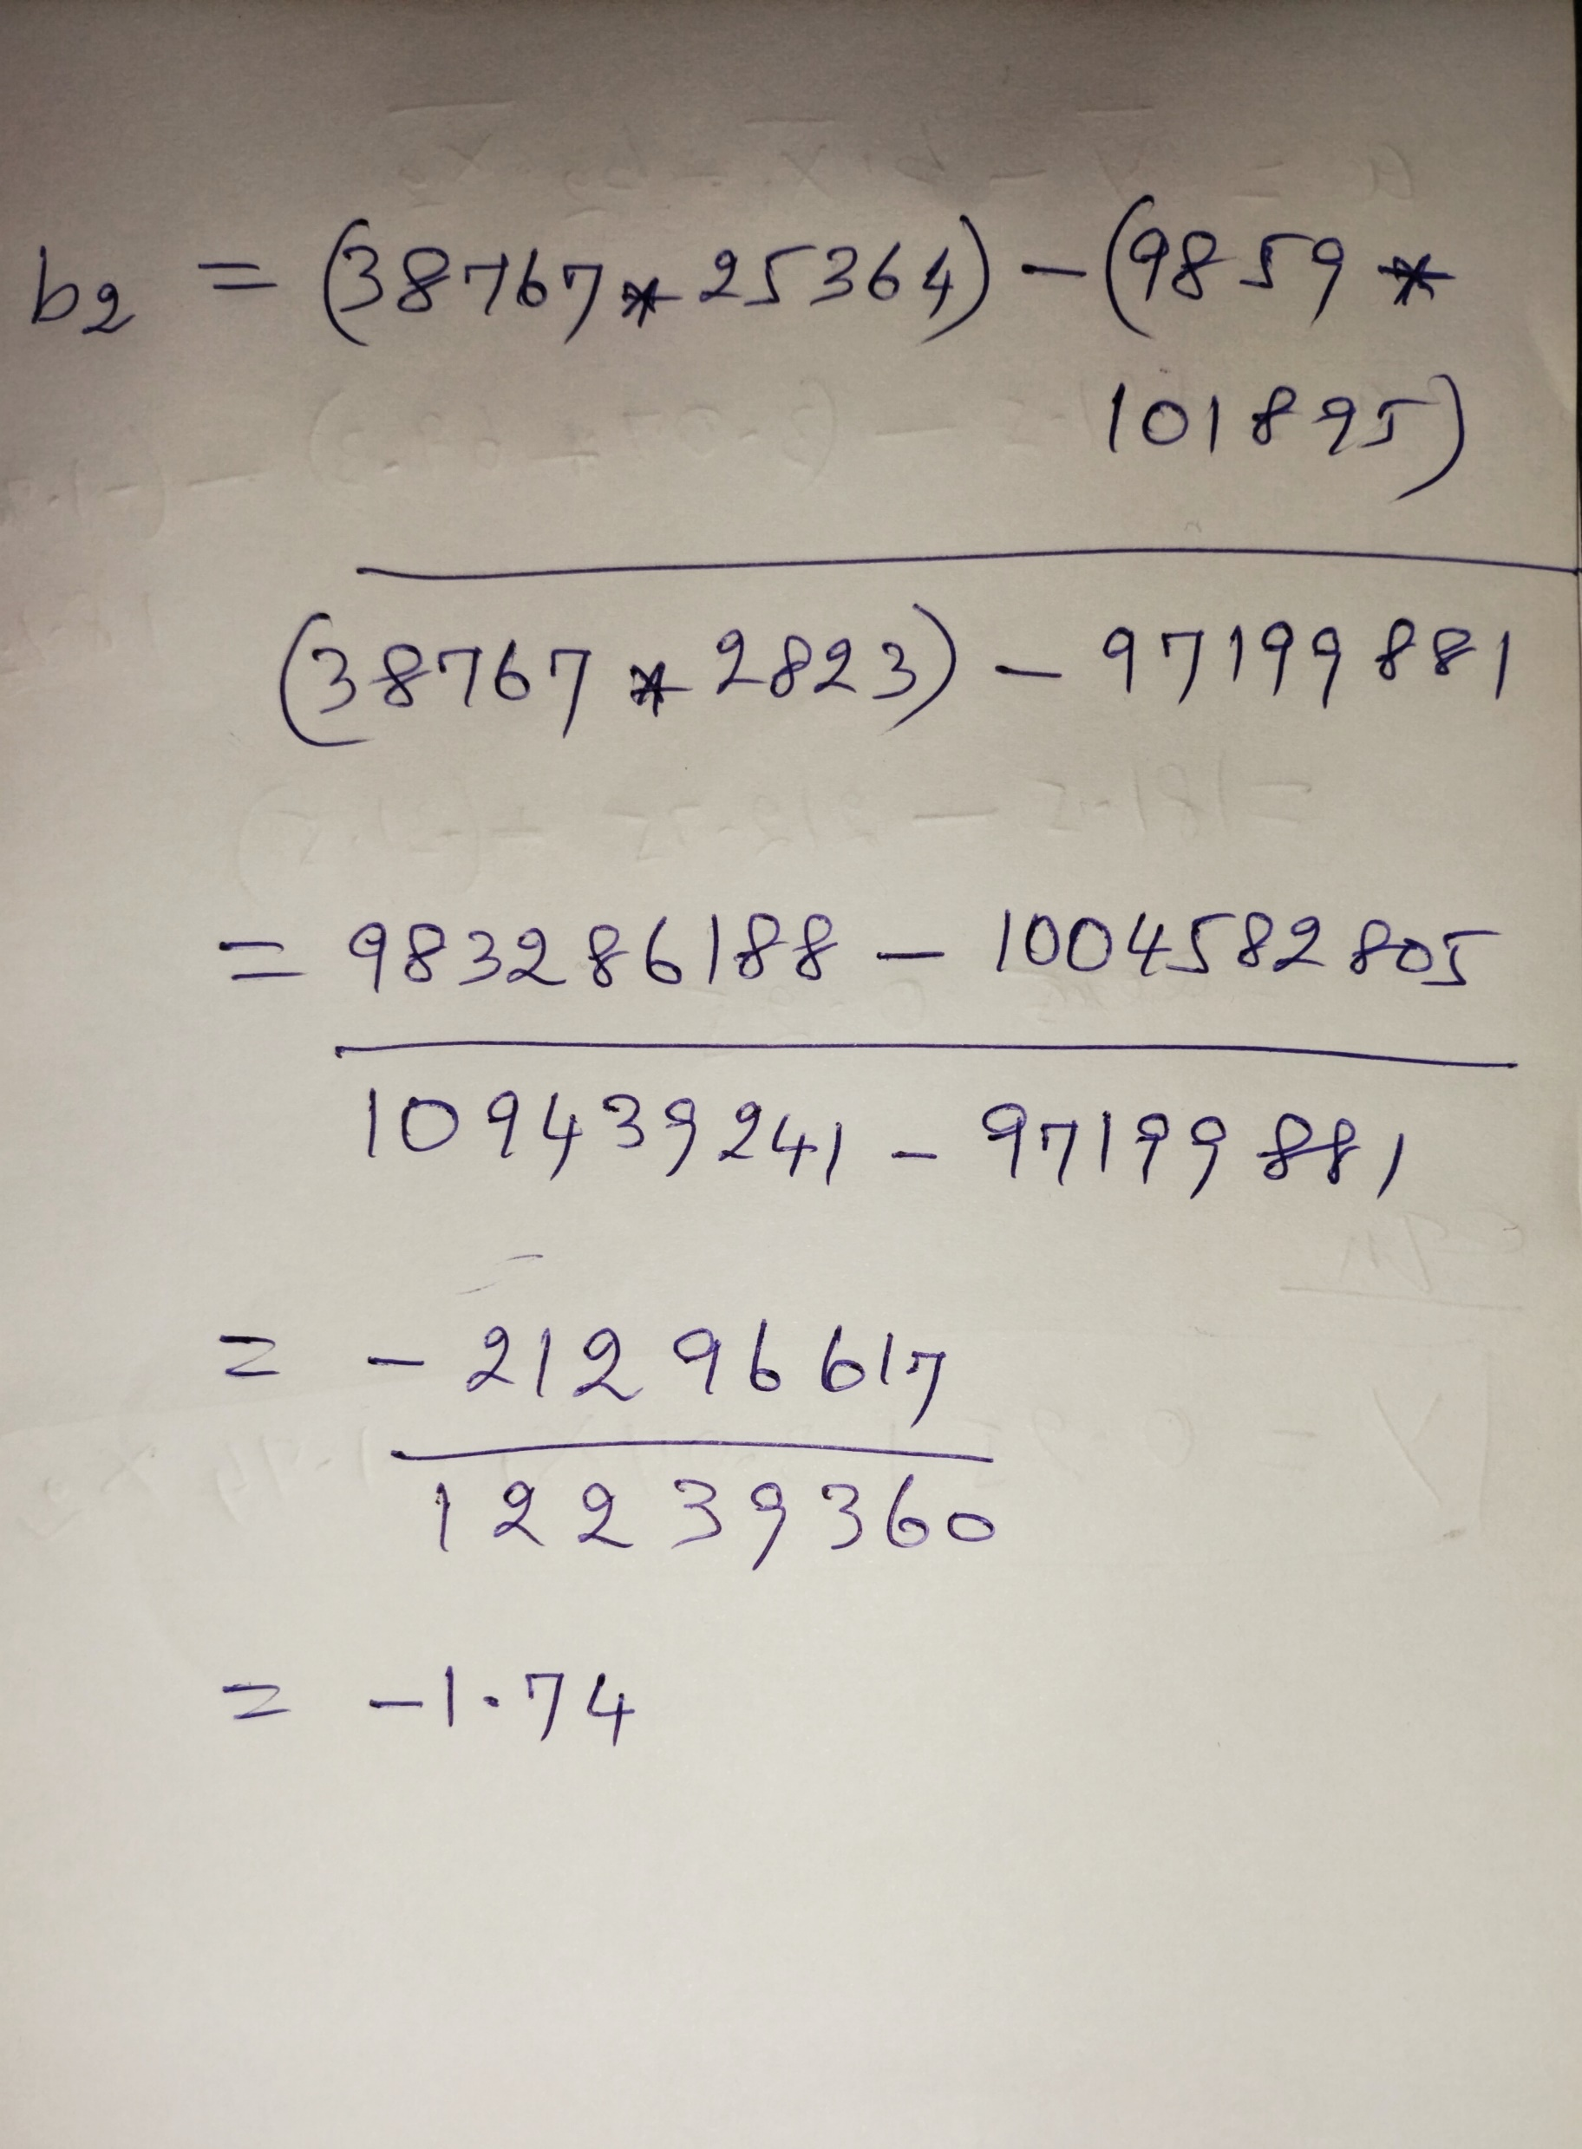
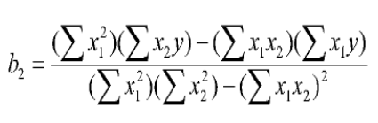

Slide 23
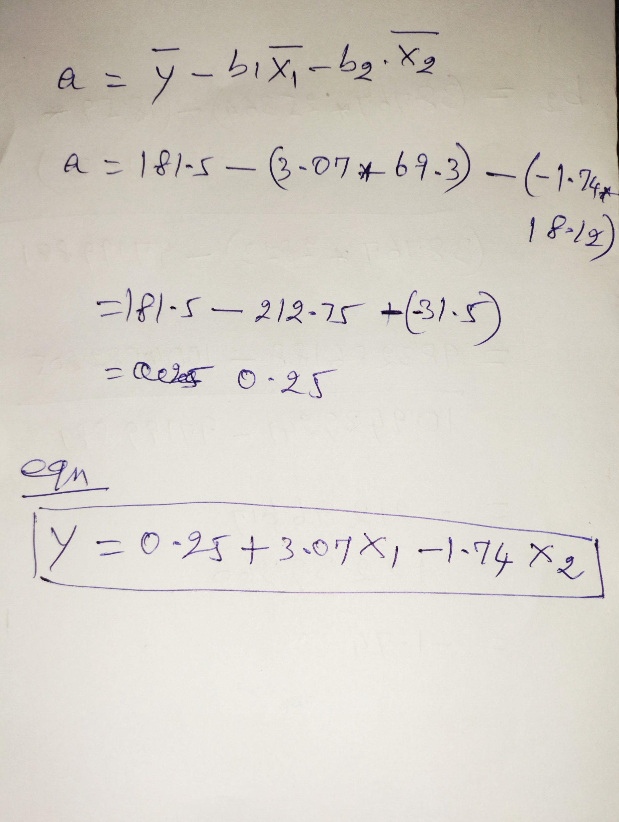

Slide 24
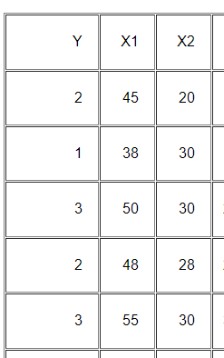
Find the Multiple linear regression equation for the following dataset. Also find the y for x1=47 x2=25

Slide 25
Area = 1000
Bhk = 3
br=2

