Slide 1

Note: The data and information in this document is reflective of a hypothetical situation and client. This document is to be used for KPMG Virtual Internship purposes only.
Sprocket Central Pty Ltd
Data analytics approach

Slide 2
Note: The data and information in this document is reflective of a hypothetical situation and client. This document is to be used for KPMG Virtual Internship purposes only.
Agenda
Introduction
Data Exploration
Model Development
Interpretation

Slide 3

Note: The data and information in this document is reflective of a hypothetical situation and client. This document is to be used for KPMG Virtual Internship purposes only.
Introduction
The attributes took into consideration to come up with a recommendation for our top customers:
Past 3 year bike related purchases
Job Industry Category
Wealth Segment
Cars owned
States

Slide 4
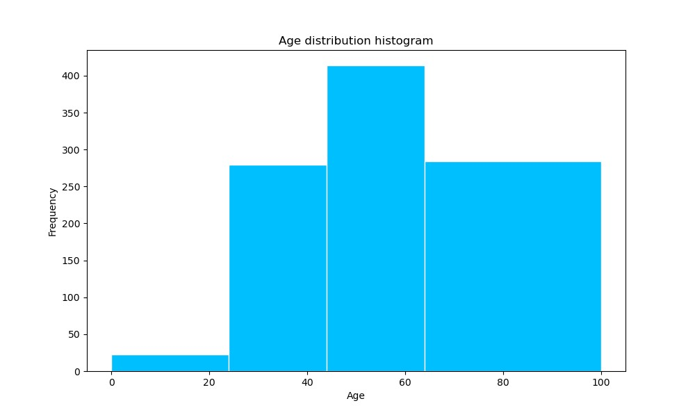
Note: The data and information in this document is reflective of a hypothetical situation and client. This document is to be used for KPMG Virtual Internship purposes only.
Data Exploration
INSIGHTS FROM THE AGE DISTRIBUTION OF NEW CUSTOMERS
This age distribution shows that:
Most of the persons on the list of new customers are in the age range of 45 to 65.
There are hardly any individuals in the age group of 10 to 25.

Slide 5
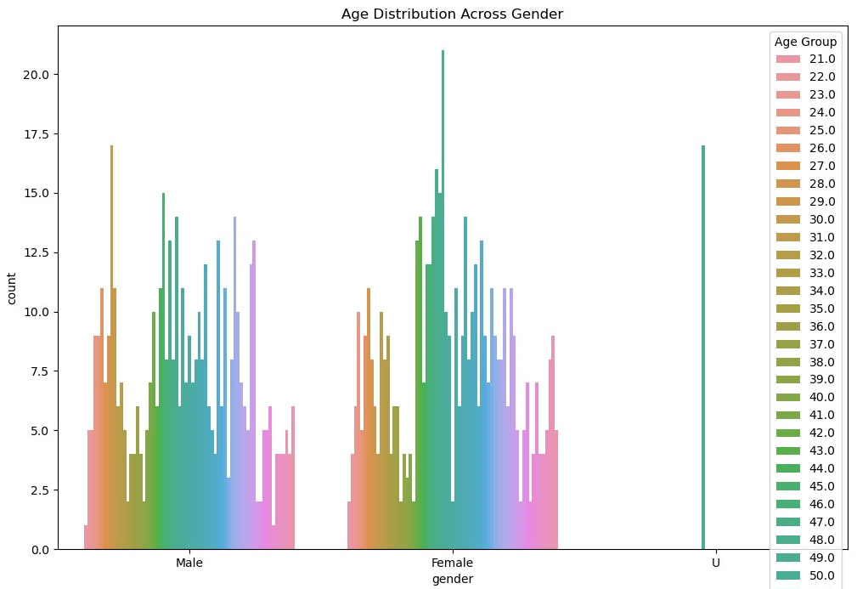
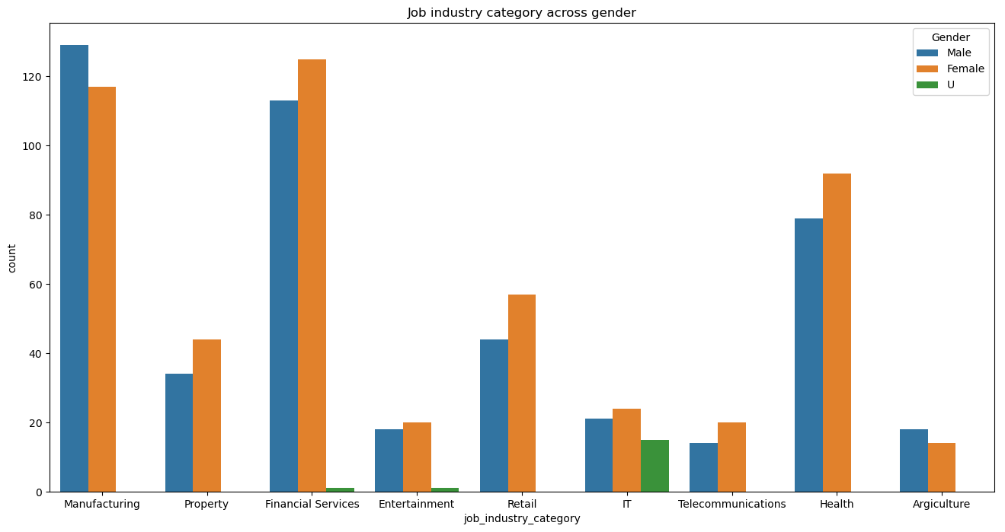
Note: The data and information in this document is reflective of a hypothetical situation and client. This document is to be used for KPMG Virtual Internship purposes only.
Data Exploration
This plot depicts the age group across the gender
The insights to be noted are:
Women are more in charge.
Therefore, the targeting strategy should be more geared towards women than it should be towards men for the obvious reasons that women dominate the job market.

Slide 6
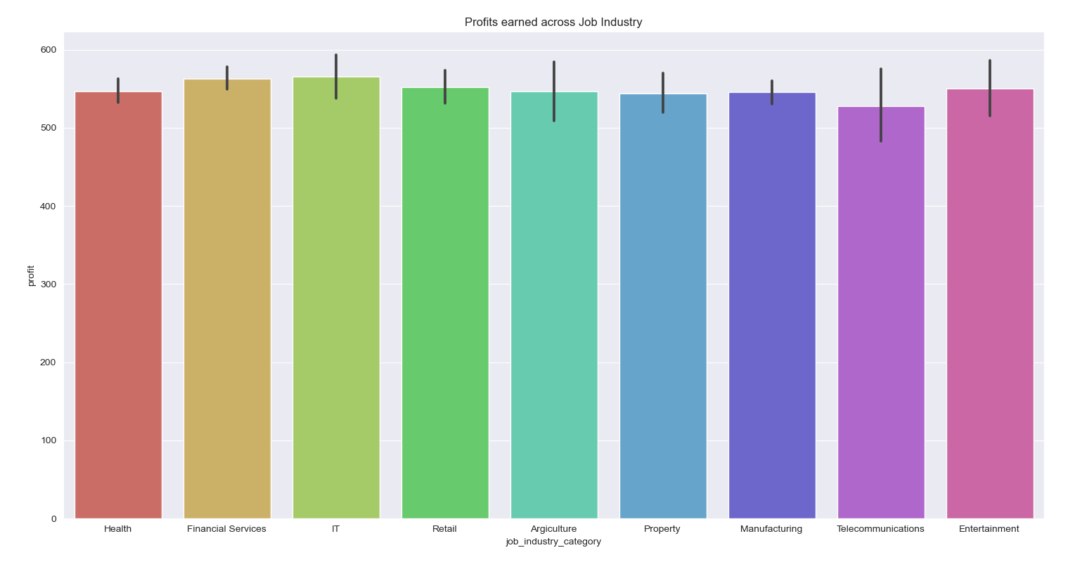
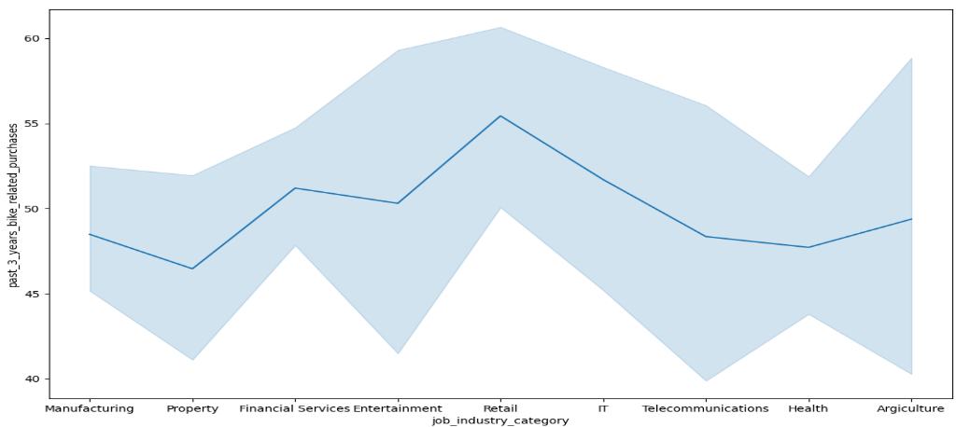
Note: The data and information in this document is reflective of a hypothetical situation and client. This document is to be used for KPMG Virtual Internship purposes only.
Data Exploration
INSIGHTS ON JOB INDUSTRY
This plots shows that:
The financial, IT, health, and retail industries provide the majority of profits.
Following the retail sector in making bike-related purchases were the financial and IT sectors.

Slide 7
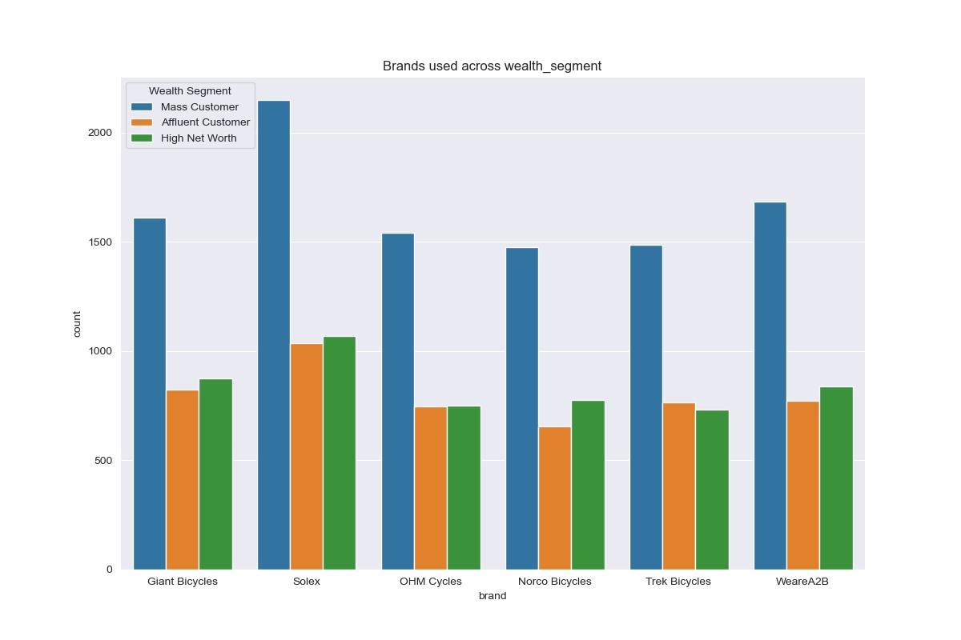
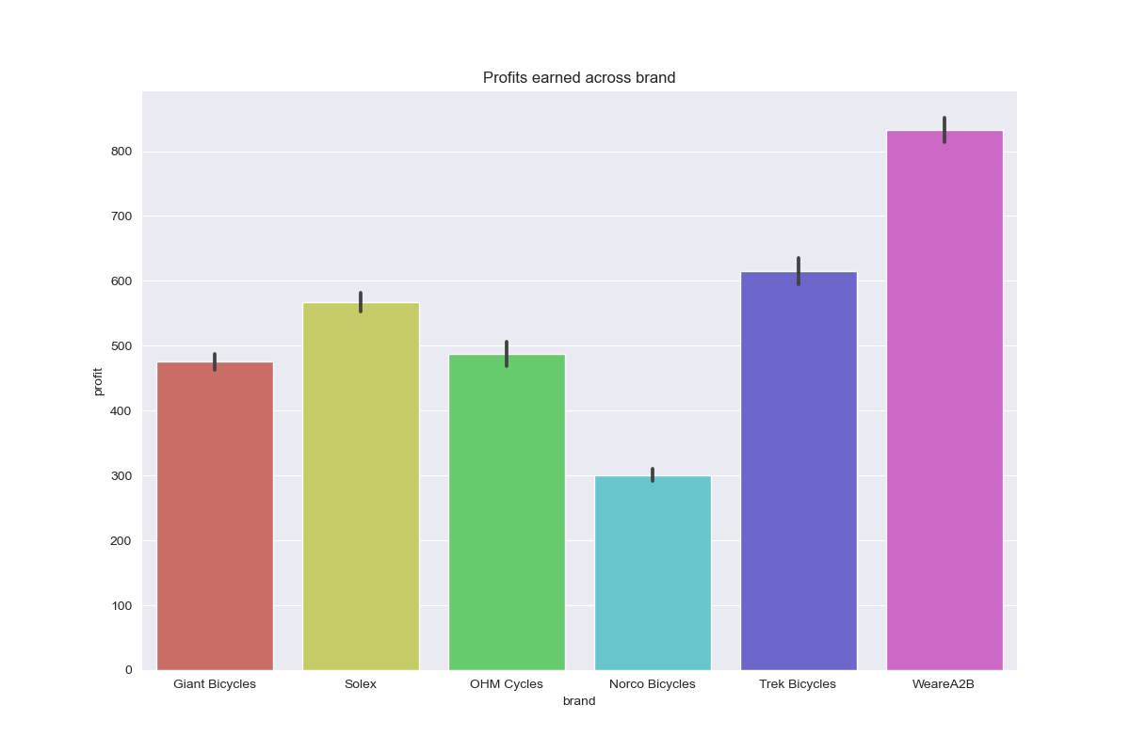
Note: The data and information in this document is reflective of a hypothetical situation and client. This document is to be used for KPMG Virtual Internship purposes only.
Data Exploration
INSIGHTS ON THE PROFIT OF BRANDS
This distribution shows that:
The most profitable brand is WeareA2B, followed by Trek Bicycles and Solex. Additionally, Solex is the most popular brand among mass consumers.

Slide 8
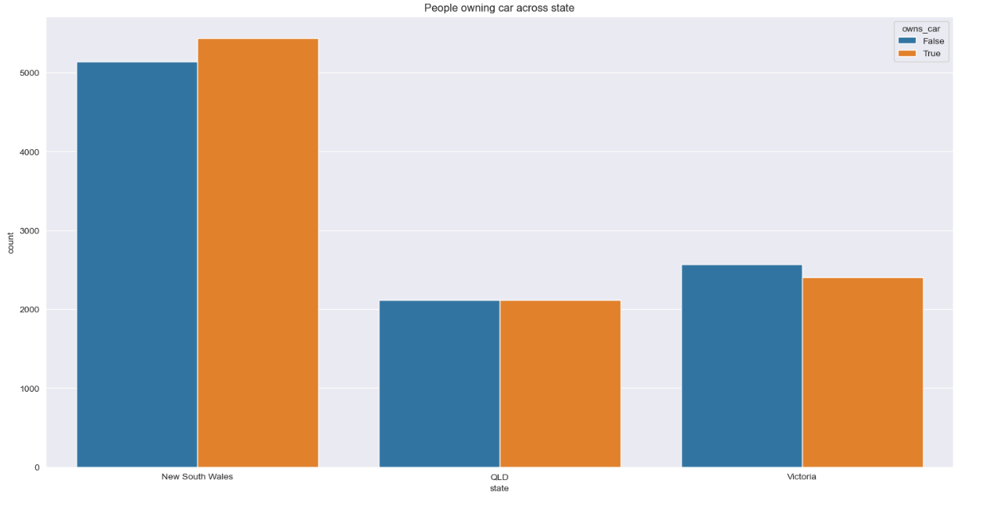
Note: The data and information in this document is reflective of a hypothetical situation and client. This document is to be used for KPMG Virtual Internship purposes only.
Model Development
This plot depicts the age group across the gender
The insights to be noted are:
The State of New South Wales would be the greatest place to pick clients because there are almost equal numbers of car owners and non-owners. This may present us with a chance.
Additionally, we can introduce various promotions to encourage people in Victoria and Queensland to purchase our bicycles.

Slide 9

Note: The data and information in this document is reflective of a hypothetical situation and client. This document is to be used for KPMG Virtual Internship purposes only.
Model Development
So, who are our high targeted customers?
From the New Customer List, the high value customers would be:
An Age group of 45-55
Majority of high value customers are females
High valued and profitable industries are Financial, IT, Health and Retail industries
Customers currently living New South Wales and Victoria

Slide 10
Note: The data and information in this document is reflective of a hypothetical situation and client. This document is to be used for KPMG Virtual Internship purposes only.
THANK YOU

