Slide 1

COSSUP OFR NLP
Nick Anthony, MS
Chris Delcher, PhD
University of Kentucky

Slide 2
Natural Language Processing (NLP) Overview
PDF text extraction
Biomedical concept recognition
Large Language Models
Notes:
NLP is a broad topic that can achieve a lot of tasks related to text. Relevant to this project are:
Ability to parse text out of a PDF document. This results in you having the data (usually in a very unstructured format – think of a huge paragraph) for all of the text on each PDF page.
Ability to extract specific concepts or entities from text. Primarily for our purposes this refers to biomedical concepts meaning anything related to medicine. Examples include drug names such as fentanyl, cocaine or other “conceptual ideas” such as homeless or social determinants of health.
Large language models (have you heard of ChatGPT?) have revolutionized the NLP industry by providing very robust machine learning models that are capable of understanding textual data like never before. For us, this means we can provide the model with a large corpus (body) of text and ask it questions. For example, “How many illicit drugs are there in this medical encounter?”

Slide 3
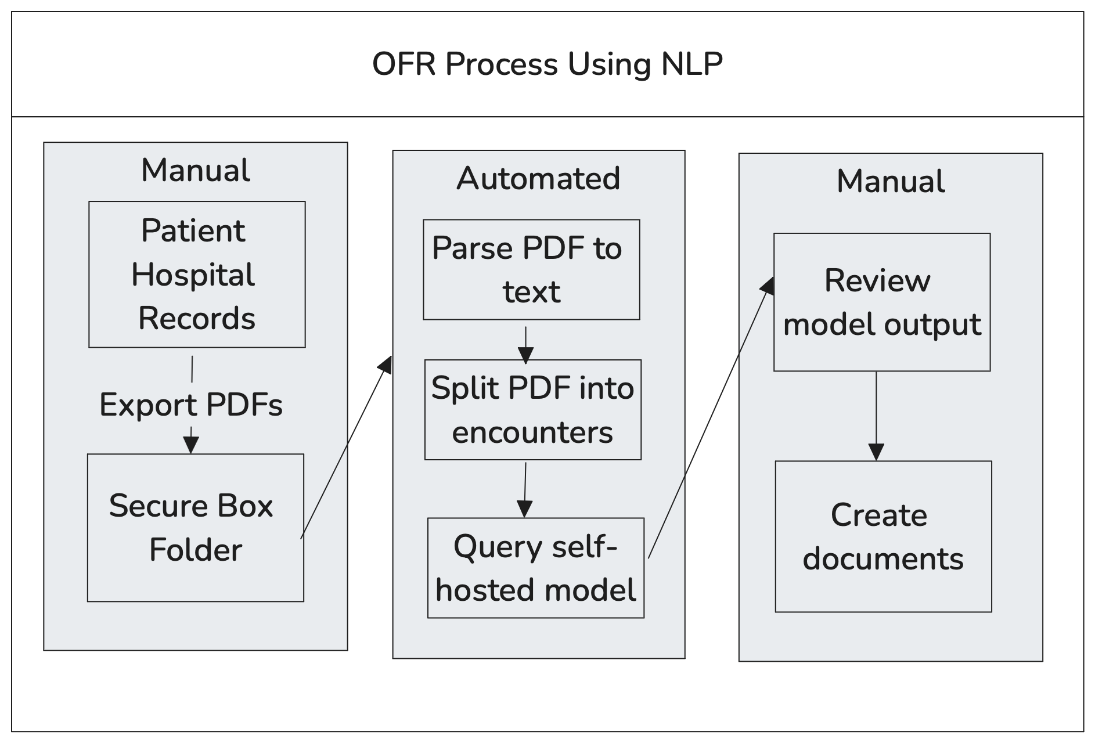
Project Architecture Overview
Notes:
Our planned project architecture takes advantage of all of these NLP methods to help automate and simply the OFR process.
NOTE that we do not intend to remove the human review component, it is still vital to ensure data accuracy and reliability.
Our process starts by having someone go into the medical records system and export the large PDF from EPIC containing a decedent’s entire medical history. That person will then upload the PDF to a secure Box folder and give it an appropriate name. This process repeats for each patient of interest.
Once PDFs for all relevant patients are uploaded into Box, an automated Python program can begin the process of extracting potentially relevant information for the OFR. This process starts by programmatically accessing the Box folder (so no data ever leaves Box), and then following the below steps for each PDF (descendent) in the specified folder:
Authorize via API
Access PDF file
Parse text from PDF file
Split text into encounters
Query a self-hosted model
”Self-hosted” here means not OpenAI, so the data is not being sent to a third party and is still secure
Potentially relevant questions can be broken down by entire patient overview or per-encounter
Patient Overview Questions (examples):
What is this patient’s social history?
How many hospital encounters did this patient have and over what time period?
How many different hospital systems did this patient visit and which was most frequent?
Encounter Specific Questions (examples):
When did this encounter occur?
What was the chief complaint?
What major drugs, if any, were involved?
Which hospital system did this encounter occur at?
Once the model has answered all of these questions for the the current patient PDF, we export the results of the model back to Box as a new Summary Document for manual review
From this point, the summary document can be used as a reference to create presentations, timelines, etc.

Slide 4
Current Status
Programmatic access to Box folder with PDFs of patient medical history
PDF parsing (early stages)
Running LLM
Notes:
So where are we today?
Steps:
Programmatic access to the Box folder
Able to parse text from PDFs
Currently only able to parse the entire PDF, still working on splitting it into individual encounters
Self-hosted LLM running with some simple queries tested against the entire patient history
Logistics:
Contract execution is almost completed

Slide 5
Next Steps
Replicate OFR question/answering on entire patient history
Replicate OFR question/answering on per-encounter basis to develop patient timeline
Focus on extracting:
Toxicology and drug data
Mental health
Social health and history
Relevant dates and hospital systems

