Slide 1
Introduction to Control System Theory

Slide 2

Control Theory

Slide 3
Control Theory
Definition: Control theory is a branch of engineering and mathematics that deals with the behavior of dynamical systems. It focuses on designing systems that can control the behavior of other systems to produce specific outputs.
Control theory develops mathematical models and algorithms to manipulate the behavior of systems, ensuring they operate as desired.

Slide 4
Control System
Controller
3 rad/sec
2.2 rad/sec

Slide 5
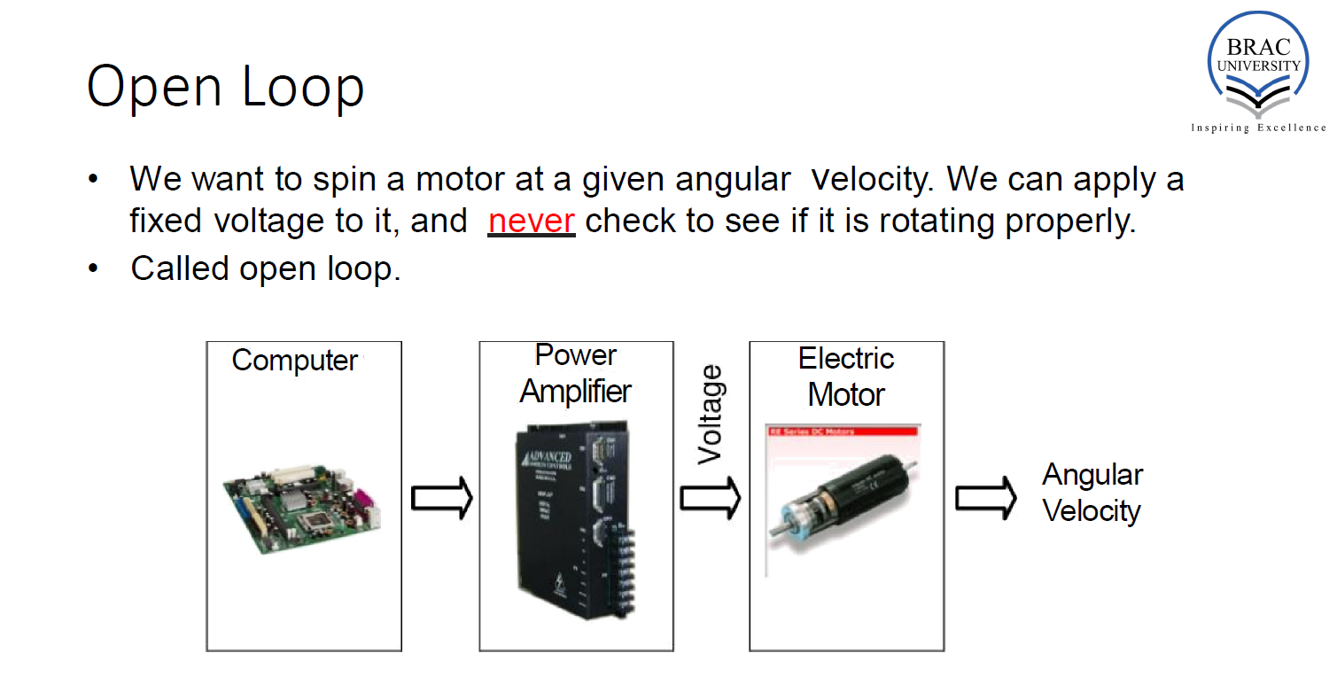

Slide 6
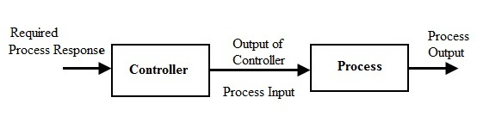

Slide 8
3 rad/s
2.2 rad/s

Slide 9
Required Velocity
Output Velocity
3 rad/s
2.2 rad/s

Slide 10
Open Loop Control
Required Velocity
Output Velocity
3 rad/s
2.2 rad/s

Slide 11
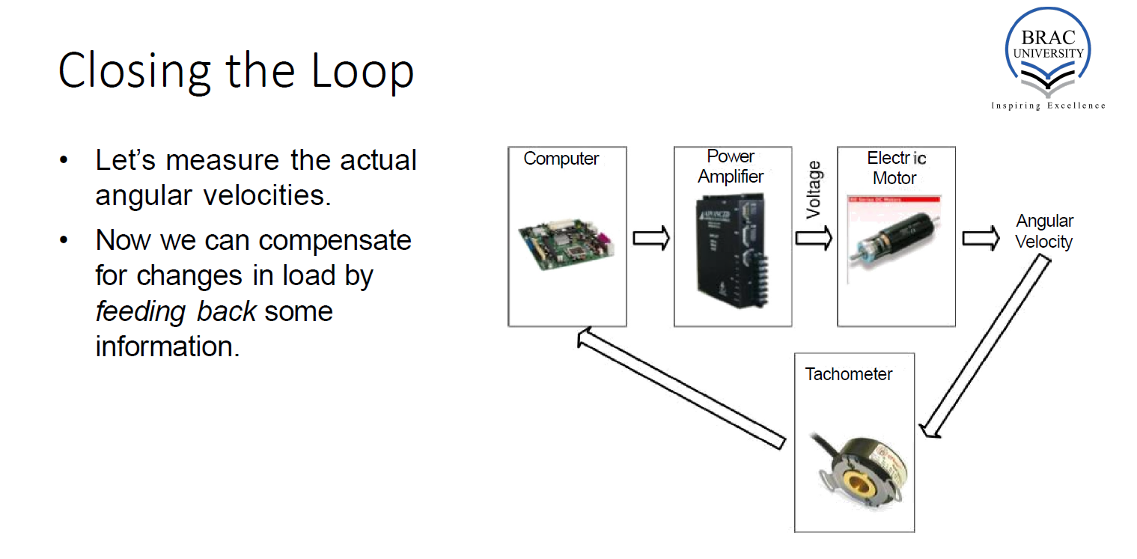

Slide 12
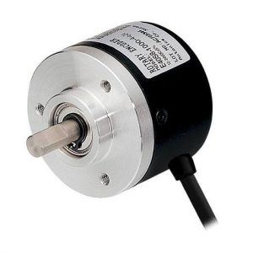
Let’s measure the actual angular velocities.
Now we can compensate for changes in load by feeding back some information.

Slide 13
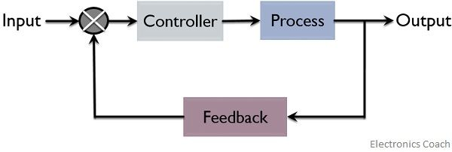
Closed Loop Control

Slide 14
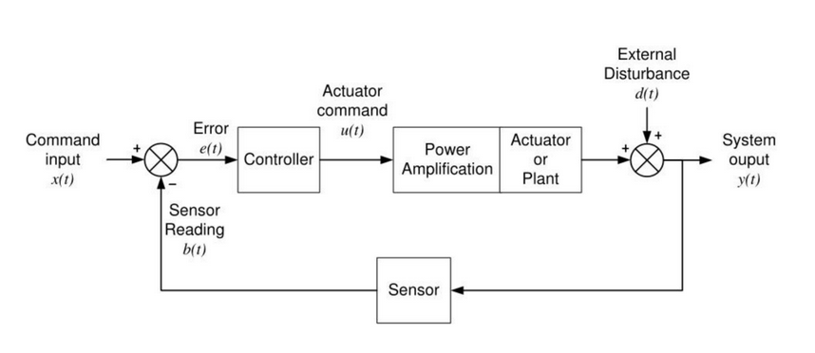
Feedback Diagram

Slide 15
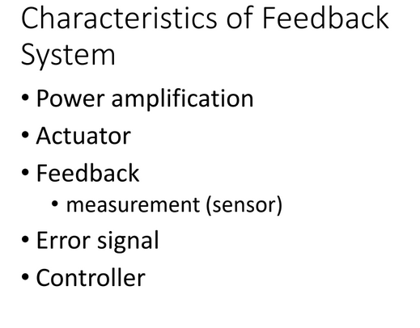

Slide 16
Components
Input: The signal or commands applied to the system.
Output: The response of the system to the input signals.
Controller: The component responsible for generating control signals based on the system's output and desired behavior.
Feedback: Information about the system's output that is fed back to the controller to adjust the control signals.

Slide 17
Theoretical Concepts
Feedback: Feedback involves using information about the output of a system to adjust the control input, thereby regulating the system's behavior.
Ex. Thermostat, measures the current room temperature(feedback), compares it to the desired temperature set by user, adjusts the heating or cooling.
Stability: Stability ensures that the system's response remains bounded over time, even in the presence of disturbances or changes in operating conditions.
Ex. balancing a pencil on the tip of a finger. Moving your finger slightly, the pencil wobbles but eventually return to its position. The pencil returns to equilibrium despite disturbances illustrates stability.

Slide 18
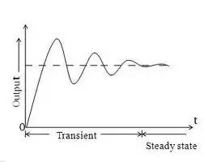
Theoretical Concepts
Transient Response: refers to how a system behaves during the transition from one state to another after a change in inputs.
Ex. Turning on a light switch, the time it takes for the light to reach its steady state and any oscillations or overshoot during this transition represent the transient response of the lighting system.
Steady-State Response:describes the behavior of the system once it has settled into a stable operating condition.
Ex. In an elevator system, when you press a floor button, the elevator initially accelerates, then moves at a constant speed, and finally decelerates as it reaches the desired floor.

Slide 19
time domain

Slide 20
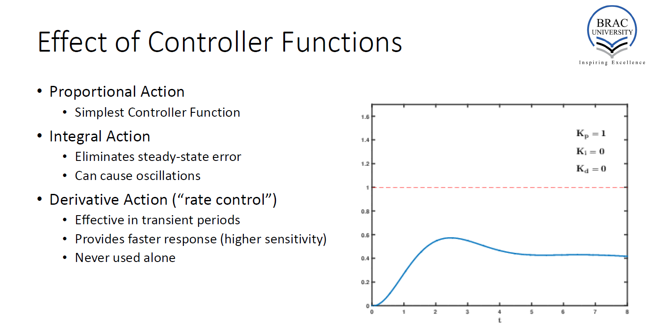

Slide 21
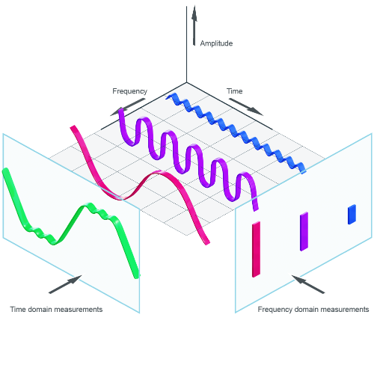
Time Domain to Frequency Domain

Slide 22
x(t)
x(s)
Laplace Transform

Slide 23
Block Diagram
G(t)
X(t)
Input
Y(t)
Output
Y(t) = X(t)*G(t)
Y(t)/X(t) = G(t)
Gain = Y(t)/X(t)= Output/Input

Slide 24
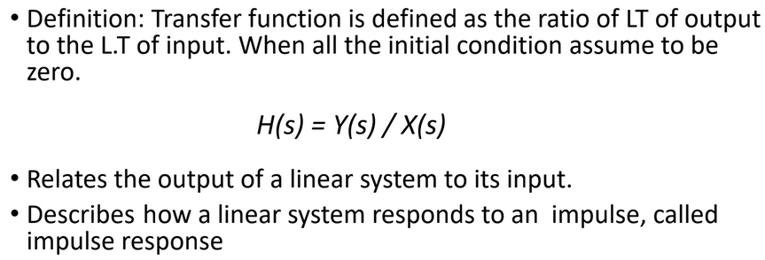
Transfer Function
H(s)
X(s)
Input
Y(s)
Output

Slide 25
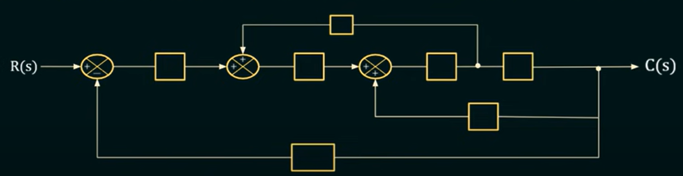

Slide 26
Next Class
Block Diagram Solving

Slide 27
Thank You

