Slide 1
Introduction to Robotics
CSE 461
Class Topic: Introduction to Control System Theory (PID)
Utsha Kumar Roy
Lecturer
Brac University

Slide 2
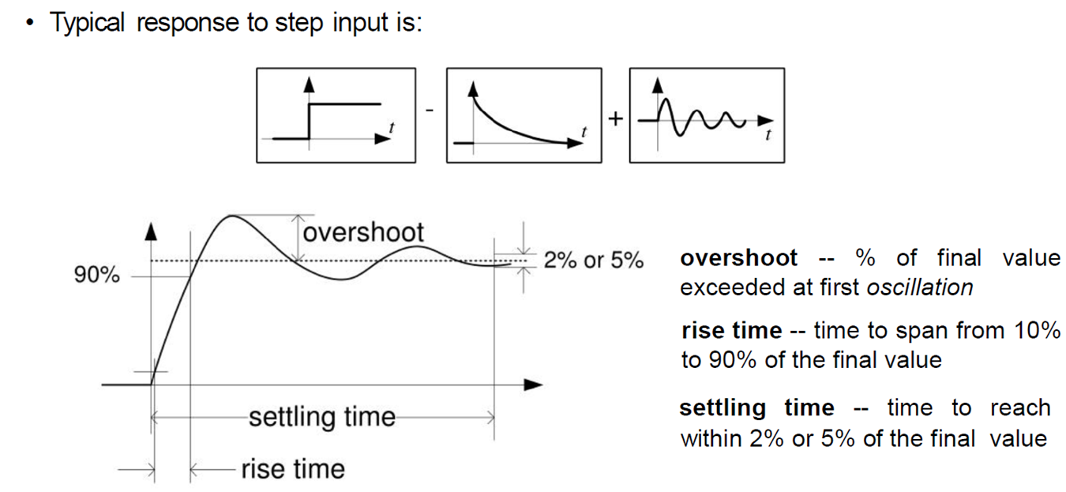
2nd order control system

Slide 3
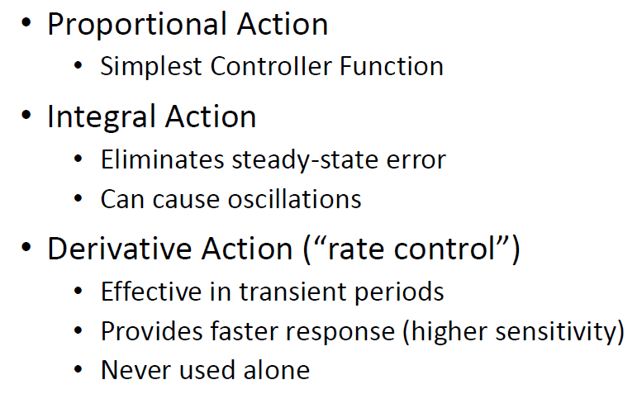
Effect of PID controller function

Slide 4
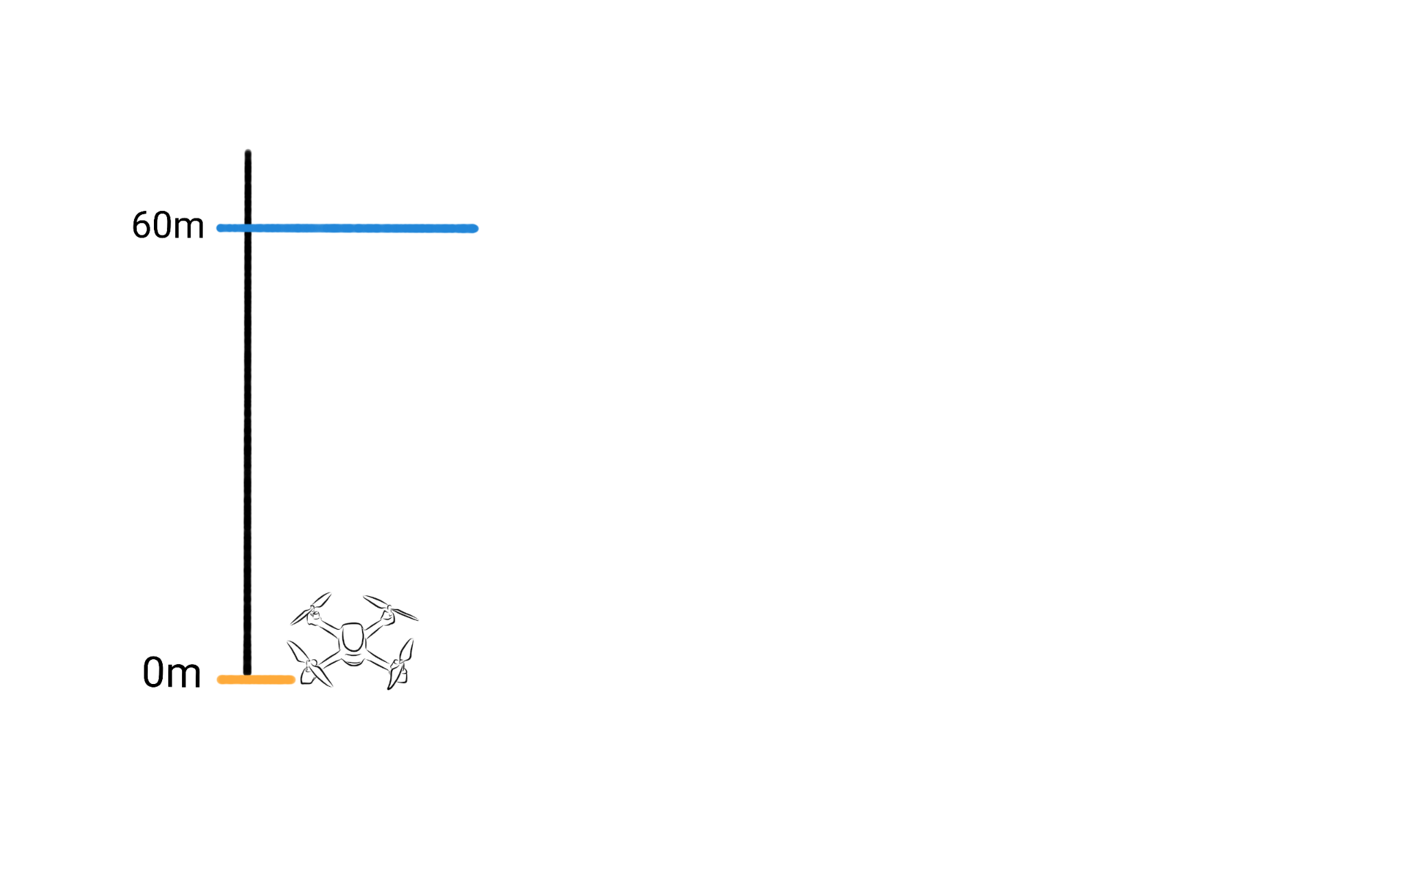
https://www.youtube.com/watch?v=wkfEZmsQqiA

Slide 5
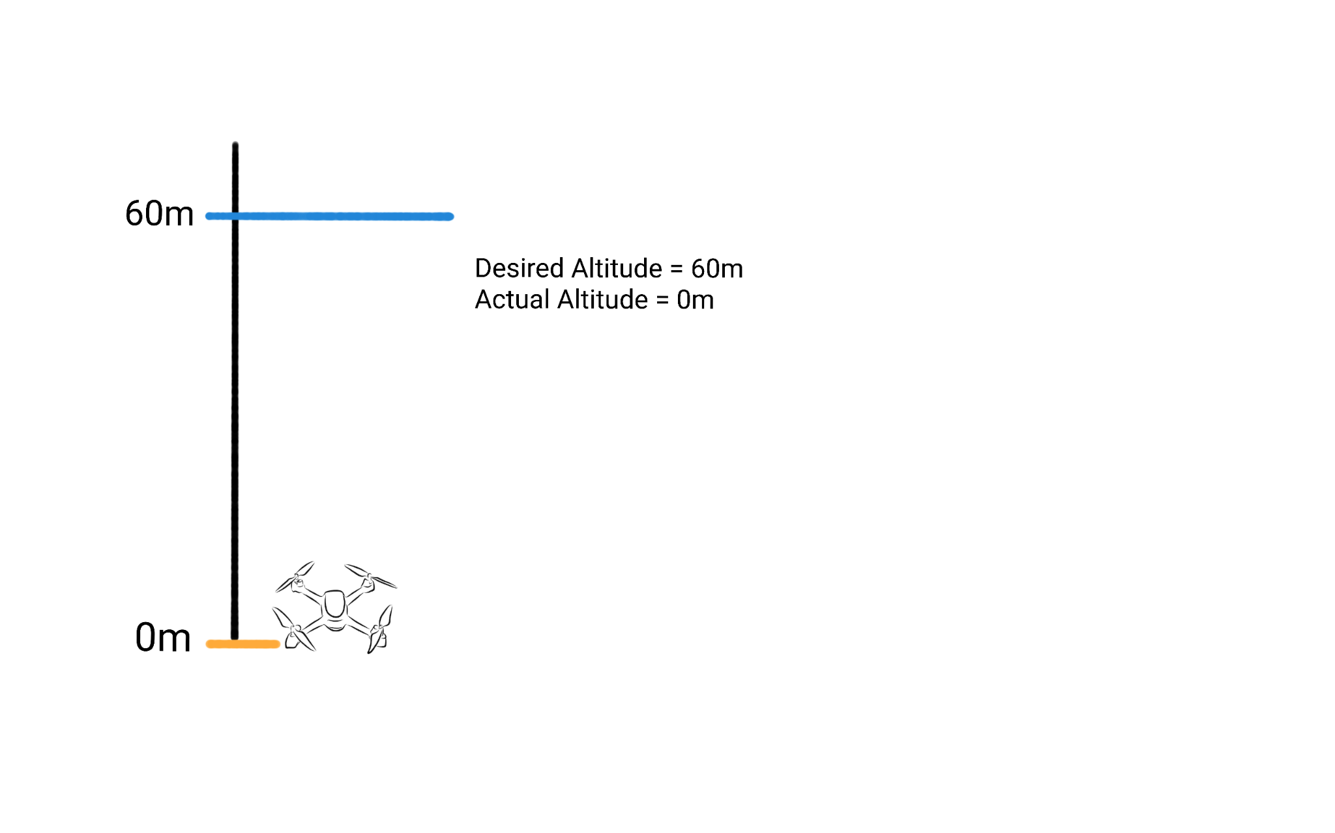

Slide 6
Desired Altitude - Actual Altitude
= 60m - 0m
= 60

Slide 7
Desired Altitude - Actual Altitude
= 60m - 0m
= 60
= Error

Slide 8
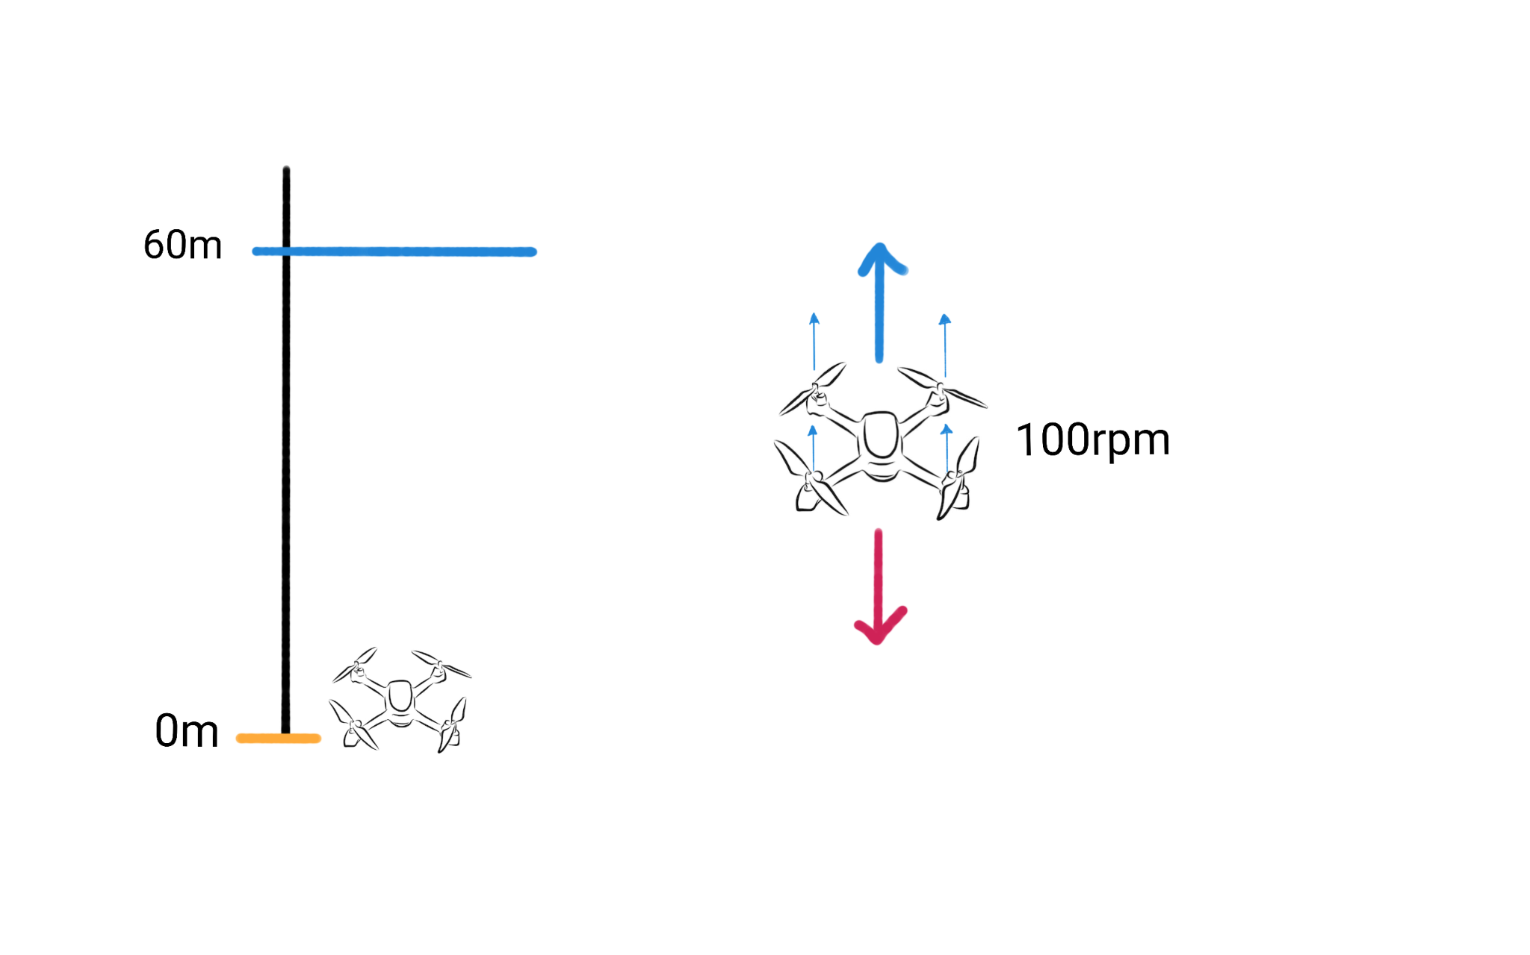

Slide 9
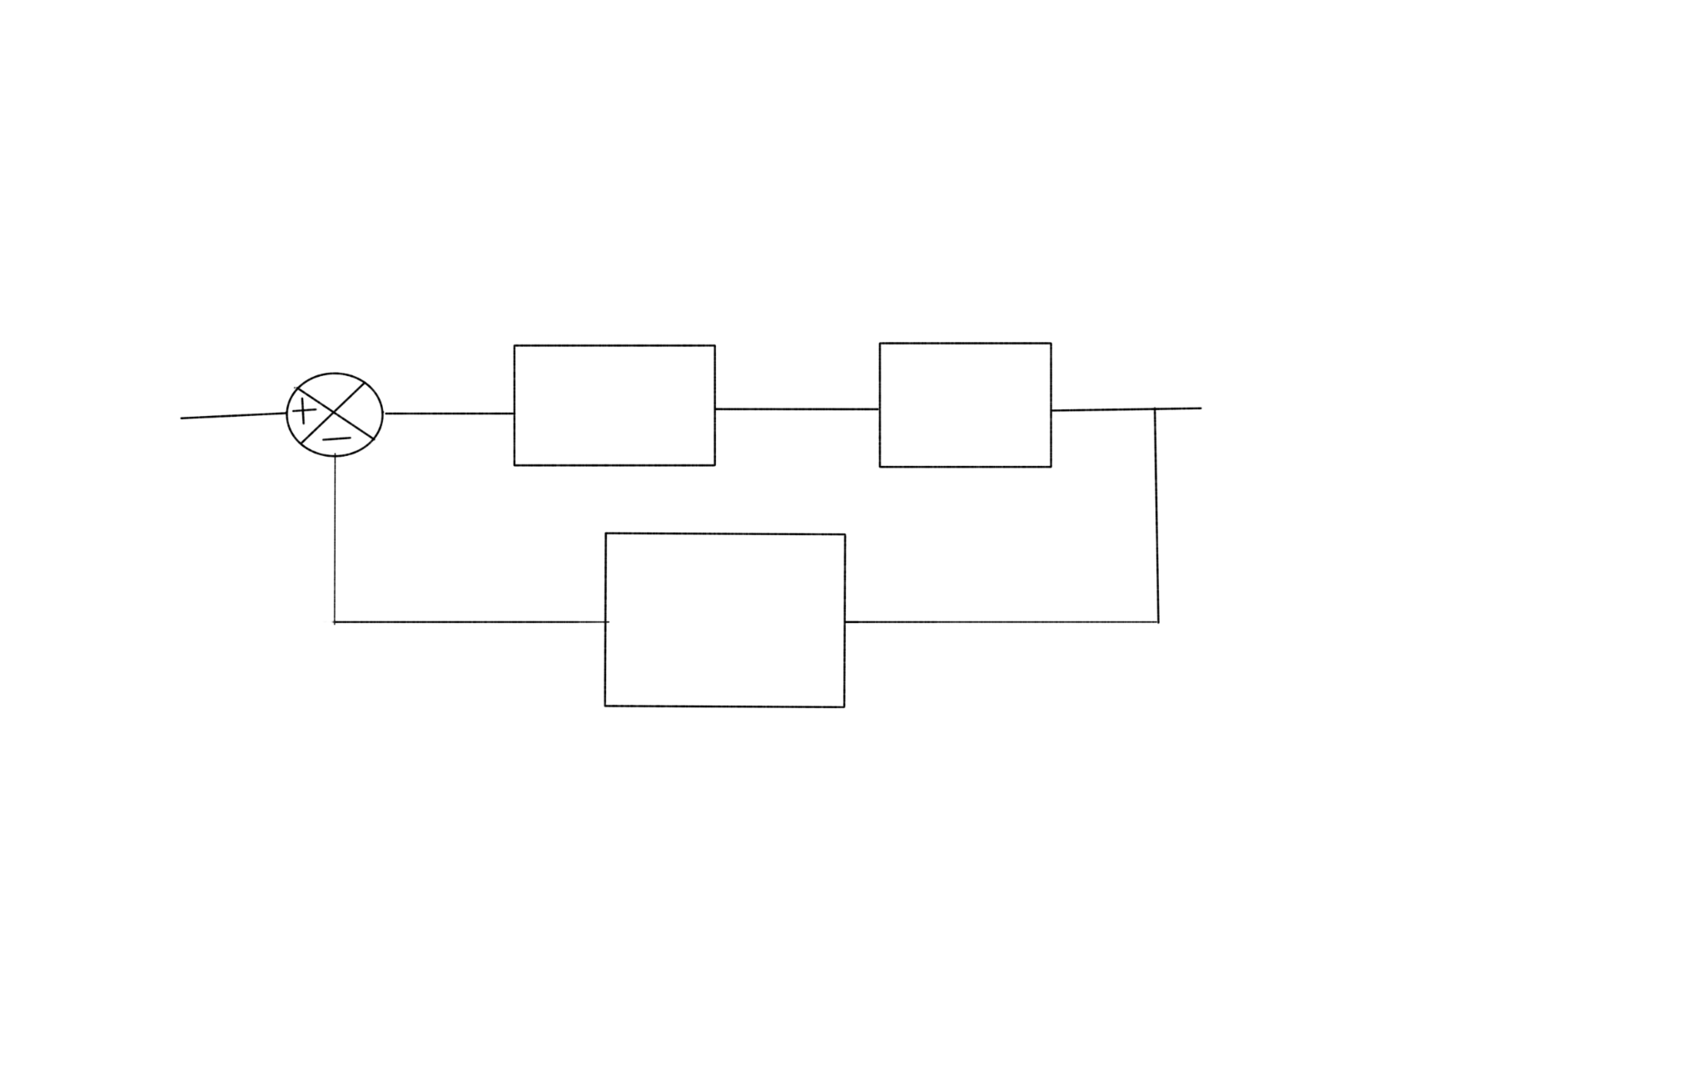
Desired Altitude
Gain
Propeller
Actual Altitude
Altitude Measuring Sensor

Slide 10
Desired Altitude
1
Propeller
Actual Altitude
Altitude Measuring Sensor

Slide 11
Desired Altitude
1
Propeller
Actual Altitude
Altitude Measuring Sensor
Desired Altitude - Actual Altitude
= 60m - 0m
= 60
Propeller Speed = 60 * 1 = 60 rpm

Slide 12
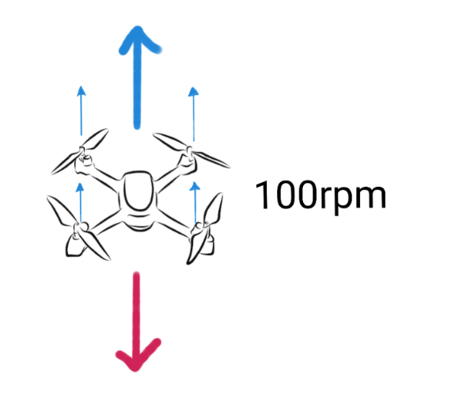
Desired Altitude
1
Propeller
Actual Altitude
Altitude Measuring Sensor
Desired Altitude - Actual Altitude
= 60m - 0m
= 60
Propeller Speed = 60 * 1 = 60 rpm

Slide 13
Desired Altitude
2
Propeller
Actual Altitude
Altitude Measuring Sensor

Slide 14
Desired Altitude
2
Propeller
Actual Altitude
Altitude Measuring Sensor
Desired Altitude - Actual Altitude
= 60m - 0m
= 60
Propeller Speed = 60 * 2 = 120 rpm

Slide 15
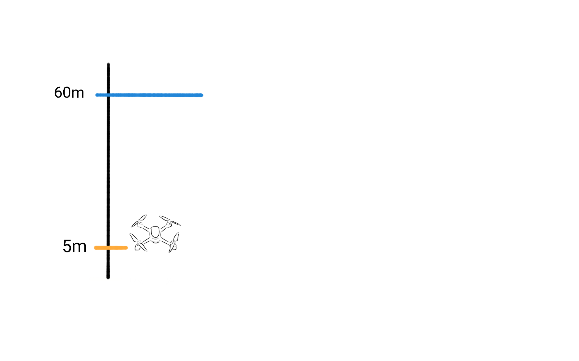
Desired Altitude
2
Propeller
Actual Altitude
Altitude Measuring Sensor
Desired Altitude - Actual Altitude
= 60m - 5m
= 55
Propeller Speed = 55 * 2 = 110 rpm

Slide 16
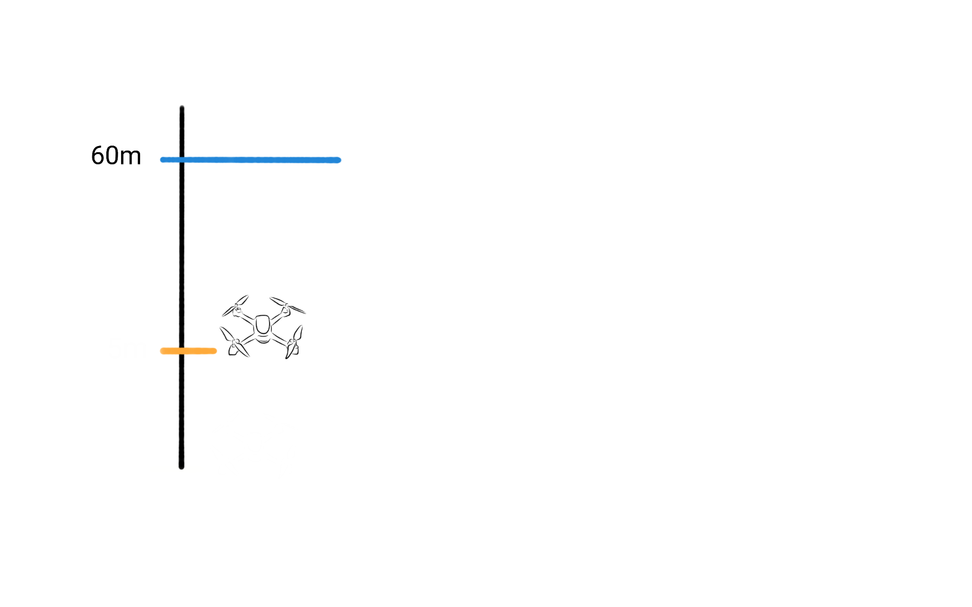
Desired Altitude
2
Propeller
Actual Altitude
Altitude Measuring Sensor
Desired Altitude - Actual Altitude
= 60m - 10m
= 50
Propeller Speed = 50 * 2 = 100 rpm
10m

Slide 17
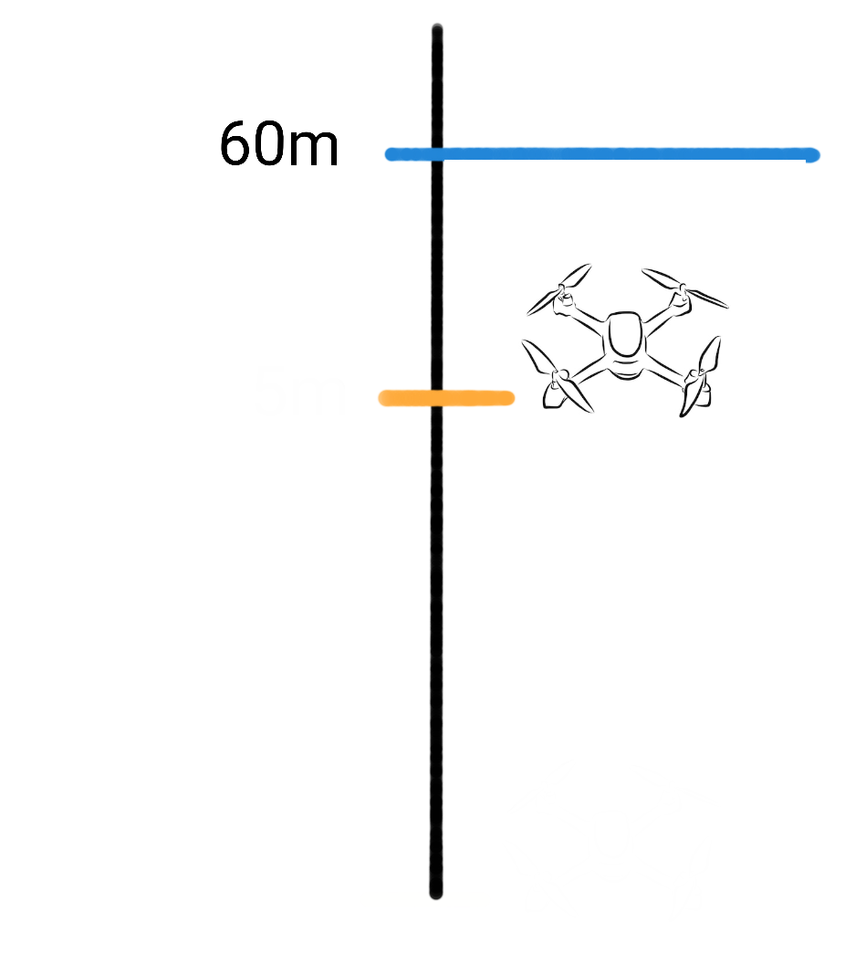
Desired Altitude
10
Propeller
Actual Altitude
Altitude Measuring Sensor
Propeller Speed = 10 * 10 = 100 rpm
Error = 10
50m

Slide 18
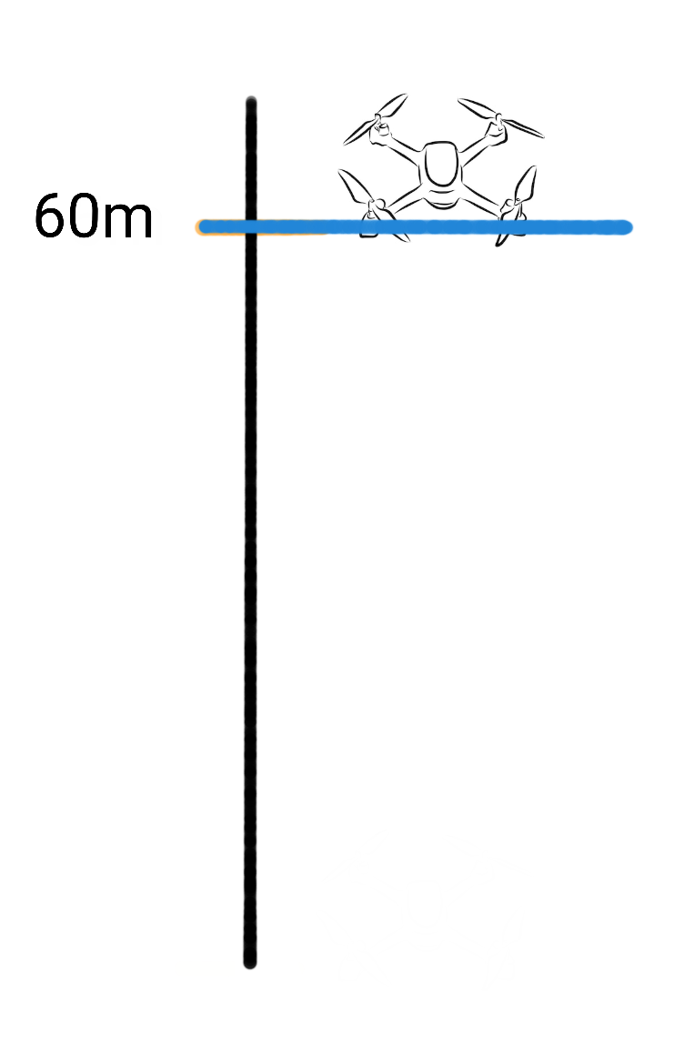
Desired Altitude
10
Propeller
Actual Altitude
Altitude Measuring Sensor

Slide 19
Desired Altitude
10
Propeller
Actual Altitude
Altitude Measuring Sensor
Desired Altitude - Actual Altitude
= 60m - 60m
= 0
Propeller Speed = 0 * 10 = 0 rpm

Slide 20
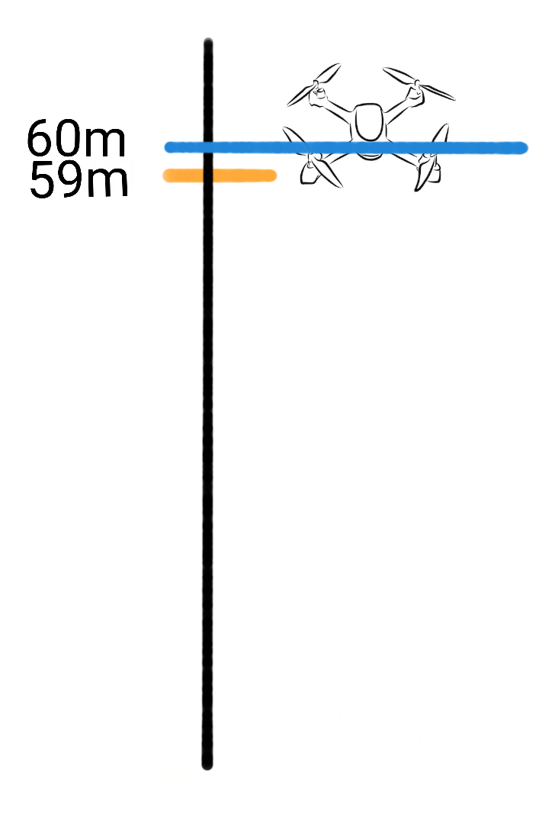
Desired Altitude
100
Propeller
Actual Altitude
Altitude Measuring Sensor
Desired Altitude - Actual Altitude
= 60m - 59m
= 1
Propeller Speed = 1 *100 = 100 rpm

Slide 21
Desired Altitude
10
Propeller
Actual Altitude
Altitude Measuring Sensor
Propeller Speed = 10 * 10 = 100 rpm
Error = 10
50m
Output = Kp * error

Slide 22
Desired Altitude
10
Propeller
Actual Altitude
Altitude Measuring Sensor
Propeller Speed = 10 * 10 = 100 rpm
Error = 10
50m
Output = Kp * error
Proportional Control

Slide 23
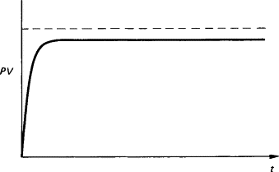
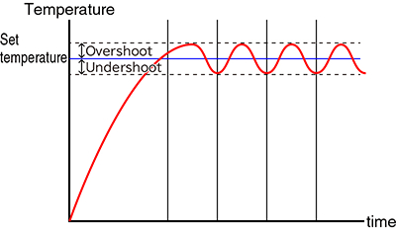
Proportional Control

Slide 24
Desired Altitude
Ki*e + Kp * ∫e
Propeller
Actual Altitude
Altitude Measuring Sensor
Propeller Speed = 10 * 10 = 100 rpm
Error = 10
50m

Slide 25
Desired Altitude
Ki*e + Kp * ∫e
Propeller
Actual Altitude
Altitude Measuring Sensor
Propeller Speed = 10 * 10 = 100 rpm
Error = 10
50m
Output = Kp * error + Ki * (error1 + error2 + error3)

Slide 26
Desired Altitude
Ki*e + Kp * ∫e
Propeller
Actual Altitude
Altitude Measuring Sensor
Propeller Speed = 10 * 10 = 100 rpm
Error = 10
50m
Output = Kp * error + Ki * (error1 + error2 + error3)
Proportional - Integral Control

Slide 27
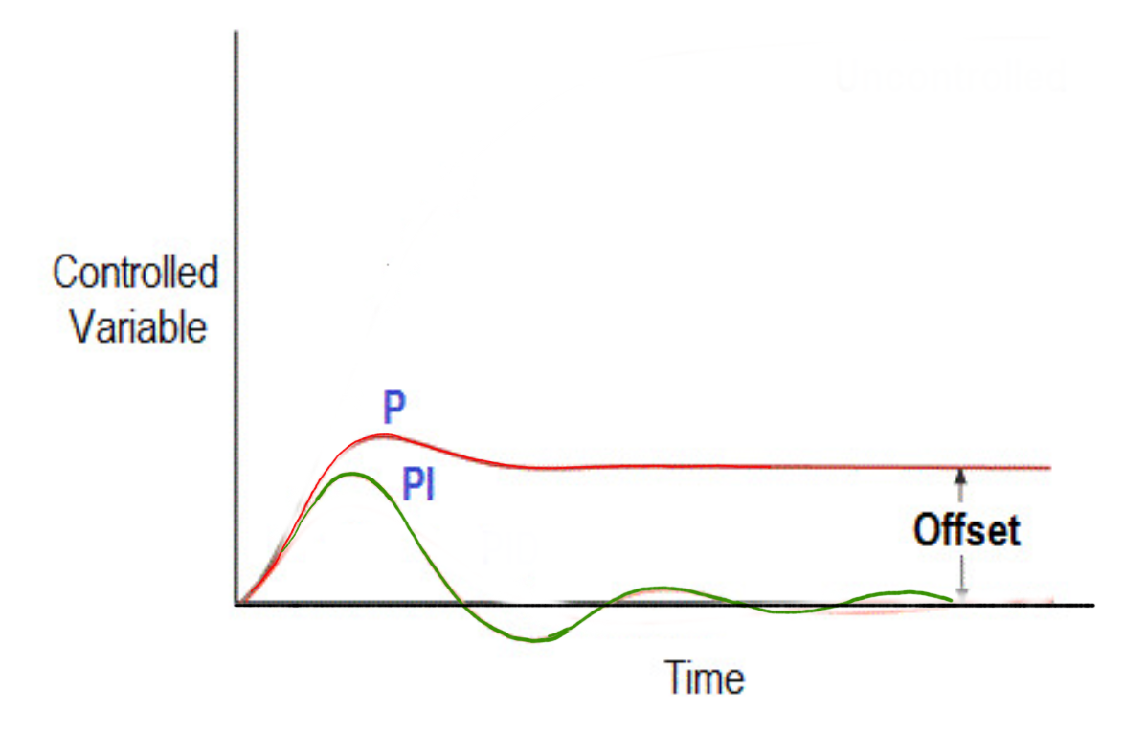
Desired Altitude
Ki*e + Kp * ∫e
Propeller
Actual Altitude
Altitude Measuring Sensor
50m

Slide 28
Ki*e +
Kp * ∫e + Kd * ∇ e
Actual Altitude
Desired Altitude
Propeller
Altitude Measuring Sensor
Propeller Speed = 10 * 10 = 100 rpm
Error = 10
50m
Output = Kp * error + Ki * (error1 + error2 + error3) + Kd * ( error3- error 2)

Slide 29
Ki*e +
Kp * ∫e + Kd * ∇ e
Actual Altitude
Desired Altitude
Propeller
Altitude Measuring Sensor
Propeller Speed = 10 * 10 = 100 rpm
Error = 10
50m
Output = Kp * error + Ki * (error1 + error2 + error3) + Kd * ( error3- error 2)
Proportional - Derivative - Integral Control
(PID) Control

Slide 30
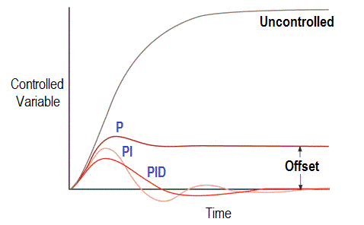
Proportional - Derivative - Integral Control
(PID) Control

Slide 31
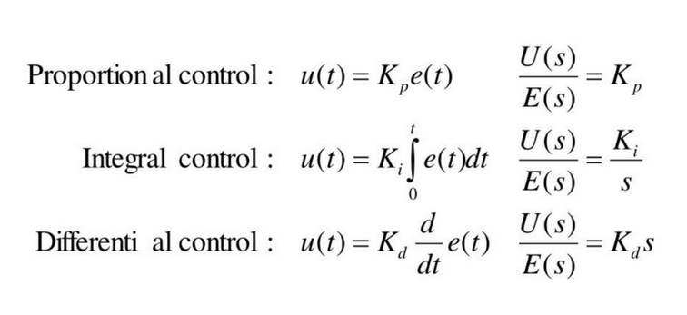
PID Controller

Slide 32
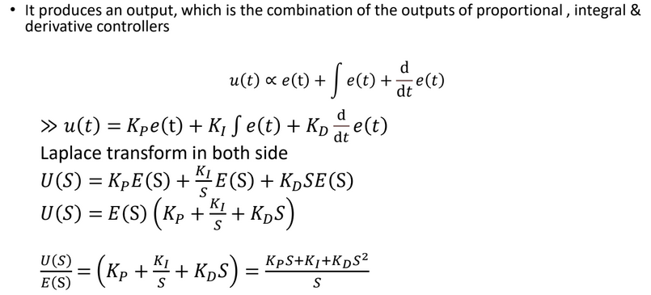

Slide 33
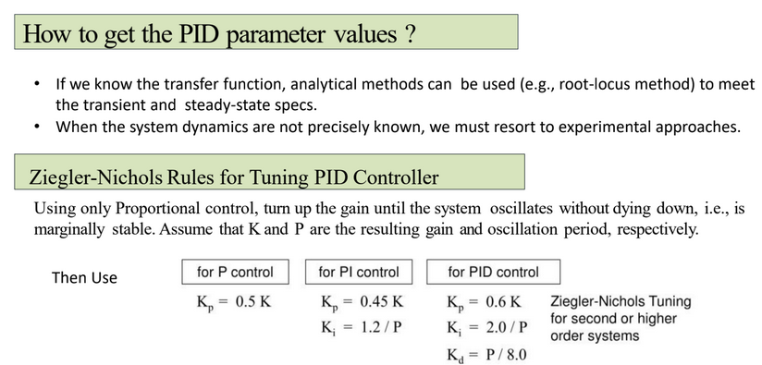

Slide 34
Generating PID parameters
Auto-Tuning Algorithms:
Relay-based Auto-Tuning
A relay is introduced in the control loop.
Observes the system's oscillatory response.
Calculates PID parameters based on oscillation characteristics.
Trial and Error: Iteratively adjust parameters based on system response.

Slide 35
Advantages and Applications of PID control
Advantages:
Simple: easy to understand.
Effective: Accurate and stable, even in dynamic environments.
Robust: Can be adopted to different robot systems
Application:
Arm positioning
Robot Navigation
Speed Control
Balance control

Slide 36
Conclusion
PID control---most widely used control strategy today
Over 90% of control loops employ PID control, often the derivative gain set to zero (PI control)
The three terms are intuitive---a non -specialist can grasp the essentials of the PID controller’s action. It does not require the operator to be familiar with advanced math to use PID controllers
Engineers prefer PID controls over untested solutions

