Slide 1
Frontier Based Algorithm Simulation
Brac University

Slide 2
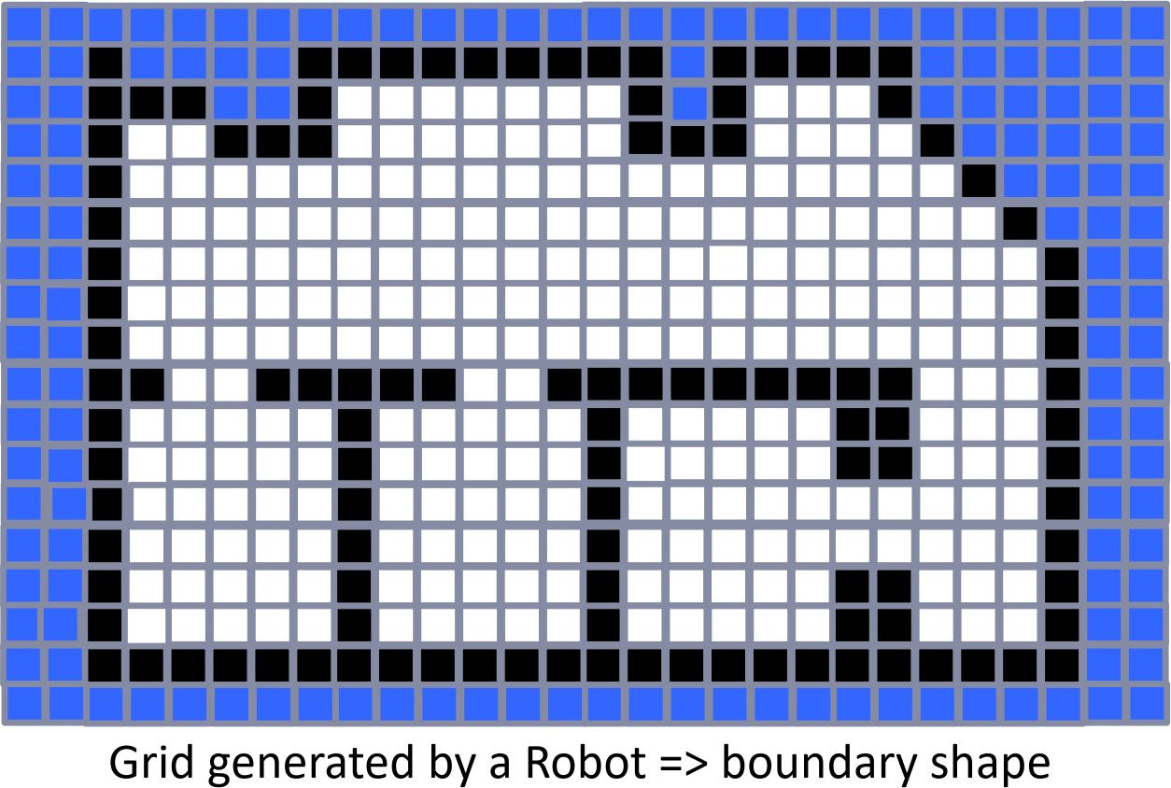

What is an Occupancy Grid?
🡽 A way of representing a map as a gridded world where each cell is either “occupied” or “empty” or
“unknown”.

