Slide 1

Introduction to Robotics
CSE 461
Class Topic: Introduction to Machine Learning and Neural Network

Slide 2
Tumor Size | Condition
10 | malignant
2 | benign
1 | benign
5 | malignant

Slide 3
Tumor Size | Condition
10 | malignant
2 | benign
1 | benign
5 | malignant

Slide 4
Tumor Size | Condition
10 | malignant
2 | benign
1 | benign
5 | malignant

Slide 5
Tumor Size | Condition
10 | malignant
2 | benign
1 | benign
5 | malignant
4

Slide 6
Tumor Size | Age | Condition
10 | 50 | malignant
2 | 30 | benign
1 | 45 | benign
5 | 40 | malignant

Slide 7
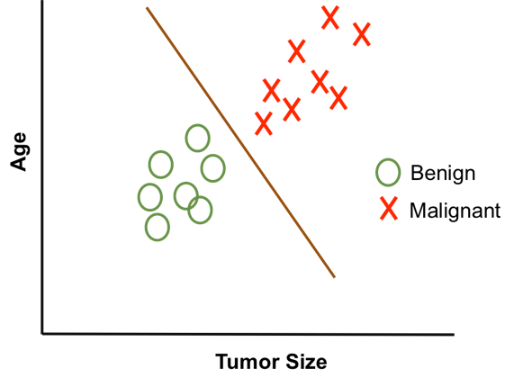
Tumor Size | Age | Condition
10 | 50 | malignant
2 | 30 | benign
1 | 45 | benign
5 | 40 | malignant

Slide 8
Tumor Size | Age | Condition
10 | 50 | malignant
2 | 30 | benign
1 | 45 | benign
5 | 40 | malignant
0.9*10 + 0.1*50 = 9 + 5 = 14

Slide 9
Tumor Size | Age | Condition
10 | 50 | malignant
2 | 30 | benign
1 | 45 | benign
5 | 40 | malignant
0.9*10 + 0.1*50 = 9 + 5 = 14
0.9*2 + 0.1*30 = 1.8 + 3 = 4.8
0.9*1 + 0.1*45 = 0.9 + 4.5 = 5.4
0.9*5 + 0.1*40 = 4.5 + 4 = 8.5

Slide 10
Tumor Size | Age | Condition
10 | 50 | malignant
2 | 30 | benign
1 | 45 | benign
5 | 40 | malignant
0.9*10 + 0.1*50 = 9 + 5 = 14
0.9*2 + 0.1*30 = 1.8 + 3 = 4.8
0.9*1 + 0.1*45 = 0.9 + 4.5 = 5.4
0.9*5 + 0.1*40 = 4.5 + 4 = 8.5
6.5

Slide 11
Tumor Size | Age | Condition
10 | 50 | malignant
2 | 30 | benign
1 | 45 | benign
5 | 40 | malignant
Tumor Size = 9
Age = 42
6.5

Slide 12
Tumor Size | Age | Condition
10 | 50 | malignant
2 | 30 | benign
1 | 45 | benign
5 | 40 | malignant
Tumor Size = 9
Age = 42
0.9*9 + 0.1*42 = 8.1 + 4.2 = 12.3
6.5

Slide 13
Tumor Size | Age | Condition
10 | 50 | malignant
2 | 30 | benign
1 | 45 | benign
5 | 40 | malignant
Tumor Size = 9
Age = 42
0.9*9 + 0.1*42 = 8.1 + 4.2 = 12.3
malignant
6.5

Slide 14
x1
x2
y
Tumor Size | Age | Condition
10 | 50 | malignant
2 | 30 | benign
1 | 45 | benign
5 | 40 | malignant
w1 * x1 + w2 * x2 = y
0.9*9 + 0.1*42 = 8.1 + 4.2 = 12.3
malignant
6.5

Slide 15
x1
x2
y
Tumor Size | Age | Condition
10 | 50 | malignant
2 | 30 | benign
1 | 45 | benign
5 | 40 | malignant
w1 * x1 + w2 * x2 = y
x1, x2, ....., xn = Features
y = output/ target
w1, w2, ....., wn = Weights

Slide 16
x1
x2
y
Tumor Size | Age | Condition
10 | 50 | malignant
2 | 30 | benign
1 | 45 | benign
5 | 40 | malignant
w1 * x1 + w2 * x2 = y
Let w1 = 0.1 and w2 = 0.9
x1 = 2 and x2 = 5
0.1*2 + 0.9*5 = 0.2 + 4.5 = 4.7
benign

Slide 17
x1
x2
y
Tumor Size | Age | Condition
10 | 50 | malignant
2 | 30 | benign
1 | 45 | benign
5 | 40 | malignant
w1 * x1 + w2 * x2 = y
Let w1 = 0.1 and w2 = 0.9
x1 = 2 and x2 = 30
0.1*2 + 0.9*30 = 0.2 + 27 = 27.2
malignant

Slide 18
x1
x2
y
Tumor Size | Age | Condition
10 | 50 | malignant
2 | 30 | benign
1 | 45 | benign
5 | 40 | malignant
w1 * x1 + w2 * x2 = y
Let w1 = 0.1 and w2 = 0.9
x1 = 2 and x2 = 30
0.1*2 + 0.9*30 = 0.2 + 27 = 27.2
malignant
Weights are very important.

Slide 19
Size(sq-feet) | Bedroom | Kitchen | Main road | Balcony | Price(dollar)
1600 | 4 | 1 | 0.2 | 2 | 20000
1400 | 3 | 1 | 0.5 | 1 | 12000
1600 | 2 | 1 | 0.2 | 2 | 10000
2000 | 4 | 2 | 0.1 | 3 | 43000

Slide 20
x1
x2
x3
x4
x4
y
Size(sq-feet) | Bedroom | Kitchen | Main road | Balcony | Price(dollar)
1600 | 4 | 1 | 0.2 | 2 | 20000
1400 | 3 | 1 | 0.5 | 1 | 12000
1600 | 2 | 1 | 0.2 | 2 | 10000
2000 | 4 | 2 | 0.1 | 3 | 43000

Slide 21
x1
x2
x3
x4
x5
y
Size(sq-feet) | Bedroom | Kitchen | Main road | Balcony | Price(dollar)
1600 | 4 | 1 | 0.2 | 2 | 20000
1400 | 3 | 1 | 0.5 | 1 | 12000
1600 | 2 | 1 | 0.2 | 2 | 10000
2000 | 4 | 2 | 0.1 | 3 | 43000
w1 * x1 + w2 * x2 + ….. + w4 * x4 = y

Slide 22
Two Types
Regression
Classification

Slide 23
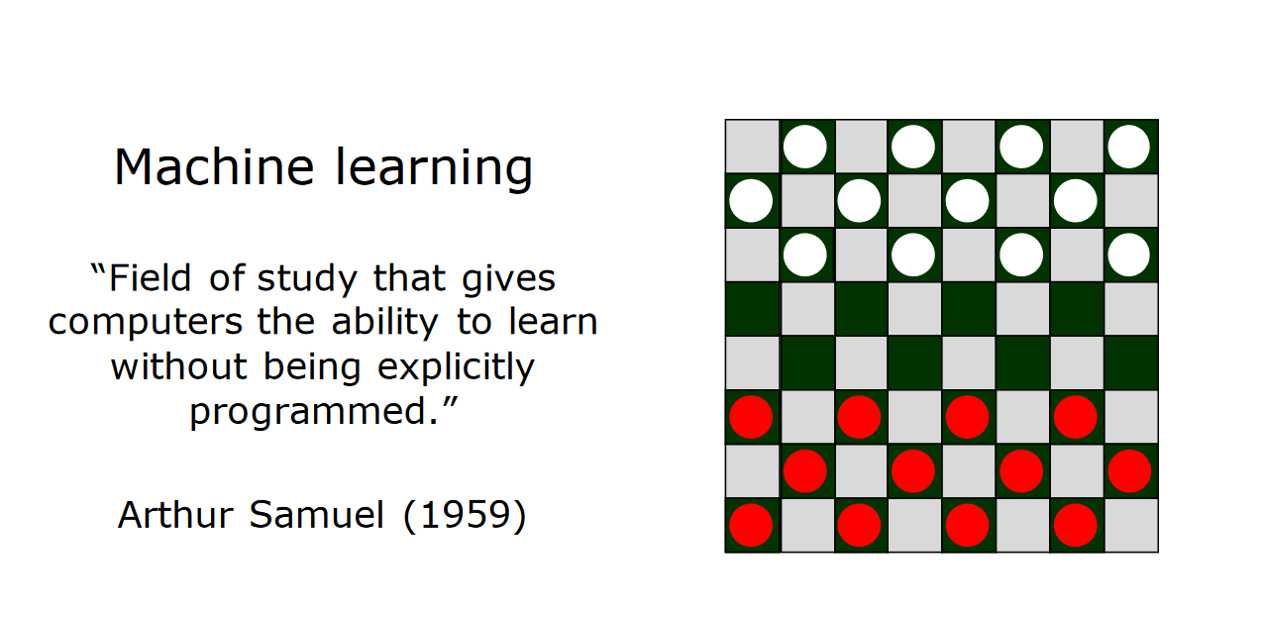

Slide 24
What if x3 is not important?
w1 * x1 + w2 * x2 + w3 * x3 = y

Slide 25
What if x3 is not important?
w1 * x1 + w2 * x2 + w3 * x3 = y
Simply set w3 = 0
w1 * x1 + w2 * x2 = y

Slide 26
Mother Law of Machine Learning
w1 * x1 + w2 * x2 + w3 * x3 = y

Slide 27
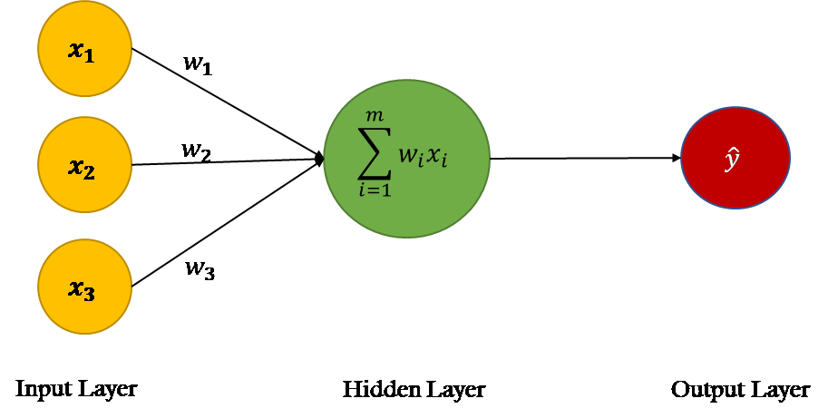
Mother Law of Machine Learning
w1 * x1 + w2 * x2 + w3 * x3 = y

Slide 28
Mother Law of Machine Learning
w1 * x1 + w2 * x2 + w3 * x3 = y

Slide 29
Mother Law of Machine Learning
w1 * x1 + w2 * x2 + w3 * x3 = y

Slide 30
Neural Network
w1 * x1 + w2 * x2 + w3 * x3 = y

Slide 31
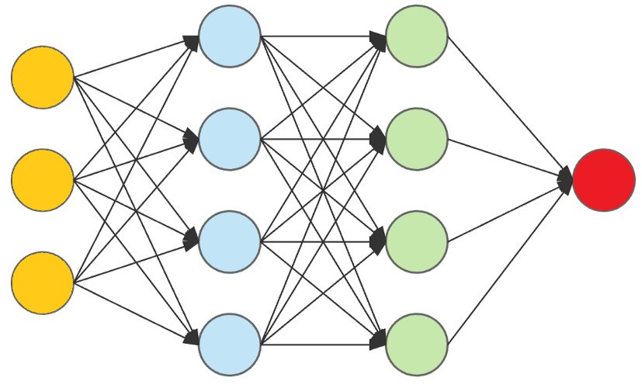
Neural Network

Slide 32
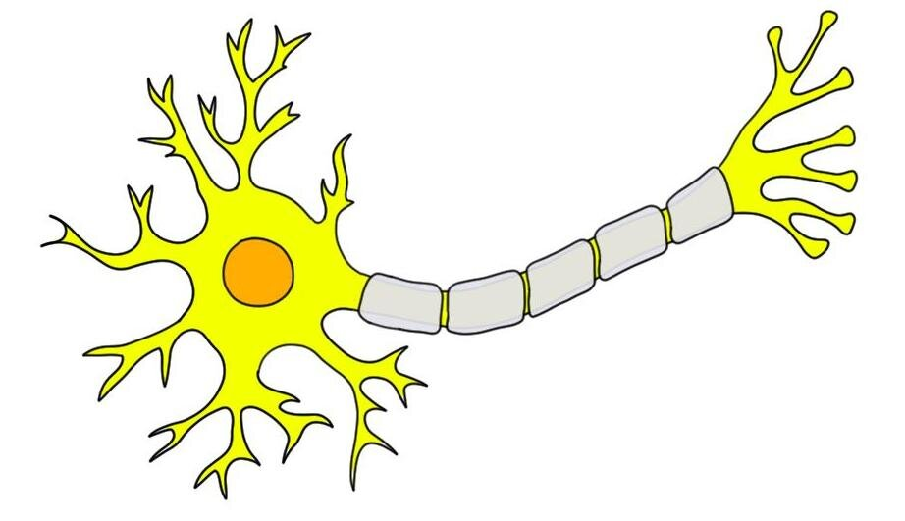
Human Brain
Decision
Informations

Slide 33
Machine Brain
Decision
Informations

Slide 34
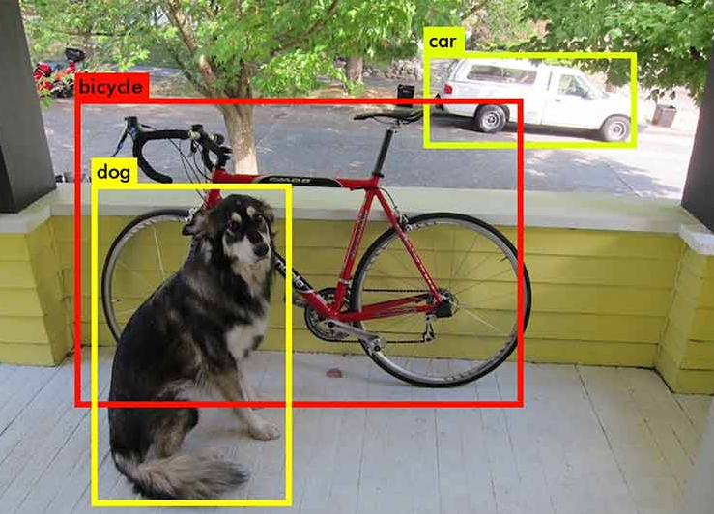
Next Class
CNN, Object Detection using Machine Learning

Slide 35
Thank You So Much

