Slide 1
Introduction to Control System Theory

Slide 2
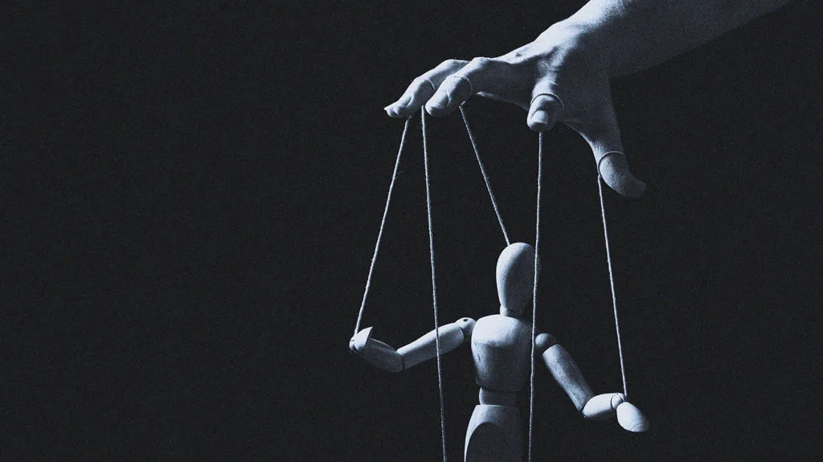
Control Theory

Slide 3
Control Theory
Definition: Control theory is a branch of engineering and mathematics that deals with the behavior of dynamical systems. It focuses on designing systems that can control the behavior of other systems to produce specific outputs.
Control theory develops mathematical models and algorithms to manipulate the behavior of systems, ensuring they operate as desired.

Slide 4
Control System
Controller
3 rad/sec
2.2 rad/sec

Slide 5
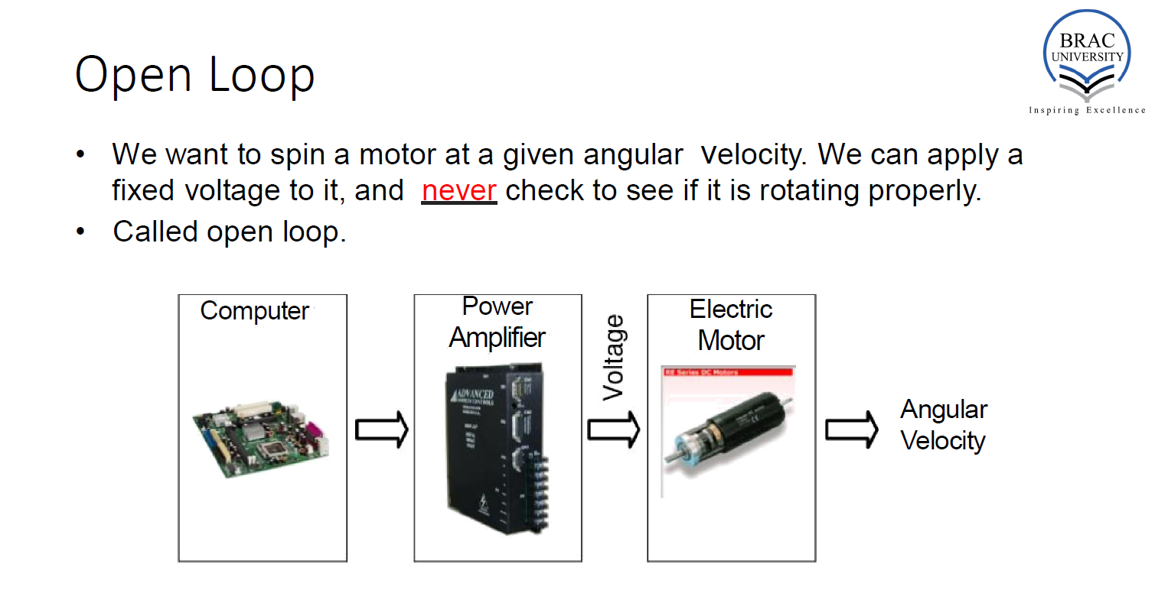

Slide 6
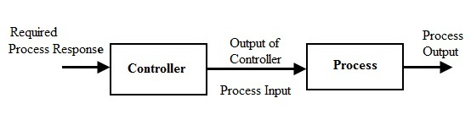

Slide 8
3 rad/s
2.2 rad/s

Slide 9
Required Velocity
Output Velocity
3 rad/s
2.2 rad/s

Slide 10
Open Loop Control
Required Velocity
Output Velocity
3 rad/s
2.2 rad/s

Slide 11
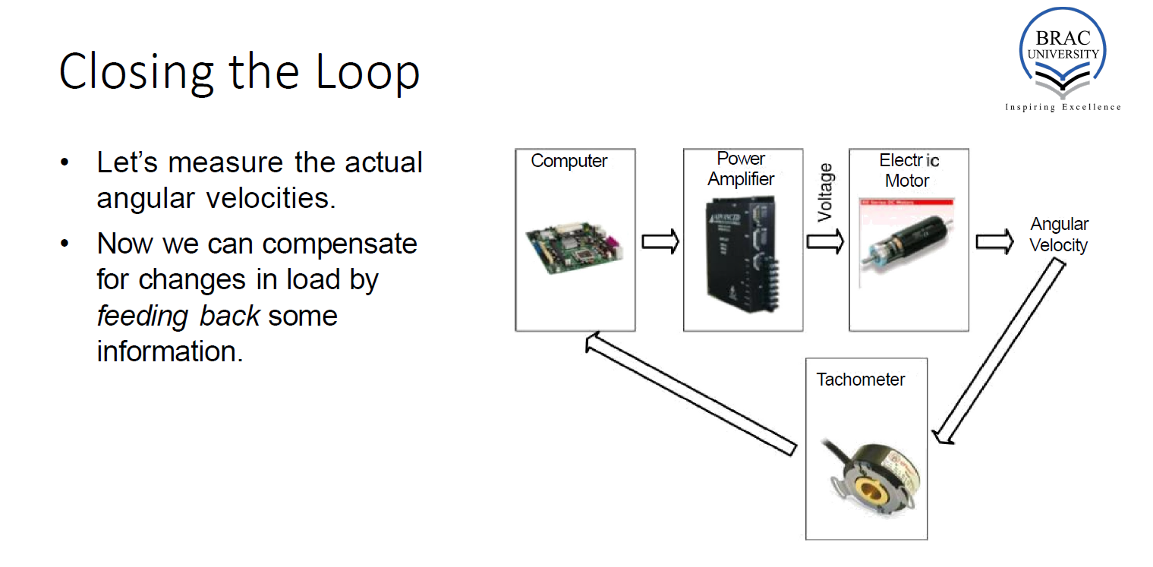

Slide 12
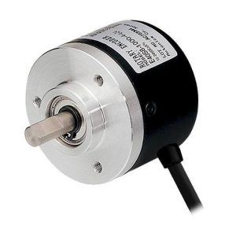
Let’s measure the actual angular velocities.
Now we can compensate for changes in load by feeding back some information.

Slide 13
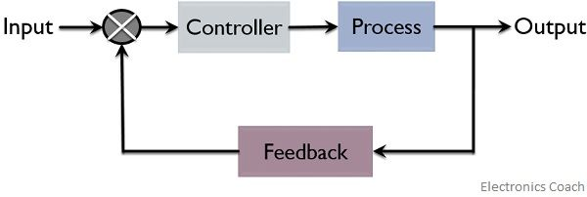
Closed Loop Control

Slide 14
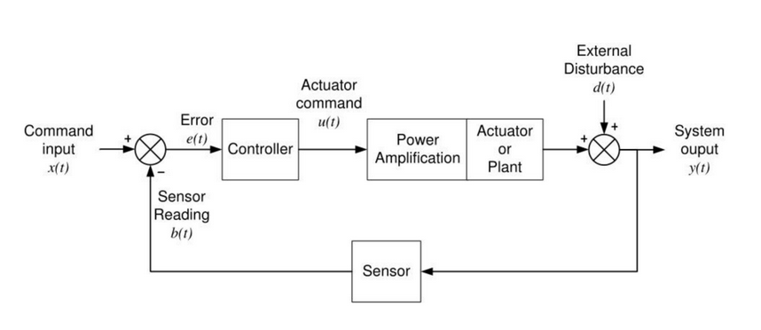
Feedback Diagram

Slide 15
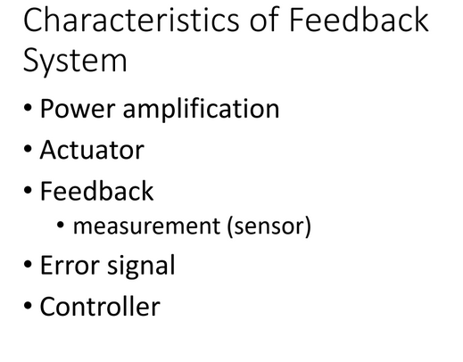

Slide 16
Components
Input: The signal or commands applied to the system.
Output: The response of the system to the input signals.
Controller: The component responsible for generating control signals based on the system's output and desired behavior.
Feedback: Information about the system's output that is fed back to the controller to adjust the control signals.

Slide 17
Theoretical Concepts
Feedback: Feedback involves using information about the output of a system to adjust the control input, thereby regulating the system's behavior.
Ex. Thermostat, measures the current room temperature(feedback), compares it to the desired temperature set by user, adjusts the heating or cooling.
Stability: Stability ensures that the system's response remains bounded over time, even in the presence of disturbances or changes in operating conditions.
Ex. balancing a pencil on the tip of a finger. Moving your finger slightly, the pencil wobbles but eventually return to its position. The pencil returns to equilibrium despite disturbances illustrates stability.

Slide 18
“How do we evaluate a system performance?”

Slide 19
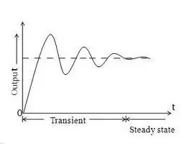

Slide 20
Performance Measures
Transient Response: refers to how a system behaves during the transition from one state to another after a change in inputs.
Ex. Turning on a light switch, the time it takes for the light to reach its steady state and any oscillations or overshoot during this transition represent the transient response of the lighting system.
Steady-State Response: Describes the behavior of the system once it has settled into a stable operating condition.
Ex. In an elevator system, when you press a floor button, the elevator initially accelerates, then moves at a constant speed, and finally decelerates as it reaches the desired floor.

Slide 21
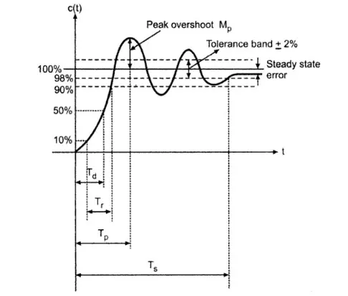
Key Transient Performance Metrics
1. Rise Time (T_{r}​)
Time taken for the response to rise from 10% to 90% of the final value
Indicates how fast the system responds
2. Peak Time (T_{p}​)
Time required to reach the first maximum peak of the response
Shows how quickly the system reaches its highest point
3. Maximum Overshoot (M_{p}​)
The amount by which the response exceeds the final value
Usually expressed as a percentage
Indicates system oscillation
4. Settling Time (T_{s})
Time required for the response to remain within a certain tolerance band (typically ±2% or ±5%) of the final value
Indicates how quickly the system stabilizes

Slide 22
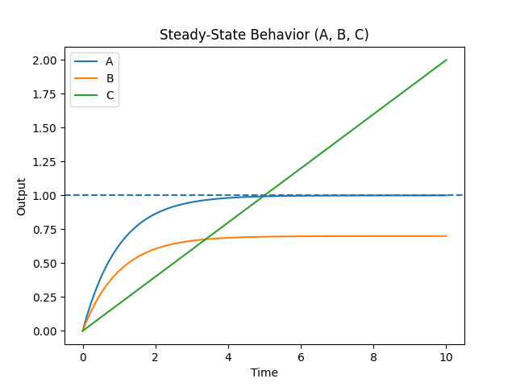
Key Steady-State Performance Metric
Steady-State Error (e_{ss}​)
The difference between the desired input and actual output as time approaches infinity
Indicates the accuracy of the system
Types of Steady-State Error
• Zero Error
Output exactly matches input
Ideal case
• Finite Error
Small constant difference remains
• Infinite Error
System cannot follow the input
Brain Strom: Identify the type of e_{ss}

Slide 23
Example 1
Situation: Drone Stabilization / Self-Balancing Robot
A drone suddenly tilts due to wind
The controller must quickly correct orientation
What Behaviour Do you Expect for this system
Desired Characteristics:
Low Rise Time (Tr) → fast reaction
Low Peak Time (Tp) → quick correction
Some overshoot is acceptable (small oscillation OK)
“If the system reacts slowly, the drone may crash.”

Slide 24
Example 2
Situation: Radioactive Decay / Drug Release / Chemical Degradation
A substance decays over time (e.g., half-life process)
You do NOT want sudden change
What Behaviour Do you Expect for this system
Desired:
High rise time (slow change)
Smooth exponential decay
No oscillation
Stability over long time
“If decay happens too fast, the system becomes uncontrollable or useless.”

Slide 25
Observation
Different systems require different behaviors
Some need fast response
Some need smooth and stable response
Performance depends on:
Rise Time
Overshoot
Settling Time
Steady-State Error
Key Idea
We need a way to adjust and control these parameters
So that the system behaves according to our requirements
Solution
We introduce a Controller
A controller modifies the system input
It helps achieve:
Faster response
Reduced overshoot
Better stability
Improved accuracy
Problem
These parameters are not fixed
The system may not naturally behave as desired
One of the famous controller is PID.

Slide 26
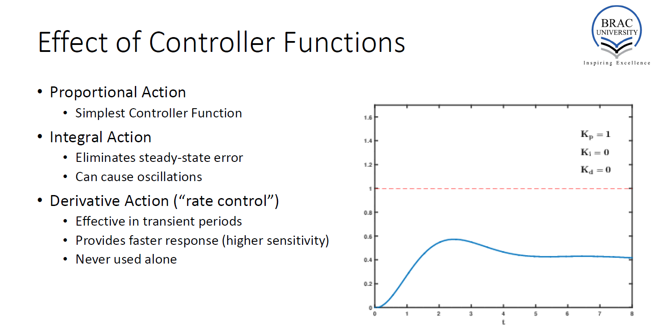

Slide 27
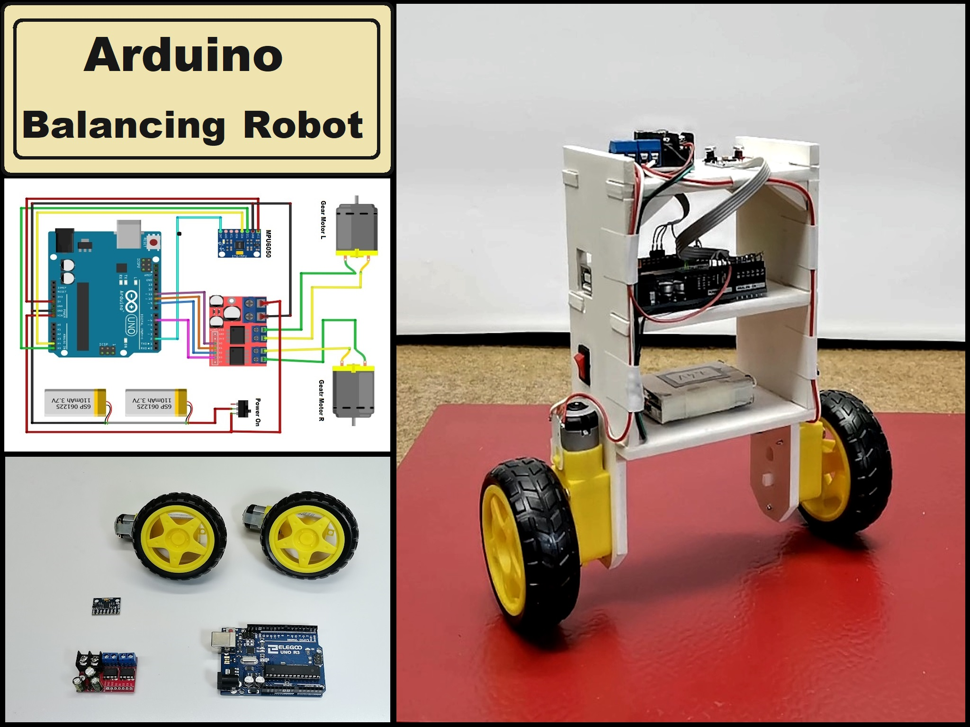
Consider a System

Slide 28
Challenges
Key Idea
We need a simple and structured representation That shows:
Input
Output
Relationships between components
How do we:
Visualize the system?
Understand signal flow?
Analyze behavior?
Design controllers?
Solution
Use a Block Diagram
Represents system components as blocks
Shows how signals flow between them
Helps in:
Analysis
Design
Simplification

Slide 29
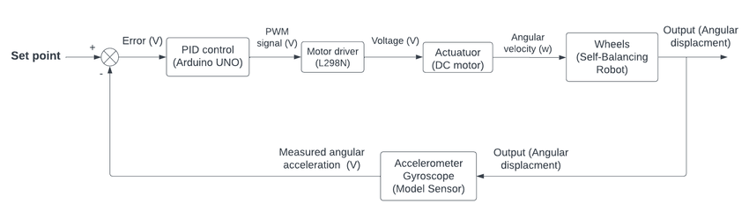

Slide 30
From Block Diagram to Mathematics
Now we have a visual model…
but engineers don’t just look at diagrams —
we need a way to analyze and compute behavior.
Therefore, the first question is -
How do we predict the output from the input?

Slide 31
Gain
G(t)
X(t)
Input
Y(t)
Output
Y(t) = X(t)*G(t)
Y(t)/X(t) = G(t)
Gain = Y(t)/X(t)= Output/Input
Gain tells us how strongly the system reacts to the input.
By changing the gain, we can change the system behavior.
That means we can influence the performance measures such as rise time, overshoot, settling time, and steady-state error.

Slide 32

For the SELF Balancing ROBOT
By using only P-controller (K_{p}), we can get the Equation of the system,
Let Say after solving the SELF BALANCING ROBOT we get the GAIN
Here, by changing the K_{p} value, we can change the Gain. Hence, the behaviour of the system.

Slide 33


Limitations of Time-Domain Analysis
What we have been doing
We analyze system behavior in time domain
Solve differential equations
Observe response: rise time, overshoot, settling time
Problem 1: Hard to Solve
We model systems using differential equations
Example:
For each K_{p}, we must solve again
The process is repetitive and time-consuming
Problem 2: Noise & Sensor Issues
Example:
IMU sensor gives:
Actual tilt
vibration noise (Have Frequency A)
small disturbances (Have Frequency B)
In time domain:
Everything looks mixed
Hard to separate real motion vs noise

Slide 34
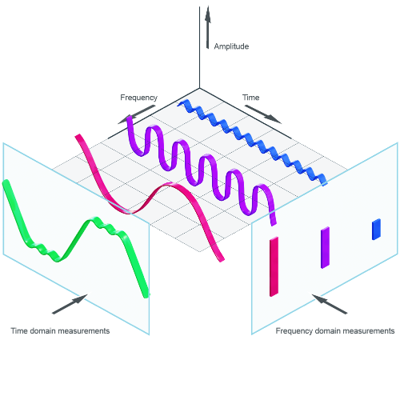
Time Domain to Frequency Domain

Slide 35
Time Domain to Frequency Domain

Slide 36
x(t)
x(s)
Laplace Transform

Slide 37
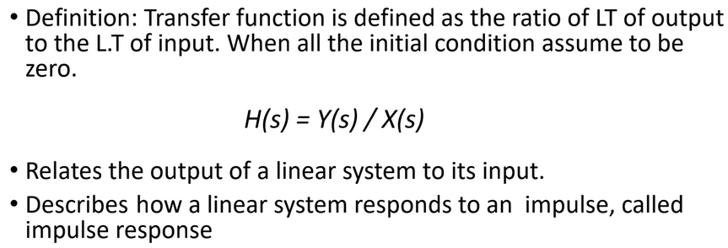
Gain Becomes Transfer Function
H(s)
X(s)
Input
Y(s)
Output

Slide 38
Next Class
Block Diagram Solving

Slide 39
Thank You

