Slide 1
Big Brain of Robot
Brac University
Notes:
How Does a Robot Think?
How can a robot make decisions like humans?

Slide 2
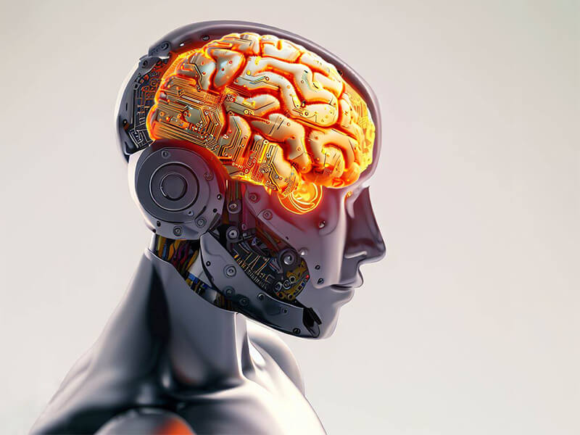
Robot with Brain

Slide 3
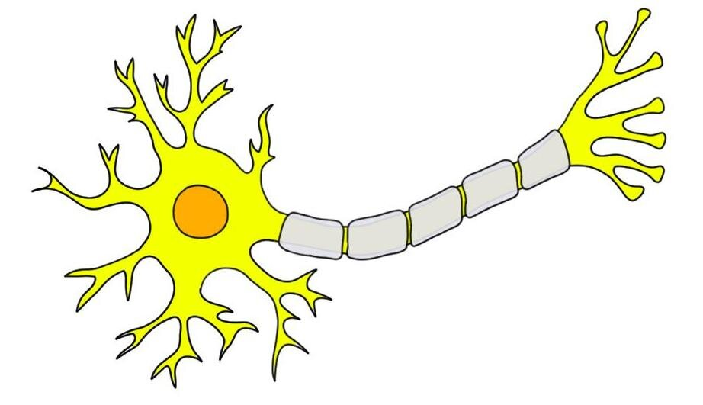
Inspired by the Human Brain
Decision
Informations
Neurons process signals
Connections = learning
Reference: McCulloch & Pitts (1943 neuron model)

Slide 4
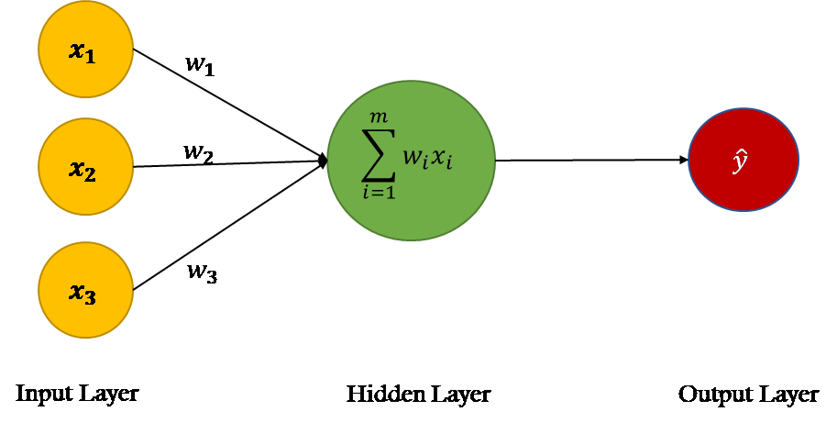
Artificial Neuron

Slide 5
Artificial Neuron

Slide 6

Machine Learning
Machine learning is the scientific study of algorithms and statistical models that computer systems use to perform tasks without explicit instructions. It is broadly defined as the capability of a machine to imitate intelligent human behavior.

Slide 7
Mother Law of Machine Learning
w1 * x1 + w2 * x2 + w3 * x3 = y
So there are 3 inputs
3 corresponding weights
If the input number is n.
How many weights will be there?
n

Slide 8
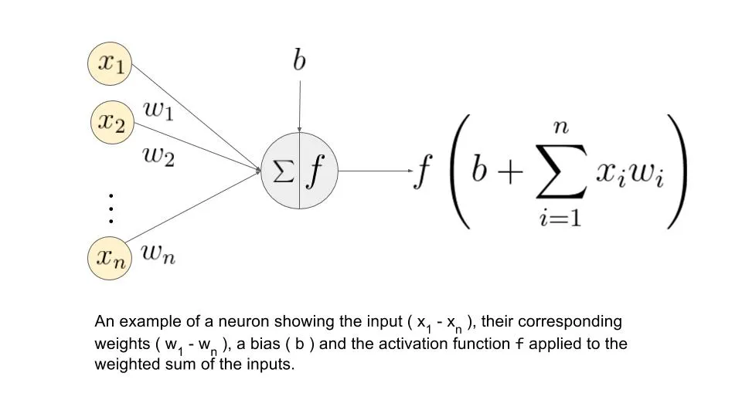
Mother Law of Machine Learning
Neuron Output = ∑w_{i} x_{i}
Good to Know: In practice, neural networks include two additional components. (i) Bias: an extra input with a fixed value x₀= 1, which has its own weight w₀​. This allows the neuron output to shift (acts like a threshold). (ii) Activation Function: the neuron output is passed through a function f(⋅) (e.g., ReLU, sigmoid) to introduce non-linearity.
For simplicity, in this course we will ignore both bias and activation functions and focus only on the linear model. The right figure shows the neurons that are implemented practically.

Slide 9
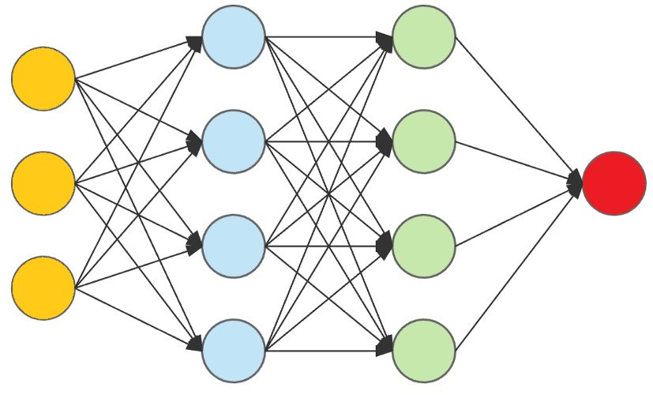
Neuron Connections

Slide 10
Fun: Neuron Connections
How many hidden layers are there?
How many weights are in the network?
Two Hidden layers
From input to first hidder layer : 4 + 4 + 4 = 4 * 3 = 12
From 1st hidden layer to second hidden layer: 4 + 4 + 4 + 4 = 4 * 4 = 16
From 2nd hidden layer to output layer: 1 + 1 + 1 + 1 = 4 * 1 = 4
3 * 4
+
4 * 4
+
4 * 1
= 32

Slide 11
Robot’s Brain
Decision
Informations

Slide 12
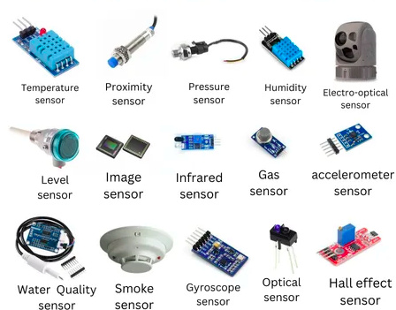
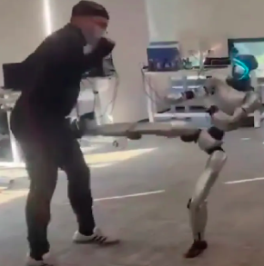
Neural Network with Real World

Slide 13

Problem: How to Find Weights?
Manually Impossible
Need an Automatics Process to find all weight values.
This Automatics Process is named Learning
How do we learn:
Studying
Excercise
etc
For robotics we named this process: Training
Notes:
Manually impossible
Need automatic learning

Slide 14
Types of Learning
Supervised: Learns a mapping from inputs to outputs using labeled data.
Unsupervised: Finds patterns or structure in data without any labels.
Semi-supervised: Uses a small amount of labeled data along with a large amount of unlabeled data to learn.
Reinforcement Learning: Learns actions by interacting with an environment to maximize cumulative reward.
But our focus will be in supervised learning
Notes:
But our focus will be in supervised and unsupervised

Slide 15
Example
Tumor Size | Condition
10 | malignant
2 | benign
1 | benign
5 | malignant
Notes:
But our focus will be in supervised and unsupervised

Slide 16
Example
Tumor Size | Condition
10 | malignant
2 | benign
1 | benign
5 | malignant
Notes:
But our focus will be in supervised and unsupervised

Slide 17
Example
Tumor Size | Condition
10 | malignant
2 | benign
1 | benign
5 | malignant
Notes:
But our focus will be in supervised and unsupervised

Slide 18
Example
Tumor Size | Condition
10 | malignant
2 | benign
1 | benign
5 | malignant
4
Notes:
But our focus will be in supervised and unsupervised

Slide 19
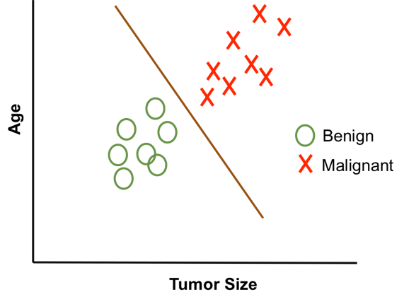
Example (Cont.)
Tumor Size | Age | Condition
10 | 50 | malignant
2 | 30 | benign
1 | 45 | benign
5 | 40 | malignant
Notes:
But our focus will be in supervised and unsupervised

Slide 20
Example (Cont.)
Tumor Size | Age | Condition
10 | 50 | malignant
2 | 30 | benign
1 | 45 | benign
5 | 40 | malignant
0.9*10 + 0.1*50 = 9 + 5 = 14
Notes:
But our focus will be in supervised and unsupervised

Slide 21
Example (Cont.)
Tumor Size | Age | Condition
10 | 50 | malignant
2 | 30 | benign
1 | 45 | benign
5 | 40 | malignant
0.9*10 + 0.1*50 = 9 + 5 = 14
0.9*2 + 0.1*30 = 1.8 + 3 = 4.8
0.9*1 + 0.1*45 = 0.9 + 4.5 = 5.4
0.9*5 + 0.1*40 = 4.5 + 4 = 8.5
Notes:
But our focus will be in supervised and unsupervised

Slide 22
Example (Cont.)
Tumor Size | Age | Condition
10 | 50 | malignant
2 | 30 | benign
1 | 45 | benign
5 | 40 | malignant
0.9*10 + 0.1*50 = 9 + 5 = 14
0.9*2 + 0.1*30 = 1.8 + 3 = 4.8
0.9*1 + 0.1*45 = 0.9 + 4.5 = 5.4
0.9*5 + 0.1*40 = 4.5 + 4 = 8.5
6.5
Notes:
But our focus will be in supervised and unsupervised

Slide 23
Example (Cont.)
Tumor Size | Age | Condition
10 | 50 | malignant
2 | 30 | benign
1 | 45 | benign
5 | 40 | malignant
Tumor Size = 9
Age = 42
0.9*9 + 0.1*42 = 8.1 + 4.2 = 12.3
6.5
Notes:
But our focus will be in supervised and unsupervised

Slide 24
x1
x2
y
Tumor Size | Age | Condition
10 | 50 | malignant
2 | 30 | benign
1 | 45 | benign
5 | 40 | malignant
w1 * x1 + w2 * x2 = y
x1, x2, ....., xn = Features
y = output/ target
w1, w2, ....., wn = Weights
Weights are giving the importance to a feature
Notes:
But our focus will be in supervised and unsupervised

Slide 25
Another Type of Example
Size(sq-feet) | Bedroom | Kitchen | Main road | Balcony | Price(dollar)
1600 | 4 | 1 | 0.2 | 2 | 20000
1400 | 3 | 1 | 0.5 | 1 | 12000
1600 | 2 | 1 | 0.2 | 2 | 10000
2000 | 4 | 2 | 0.1 | 3 | 43000
Here what are the features and output?
Can you say, intituvelty which one has maximum weight among the features

Slide 26
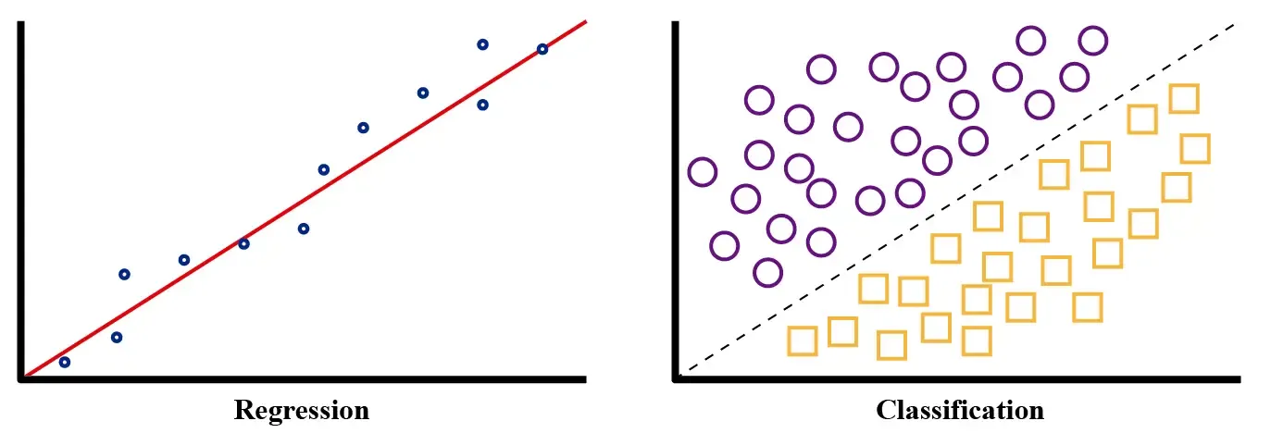
Type of Problems
The First type was we were classifying a type of output (Discrete Output): Classification
Previous Example we were predicting a value (Continuous Output): Regression

Slide 27
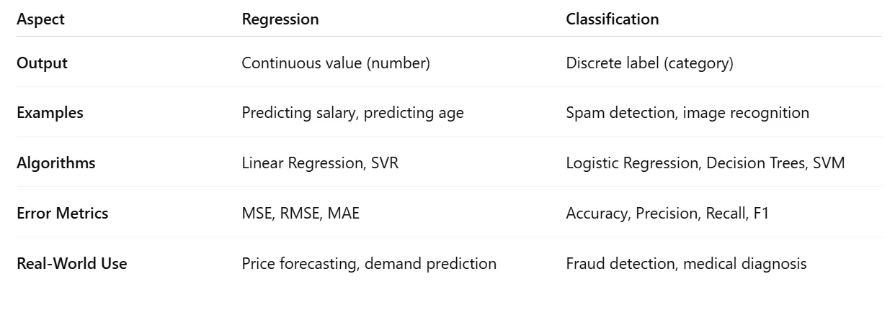
Type of Problems

Slide 28
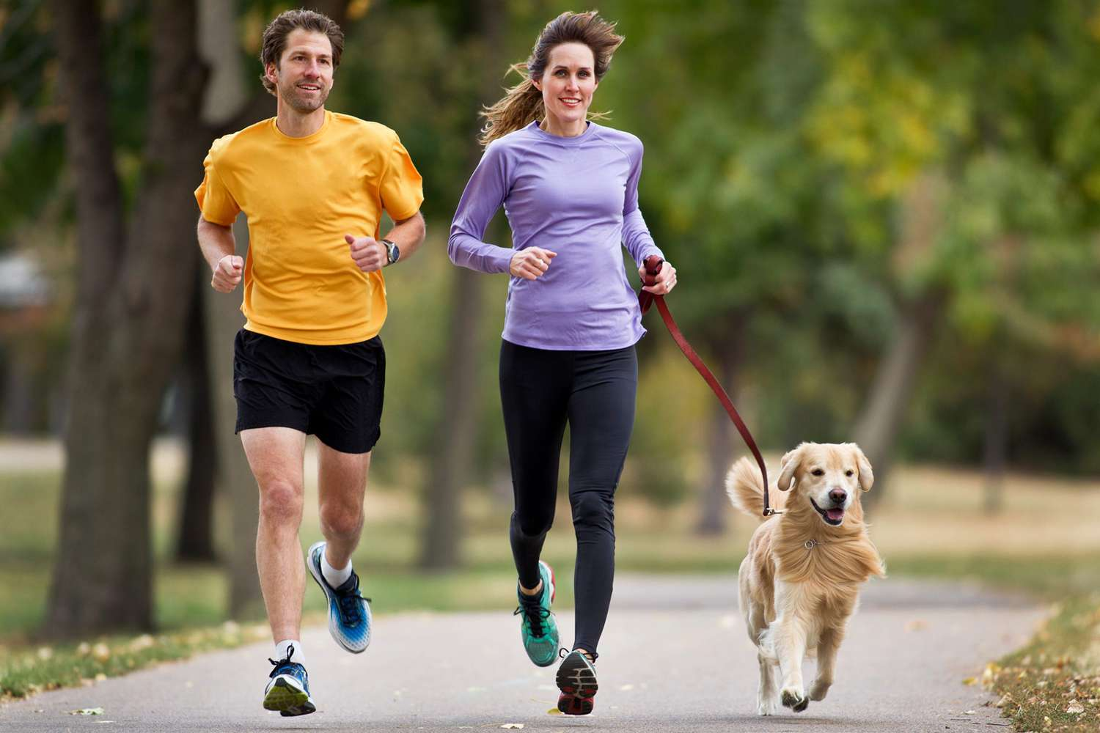
Input: Image

Slide 29
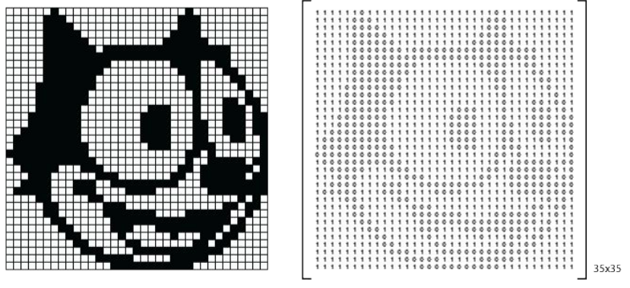
Input: Image

Slide 30
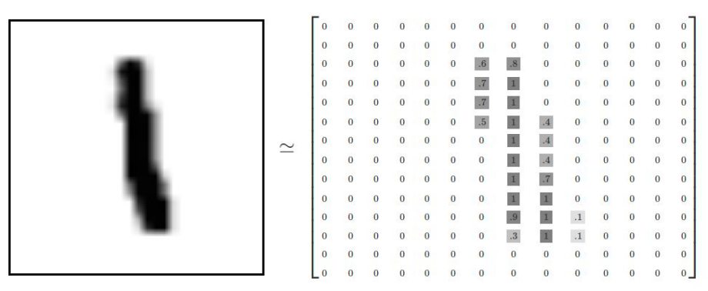
Input: Image

Slide 31
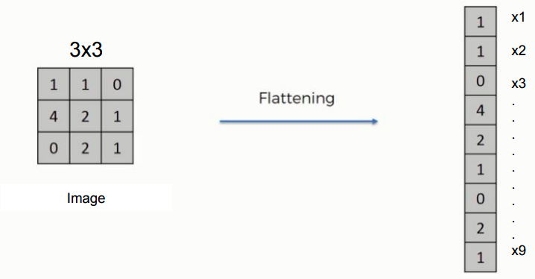
Flattening
Converting a 2D matrix into the single vector

Slide 32
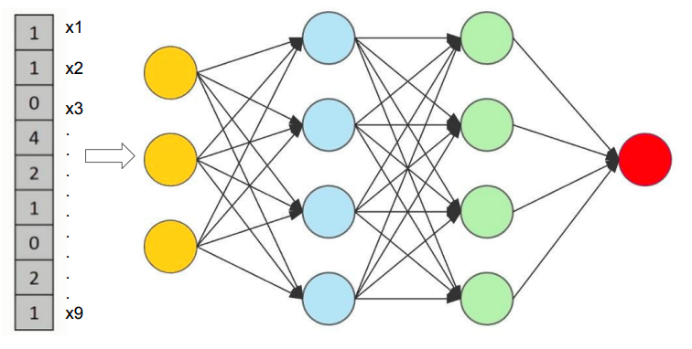
Pixels as Features

Slide 33
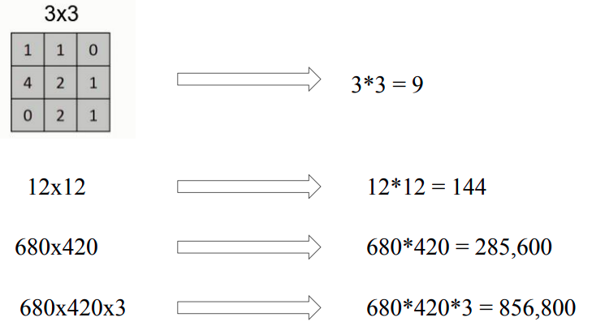
Problem with “Pixels as features”
Too many features → huge computation

Slide 34
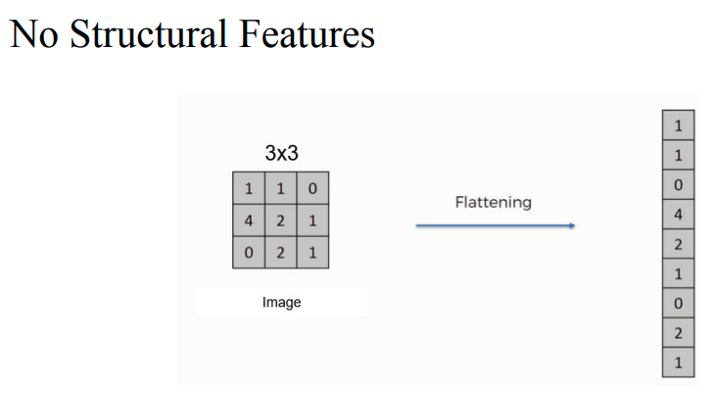
Problem with “Pixels as features”
Loses spatial structure and nearby pixels relationship ignored

Slide 35
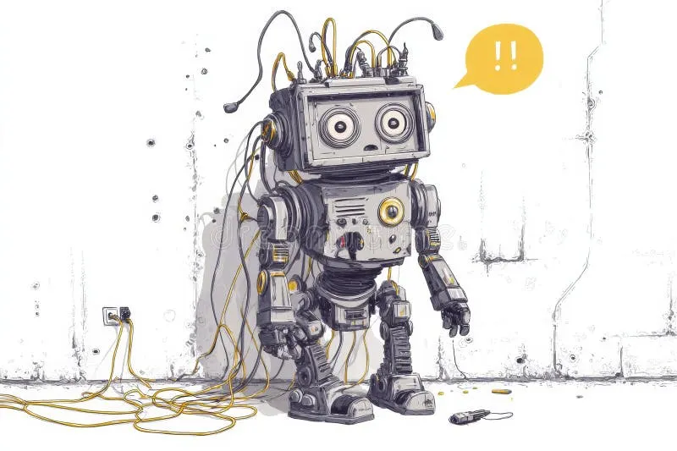
This is BAD for robots trying to understand images.

Slide 36
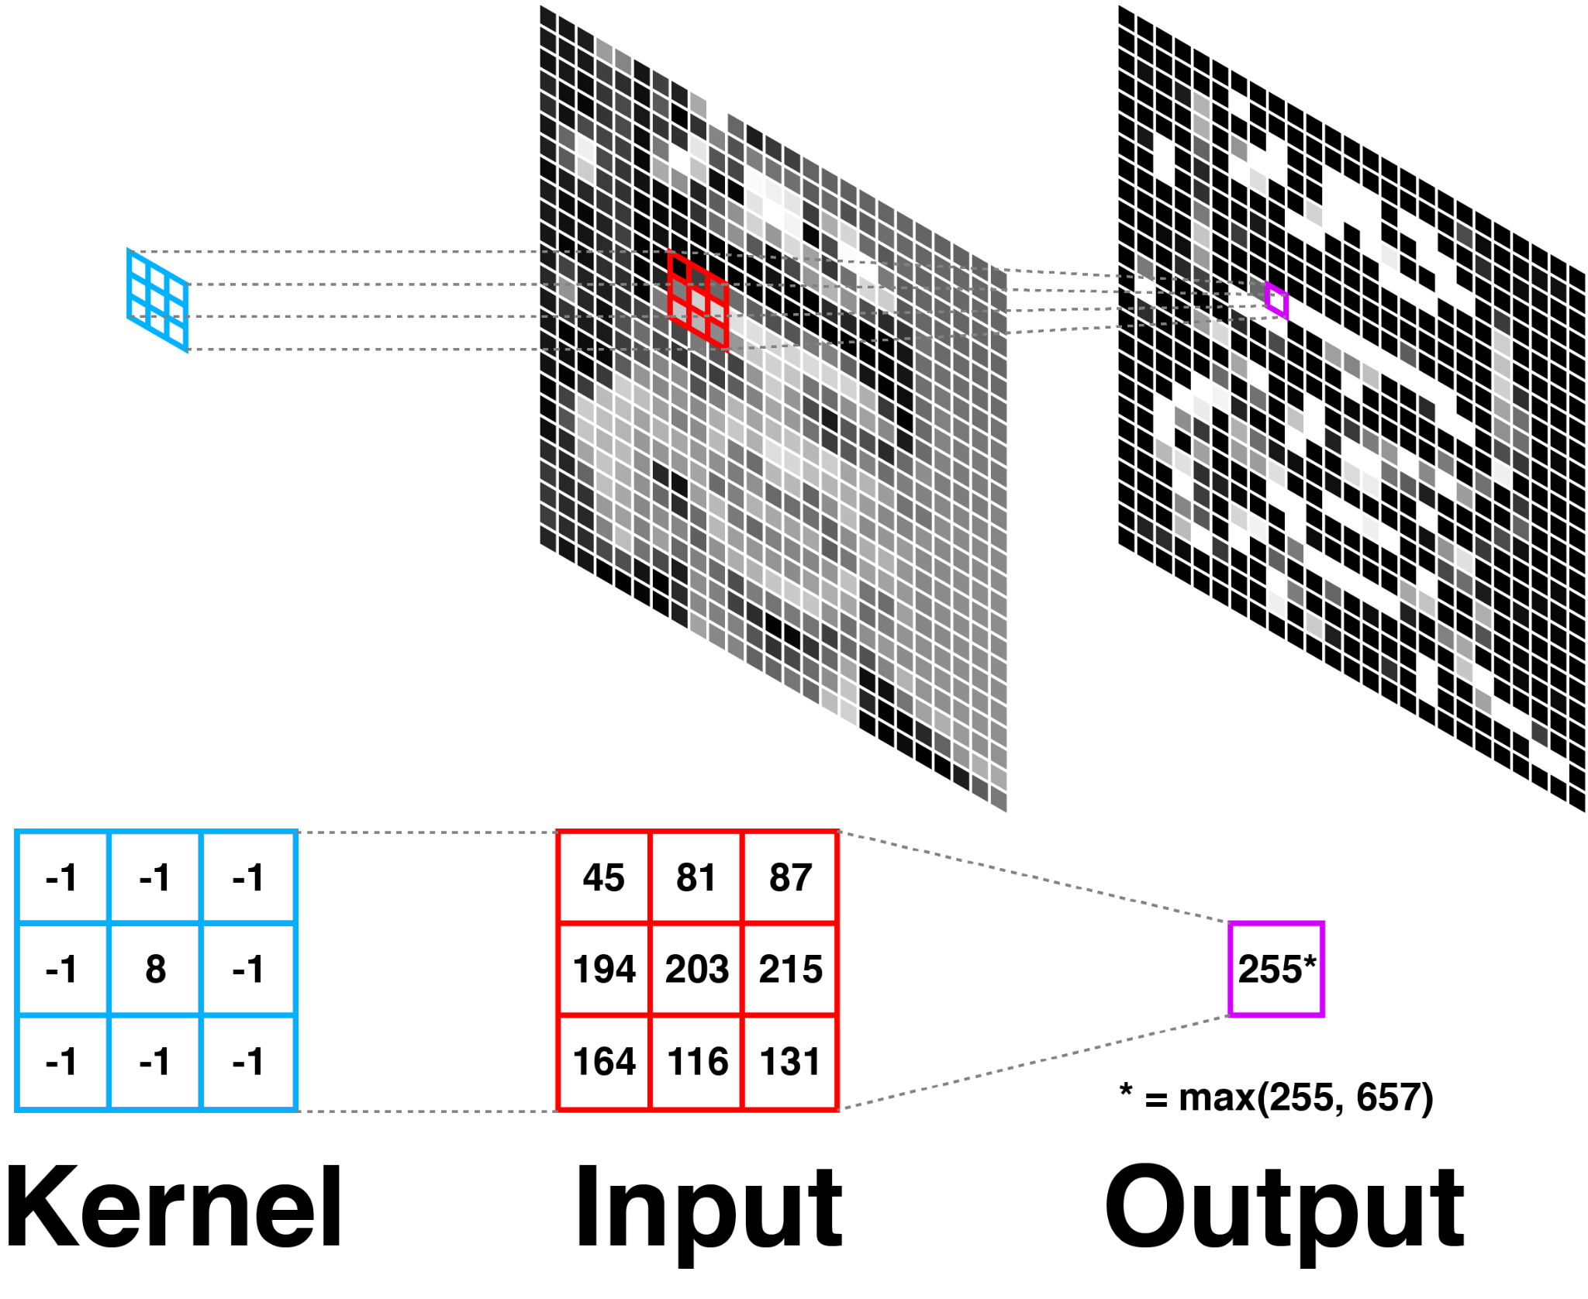
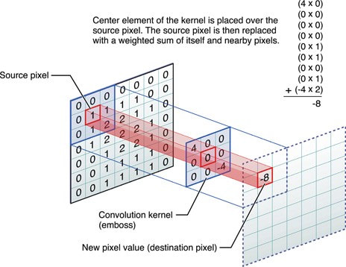
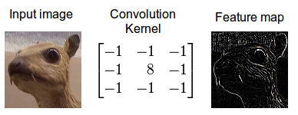
Problem Solver: Convolution

Slide 37
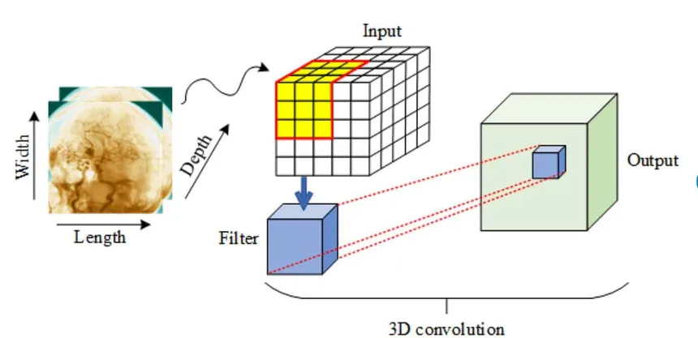
Convolution
Instead of looking at the whole image at once, we look at small regions
Step-by-step operation:
Use a small filter (kernel)
Slide it across the image
Extract features like:
edges
textures
shapes
This mimics how humans process vision.
Benefits:
Preserves spatial relationships
Reduces parameters
Extracts meaningful features

Slide 38
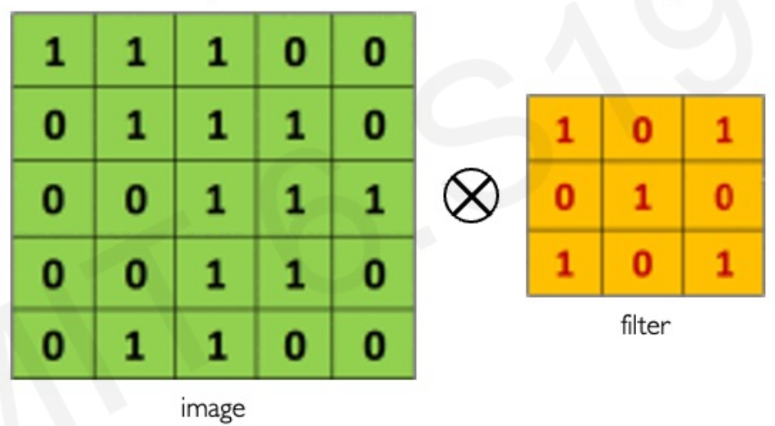
Convolution Operation

Slide 39
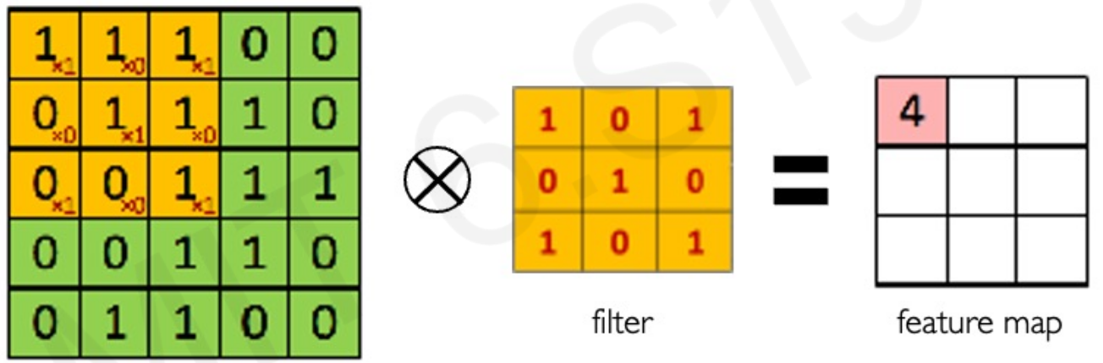
Convolution Operation

Slide 40
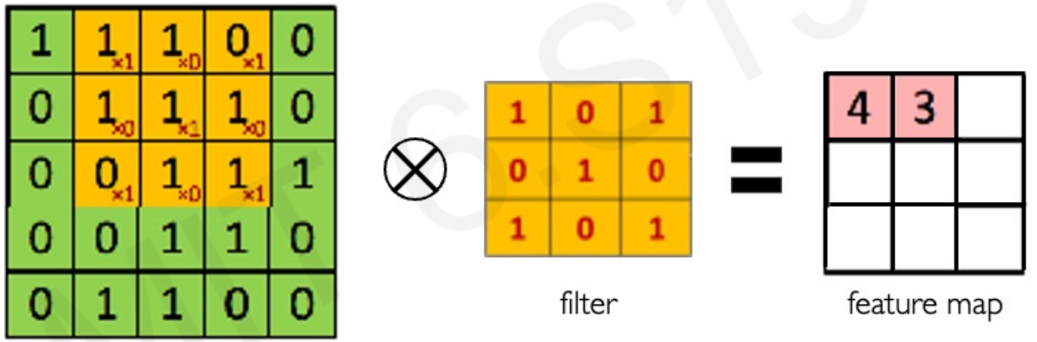
Convolution Operation

Slide 41
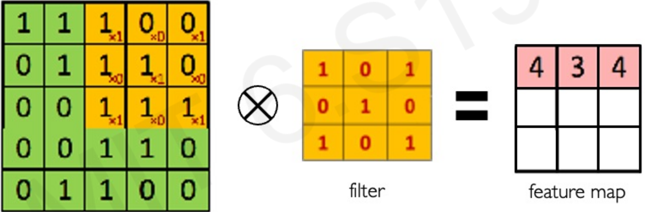
Convolution Operation

Slide 42
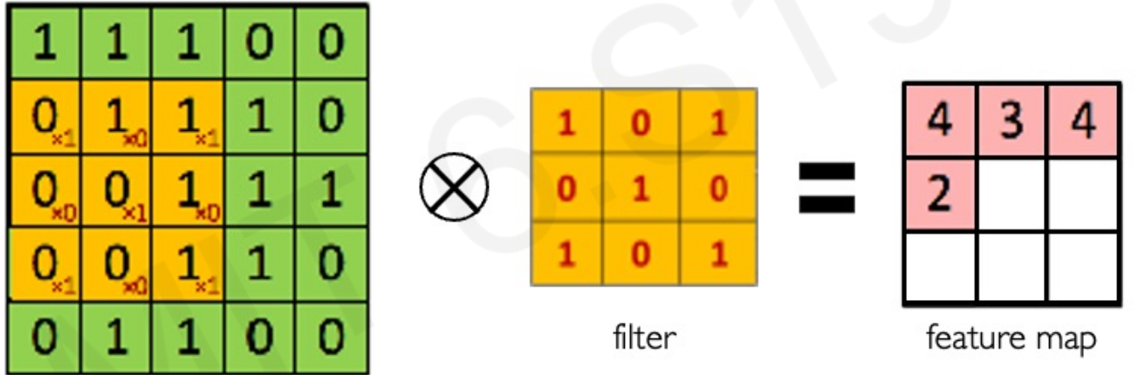
Convolution Operation

Slide 43
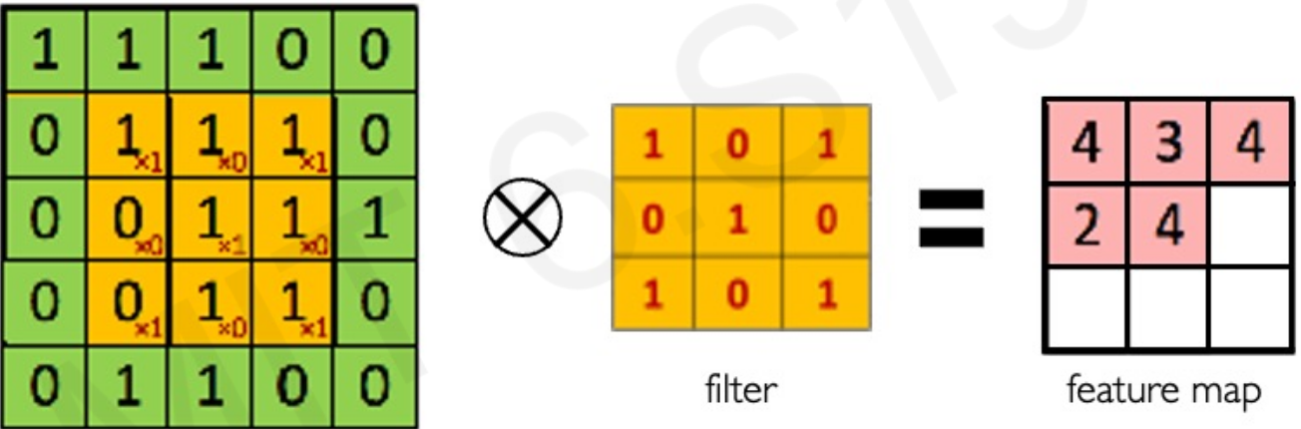
Convolution Operation

Slide 44
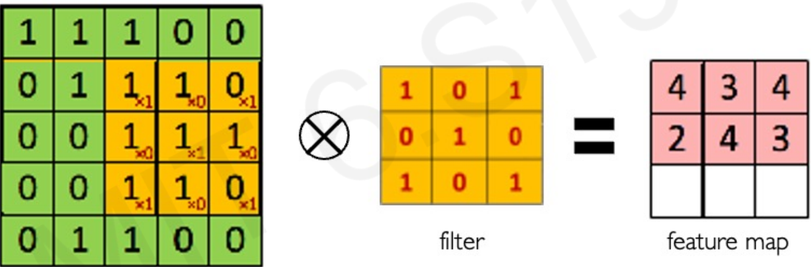
Convolution Operation

Slide 45
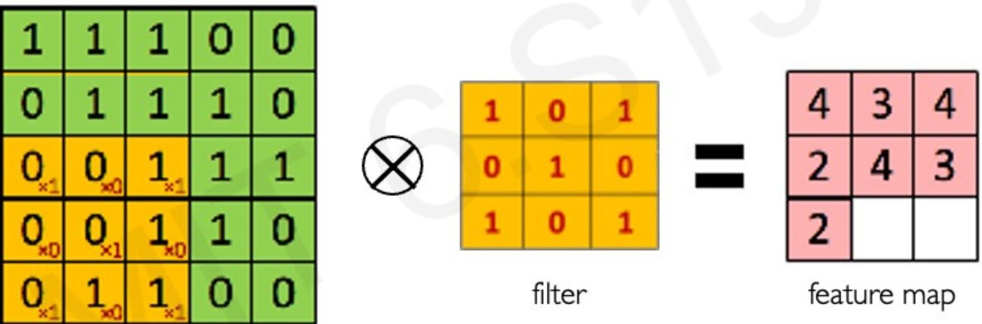
Convolution Operation

Slide 46
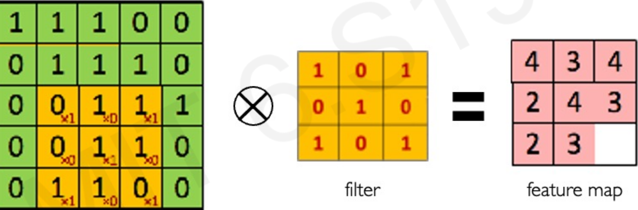
Convolution Operation

Slide 47
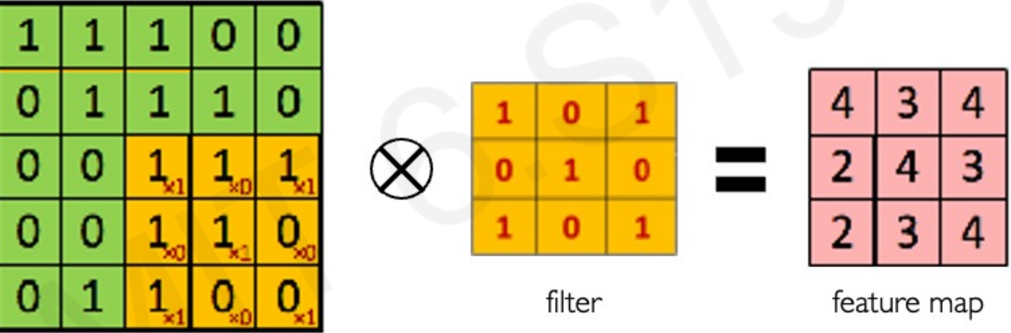
Convolution Operation

Slide 48
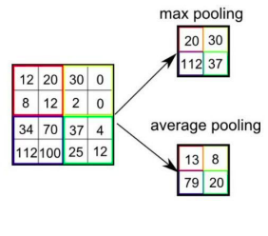
Pooling Operation
Used for reducing the number of parameters in case of large images
Also called Subsampling or Down sampling
Retains major information
Max pooling and average pooling are two types of pooling that are used

Slide 49
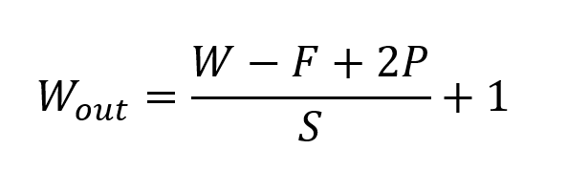
Output Dimension after Operations
W = Width of the image (any direction)
F = Filter Size
P = Padding
S = Stride
Reference: https://towardsdatascience.com/convolutional-neural-networks-explained-9cc5188c4939/

Slide 50
Stride
A hyperparameter that defines the number of pixels by which the convolutional filter (kernel) moves across the input image after each operation.
Default is (1, 1) - moves 1 pixel at a time.

Slide 51
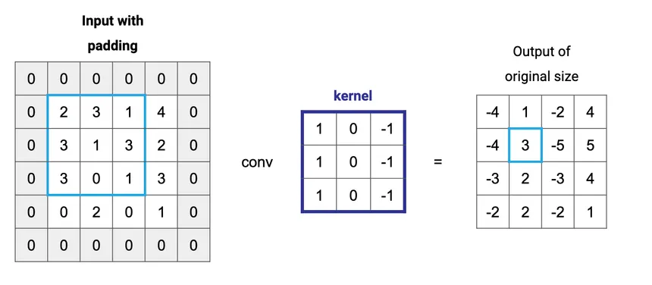
Padding
The process of adding extra pixels, typically zeros, around the border of an input image or feature map before applying a convolution operation.
Primarily used to
control the spatial dimensions of the output
preserve information at the edges that would otherwise be lost due to the filter sliding over the input boundaries

Slide 52
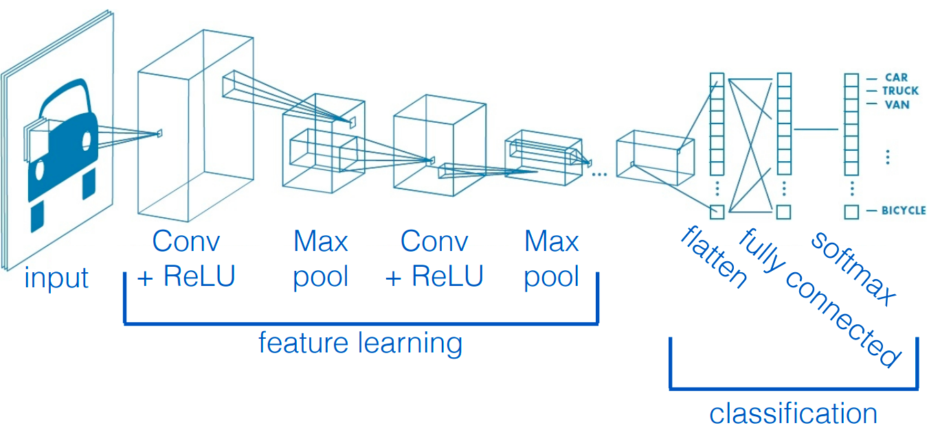
Convolution Neural Network (CNN)

Slide 53
Convolution Neural Network (CNN)

Slide 54
Convolution Neural Network (CNN)

Slide 55
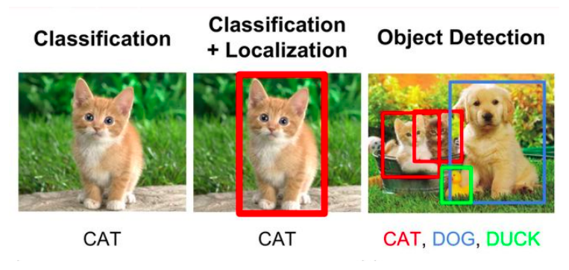
CNN Application

Slide 56
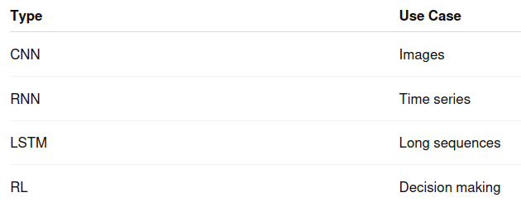
Network Types Summary
And So many….., as the time is evolving, you can find more advanced networks.
For an example, the LLM’s(GPT) are type of Transformer Networks.

Slide 57
