Slide 1
Informatics ECR event
@International Student House
18-19 January 2024

Slide 2
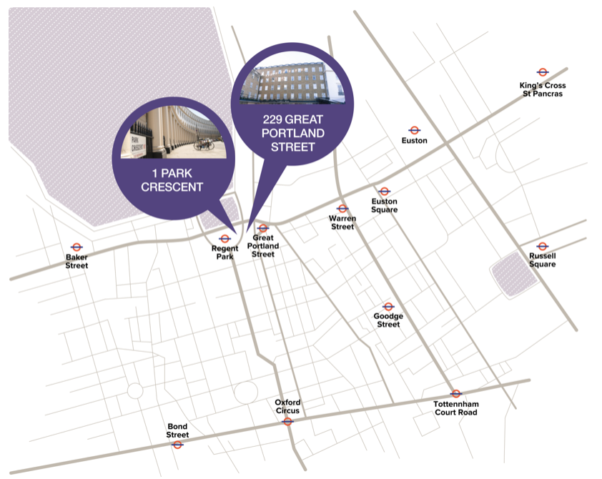
Venue
Main room (talks+dinner)
coffee/tea breaks in the room
Hybrid set-up: online speakers will have to connect 15 min. in advance
Computer + spare with all presentations
Lunch/poster room
VENUE 2
Lunch
Possibly we can make use of a kitchen area behind the room to have lunch served → more space
Poster boards will be removed & stored overnight
Poster area

Slide 3
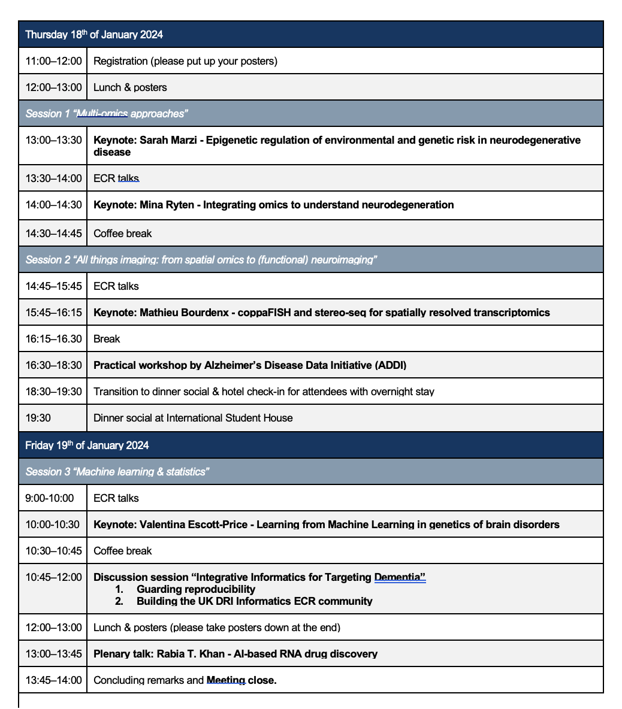
Time schedule
Poster board delivery @9am → Christina (& Abbey?) present
ADDI will sponsor a 100GBP prize for best poster (1x) and best ECR talk (1x)
Pick up poster boards @2.30pm
Portland room will be set up for dinner; remaining attendees have the option to get a drink at the Thirsty Scholar (ISH bar) or to get some fresh air in Regent’s park if the weather allows for it!

Slide 4
ADDI workshop
Demo of the workbench
Time to play around with available data (non-DRI) & questions
Test on Thursday the 11th of January 4-6pm:
Online: ADDI team (Ankit, Mukta, Monica & Graham), …
On-site: Christina, Dave (dropping in later), Charlotte (?), Maryam (?),…

Slide 5
Discussion session “Integrative Informatics for Targeting Dementia” (75 min. host: Steve)
Exploring reproducibility
5-10 min. kick-off talk: Mateus → provide context for 6 questions
1 question per table to start with → 10 min. group discussion
Aim: instead of a top-down instructive, laying out options/everyone’s experiences
Table leader can use QR code to access and update Google Doc with discussion notes (Charlotte will keep it tidy)
2. Building the UK DRI Informatics ECR community
5-10 min. kick-off talk: Amonida
Structure in same way as topic

Slide 6
Poster/talk judging
Everyone ranks 1,2,3 for poster & talk
Use slido for this, display only top 3
Remind people of keeping their top 3 in mind for voting on the last day!

Slide 7
What comes next?
New committee member? (replacement for Dave)
GitHub page UKDRI
Amonida is transitioning DRI wiki to GitHub page
Community discussion:
New events?
Hackathon? → DEMON
Training? → DEMON

