Slide 1
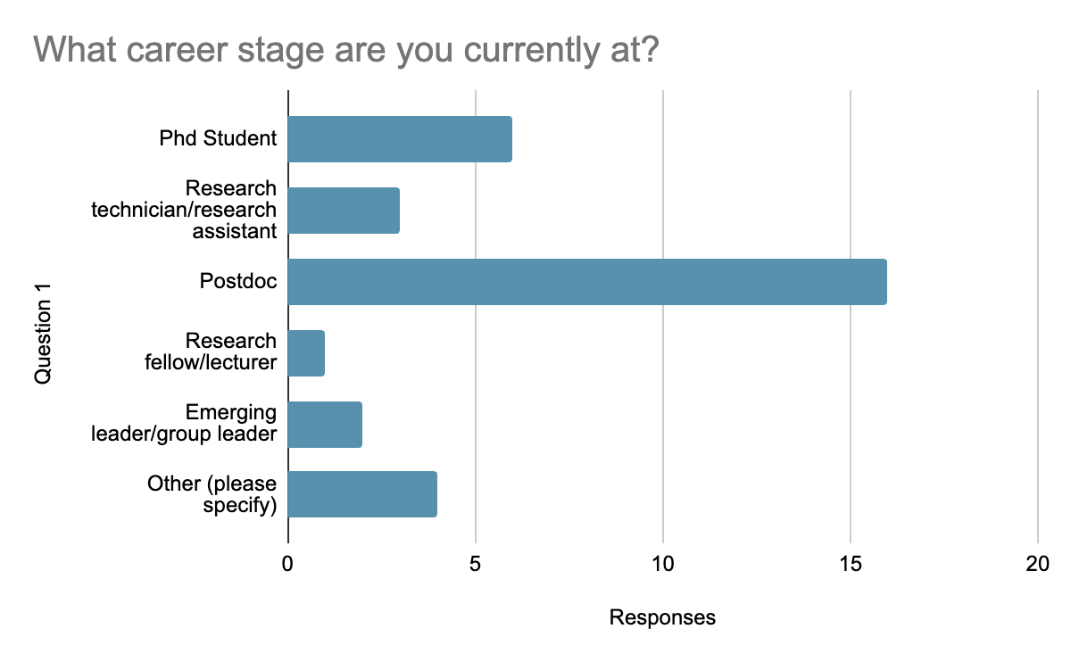
Attendees
Other: software dev, Master’s student, Platform lead

Slide 2
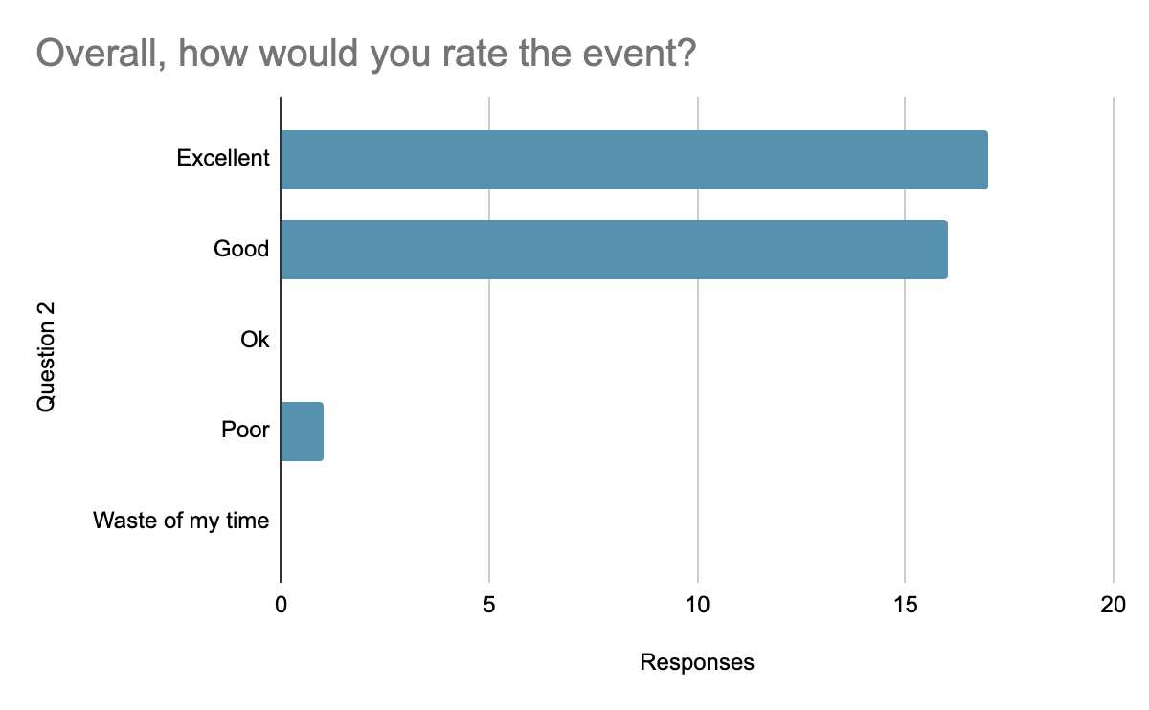
Overall rating ☺

Slide 3
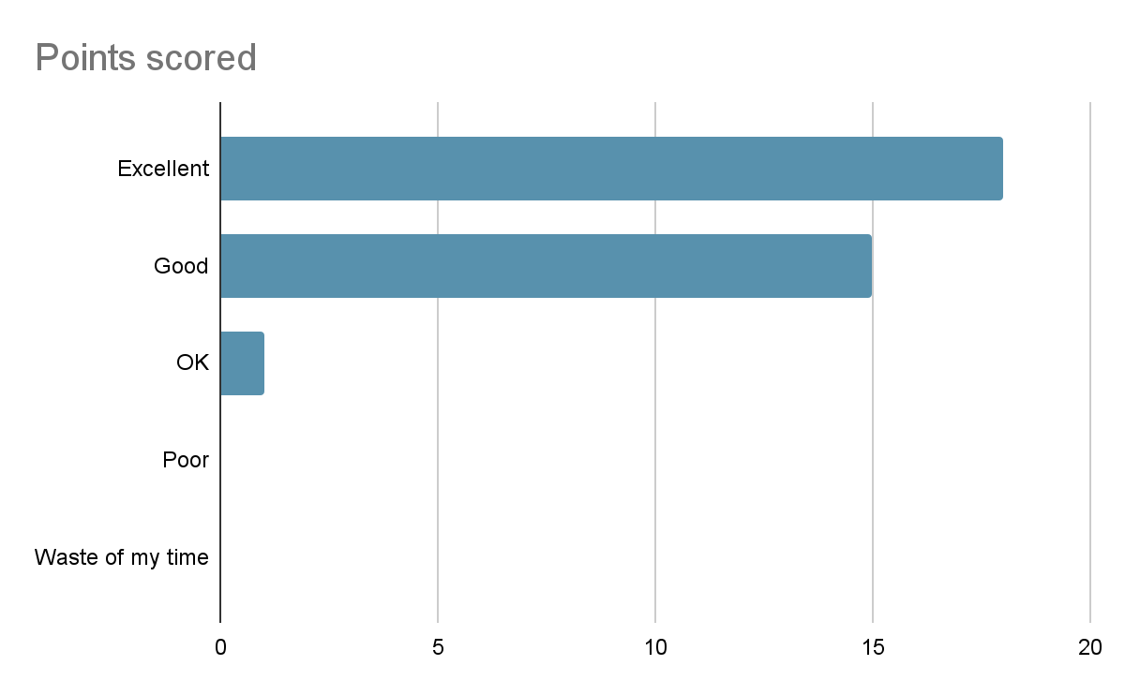
Talks
Points for improvement: even more technical →
Encourage via seminar(s)/webinar(s)
(e.g. unwrap the methods of your paper)

Slide 4
Talks
Points for improvement: even more technical →
Encourage via seminar(s)/webinar(s)
(e.g. unwrap the methods of your paper)

Slide 5
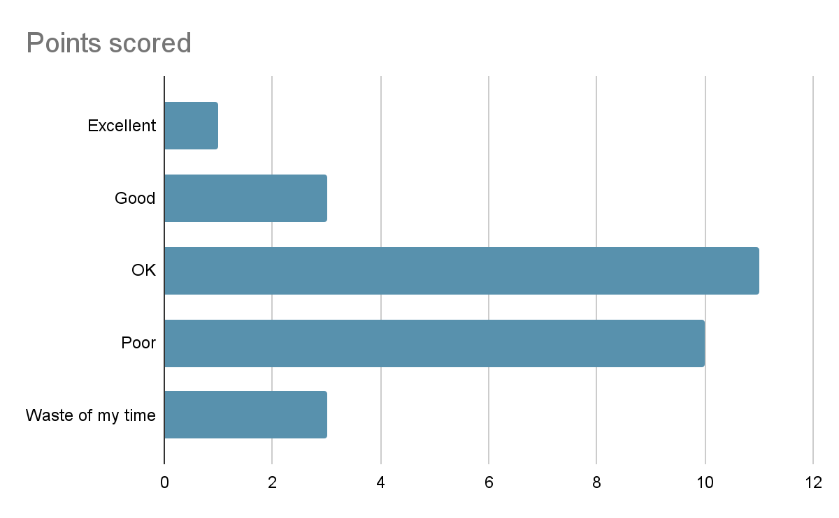
ADDI

Slide 6
Other event-related feedback
People were happy about the venue & food, could host things here again!
Request to have the next meeting not in London…
Better for (dinner) logistics to go to a place away from any center, would require a stay for all attendees
Even in London, some people need to travel far → people skipping dinner
12 people who’d be keen on being part of focus groups etc.
Points for improvement:
More/longer breaks → program was too packed
People are keen for more technical detail; workshops/tutorials, however, also a preference for having the event in one day…
Dedicated slots without PIs? (maybe by limiting senior speakers?)
More networking

Slide 7
UKDRI Informatics community
Suggested lectures/workshops (either for next event or separate?):
Getting started with Bioinformatics (addressed by EMBL-UKDRI course?)
Workflow managers (nextflow!)
Data science: statistics, machine learning techniques
Software engineering practices
Docker use, good practices for reproducibility
Biological: proteomics, single cell transcriptomics, spatial focused guided tutorial
Omics integration
Future discussion sessions:
Managing expectations
Managing ownership when working collaboratively
Software development
Links to Industry
AI
“Democratise and be more realistic. Stop imposing methods/tools from above.”

Slide 8
UKDRI Informatics community
What do we need?
Training both advanced (see earlier) & beginner (e.g. Coding/software carpentry workshops)
A session in the UKDRI GitHub
Data sharing and reproducibility + (simple explained) data sharing policy
Code review groups - maybe informal meetings where folk ask for advice on strategies
New tools sharing… Wiki? Slack channel?
Pair programming sessions?
Focus groups
Know results of this questionnaire in terms of career stage and skills of others in the community→ identify key people per center? Via GitHub profile?

Slide 9
Informatics ECR committee structure
Organize/chair meetings
Main point for communication
Support the events
…..
Minute keeper
Keep private committee repo up-to-date
….
Encourage profile building?
UKDRI repo template?
Categorize/label repos by theme/topics to easily find tools?
Add Readme for becoming the first Google search hit ☺
Chair
Secretary
GitHub curator
e.g. technical webinars?
e.g. Hackathon?
e.g. workshops/tutorials?
Event lead x
Event lead x
Event lead x
Amonida = HQ support ☺

