Slide 1


Coding in public: recognising vulnerability as a barrier to reproducibility
IASSIST Conference 2024
Halifax, Nova Scotia
Copyright © 2021. Created by Computational Social Science Training Team, UK Data Service.
Notes:
Hello and thank you for coming to my presentation on Coding in Public.

Slide 2

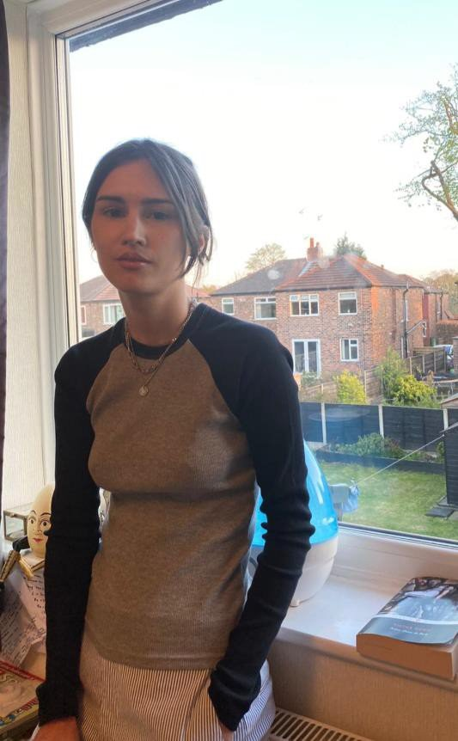
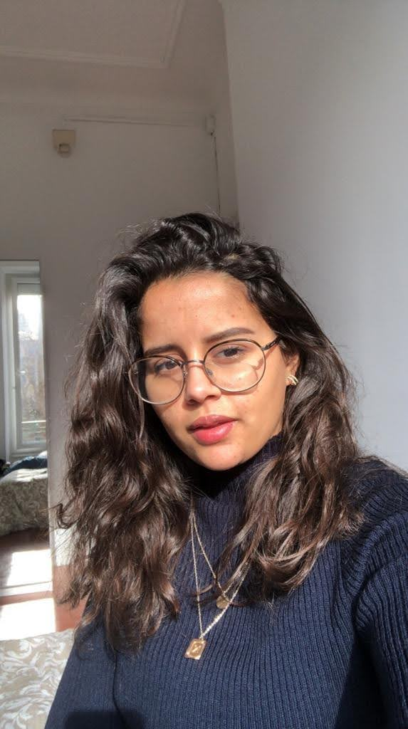
Who we are
Dr. Jools Kasmire Jupyter notebooks
Raise awareness of repositories with executable code and data
Louise Capener Python
Being more purposeful with code commenting
Nadia Kennar
R
Ensure all research documents and code are obtainable and organized
Notes:
My name is Dr. Jools Kasmire and I typically work in jupyter notebooks. My reproducibility goal is to rais awareness of repositories with executable code and data.
My two colleagues on this research project are Louise Capener, who works in python and wants to become more purposeful with code commenting and Nadia Kennar, who works in R and wants to ensure all research documents and code are obtainable and organised.

Slide 3
Table of Contents
The workshop
Emergent themes
How barriers intersect with intersectionality
Recommendations for the future
Notes:
Briefly, I will start by describing the Reproducibility workshop we ran in which we collected all the data.
Then I will describe the themes that emerged from that data.
Following that, I discuss how the reproducibility as a barrier intersects with intersectionality.
I conclude with some hopeful if possibly blithesome recommendations for the future.

Slide 4
The workshop - single “full day” of 3 sessions
Free with lunch and drink breaks provided
3 practical sessions
Time for practical, hands-on work, questions and discussion, etc.
Interactive anonymous polls, free text entry, etc.
Ethics approval granted
Notes:
So we advertised for a free, in-person, full-day workshop with free lunch and drink breaks provided. The day had 3 different sessions, each with useful learning points as well as some practical hands-on work and plenty of time for questions and discussions.
Each session also included many interactive, anonymous polls, free text entry forms, word clouds and the like conducted through mentimeter, which is how we collected the data.
Ethics approval was granted as all participants were over 18 and had agreed to participate, were free to leave at any time, and all potentially delicate questions were optional and anonymous.

Slide 5
Session 1 - What is reproducibility? Why care?
Introduce idea of reproducible research as like a clear recipe
Discussion of repercussions, drivers, potential solutions, etc.
Majority had heard of reproducibility
Majority had tried to reproduce a project
Participants cared about reputation and creating good work
Lack of clarity over responsibilities and practical actions
Notes:
The first session started by exploring what reproducibility is, which I described as being like a really clar recipe, as well as what the crisis of reproducibility was including repercussions, drivers, possible solutions and more.
Most of the participants understood a bit about reproducibility and recognised it as part of the scientific method.
Helpfully, most of them had also tried to reproduce some research, either their own or someone elses.
It was clear that participants cared about reputations, their own, their research institution’s, their fields and the wider reputation of science and research.
But it was also clear that participants felt real out to sea about exactly how they were meant to make their work more reproducibile.

Slide 6
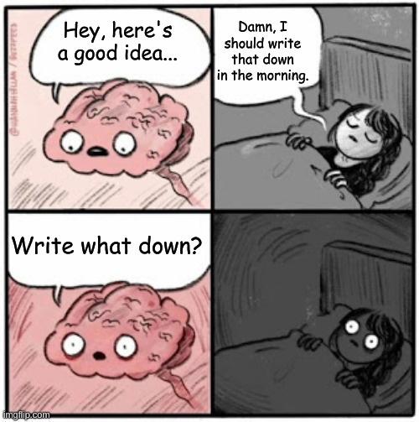
Session 2 - Habits, communication, documentation
Notes:
Session two got into some practical strategies for reproducibility as they relate to habits, communication and documentation.
This session emphasized that brains are good for having ideas, not keeping them and that good science and reproducible research begins with writing EVERYTHING down.
I introduced a few clear strategies and example processes for building the kind of habits that improve communication, which when formalised becomes useful documentation and that, in turn, improves reproducibility.
I shared how good habits, communication and documentation are useful in a range of contexts from peace of mind to career progression and conflict resolution.
This session ended with how good research habits, clear communication and useful documentation are beneficial for the researcher and their team in the present but also to the researcher and other researchers in the future.

Slide 7
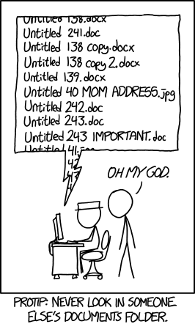
Session 3 - Tools, code, data sharing
Notes:
The third session was also very practical.
It focused on tools, code and data sharing solutions such as online repositories, version control, DOI and many more and how these make it easier to write and share good research recipes.
This session looked common research problems and potential solutions that make it easier to have good habits.
For example, in the comic here, the problem is that no one, maybe even including the original researcher, is going to stand a chance of finding the right file. The solution I suggest is to combine version control software with agreed naming and storage conventions in a shared cloud repository. Then, everyone involved can find the right file, even after a long time has passed and the “right file” is no longer top of mind or in the “recent files used” lists.
This session emphasised that it is not an all-or-nothing situation and that there is benefit even from some of the people using some of the tools.
We also covered a few solutions for some of the contexts that were especially unclear, like when working with secure data.

Slide 8
Emergent theme 1 - Does it apply to me?
Unclear on how reproducibility works for
“soft” sciences
Secure data
Qualitative research
Need for clear training and/or examples
Need support to get started, test new approaches, etc.
Notes:
So, the first theme to emerge was “Does it apply to me?”.
In effect, social scientists knew about reproducibility but had not really seen it in action and didn’t know how make their research more reproducible.
For example, most researchers would just assume there was nothing to be done if they worked with secure data and could not share it. They had a few options like
creating a synthetic data set, or
creating very detailed metadata , or
lodging their data with UKDS under a restricted access agreement.
The same goes for soft sciences or qualitative research – they assumed their was nothing to do and that reproducibility didn’t apply when actually, there are still options.

Slide 9
Emergent theme 2 - Vulnerability
Imposter syndrome
Fear of criticism/doing it wrong/code anxiety
Reporting negatives is never easy
Lack of time, resources, clear support to gain confidence
Lack of encouragement or expectation to try new things
Sometimes even lack of permission to try new things
Notes:
The second theme was around vulnerability. In essence, researchers weren’t very keen to engage with reproducibility because they were afraid.
They were afraid of making mistakes that might be mocked, criticised or that might “Break the project”. I hear things like this a lot, for example, around learning to code. People are really afraid that they will delete the mainframe or something and cost everyone the entire project.
Similarly, they are afraid to get negative results and sometimes to be clear about how they got their results in case someone reruns their analysis and finds something negative. Problems publishing negatives results is a problem throughout research, but some fields like medical research, are at least requiring it in some ways.
But a lot of the fear and vulnerability came from lack of support and information on reproducibility. This included insufficient provision within formal degree training and lack of encouragement or opportunities to self-educate on the topic. In my own personal experience, there were even cases of not getting permission to use reproducible tools or services because it was out of the PI’s personal experience.

Slide 10
Emergent theme 3 - Reproducibility is a burden
No time planned within a grant to deal with reproducibility
No (clear) publication requirements or standards
Unclear on how to get credit for reproducibility work
Best when well-planned, well-communicated, fully participative
Useful tools may not be planned, budgeted, available, etc.
Poorly done means more time and intensive manual work needed
Notes:
The third theme was that at present, and to those who have no experience, reproducibility ONLY seems like more work.
Even worse, it seems like more of the worst kind of work.
The kind of work that is unclear, unsupported, without good examples.
The kind of work that you can’t put on your CV or that won’t help you get promotion.
The kind of work that is a huge hassle because there is always that one team member who keeps sending tracked changes word documents as attachments in email instead of using the version-controlled cloud storage.
And SOMEONE has to download that tracked changes document, manually copying over the changes, store it properly and confirm with the uncooperative team member that the changes have been made, etc.

Slide 11
Reproducibility is currently a barrier without
Practical support: training, time, tools, mentoring, leadership, examples, standards, best-practice guidance, etc.
Opportunities: to do and/or publish reproducibility efforts, ways to publish code/data, paid support to do reproducibility work, etc.
Culture change: value transparency, adjust image of “intelligence” or “academic”, reduce pressure on research positions, change funding/publication/promotion criteria, DEI efforts in academia, etc.
Notes:
All of these themes mean that reproducibility is, for the most part, a challenge or a barrier unless there is
Practical support
Opportunities
And culture change.
However, the barrier of reproducibility does not affect all researchers equally.

Slide 12
Barriers and intersectionality
Workplace pressures matter.
Some researchers feel those pressures more.
Reproducibility is more of a barrier to more pressured researchers.
Notes:
Which is how reproducibility as a barrier intersects with intersectionality.
Precarious work, low pay, long hours, tight budgets, looming deadlines plus pressure to publish, get funding, get promotion, etc.
Think about all the pressures in a research workplace drive researcher burnout or that contribute to leaky pipelines.
Now how do you think reproducibility, which feels unclear, vulnerable and burdensome, plays out in this environment?
Researchers will feel this pressure more if they are less established, part-time, career-change, interdisciplinary and/or from marginalised groups like women, disabled, people of colour, working class, refugees, carers, LGBTQIA+ or otherwise those who may not see themselves as stereotypical academics or as part of the “in-group”.
In this context, the barrier of reproducibility is even more of a barrier to these pressured researchers.

Slide 13
Recommendations for the future
Be the change you want to see in the world.
Give your team the support and resources they need.
Can you create opportunities?
Change your own culture.
Notes:
So, my cheerfully optimistic recommendations for the future are to start doing the things that you want to see done.
This means providing the support that you want to see provided, although that support will look different in different teams. It might mean requesting funding for the useful software, creating a clear and agreed upon comms plan, or even reaching out to that persistent email-attachment person to understand why they are not using the version control repository.
It also means creating the opportunities you want created. Can you hire an intern to test your project’s reproducibility? Can you add something about code and data sharing to your project proposal? Can you ask your university ethics approval team to make reproducibility an ethical requirement? Can you approve time for a team member to volunteer for the Turing Way (an open-source handbook to reproducible and ethical research)?
Finally, it also means changing your own culture. Reflect and see if you are putting unfair support, opportunities, and work tasks onto your team that might be entrenching existing patterns. Make sure your team knows when you feel unsure of yourself or vulnerable so they can see that good researchers are not impervious or perfect. Make a real effort to write useful commit log messages when you commit to version control repositories.

Slide 14
Contact details
j.kasmire@manchester.ac.uk
@JKasmireComplex

