Slide 1
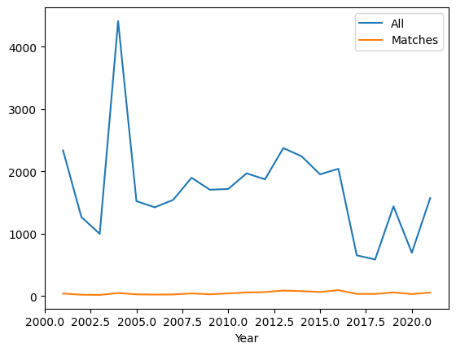
Number of abstracts over the years

Slide 2
Most common words in abstracts
All abstracts | 'gene' | 'patient' | 'mutat' | 'genet' | 'studi' | 'use' | 'case' | 'result' | 'analysi' | 'associ'
Count | 69245 | 60113 | 57719 | 42684 | 32414 | 28317 | 27007 | 25783 | 24804 | 24741
Matched abstracts | 'patient | 'gene' | 'genet' | 'disord' | 'autism' | 'syndrom' | 'delet' | 'mutat' | 'case' | 'clinic'
Count | 2081 | 1921 | 1235 | 1088 | 1088 | 1087 | 1068 | 984 | 953 | 902

Slide 3
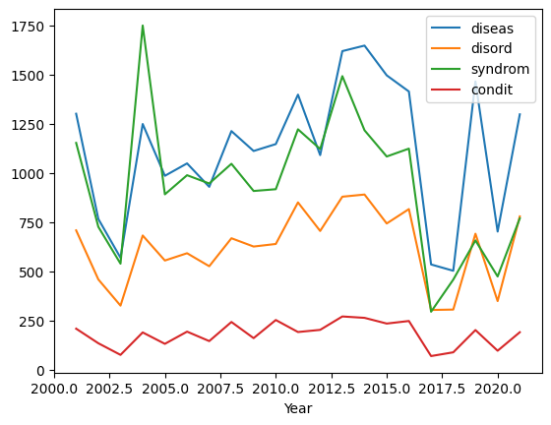
Target word counts over the years

Slide 4
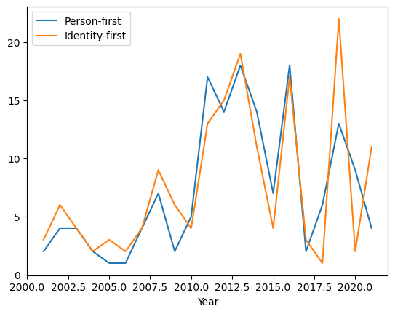
Person-first and Identity-first counts by year

