Slide 1
Accessing LFS and APS data via the UK Data Service
Jen Buckley
UK Data Service, User Support and Training
Introduction to the Labour Force Survey and Annual Population Survey
20th May 2021
Copyright © 2021 UK Data Service. Created by UK Data Service, University of Manchester.

Slide 2
What we’ll cover
Introduction and accessing EUL data
What do you do if you think you need Secure Access data?
Remote access to controlled data via the UK Data Service’s Secure Lab

Slide 3

What is the UK Data Service?
Resource funded by the ESRC
Access to a wide range of secondary social science data
Support, training and guidance
ukdataservice.ac.uk
Notes:
The UK Data Service is a comprehensive resource funded by the ESRC. It is made up of the former services ESDS, Census.ac.uk, and the Secure Data Service.
We provide a single point of access to a wide range of social science data
As well as the data, we also provide support, training and guidance

Slide 4
How we work
Communication via helpdesk – queries directed to right team internally
Teams
Access (University of Essex)
User Support and training (for LFS at University of Manchester, Cathie Marsh Institute)
Secure Access/Secure Lab (University of Essex)

Slide 5
Series records
Annual Population Survey
Labour Force Survey
What?
Information about each series as a whole
Links to all the datasets, grouped by type
Quarterly Labour Force Survey
Notes:
Go to them through a link.

Slide 6
Catalogue records
Example: Quarterly Labour Force Survey, October - December, 2020
What?
Abstract and study details
Documentation
Access data
Citation

Slide 7
Licenses
LFS and APS made available under two licenses
End User License
Secure access

Slide 8
Accessing EUL data
Register with UK Data Service
Project to record use
Download in preferred format
Zip file with data and documentation

Slide 9
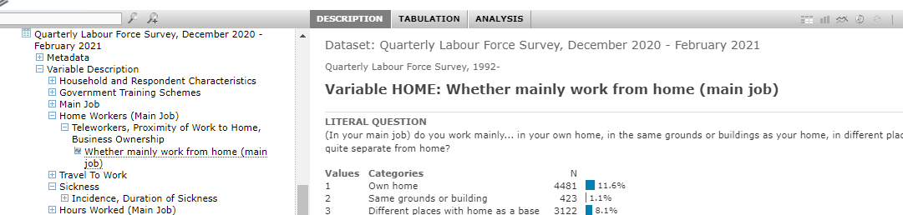
NESSTAR
Online browsing of data
Simple analyses (tables, correlation)
Download data

Slide 10
Cite data
Citations on catalogue page
For multiple datasets, cite from the series page:
Office for National Statistics, Social Survey Division, Northern Ireland Statistics and Research Agency, Central Survey Unit. (2021). Quarterly Labour Force Survey, 1992-2020. [data collection]. UK Data Service. Series page: http://doi.org/10.5255/UKDA-SN-8738-2

Slide 11
Questions
Jen Buckley
Jennifer.buckley@manchester.ac.uk

Slide 12
What do you do if you think you need Secure Access data?
Maddison A. Jones, Data Access Services
Alix Taylor, Data Access Services
Online workshop: Introduction to the Labour Force Survey and Annual Population Survey
20 May 2021
Copyright © 2021 UK Data Service. Created by UK Data Archive, University of Essex

Slide 13
What we’ll cover
What’s available in the Secure Access versions
Legal gateway for access
How to apply
Tips for a good application

Slide 14
Secure Access vs. End User Licence
More detailed variables
Check catalogue records
Check data dictionaries
Data defined as ‘personal’ by the Office for National Statistics (ONS)

Slide 15
Legal gateway for access
Digital Economy Act (DEA, 2017)
Accredited Researchers
Accredited Projects
Accredited Processors
Notes:
Secure Access datasets must have a legal gateway for access in order to be used by researchers. For datasets in our collection that are owned by the ONS, such as the Labour Force Survey, the legal gateway is the Digital Economy Act, 2017 – DEA for short. Prior to the implementation of the DEA as a legal gateway, the default gateway for access to ONS-owned data was the Statistics and Registration Services Act, 2007.
Access is governed by the Code of Practice under the Research Strand of the DEA, which requires both researchers and their projects to be accredited, and for the trusted research environment that they will access the data within, to be accredited as a processor. Researchers must be accredited before they can have access to their project.
The body responsible for the implementation of the Code of Practice and the accreditation of researchers, projects and processors, is the UK Statistics Authority. The UK Data Archive was accredited as a processor by the Statistics Authority in 2020.

Slide 16
How to apply
Apply for AR status via ONS RAS
Attend Safe Researcher Training
Receive AR number
Locate dataset in catalogue; add to project
Complete and submit application documentation
Application documentation checked by UKDS
Application sent to ONS for data owner approval*
ONS send approval to UKDS
UKDS submit application to RAP
Notes:
Now we’ll walk through the application process. The process you’ll see on screen is for a researcher who is new to using our Secure Lab, is working alone and has never applied for ONS-owned data before.
The first step for a researcher is to apply for Accredited Researcher (AR for short) status. AR applications are managed by our colleagues at the ONS Secure Research Service, and researchers can apply for AR status via the ONS Research Accreditation Service (RAS for short).
Researchers must attend and pass Safe Researcher training before they can be awarded AR status. If you’re applying for access to LFS data in Secure Lab, we recommend that you book onto one of our Safe Researcher training courses, because we cover material specific to using the Secure Lab environment, but ONS will offer you the option within RAS to book onto one of their courses. If you attend training with ONS or another organisation that provides the Safe Researcher training, we will ask you to complete a short online course that covers the service-specific material that we deliver as part of our training sessions.
Once you’ve passed the training, ONS will send your AR number to you – keep a copy of this safe, as you will need to quote it on your project application.
You will then need to locate the Secure Access LFS dataset that you want to use via our online catalogue and follow the on-screen prompts to add it to your account and then to a project – if you’re not already registered and logged in, then the website will prompt you to register and login before you can add the data to a project.
Once you’ve added the dataset to a project, you will be able to download the application documents. The project application form contains guidance on completing the form – importantly, you should note that you will also need to supply evidence of institutional ethics approval and complete an ethics self-assessment form, both of which need to be submitted alongside your project application form. You will also need to complete and submit a Secure Access User Agreement, which needs to be countersigned by a legal representative from your institution – this doesn’t need to be sent at the same time as your application forms, but it’s best to get it in sooner rather than later. Similarly, you will also need to complete an online form with your IP address and other technical information, which is sent to our Technical Support team for checking.
We then triage your application, checking for feasibility and public benefit. This can involve some back and forth with you discussing the application, but once it’s passed our checks, we send it to the ONS for data owner approval.
Once the ONS return their approval decision, we then pass your application to the Statistics Authority’s Research Accreditation Panel (RAP for short), via their secretariat.

Slide 17
How to apply (continued)
Application considered by RAP
UKSA return RAP decision to UKDS
UKDS process approval
UKDS check for any outstanding documentation
UKDS check your device and set up Secure Lab account and project
If you attended SRT with ONS, UKDS will ask you to complete service specific training
UKDS process service-specific training result
UKDS complete final account checks and issue login details
UKDS finalise project record
Notes:
RAP members are independent and appointed by the Statistics Authority: they will carefully scrutinise applications to ensure that they are feasible, provide public benefit and are ethically and methodologically sound. Some applications can be considered via a precedent process, which means that they can be considered by a sub-group of the panel, rather than being sent for full panel scrutiny. In precedent cases, the turnaround is quite quick and a decision can be reached within a couple of weeks. If an application has to go to full panel, it will be presented at the next full RAP meeting.
The RAP secretariat will relay RAP’s decision to us on whether the project can be accredited or not. Provided the application passes their scrutiny and is well completed and doesn’t require further clarifications or amendments, it should be accredited.
Once we receive the accreditation decision, we check if we’re missing any documentation from you – if anything is missing, we will let you know. Otherwise, it’s a straightforward case of confirming the application approval to you and handing over to our Technical Support team to finalise their checks and account and project set-up.
If you have submitted your technical information early on in the application process, Technical Support will likely have already contacted you to undertake their checks and begin the set-up process. If you leave submitting the details to this point, it can slow the last steps of the process down, but the team are quick at getting their checks done.
If you didn’t attend Safe Researcher training with us, then this is roughly the point in the process that we’d ask you to complete the short online service-specific training.
Once all of that is complete, the Technical Support team will issue your Secure Lab account and give you access to your project space. They then hand back to our team to finalise the project record, so you will then see the request in the project record area of your UK Data Service account changed from a ‘Request Access’ status to ‘Active’ and all the workflow steps in your request marked as complete.

Slide 18
Tips for a good application
Submit all required documents
Follow application guidance
Use clear, concise language
Write for people that don’t know your subject
Notes:
As we’ve covered already, it’s crucial that you submit all the required documents for the application – it’s best to submit these in one go, rather than sending them piecemeal.
Please follow the application guidance – we provide guidance at the front of the project application form on how to complete the various sections, so please make full use of that guidance. If you’re unsure on any sections and need help, please contact our Helpdesk and we’ll be happy to support you.
Please also ensure that your content is clearly written and can be easily understood by someone who doesn’t know your specialist research area – this will make it easier for the people screening and scrutinising your application, which in turn means that they can process and make decisions on your application sooner. Think of it as helping us to help you!

Slide 19
Tips for a good application (continued)
Set out specific research questions/hypotheses
Complete all sections fully
Address any and all feedback
Check, double-check and triple-check content
Notes:
Under the DEA, projects must have a clearly defined scope. Scope is determined by the research questions and hypotheses that you want to answer and test, so setting these out really clearly again will help keep the processing of your application moving along.
Ensuring that you complete all sections of the forms fully, in line with the guidance, also helps us to process the application more quickly, as it minimises the likelihood of us having to return your forms to you asking for more information.
If we have to ask you to make any changes, we then have to completely re-screen your form, so please make sure that you address any and all feedback, and if you make changes to any sections that we haven’t asked you to change, please let us know. It will slow your application down if we have to re-screen it multiple times.
Lastly, please check your content thoroughly – we don’t provide a proof-reading service, but ensuring that your application has correct spelling, punctuation and grammar will help it along. A poorly completed application with typos slows our screening down and doesn’t look good to data owners or the RAP, so we recommend making sure that your forms are as perfect as possible.

Slide 20
Questions

Slide 21
Remote access to controlled data via the UK Data Service’s Secure Lab
Beate Lichtwardt, User Support and Training
Online workshop: Introduction to the Labour Force Survey and Annual Population Survey
20 May 2021
Copyright © 2021 UK Data Service. Created by UK Data Archive, University of Essex

Slide 22
Roadmap
How does it work – Remote access to Secure Lab data, Security Philosophy
Available software in Secure Lab
Importing and linking data
Using Secure Lab efficiently
Accessing international controlled data for comparative research

Slide 23
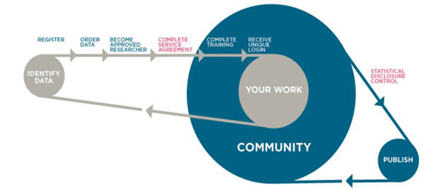
Remote access to Secure Lab data
Access via web-based interface that uses secure encrypted Citrix Virtual Private Network technology
Data not downloadable, access remotely from organisational desktop (or UKDA Safe Room)
Outputs subject to Statistical Disclosure Control (SDC) process

Slide 24
Security Philosophy: Five Safes framework
Safe data: data is treated to protect any confidentiality concerns
Safe projects: research projects are approved by data owners for the public good
Safe people: researchers are trained and authorised to use data safely
Safe settings: a Secure Lab environment prevents unauthorised use
Safe outputs: screened and approved outputs that are non-disclosive

Slide 25
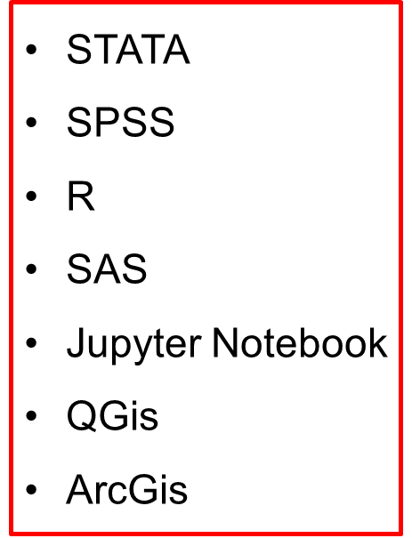
Available software in Secure Lab
MLwiN
Anaconda3 (inc. Python)
Acrobat Reader
Winzip
7zip
Explorer
Qtconsole
Spyder
Notepad++
MS Access
MS Excel
MS PowerPoint
MS Word

Slide 26
Importing and linking data - Secure Lab
External data can be imported into the Secure Lab project area of a researcher and linked to ONS business data ! Permission is required from the Secure Access data owner and the external data owner !
ONS business data can be linked to one another in Secure Lab

Slide 27
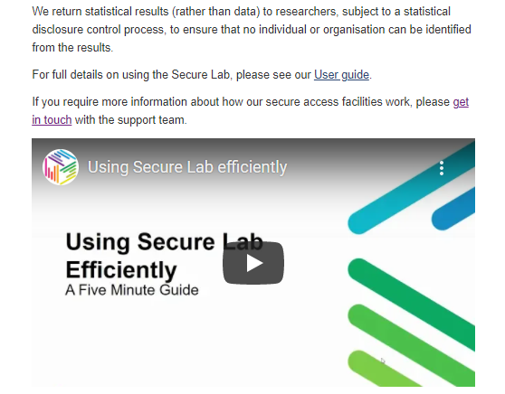
Using Secure Lab efficiently
https://www.ukdataservice.ac.uk/use-data/secure-lab/how-it-works.aspx

Slide 28
Accessing international controlled data for comparative research
Safe Room Remote Desktop Access available for data from:
Institute for Employment Research (IAB), Germany (information on available datasets: IAB RDC on-site use files at https://fdz.iab.de/en/FDZ_Overview_of_Data.aspx)
Secure Data Access Centre (CASD), France (available datasets: https://www.casd.eu/en/available-data-on-casd/)
-> via UK Data Service Safe Room, University of Essex

Slide 29
Questions
Beate Lichtwardt
blicht@essex.ac.uk

