Slide 1
Make sense of the documentation
Jen Buckley
UK Data Service, User Support and Training
Introduction to the Labour Force Survey and Annual Population Survey
20th May 2021
Copyright © 2021 UK Data Service. Created by UK Data Service, University of Manchester
Notes:
First practical session – look at how to make use of the documentation

Slide 2
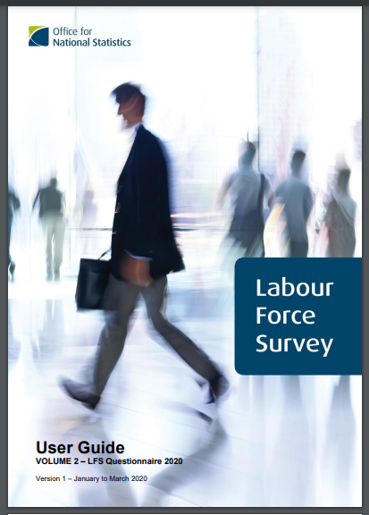
What?
11 Volume User Guide!
Plus
Additional data reports
Data dictionary
Notes:
One of the reasons we’ve included this session is that the LFS has some of the most extensive document for a survey.
There is an amazing 11 volume user guide. There’s also additional reports and documents such as data dictionaries.
So if you come up against questions, there is usually some information about it somewhere.

Slide 3
What for?
Study design, weights and different datasets
(Information from previous session)
Understanding variables
What’s asked when (waves and quarters)
What’s changed over time
Derived variables
Which variables are in which datasets
Notes:
The documentation provides detail about the study design, weighs and the different datasets – which Martina and Simon went through earlier.
There is also a lot of information about how to understand the variables in the dataset
Such as …and this is what we’ll focusing on in the practical session.

Slide 4
Where is the documentation?
Catalogue records
ONS website (google LFS user guide)
In data downloads
Notes:
So first question – where is it – on the catalogue page you can access all the documentation for a particular dataset. You can get also the user guide on the ONS website – which comes up better in a search engine.
You also get it when you download the data.

Slide 5
Documentation relating to variables
LFS User Guide Vol. 2 - Questionnaire 2020
LFS User Guide Vol. 3 - Details of LFS Variables 2020
LFS User Guide Vol. 4 - Standard Derived Variables 2016
UK Data Archive Data Dictionaries
Let’s look
Notes:
When is comes to look at information about variables – there are 4 key places to look.
We have a copy of the questionnaire – see full question and routing.
Volume with details of all variables including derived variables.
A detailing how derived variables have been derived
There also data dictionaries – useful for checking if variables are actually in the dataset
e.g. are they in the EUL dataset, in that particular quarter or have they been included in the longitudinal files.
Let’s have a look:
Questionnaire - volume 2
Big document
Contents page - Good for getting an overview of the topics
Detailed information at the beginning about how to decipher the questionnaire document – e.g. frequency markers [scroll to next page] which dataset, routing.
How to find what you want? Mix of the contents page and searching – quite a lot of terms will bring up a lot results But searching very useful too. Though might depend on the topic quite a few terms will being up a lot of responses – e.g. questions on trade union members – I can search brings up a few – but questions on training – more options
Volume 3 - Variable details
Includes derived variables/good for finding out about variable changes – go to layout on p.g. 9
You can search for topics/or variables like with the questionnaire – or look up particular variables you want to know more about - e.g. you know there is a variable called LOOK4, which records whether someone is looking for work and you want to know more about it.
Volume 4 – derived variables – flow charts full logic.
Data dictionary
check variables before downloading – useful if not clear from the documentation – useful for longitudinal files/aps – LOOK4

Slide 6
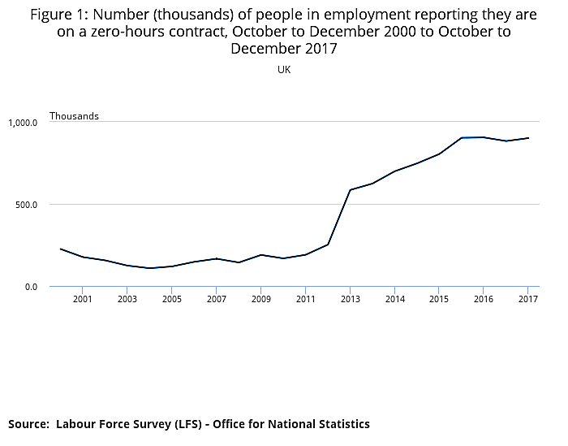
Practical exercise
Zero-hour contracts
Use the documentation to review variables and options for analysis
See handout
Notes:
Now over to you.
Use the documentation to find out about variables and options for analysis.
Worksheet, with steps and review questions for checking your understanding. There is an answer you can reference when you want.
Feel free to ask questions as you go in the chat or turning microphone on. We’ll spend about 15 minutes and then have a recap at the end.
Quiz

Slide 7
Explore the data
Jen Buckley
UK Data Service, User Support and Training
Introduction to the Labour Force Survey and Annual Population Survey
20th May 2021
Copyright © 2021 UK Data Service. Created by UK Data Service, University of Manchester
Notes:
Great – so our final session of the day – chance for your to explore the data with some practical exercises.

Slide 8
What? Recreate ONS estimates
Practical 1: Estimates of temporary employment
EMP07 Temporary Employees
Quarterly Labour Force Survey, October - December, 2020
Practical 2: The distribution of weekly earnings of full-time employees
EARN04: Gross weekly earnings of full-time employees
Quarterly Labour Force Survey, October - December, 2020
Practical 3: Examining Labour Market Flows.
Labour market flows NSA: sheet in dataset X02
Two-Quarter Longitudinal Dataset, July - December, 2020
Notes:
The exercises are all recreating analysis published by the ONS.
there’s three exercises in total
1. estimate of temporary employees – which uses the Quarterly file
Then looking the distribution of weekly earnings – so using information in income
Then the final exercise looks at one of the longitudinal dataset and some different of looking at labour market flows.

Slide 9

Get started: open syntax file
Zip file: LFS_workshop
sent in advance
on miro board
Extract contents
Open file for first exercise
LFS_workshop\Explore_LFS\SPSS_syntax
Where is your data saved?
‘LFS_workshop’ folder
Notes:
The exercises are all in the syntax for other code files. So to get started we’ll find the files we need.
A folder was sent in advance by email and it can also be found on drop box.
In there, there is an Explore_LFS folder and then folder for Stata, SPSS and R.
I’m going to open SPSS and I see there are three files. Open the file for Practical 1.
Another thing you will need to know – is where your data is saved – you may also find it useful to add the data to the LFS workshop.
Can show – then give time for them to do it.
Flag any problems in the chat/or use your microphone.
Great – next step is to open data.
One way is to do this through your syntax or other code file.
So I start by seting the working directory to indicate where the data is saved, then use a command to open the data.
Alternatively, you can also open the data using the menus.
Syntax file also has review questions – designed to help you check that you know what’s going on.
This first one is pretty straightforward – number of variables. Go ahead and do that now – any questions – speak or use the chat.
Give time to do this
Review: raise hands or type in the number of variables when done? There are 786.
Now your turn – best to take it in steps. Tell them about the answer sheet. (10 minutes to go through)
Recap – use answer sheet.
Missing cases due to variable routing, so always important to know who is included.
The weights in the LFS gross to population totals – so you see a very big change when they applied.
Filter to get those in employment and temporary workers
1,578,799 in temporary employment
Size of the LFS (74,832) means we still have a good number of cases for this small sub-group (1,616).
Exercise 2 - Open syntax – get the full data open again. Again, you have review questions to use as you go along.
In this case, you need to complete some of the code yourself to apply a filter, you need to select the right values.
Recap – median weekly earnings were £567 and women in the bottom decile were getting £290.
This exercise looked at fulltime employees. But the number in this table is lower than the estimate given by the ONS – why is that? Here we are looking at earnings – we use the income weight and we filter cases with valid income values – so we don’t have all the fulltime employees. So to get the right estimate of fulltime employees we need to use the main weight and only filter on being a fulltime employee.
Exercise 3
uses three different methods of examining labour market flows
Two-Quarter Longitudinal Dataset. Make sure you open the right dataset!
Recap
Variables get a suffix 1 or 2
variable called FLOW – which indicates change.
We can identify people who have changed jobs be selecting those employed at one but also at time point 2 with continuous employment less than 3 months.
So between last summer and Autumn – did more people go from being self-employed to employed – or employed to self-employed> more switched from self-employed to employee – if you follow the link to the table, you can see how this varies to other periods.

