Slide 1
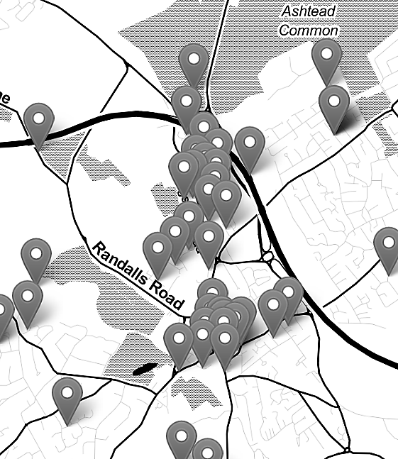

Mapping Crime Data in R: Live Code Demonstration (10/03/2026)
Nadia Kennar, Research Associate at the UK Data Service (Cathie Marsh Institute, UoM)
Copyright © 2026 University of Manchester, Cathie Marsh Institute, UK Data Service.

Slide 2
Interaction
During this workshop you can use the Zoom chat for technical questions or comments (to chat with the facilitator – Emma Green).
If you want to ask questions in relation to the content of this talk, then you can use the Zoom Q+A function.
I will aim answer questions at the end of each Topic chapter.

Slide 3
Troubleshooting audio problems
Check your speaker/headset is plugged in / volume is on.
Click on audio to change to listening via phone
This workshop is live on YouTube. We are also recording this workshop and will post it on YouTube (https://www.youtube.com/user/UKDATASERVICE)

Slide 4
Crime Surveys User Conference 2026
Are you interested in research on crime? Do you want to know the latest developments in crime data from UK social surveys?
This free conference, organised by the UK Data Service in collaboration with the Office for National Statistics, Scottish Government and Home Office, will be held online on Wednesday 11 March 2026.
Attendees will hear a mixture of presentations from the data producers and researchers who have used data from the Crime Survey for England and Wales, Scottish Crime and Justice Survey, and more.
Book your place at: https://ukdataservice.ac.uk/events/crime-surveys-user-conference-2026-03-11/

Slide 5
Upcoming UKDS Events:
Crime Survey User Conference 11/03/2026
UK Data Service essentials: Introduction, finding and accessing data: 17/03/2026
Dissertation projects: Introduction to secondary analysis for qualitative and quantitative data 24/03/2026
Linked digital trace and survey data for secondary research: Potential and constraints 26/03/2026
Computational Social Science Drop-in 14/04/2026
How to become a computational social scientist 15/04/2026
Using QGIS to map 2021/2022 census data from the UK Data Service 22/04/2026
For the full list of events browse our event page
https://ukdataservice.ac.uk/training-events/

Slide 6
Content
Topic 1 — we start by reading in the crime data, doing some basic exploratory analysis and producing our first point maps
Topic 2 — we move into shapefiles, learning how to read them in, join them to our crime data and produce choropleth maps with different classification methods
Topic 3 — we bring in census data to calculate crime rates, which gives us a more meaningful picture than raw counts alone
Topic 4 — finally we cover some more advanced spatial analysis including spatial interpolation for missing data, heatmaps, interactive maps using Leaflet and a brief introduction to spatial regression
*Additional Topics

Slide 7
Survey
Please complete our short survey as you leave!

Slide 8
Thank You.
Email: nadia.kennar@manchester.ac.uk
Twitter: @NadiaKennar

Slide 9
References
https://www.esri.com/en-us/what-is-gis/overview#liSwitcher
https://blog.ukdataservice.ac.uk/gis-spatial-data/
Dermanis (2005) : https://www.researchgate.net/profile/Athanasios-Dermanis/publication/233387161_Coordinates_and_Reference_Systems_in_Greek/links/0912f50a149d9568b7000000/Coordinates-and-Reference-Systems-in-Greek.pdf
Luc Anselin (2009) : https://link.springer.com/chapter/10.1007/978-3-642-03647-7_5
Ratcliffe (2009) Spatial and Temporal Challenges: https://link.springer.com/chapter/10.1007/978-0-387-77650-7_2
Bowers (2001) Mapping and Analysing Crime Data : https://link.springer.com/chapter/10.1007/978-0-387-77650-7_2
https://core.ac.uk/download/pdf/161890428.pdf
https://www.ed.ac.uk/files/imports/fileManager/chainey.pdf
https://www.crimrxiv.com/pub/slkb1v54/release/1
https://tubecreature.com/#/livesontheline/current/same/U/*/FFTFTF/11.469326848406268/-0.1622/51.5142/
https://www.crimrxiv.com/pub/slkb1v54/release/1
https://www.sciencedirect.com/topics/earth-and-planetary-sciences/modifiable-areal-unit-problem
https://engaging-data.com/country-centered-map-projections/
Images on slide 28, 42, 43, 44 and 45 were generated with the assistance of AI. Source: ChatGPT 4 with Dall-E. Date: 07/01/2024.

