Slide 1
Introduction to Text-Mining for Digital Health: Basic Processes
The webinar will begin at 2 pm
You now have a menu in the top right corner of your screen.
The red button with a white arrow allows you to expand and contract the webinar menu, in which you can write questions/comments.
Feel free to type questions as we go, we will answer as many as we can at the end
We can’t hear you.
Notes:
Hello everyone.
The webinar starts in 5 minutes.
If you want to ask a question you can do so at any time by typing into the questions box at the top right of your screen – press the red arrow if you can’t see it.

Slide 2
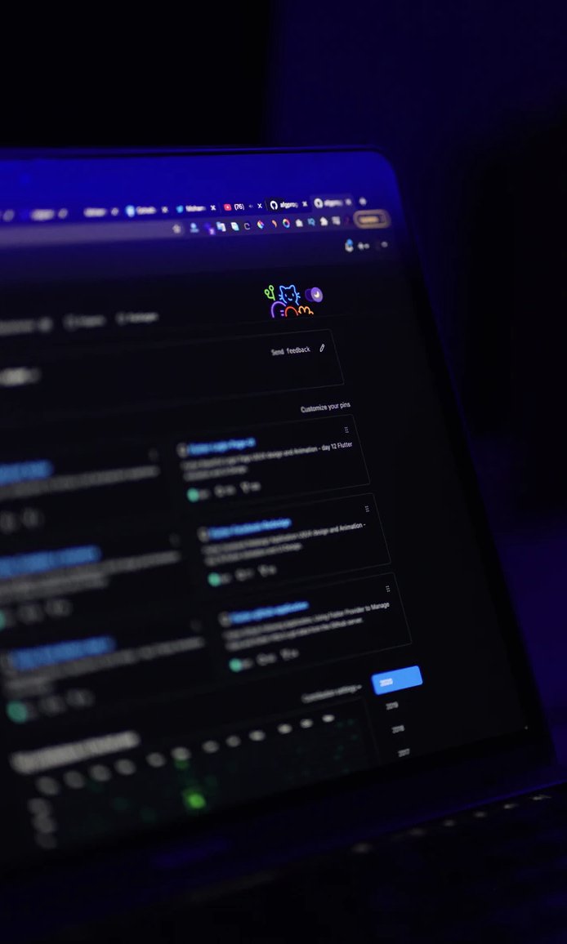


Text-Mining: Basic Processes
Louise Capener
Research Associate at Cathie Marsh Institute and UK Data Service
louise.capener@manchester.ac.uk
@CapenerLouise
Notes:
Hello! My name is Louise Capener and I’m a research associate at the UK Data Service. Today I will be talking about the basic processes of text-mining including the cleaning and preparatory processes and some of the first natural language processing steps

Slide 3
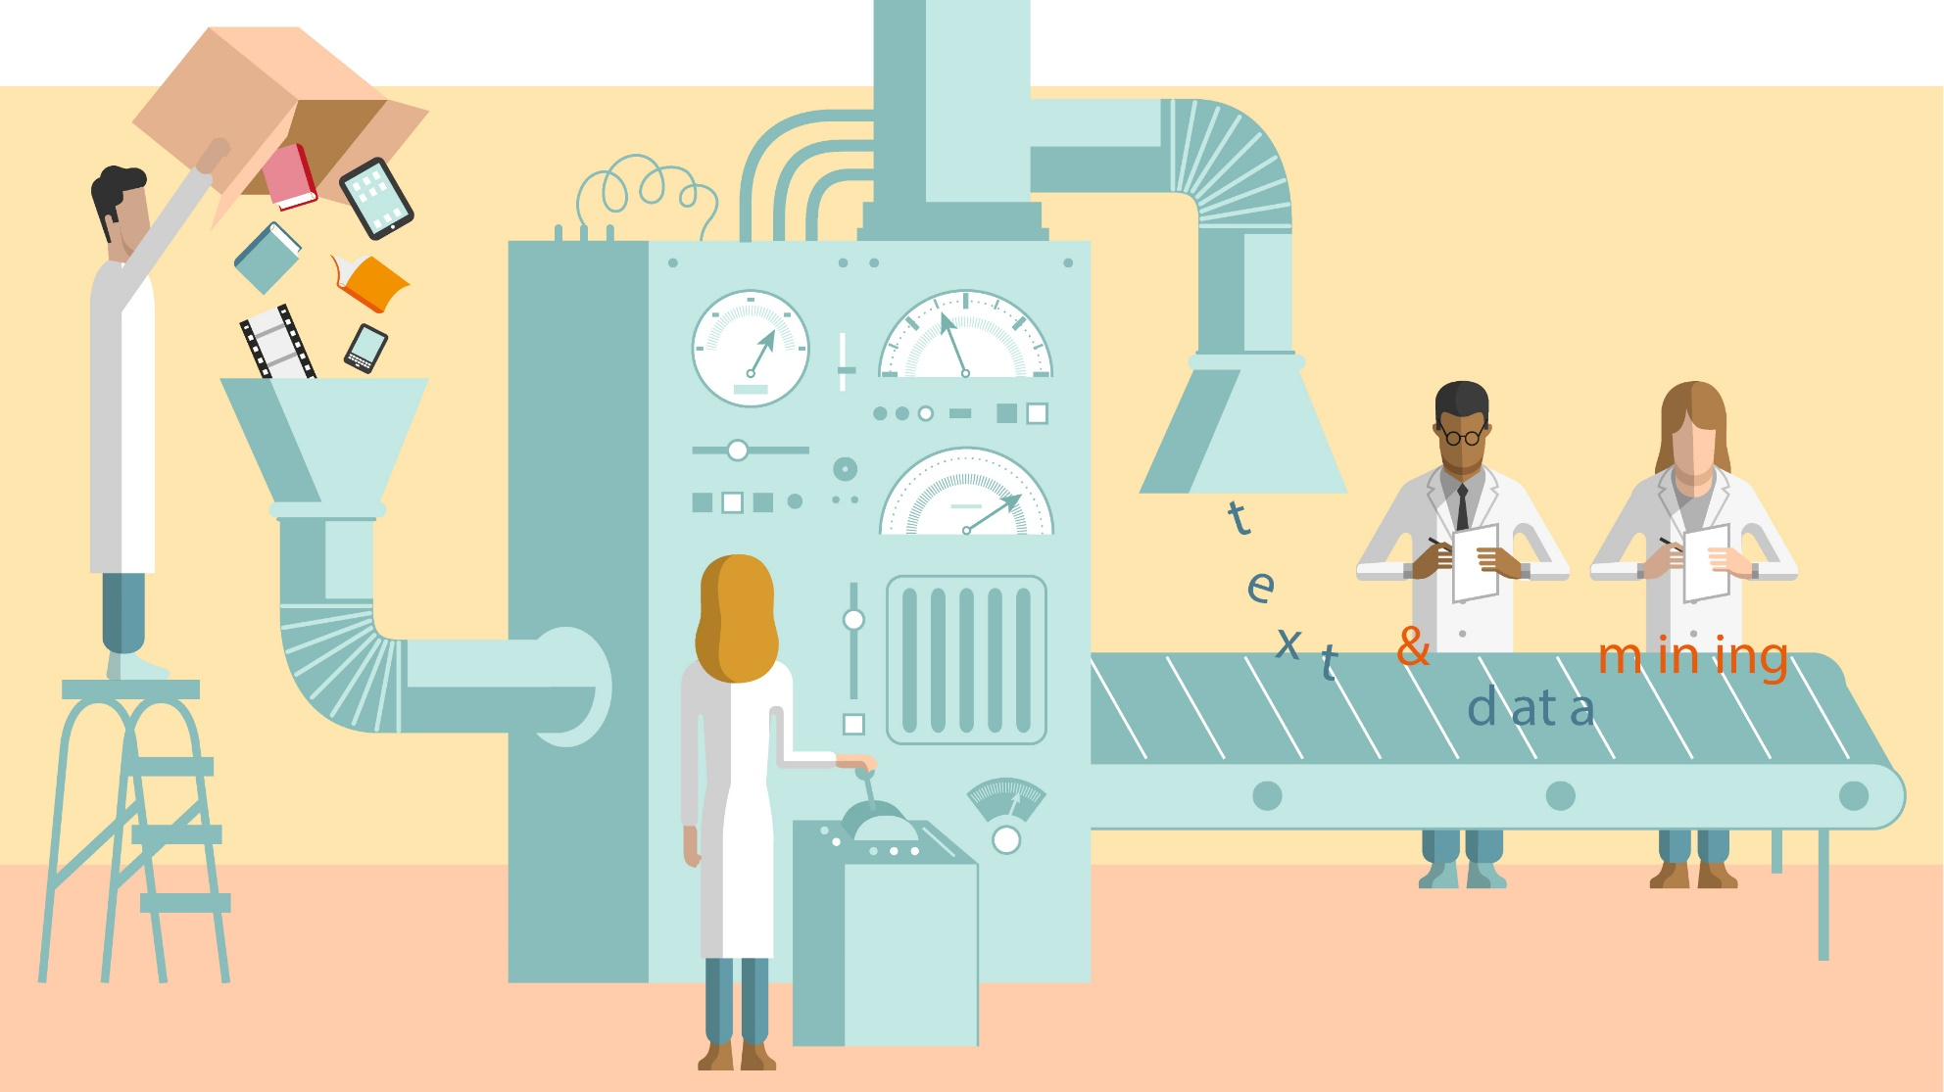
Text-mining is a form of data-mining
Notes:
So, if you attended the introductory webinar, you might remember that text-mining is about turning
CLICK
unstructured or semi-structured input into
CLICK
structured output.
Today’s webinar will demonstrate some of how that transformation actually works in practice.

Slide 4
Text-mining has 4 basic steps
Retrieval
Processing
Extraction
Analysis
Processing:
Tokenisation (dividing raw data)
Standardising (case, spelling, RegEx)
Removing irrelevancies (punctuation, stopwords, etc.)
Consolidation (stemming and/or lemmatising)
Basic NLP:
Tagging, Named Entity Recognition and Chunking
Basic Extraction:
POS-tagging
Chunking
Named Entity Recognition
Word frequency
Similarity
Discovery
Notes:
If you attended the introductory webinar, you might also remember that text-mining has four basic steps
CLICK
retrieval, processing, extraction and analysis. Today, we are only focussing on
CLICK
Processing and extraction, which are not always linear. This is especially so if you are new to text-mining or are doing a new kind of analysis, you should expect these steps to be a bit iterative. What you’ll find is you probably will go round these steps a few times before you really get the pipeline that you want.
CLICK
Specifically, today will cover these topics in processing, basic extraction and basic NLP that lies somewhere between the two, depending on your research approach and needs.
We’ll cover processing steps like tokenization, standardising, removing irrelevancies, consolidation, and some basic natural language processing like tagging, named entity recognition and chunking. And some basic extraction which includes word frequency, similarity, and discovery.
Don’t worry too much if you don’t know what these things are because I will go through them all in detail in just a second.

Slide 5
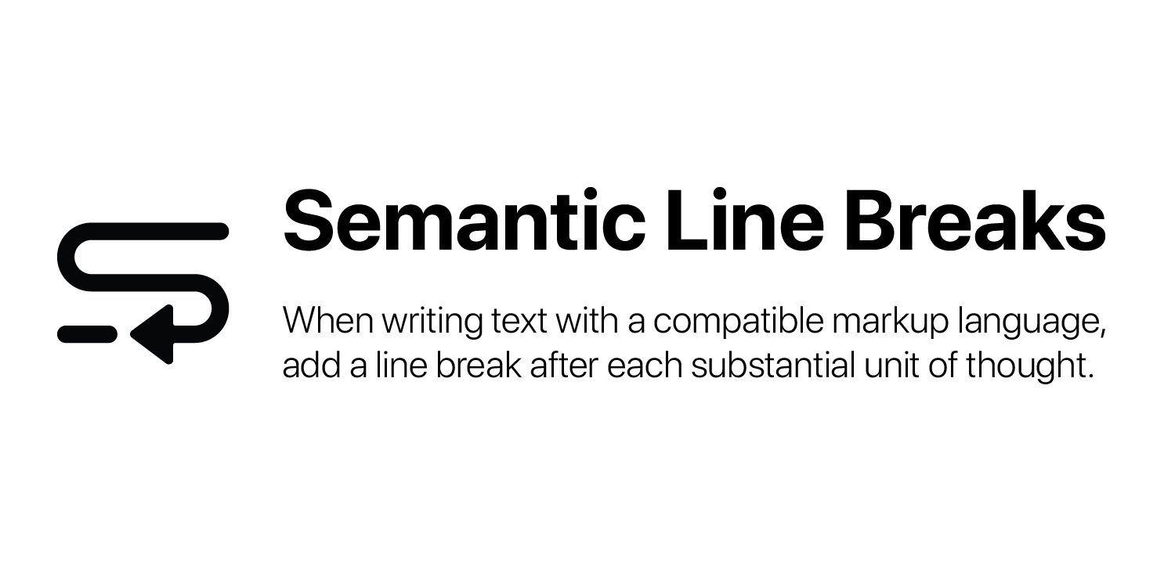

Processing – Raw data into useful data
Great big file with the text content of hundreds of newspaper articles.
You may want to:
Break it into many small files of one article each (with useful names)
Insert a line break after each article
Write out each article to a dictionary with key-value pairs for article features
[‘Author(s)’: ‘Writer1, Writer2’
‘Date’: ‘Junetember 43, 3024’
‘Headline’: ‘New SARS-CoV-88 Vaccine Causes Head to Explode!’
‘Publication’: ‘Fake News Corp.’
‘Article’: ‘Yada yada yada, blah.’]
Notes:
First off, you need to turn the raw data that you acquired during the retrieval step into something you can work with – into something that you can do text processing on. Let’s assume you have
CLICK
A great big file with hundreds of newspaper articles in it. You might want to:
CLICK
Break it into smaller files with one article each or CLICK
Insert a line break or delimiter after each article so that you could import the file into a spreadsheet programme with each article on its own row. You could also CLICK
Turn each article to a dictionary entry with key-value pairs for the article contents, so you could do this for the typical kind of article things, you know like author and title and date and things like that.
All of these are potentially useful ways to process a raw data file into something that’s suitable for text mining, and they each lend themselves to different kinds of analysis. Let’s consider these, with a few health-related examples.
The first, as separate files, is useful if the text, rather than the author or the date, is the focus. You might want a division like this if you want lots of examples of text to work with. This allows you to compare the contents of each file easily – you can dig into the text and compare it to other texts. Maybe you want to compare interviews with different long covid patients.
The second, where we have each article on its own row in a spreadsheet, if you want to analyse them as document entities, so for example an article on this date by this author as one entity, rather than as whole units or blocks of text. This could be useful if you want to look at mainstream coverage of the corona virus outbreak from a certain date.
The third, the key-value pairs, is useful if you want to discover relationships between these features and the text. Maybe you want to see if you can discover language or style unique to a publication. Or maybe you want to see how a topic like covid 19 vaccinations are approached by different publications over time. Or maybe you want to see how well headlines match article content.
So, there’s lots of different sorts of ways that you can focus on text mining, and that influences how you break up your text into different text mining suitable files.

Slide 6
Processing – Tokenisation
Tokens = lowest unit of natural language processing analysis.
Example:
text = ”I’m feeling fluey, tired, and ill. It’s probably COVID, but I’m still testing negative"
Tokenize by words
[
]
Tokenize by sentences
[ ]
'I'
”’m"
'feeling'
'fluey'
',’
'tired'
','
‘and’
'ill'
'.'
'It'
‘’s’
'probably'
'COVID
'but'
'I'
’’m'
'still'
'testing'
'negative'
'.'
“I’m feeling fluey, tired, and ill.”
”It’s probably COVID, but I’m still testing negative.”
Notes:
But even after you break your big data set up into suitable sized things, you know however it is you choose to do this, many different kinds of text-mining will require breaking each one of those things down further to the lowest unit of analysis.
CLICK
That process is called tokenisation. Lot’s of things can be tokens, including whole documents, chapters, paragraphs, sentences, words, word-stems and more. The most common ones I have seen are words and sentences.
CLICK
Let’s look at an example. Imagine one of my small files, or one of my rows in a spreadsheet, or one of the fields in a dictionary key-value pair contained this string of text.
I could tokenise this string as
CLICK
Words. That means transforming it from one long string into a list of many small strings. Notice that apostrophe m counts as its own word. Also any punctuation also counts as its own word when you tokenise by words. Alternatively, I could tokenise the original string as
CLICK
Sentences. This still transforms one long string into a list of smaller strings, but in this case fewer of them. At this point the full stops at the ends of the sentences are included as part of the token.
In terms of whether you want to tokenize by words or sentences, there’s no right or wrong answers here, it’s really going to depend on what kind of analysis you want to do.

Slide 7
Processing – Standardising
Goal is to replace multiple forms of ‘same’ token with a single form
RegEx is like find-and-replace - useful for standardising on terminology/acronyms/etc.
Example: “ill" --> “unwell"
‘I’m feeling fluey, tired, and ill. It’s probably COVID, but I’m still testing negative.’
‘I’m feeling fluey, tired, and unwell. It’s probably COVID, but I’m still testing negative.’
Notes:
Next, we have standardisation which is about
CLICK
replacing multiple ways that a given word or phrase might be written with a single option. This improves analysis as otherwise the different forms would be counted as different words.
For example, spelling colour in the American or British ways, miles per hour being written out or written as ‘m’, ‘p’, ‘h’ or even just written in lowercase or uppercase.
CLICK
One tool, that I want to highlight for standardisation is RegEx, which stands for Regular Expressions. It’s useful for standardising terminology, acronym, etc, and it works like
CLICK
Find and replace in word processors. For example, if I want replace ‘ill’ with ‘unwell’ in my text example, my original text
CLICK
Would become
CLICK
A new text that has ‘ill’ replaced with ‘unwell’.
Now, this is going to sound very tedious and boring, and you have to go through all of your text loads of times and find out what’s in there and which words should be standardised, and that’s a big part of data exploration and processing.

Slide 8
Processing – Standardising
Multiple replacements with a RegEx dict = {‘ill’ : ‘unwell’,
‘tired’ : ‘fatigued’,
‘COVID’ : ‘covid-19’,}
‘I’m feeling fluey, tired, and ill. It’s probably COVID, but I’m still testing negative.’
‘I’m feeling fluey, fatigued, and unwell. It’s probably covid-19, but I’m still testing negative.’
Many standardisation tools with different targets
case converter
spellcheck
Notes:
But, once you find out these things, you can actually do multiple operations at once.
I can also define a set of regular expressions to find and replace, so that I don’t have to go one by one. So I can replace ‘ill’ with ‘unwell’, ‘COVID’ with ‘COVID-19’, and ‘tired” with “fatigued”.
CLICK
So that the original text
CLICK
Is transformed into
CLICK
A new output with multiple changes.
CLICK
So I can change this sentence in one operation into that sentence.
There are many different tools to use for standardisation. Most of these tools target a particular kind of standardisation, but in general they can be understood to work a bit like a RegEx dict.
For example, a case converter comes with a built in dictionary that has the lower and uppercase forms of all the letters already defined. Then you can simply apply the case converter to iterate over the text, switching to all upper case or all lower case. Likewise, a spell checker finds commonly misspelled words and replaces them with correct ones, etc. These spell checkers already have established dictionaries as part of the process.
Each of these tools tend to target a particular kind of standardisation, and you might need lots of different standardisation loops in order to get your text into the format you desire.

Slide 9
Processing – Removing irrelevancies
Punctuation
'I'
”’m"
'feeling'
'fluey'
',’
'tired'
','
‘and’
'ill'
'.'
'It'
‘’s’
'probably'
'COVID
'but'
'I'
’’m'
'still'
'testing'
'negative'
'.'
'I'
’m’
'feeling'
'fluey'
'tired'
‘and’
'ill'
'It'
‘s’
'probably'
'COVID
'but'
'I'
‘m'
'still'
'testing'
'negative'
Notes:
Depending on your analysis, you may or may not want to remove some things that are present in text but irrelevant to your purposes.
For example…
CLICK
Punctuation, which in and of itself does not have a whole lot of meaning.
If you are looking at words as a unit of analysis, then a full stop or a comma should not count as a word, but the tokenisation process has put them as separate words.
So my original text,
CLICK
Is transformed into
CLICK
A new output in which the full stops and commas are gone. Also, the apostrophe has gone from the ‘s . You can change the process of removing punctuation so that apostrophes don’t get removed if you want to keep them, for example.

Slide 10
Processing – Removing irrelevancies
Stopwords
'I'
”’m"
'feeling'
'fluey'
',’
'tired'
','
‘and’
'ill'
'.'
'It'
‘’s’
'probably'
'COVID
'but'
'I'
’’m'
'still'
'testing'
'negative'
'.'
'I'
’m’
'feeling'
'fluey'
'tired'
'ill'
'It'
‘s’
'probably'
'COVID
'I'
‘m'
'still'
'testing'
'negative'
Notes:
Another example of the kind of thing you might want to remove
CLICK
Is stop words.
Stop words are usually determiners, conjunctions, adverbs and the like.
Just like punctuation, they matter a lot for sentence-wide meaning, but have little actual content as words.
Also, for any given language, they tend to have more or less the same distribution in text regardless of author or style so don’t help you analyse text much.
Many text-mining approaches just remove them, which if we do to our text…
CLICK
Produces
CLICK
A new list of word tokens that are just about interpretable for humans.
But this list is definitely a list that can be analysed statistically.
In practice, the texts you are likely to be working with will be much longer, and so much more suitable for statistical analysis.
I just needed a short example that would fit on the screen for clarity.

Slide 11
Processing – Consolidation
Removing different word forms so they count as ‘the same word’
Stemming
'I'
’m’
'feeling'
'fluey'
'tired'
'ill'
'probably'
'COVID
'I'
‘m'
'still'
'testing'
'negative'
'I'
’m’
'feel'
'fluey'
'tire'
'ill'
'It'
‘s’
'probabl'
'COVID
'I'
‘m'
'still'
'test'
'neg'
Notes:
Consolidation is about turning the various linguistic forms of the ‘same word’
CLICK
into just one word so they can be counted as ‘the same’. There are a few ways to do this, one of which is
CLICK
Stemming. Stemming aggressively strips back word markers, like verb endings and plurals in sort of very basic way using rules like “remove ed from words that end in ed or remove s from words that end in s.”
Putting our sample text
CLICK
through a stemmer
CLICK
Returns a new list that
CLICK
With plurals and verb endings removed. Testing has become ‘test’, ‘feeling’ has become ‘feel’, ‘probably’ we can see that the y has been removed.
If we are happy with this stemming process, we might decide that we are done with the cleaning and can dive into the text-mining, but maybe this is too much consolidation. Sometimes we want the different verb forms to be counted together, but not counted with nouns or adjectives. Plus, the rules associated with stemming are a but inelegant. They don’t account for irregular plurals or irregular tenses.

Slide 12
Processing – Consolidation
Lemmatising
'My'
’ankle’
'ached'
’a'
'lot'
yesterday
'.'
I
'went'
'to'
'the'
'doctor'
'and'
'he'
'said'
'it’s'
'not'
'broken’
','
'just'
’sprained’
'.'
‘I'
‘m'
‘becoming'
‘more’
‘optimistic
‘!’
'My'
’ankle’
'ache'
’a'
'lot'
yesterday
'.'
I
'go'
'to'
'the'
'doctor'
'and'
'he'
'said'
'it’s'
'not'
'break’
','
'just'
’sprain’
'.'
‘I'
‘m'
‘become'
‘more’
‘optimistic
‘!’
Notes:
Another option for consolidation is
CLICK
Lemmatising. Lemmatising is similar, but more sophisticated. It reduces nouns to the singular form and verbs to the root verb, but keeps these separate.
For this consolidation method I’m using a different example sentence, because my original one didn’t have any words that needed lemmatising.
This example reads: “My ankle ached a lot yesterday. I went to the doctor and he said it’s not broken, just sprained”.
So if we put our processed text
CLICK
Through a lemmatizer
CLICK
We get a new list of text tokens
CLICK
And we can see that “ached” has changed to “ache”, “went” has changed to go”, “broken” to ”break”, and so on. The output that we’ve produced here is considerably different to the output we would have got if we stemmed this sentence. If we had stemmed this sentence, ‘become’ would have had its ‘e’ removed and ‘ached’ would have had it’s ‘ed’ at the end removed.

Slide 13
Basic NLP – Part of Speech (POS) tagging
’ankle’
'ached'
'lot'
yesterday
'went'
'doctor'
'said'
'not'
'broken’
’sprained’
’becoming’
’more’
optimistic’
(‘ankle’, ‘NN’)
(‘ached', ‘VBD’)
(‘lot’, ‘NN’)
(‘yesterday', ‘NN’)
(’went’, ‘VBD’)
(‘doctor’, ‘NN’)
(‘said’, ‘VBD’)
(‘not’, ‘RB’)
(‘broken’, ‘VBN’)
(‘sprained’, ‘VBN’)
(’becoming’, VBP’)
(’more’, VBG’)
(’optimistic’, RBR’)
Notes:
Now, let’s go back to our original covid sentence.
Which introduces us to the topic of Part of speech tagging, which is a basic NLP function. I find that his sometimes counts as processing and sometimes as extraction. It does use linguistic structure, so it is text-mining rather than clean up and preparation of data, but it is not usually a goal of NLP in and of itself.
CLICK
POS-tagging can start with raw text or processed text. Putting this through
CLICK
A POS-tagger produces
CLICK
A new list of text tokens paired with a POS-tag. We see singular noun tags, verb in past tense tags, verbs in past participle tags, and basic adverb tags (RB).

Slide 14
Basic NLP – Post POS-tagging Lemmatisation
(‘ankle’, ‘NN’)
(‘ached', ‘VBD’)
(‘lot’, ‘NN’)
(‘yesterday', ‘NN’)
(’went’, ‘VBD’)
(‘doctor’, ‘NN’)
(‘said’, ‘VBD’)
(‘not’, ‘RB’)
(‘broken’, ‘VBN’)
(‘sprained’, ‘VBN’)
(’becoming’, VBG’)
(’more’, RBR’)
(’optimistic’, JJ’)
‘ankle’
‘ached'
‘lot’
‘yesterday'
’went’
‘doctor’
‘said’
‘not’
‘broken’
‘sprained’
’become’
‘much’
’optimistic’
Notes:
We can also choose to POS-tag our words before we perform lemmatisation. This produces a properly lemmatised output.
So we take our POS-tagged text
CLICK
Put it back through the lemmatiser,
CLICK
this time telling it to check the POS-tags and we get
CLICK
A properly lemmatised output, with the verbs reduced to a root verb form and the plurals properly singularised. (We can see that ‘MORE’ has changed from being a comparative form of adverb, to just a root adverb ‘much’.
CLICK
We can also choose to output just the lemmatised strings, rather than lemmatised string and POS-tagged pairs, if we want.

Slide 15
Basic NLP – Chunking
(‘My', 'PRN’)
(‘ankle’, NN)
(‘ached’, VBD)
(‘a’, DT)
(‘lot’, NN)
(‘yesterday’, RB)
(‘.', ‘PUN’)
S
(‘My', 'PRN’)
(‘ankle’, ‘NN’)
(‘ached’, ‘VBD’)
(‘a’, ‘DT’)
(‘lot’, ‘NN’)
(‘yesterday’, ‘RB’)
(./.)
(S My/PRP ankle/NN ached/VBD a/DT lot/NN yesterday/RB ./.)
Notes:
Another useful basic NLP process is chunking, which requires word tokenised and POS-tagged text as input and builds it back up into larger structures that have logical relationships.
CLICK
Importantly, this works best if you have NOT put the text through all the standardisation and consolidation processes.
CLICK
If we put this through a chunker it returns a chunk like this where it recognises that…
CLICK
… all of these words belong to the same sentence. So, we’ve taken it apart into words and are then able to build it back up into a sentence that is recognised linguistically as a sentence. Note, I have displayed this visually to make it easy for humans to read. What is ACTUALLY returned is not quite so easy to read.
CLICK
Although it is in a format the computers find easy to read.

Slide 16
Basic NLP – Named Entity Recognition
(‘Bruce', ‘NNP’)
(‘Wayne', ‘NNP’)
('is', ‘VBZ’)
(‘the', ‘DT’)
(‘CEO', ‘NN’)
(‘of’, ‘IN’)
(‘Wayne', ‘NNP’)
(‘Enterprises', ‘NNP’)
(‘,’, ‘PUN’)
(‘but’, ‘CC’)
('is', ‘VBZ’)
(‘also', ‘RB’)
(‘Batman', ‘NNP’)
(‘.’, ‘PUN’)
Notes:
A particular kind of chunking operation that you might find useful is Named Entity Recognition, which aims to group the tokenised and POS-tagged words into sentences but also into noun-phrases that are associated with people, organisations, places, etc.
To demonstrate this, I need a new sample text
CLICK
Which, if we put it through a named entity recognition chunker
CLICK
Returns

Slide 17
Basic NLP – Named Entity Recognition
S
PERSON
ORGANIZATION
(‘Bruce', ‘NNP’)
(‘Wayne', ‘NNP’)
('is', ‘VBZ’)
(‘the', ‘DT’)
ORGANIZATION
(‘CEO', ‘NN’)
(‘of’, ‘IN’)
(‘Wayne', ‘NNP’)
(‘Enterprises', ‘NNP’)
PERSON
(,/,)
(‘but’, ‘CC’)
('is', ‘VBZ’)
(‘also', ‘RB’)
(‘Batman', ‘NNP’)
(./.)
Notes:
A more complex output with levels of grouping. We still have the big sentence-wide group. But we also have some groups within the sentence, like Bruce, Wayne, CEO of Wayne Enterprises, and Batman.
Some are accurate. Bruce and Batman are both people.
But some are not 100%.
We can see that ‘Wayne’ has been recognised as an ‘organisation’ and that’s not quite right, but it’s probably influenced by the fact that Wayne Enterprises here is definitely an organisation.
So it hasn’t worked 100%, but because this is an automated process, you should never expect it to work 100%.
If it’s really important for you to be close to 100% you will probably have to do a lot of manual revision or maybe even train your own named entity recognition chunker.
But you can start with the ones that are freely available and then train it to get better at the kind of tasks yu will want to give it.
But anyway, named entity recognition is pretty useful.
Now that brings us to sort of the end of the processing section.

Slide 18
Processing – What to do and in what order?
Chunking and/or POS-lemmatising requires text that is already tokenised and POS-tagged.
RegEx may be best before removing uppercase to better catch acronyms or abbreviatons.
Add changes to a pipeline and run the whole thing from scratch.
Replicability is important!
Pipeline
Pipeline
Tokenisation
POS-tagging
Lemmatising
Remove punctuation/stop words
Tokenisation
Remove punctuation
Remove stop words
Stemming
Notes:
I have demonstrated a lot of different processes, but I can’t tell you which ones to do or in what order.
There are some rules of thumb
CLICK
And some common sense steps to take
CLICK
But most of the time you have to do some experimentation, some thinking, some strategizing. For example, you may get a long way through your analysis before you notice an abbreviation or acronym that would be better solved with RegEx early on.
You need to consider this to be an iterative process, which means
CLICK
you probably want to add a step into a pipeline of steps that take the output of the previous as the input to the next. You may also need to run this whole pipeline from scratch after you insert a new step into the middle somewhere, because otherwise it will be hard to keep track. So for instance, when I’m doing text-mining I’ll often do my pre-processing and processing and the output from that will then become the input for the next step which will be the extraction stage.
CLICK
Always keep track! Write what you do, when and why, so that others can reproduce your workflow.
So here you can see we have an example of 2 different text-mining pipelines.

Slide 19
Extraction - Word Frequency
'I'
”’m"
'feeling'
'fluey'
',’
'tired'
','
‘and’
‘,’
'ill'
'.'
'It'
‘’s’
'probably'
'COVID
'but'
'I'
’’m'
'still'
'testing'
'negative'
'.'
Pipeline
Word tokens
Remove uppercase, punctuation, stop words, empty strings
Stemming
Count
Example:
{'I': 2,
‘feeling': 1, ‘fluey': 1, ‘tired': 1, ‘ill': 1, ‘probably': 1, ‘COVID’: 1…}
Notes:
Word frequency can be used to identify the most recurrent terms or concepts in a set of data, which is useful for analyzing customer reviews, social media conversations or feedback or just getting a sense of what a text is ‘about’.
For instance, if the words expensive, overpriced and overrated frequently appear on your customer reviews, it may indicate you need to adjust your prices (or your target market!).
Let’s look at a couple of examples, first, a trivial one using our sample text.
CLICK
And here is a little visualisation of the pipeline
CLICK
that it went through in processing, which returns a dictionary of the word matched with a number indicating how many times it occurred in the text.
Of course, with this trivial example we could just count up how many times each word appears, but with a less trivial example like…

Slide 20
Extraction - Word Frequency
The entire text of ‘Emma’ by Jane Austen
(available through nltk.corpus.gutenberg functions)
Pipeline
Word tokens
Remove uppercase, punctuation, stop words, empty strings
Stemming
Count
10 most common words =
{'mr', 1855, 'emma', 865, 'could', 837, 'would', 821, 'miss', 614, 'must', 571, 'harriet', 506, 'much', 486, 'said', 484, 'think', 467}
Count of the word ‘common’ = 142
Notes:
The entire text of a novel, we would not really want to do that manually.
CLICK
Using the same basic pipeline, we would get too many words and counts to show. Instead,
CLICK
The 10 most common words in the text . We can also find the count for any target word, like
CLICK
The word ‘common’ which appears 142 times. You could, of course, pick any other word instead of common. This is just to demonstrate that you can get a count of every specific word, either in a big list or from a targeted query.

Slide 21
Extraction – Word similarity
Uses concepts of 'word vectors’ (built into packages like spaCy)
Score included words on 300 dimensions derived from
How the word is used in large corpora of natural language
Part of speech, etc.
What words are typically found before or after
Etc.
Word-to-Word similarity returns a score between 0 (no similarity) and 1 (identical).
Notes:
Now, we might not just be interested in how many times a word occurs, but we may want to know how many times similar words occurred. Maybe we could then group them together, or contrast them, and say “this field of research uses this word, whereas a very similar word occurs in this other field of research”, and there are these 2 research communities that are not talking to each other. For example, that might be the kind of analysis you want to do.
To do this, you will need to understand the concept of word vectors, which are build into packages like Spacey, and what these do is for words included in the word vectors package, it has a vector which has a score on 300 dimensions. And these scores are derived from how the word is used in a large corpora of natural language, so what kind of part of speech it is, or what it is most frequently used as, or what kind of words are typically found before or after it, which is referred to as collocation, and other kinds of linguistic analyses.
So we use this package to derive word vecors and then we can compare these vectors for different words. When you compare word vectors you get a score between 0 which is no similarity and 1 which is identical.

Slide 22

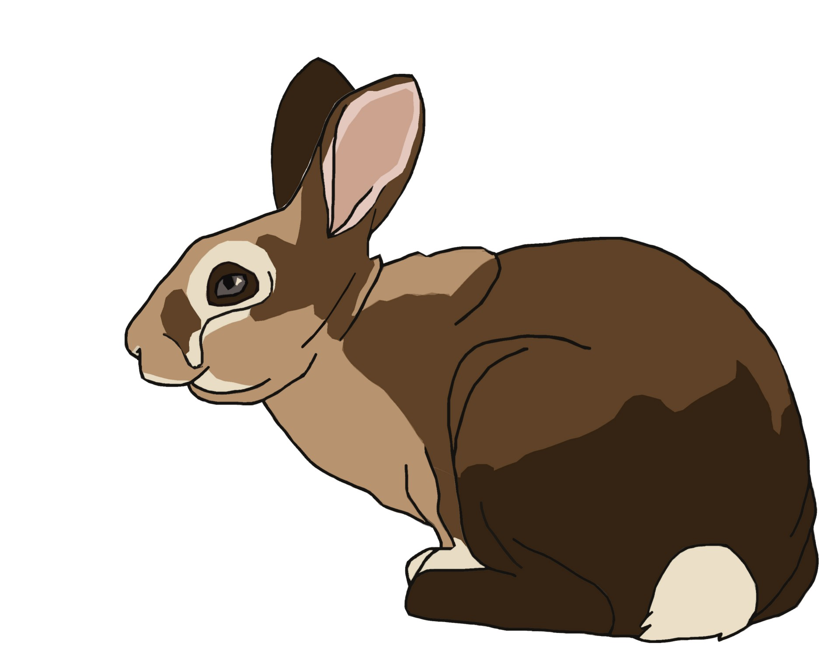

Extraction – Word similarity
 | TROLL | ELF | RABBIT
TROLL | 1 | 0.4 | 0.29
ELF | 0.4 | 1 | 0.34
RABBIT | 0.29 | 0.34 | 1
Notes:
As an example…
let’s say we have 3 words
CLICK
Troll
CLICK
Elf and
CLICK
Rabbit.
All three are nouns, so somewhat similar, but two are fictional creatures so should be more similar.
CLICK
Indeed, we find that to be the case.
Each word pairing returns one when the word is compared to itself and something between 0 and 1 when compared to another word.
Troll and elf are more similar to each other than either is to rabbit.
If we look at the pairwise comparison of word similarity we find it to be true that troll and elf have a similarity score of 0.4, whereas for troll and rabbit it’s much less at 0.34.
Interestingly, rabbit is more similar to elf than to troll, possibly because rabbits and elves are used more often together or in similar context than rabbits and trolls. So maybe they occur in similar kinds of texts, or it could be that they both live in the woods, or they’re both considered as positive, I’m not sure exactly what is the reason but according to the word vectors rabbit and elf are more similar than rabbit and troll and that kind of makes sense.

Slide 23
Extraction – Document similarity
Document similarity works in a comparable way:
Document vectors are created (no pre-loaded document vectors)
2 or more document vectors are compared
Returns value between 0 and 1
‘Emma’ and ‘Persuasion’, both by Jane Austen = 0.99
‘Emma’ by Austen and ‘Julius Caesar’ by Shakespeare = 0.97
‘Emma’ by Austen and ‘Firefox’ from Webtext corpus = 0.86
Notes:
Document similarity
CLICK
you can do something very very similar for document similarity and this is this is a really interesting option that works similar to
word similarity. But instead of having pre-loaded word vectors it builds a vector based on your documents.
NOTE: this is really sensitive to how your documents are processed so if you remove the punctuation if you stem or lemmatise you know all of that that will influence the document vector in a big way.
But what this does is the analysis builds a vector for a document and then compares the vectors between one or
between two or more documents and again it returns value of 0 and 1
For example
CLICK
so as an example Emma and persuasion are both novels by Jane Austen and score 0.99 in terms of similarity. So, we know they are very similar not least because they're both author both books by the same author.
Emma by Austin and Julius Caesar by Shakespeare are 0.97 which isless similar but is still very similar
they're both English language for example little classic literature they're both fictional you know things like that influence this ranking
Emma by Austin and Firefox (which is a selection from a web text corpus cult called web text) score only 0.86
well emma and firefox are both in English, but the grammatical structure of web text is very different than the grammatical structure of fiction
so that they score much lower in similarity
and of course you could do this with as a way of testing the likelihood that two texts are written by the same author or that two texts are
written in the same timeframe or something like that.
this is this is fundamentally the basis for how
plagiarism checkers and things like that go so those instead of scoring a
similarity they score a sort of originality thing so that that rather
than just a simple document vector they also look at sub document sections to see whether things are quoted too
closely whether the particular phrases appear identical in each or whether they're just very similar so there's
there's a lot more complex stuff that can be done but again this is just a basic natural language processing
webinar

Slide 24
Extraction – Discovery
Capturing patterns to discover context and use
Define a pattern
pattern = [{'LOWER': 'like’},
{'LOWER': 'a’},
{'POS': 'NOUN’}]
Returns
like a look
like a merit
like a gentleman
like a job
like a woman
like a bride
like a brother
like a daughter
Notes:
We can set word frequency counts to count which words are next to target words. This is called collocation and is one kind of discovery. We might, for example, want to know whether a particular noun is more often paired with positive adjectives or negative adjectives. But actually, I will show you another kind of discovery
CLICK
based on patterns. First, we define a pattern
CLICK
Which I have defined as the word ‘like’ followed by the word ‘a’ followed by a noun. Searching through ‘Emma’ with this pattern returns
CLICK
These examples. OK. This is a good start. But let’s try something more complicated.

Slide 25
Extraction – Discovery
A more complex pattern
Define a pattern
pattern2 = [{'POS':'VERB’},
{'LOWER': 'like’},
{'LOWER': 'a’},
{'DEP':'amod', 'OP':"?"},
{'DEP':'amod', 'OP':"?"},
{'DEP':'amod', 'OP':"?"},
{'POS': 'NOUN'}]
Returns
looked like a sensible young man
argued like a young man
appear like a bride
seemed like a perfect cure
enters like a brother
writes like a sensible man
Notes:
If we define a more complex pattern
CLICK
Like this one with a verb, followed by ‘like a’ followed by up to three optional modifiers followed by a noun returns
CLICK
Some more interesting fragments.
We can see here that, according to Jane Austen (or at least according to her perception of society at the time)
Men are associated with arguing and writing as well as being young and sensible, in various combinations.
We could continue this analysis to see if women are also associated with arguing and writing or if these are men only things.
Likewise with young and sensible.
You can see how this is a bit like collocation, in that we could find instances of ‘young man’ or ‘sensible man’ but ‘man argued’ or ‘man writes’ is less likely. And pure collocation would not reveal these.
The fact that these appear in ‘like a’ phrases as well suggests standards or expectations, possibly even ideals, that are a bit more abstract than just descriptions or collocations.
Worth a think.

Slide 26
Links to code, python packages and resources
https://github.com/UKDataServiceOpen/Text-Mining-Health
nltk (Natural Language Toolkit) https://www.nltk.org/book/ch01.html
nltk.corpus http://www.nltk.org/howto/corpus.html
spaCy https://nlpforhackers.io/complete-guide-to-spacy/
Semantic vectors package https://github.com/semanticvectors/semanticvectors/wiki
Geometry and Meaning, by Dominic Widdows https://web.stanford.edu/group/cslipublications/cslipublications/site/1575864487.shtml

Slide 27


Louise Capener
louise.capener@manchester.ac.uk
@CapenerLouise
Nadia Kennar
nadia.kennar@manchester.ac.uk
@NadiaKennar
Dr. J. Kasmire
UKDS
@UKDataService
UKDataService
julia.kasmire@manchester.ac.uk
@JKasmireComplex
Notes:
Í

