Slide 1

Basic Details of the Team and Problem Statement
Ministry/Organization Name/Student Innovation:
All India Council for Technical Education (AICTE).
PS Code: DR718 Problem Statement Title: Online integrated platform for projects taken up by the students of various universities/colleges. Team Name: Emerging Programmers
Team Leader Name: S M Navin Durai
Institute Code: 2114
Institute Name: Panimalar Engineering College
Theme Name: Connectverse

Slide 2
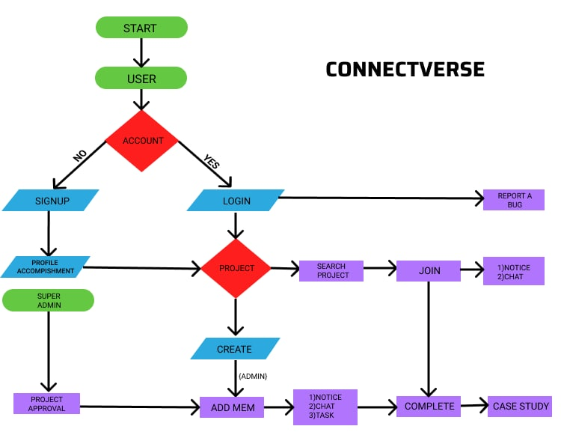
Idea/Approach Details
Idea:
When we first start coding, we may find ourselves stuck in the middle of a project or unsure of where to begin.
This is where the programmer must collaborate on his or her own project or work on the project of others.
Our project provides a platform for them to collaborate on projects, get teamwork experience, develop leadership abilities, and expand their network.
Actors:
Admin is the person in charge of the project. The user is the person who participates in the project. The project is validated by the Super Admin.
Characteristics of the Project:
Students can collaborate on their projects while also improving their cognitive achievement.
There are different levels for admins and users to collaborate on their projects, such as beginner, intermediate, and advanced.
Technology Stack:
Front-end: React-js.
Back-end: Spring Boot (Java).
Database: Postgresql (RDBMS).
Cloud: Heroku, Netlify.
Version Control: GitHub
Domain Provider: Name.com.

Slide 3
Idea/Approach Details
Describe your Use Cases here
Describe your Dependencies / Show stopper here
Create Account,
Login Account.
Complete Profile.
Create Project.
Accept Project.
Search Project.
Join Project.
Complete Project.
The User.
The Project Admin.
The Super Admin.

Slide 4
Team Member Details
Team Leader Name: S M Navin Durai
Branch: B.E Stream: CSE Year: II
Team Member 1 Name: S Ishani
Branch: B.E Stream: CSE Year: III
Team Member 2 Name: S Naveen Kumar
Branch: B.E Stream: CSE Year: II
Team Member 3 Name: S Kaushik
Branch: B.E Stream: CSE Year: II
Team Member 4 Name: S M Loga Subramani
Branch: B.E Stream: CSE Year: II
Team Member 5 Name: V Madhumitha
Branch: B.E Stream: CSE Year: III
Team Mentor 1 Name: Dr. P J SATHISH KUMAR
Branch: Academic Stream: Web Development Year: 5 Years
Team Mentor 2 Name: V Tamilarasi
Branch: Industry Stream: SAP Basis Year: 1 Year

