Slide 1

Implementing Deep learning Models
Bhakti Ukey :002922939
07-04-2022

Slide 2
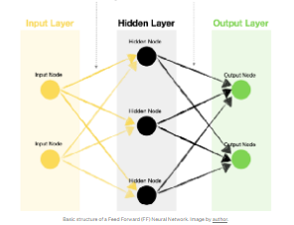
Feed Forward Neural Network on Loan Data
Most frequently used to solve classification and regression problem using labeled training dataset
Structure
For input layer and hidden layer: Activation function used is ReLu
Output Layer : sigmoid
Loss : (size of the error) BinaryCrossentropy
Optimizer: SGD (backpropogation)
Epochs:150

Slide 3
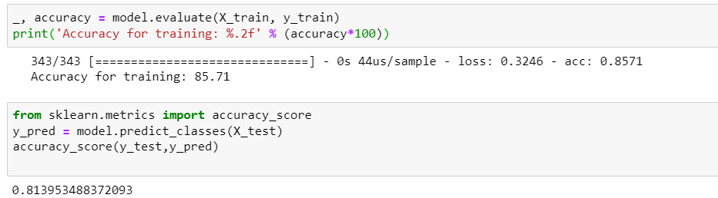
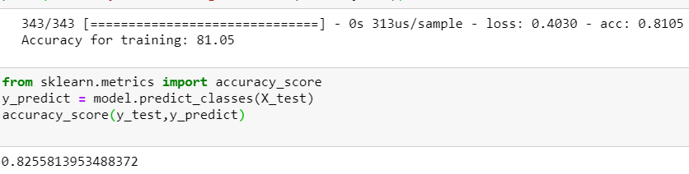
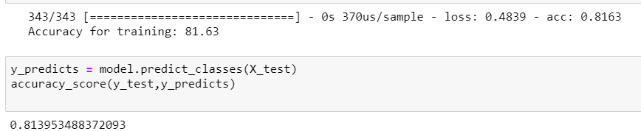
Results for Feed Forward Neural Network
With the entire data set:
Train: 86%
Test: 81%
Dropping Time_at _Add
Train: 81%
Test : 83%
Dropping tele & acc_ref
Train: 82%
Test : 81%

Slide 4
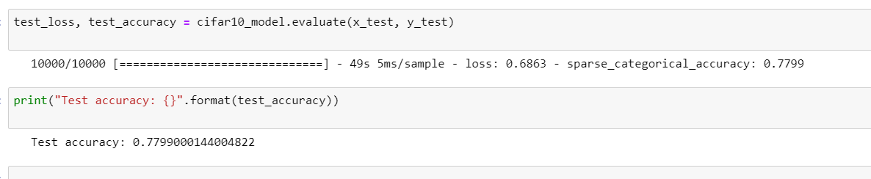
Convolution Neural Network from Scratch on CIFAR-10
The dataset consists of 60000 color images in 10 classes with a small image size of 32x32.
There are 50000 training images that are divided into a set of five batches and 10000 testing images.(90/10)
API used : Keras
Total layers : 10
Test Accuracy : 78%

Slide 5
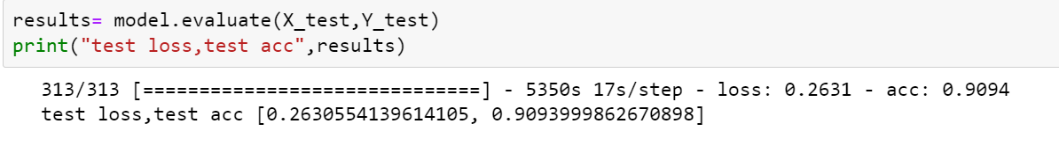
Pre-Trained CNN
InceptionResNetV2 is used as the Keras Application.
Keras expects a specific kind of input processing which is: k.applications.InceptionResNetV2
Weights used for pre-training are imagenet
Base model has 7 layers
Added 5 more layers on the top
Test Accuracy : 91%
Epochs: 4

Slide 6
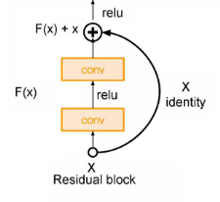
Cifar-10 Using Resnet Model
API : Pytorch(faster than keras with better debugging capability)
Architecture: Basic residual block help (vanishing gradient problem)
No of layers : 4
Epochs: 10,20,30
Best results for epochs=30

Slide 7
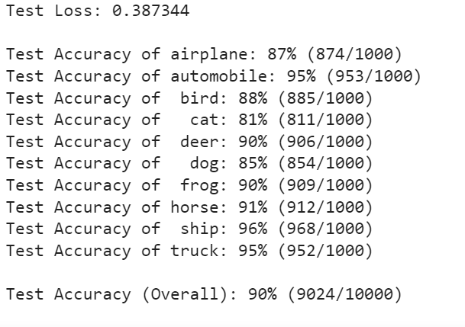
Results for Resnet
Test accuracy with 10 epochs was 86%
01
Test accuracy with 20 epochs was 89%
02
Test accuracy with 30 epochs was 90%
03

