Slide 1

Applying Gaussian Mixture Model and K-means to Boston Dataset
NAME: BHAKTI UKEY
DATE: 23-02-2021

Slide 2
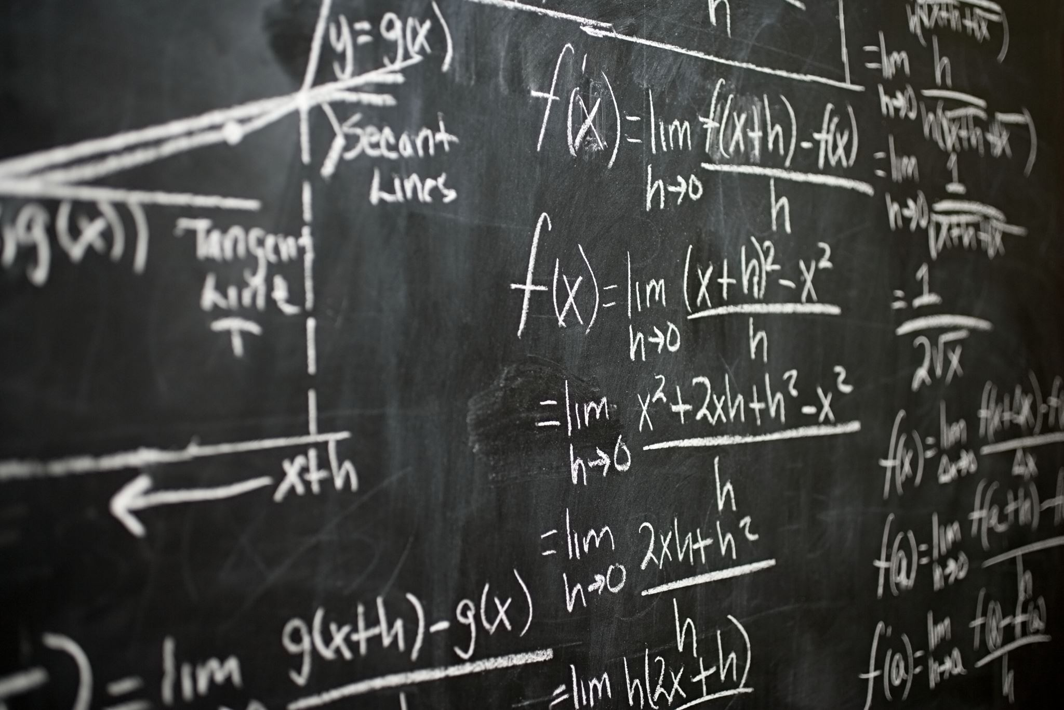
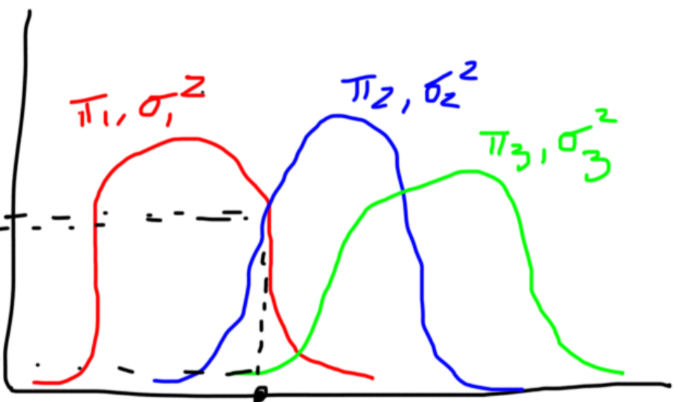
What is Gaussian Mixture Model?
GMM is an unsupervised clustering technique that assumes that there are a certain number of Gaussian distribution, and each this distribution represents a cluster.
Let’s say we have three Gaussian distributions and they have certain mean (μ1, μ2, μ3) and variance (σ1, σ2, σ3) value respectively. For a given set of data points, GMM would identify the probability of each data point belonging to each of these distributions.

Slide 3
Comparing Gaussians Mixture Models and Kmeans
KMeans | Gaussian Mixture Models
It's a distance-based model: It places a circle at the center of each cluster, with a radius defined by the most distant point in the cluster. Uses hard classification: It does not give the probability only gives the distance Works best if the data has circular clusters | It's a distribution- based model It considers each cluster to be a Gaussian distribution. Uses Soft classification: tells probability of data point belonging to possible cluster Can handle oblong(2D shaped ) clusters.

Slide 4
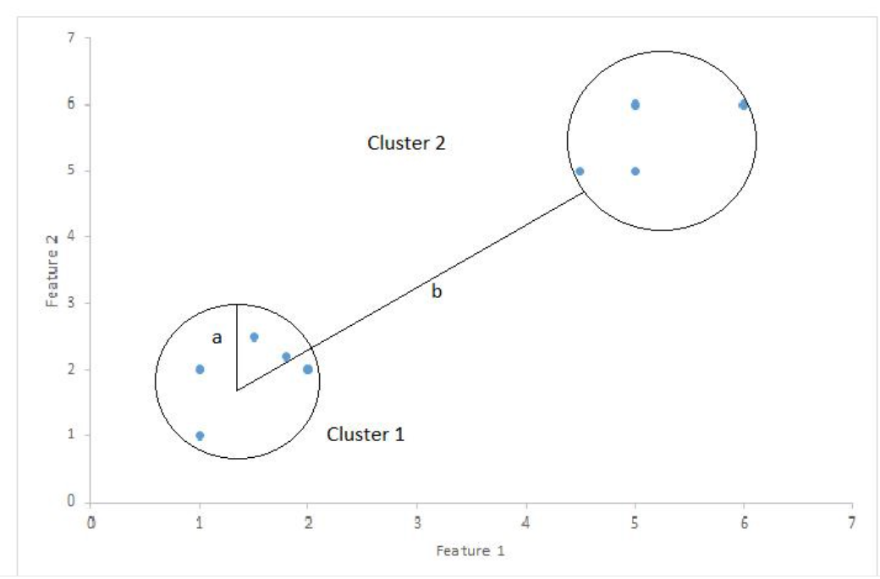
Silhouette score
Silhouette Coefficient or silhouette score is a metric used to calculate the goodness of a clustering technique. Its value ranges from -1 to 1.
1: Means clusters are well apart from each other and clearly distinguished.
0: Means clusters are indifferent, or we can say that the distance between clusters is not significant.
-1: Means clusters are assigned in the wrong way.
Silhouette Score = (b-a)/max(a,b)
Where:
a= average intra-cluster distance i.e the average between each point within a cluster.
b= average inter-cluster distance i.e the average distance between all clusters.

Slide 5
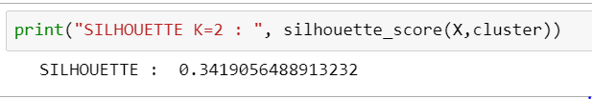

Output and Conclusion
Sihouette_score for Gaussian
Conclusion:
K=2 is the optimum number of clustering
Sihouette_score for Kmeans

