Slide 1

Applying SVM Classification on the Loan Dataset
Name: Bhakti Ukey(002922939)
Date: 02-03-2021

Slide 2
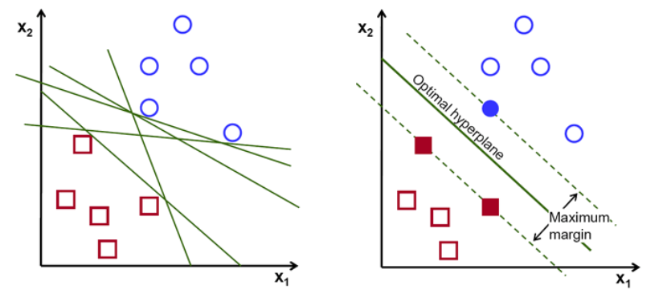
Support Vector Machine Using Kernel
SVM is a supervised Machine Learning algorithm
The objective of the support vector machine algorithm is to find a hyperplane in N-dimensional space(N — the number of features) that distinctly classifies the data points.
Kernel is used when we are dealing with non-linear dataset.
The Kernel is a function that takes the original non-linear problem and transforms it into linear one with higher dimensional space.

Slide 3
The Three Kernels
Linear Kernel: Decision boundary that separates features is linear space.
Polynomial Kernel : Decision boundary that separates features into higher order polynomial
Radial Basis Function Kernel : Decision boundary that separates features into infinite feature space.

Slide 4
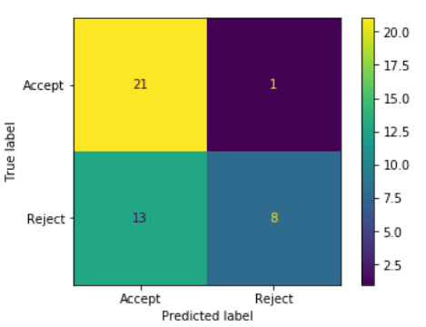
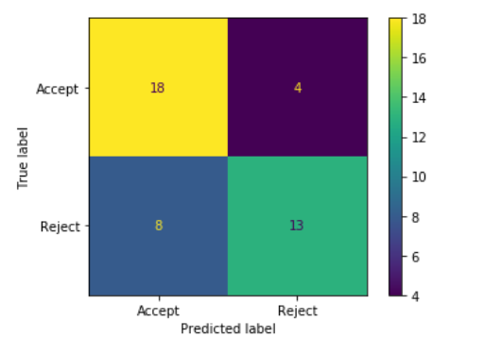
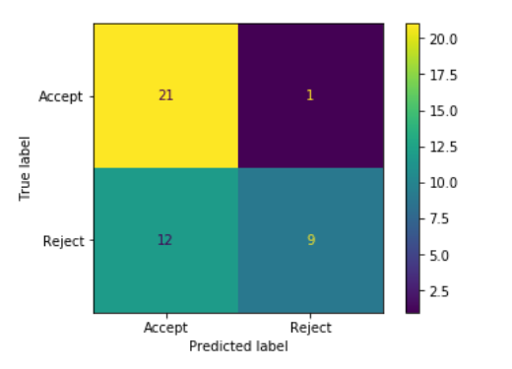
Output
Linear Kernel: Accuracy_score – 72%
Polynomial Kernel: Accuracy_score – 67%
RBF Kernel: Accuracy_score- 70%

Slide 5

Summary and Conclusion
The Linear Kernel gives the best accuracy, but the RBF classifies more datapoints correctly

