Slide 1

Image Captioning On Flicker 8K Dataset
Final Project Presentation: 04-05-2022
Bhakti Ukey : 002922939

Slide 2
Flicker_8k Dataset
The dataset has 2 folders:
Contains the 8k pictures: There are 8092 unique files
Containing various files such as: test images, train images, caption text

Slide 3
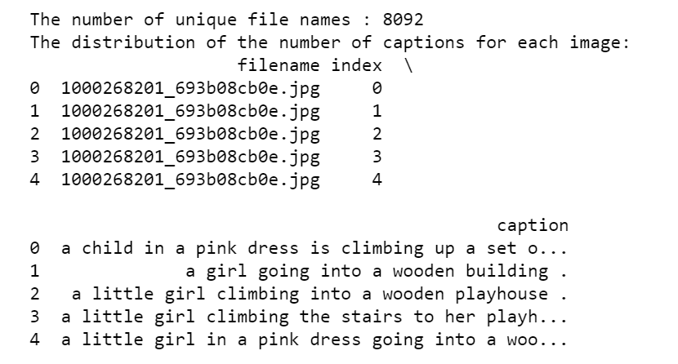
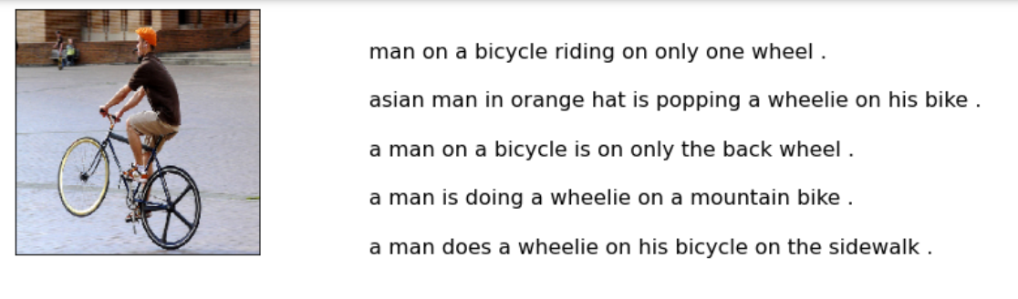
Data Visualizing
Finding
Caption
For each image
Visualizing
the
Dataset

Slide 4
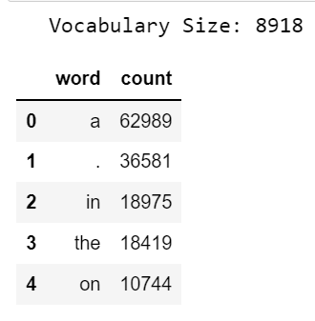
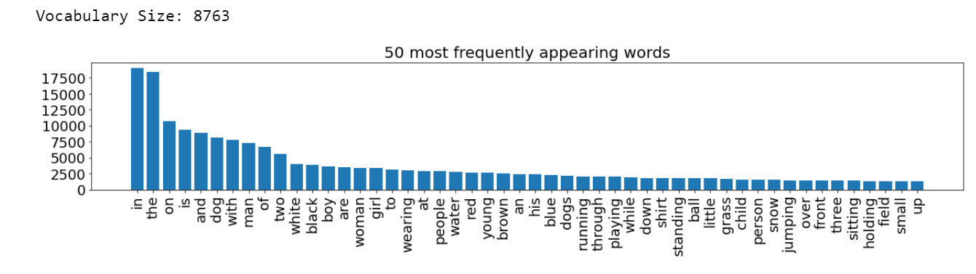
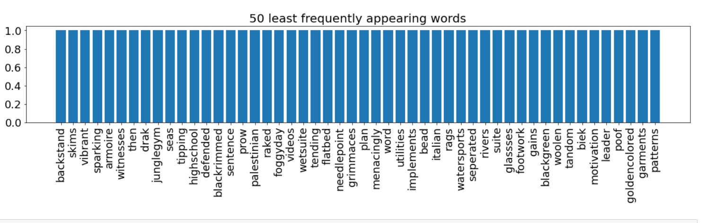
Data Visualization

Slide 5
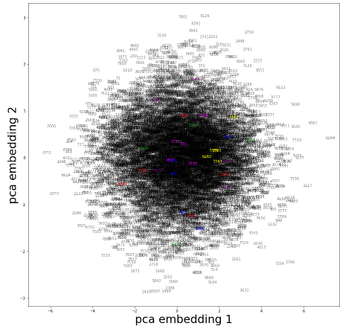
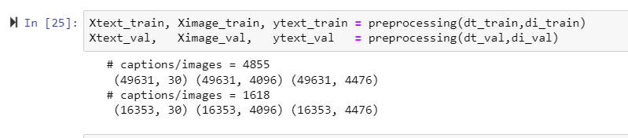
CNN+LSTM
Pretrained model used: VGG-16
Performed Feature extraction
Checked for clustering with PCA
Trained the model :

Slide 6
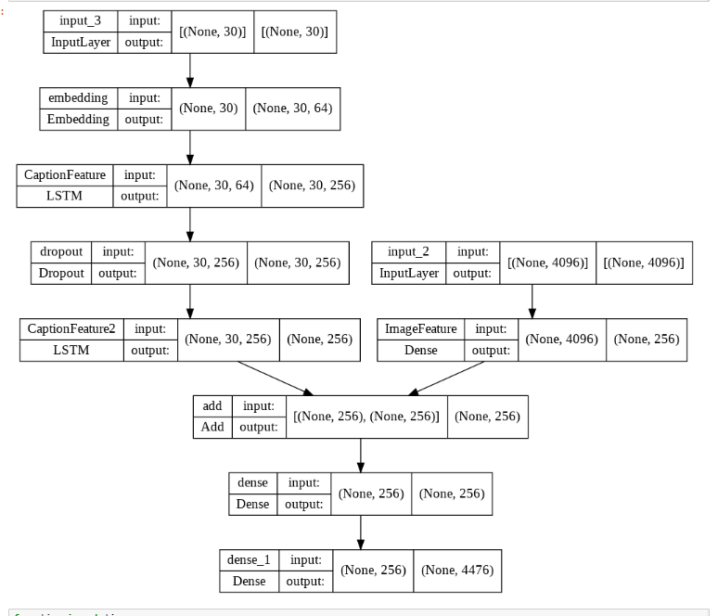
Decoder: LSTM

Slide 7
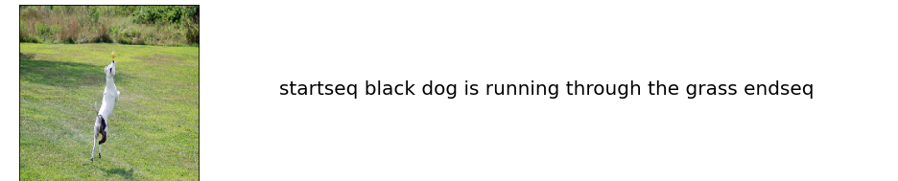
Predicted Results:

Slide 8
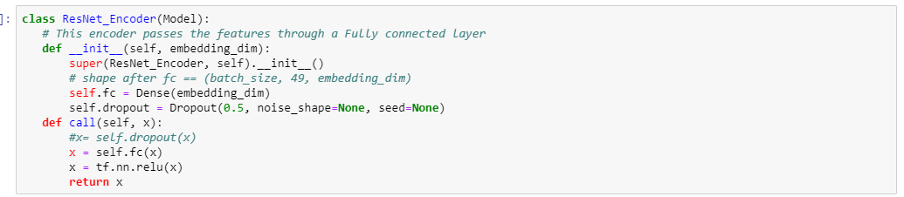
Resnet+GRU
Pretrained model :ResNet152V2
Encoder Resnet:

Slide 9
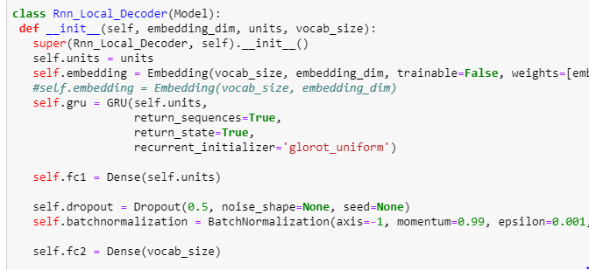
Decoder: Gru

Slide 10
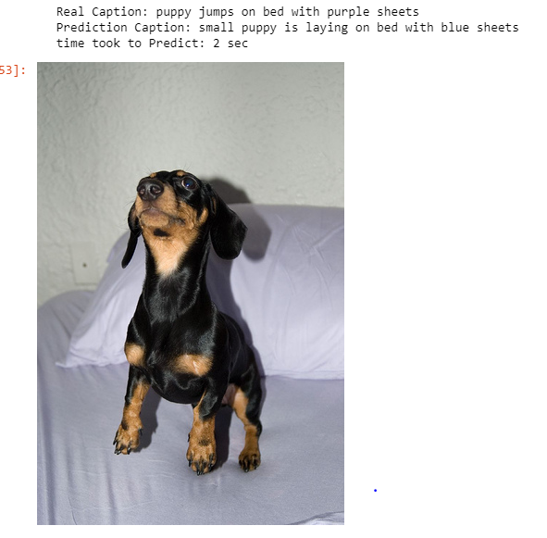
Results :GRU

Slide 11


BLEU SCORE COMPARISION
BLEU Score
for
CNN+RESNET
BLEU Score
for
Resnet+Gru

Slide 12
Conclusion
Both the models are trained successfully to generate the captions as expected for the images.
Higher Bleu Score indicates that the generated caption are very similar to actual captions
However, Higher BLEU Scores doesn’t always translate to better generated captions.
Model overfitting can lead the model to go through details in the image and generate captions which don't make sense.

