Slide 1
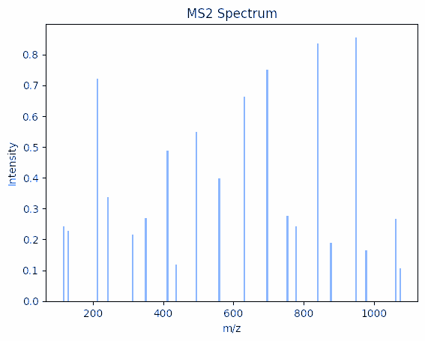
In silico proteomics
Python Vertiefungspraktikum
5. FS MoBi
Group: Isabell Bludau

Slide 2
Goal of this course
Consolidate your python skills learned in DataCamp
  Basic python libraries and data structures: lists, dictionaries, dataframes (pandas), arrays (NumPy)
  Basic programming: loops, list comprehension, basic plotting, if/else, writing of own functions
  Good cheat sheet: https://spathis.medium.com/the-only-python-cheat-sheet-you-will-ever-need-42b41cc54b3d
Perform an in silico mass spectrometry proteomics experiment
> Understand the classical mass spectrometry based proteomics workflow

Slide 3
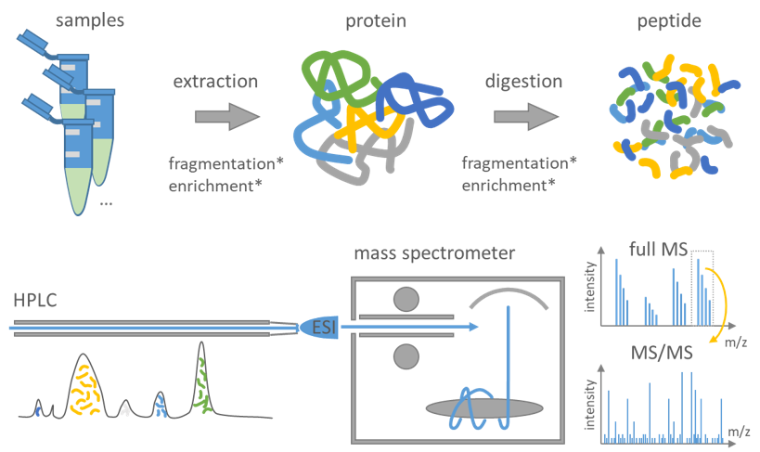
Classical bottom-up proteomics workflow
https://csbiology.github.io/BIO-BTE-06-L-7/NB02a_Mass_spectrometry_based_proteomics.html

Slide 4
In silico proteomics workflow
https://csbiology.github.io/BIO-BTE-06-L-7/NB02a_Mass_spectrometry_based_proteomics.html
(1) Extract proteins from fasta file
(2) In silico protein digestion
(3) Predict peptide retention times in liquid chromatography
(4) Simulate MS spectra

Slide 5
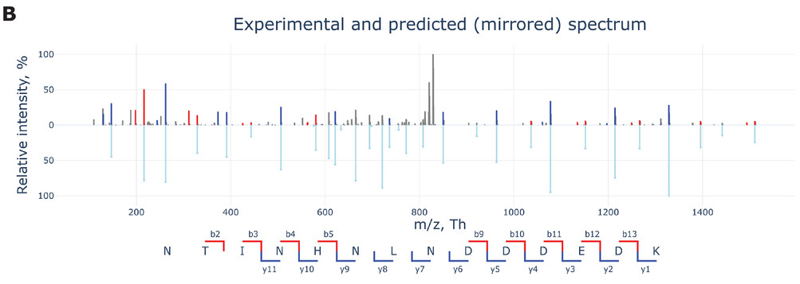
Why is in silico proteomics important?
> Identify which peptide an experimental spectrum belongs to

Slide 6
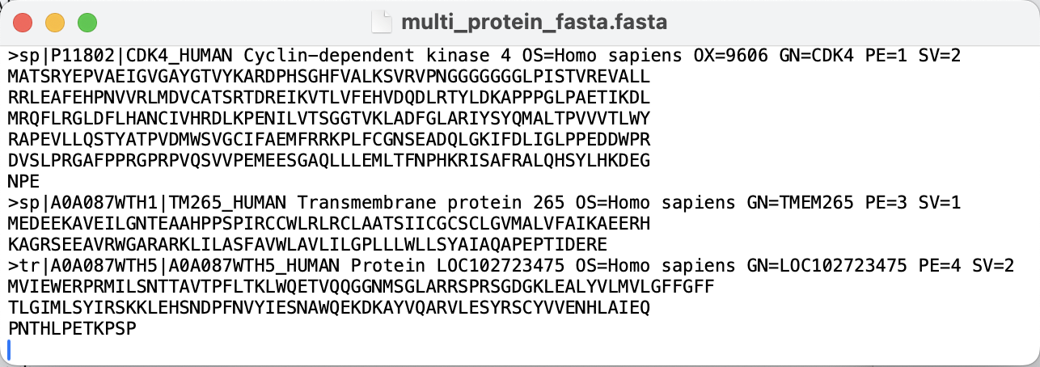
Overview
Extract proteins
from fasta file
In silico protein digestion
Predict peptide retention times in liquid chromatography
Simulate MS spectra
Understand FASTA format for protein sequences.
Practice reading files line by line and working with different data structures.
Using string operations, loops, if/else statements, lists and dictionaries.

Slide 7
Overview
Extract proteins
from fasta file
In silico protein digestion
Predict peptide retention times in liquid chromatography
Simulate MS spectra
Use regular expressions to identify enzyme-specific cleavage sites.
Write a Python function to simulate protein digestion, with configurable parameters.
Analyze the results to understand which enzymes might be best suited for proteomics analysis.
Tools: regular expressions, loops, list comprehension, dictionaries, pandas, matplotlib and seaborn

Slide 8
Overview
Extract proteins
from fasta file
In silico protein
digestion
Predict peptide retention times in liquid chromatography
Simulate MS spectra
Learn why separating peptides via liquid chromatography (LC) before mass spectrometry (MS) improves detection accuracy.
Use a retention time prediction model to estimate LC retention times based on peptide hydrophobicity.
Plot histograms of predicted retention times to analyze how peptides are separated in LC.
Tools: using external libraries, visualization with matplotlib

Slide 9
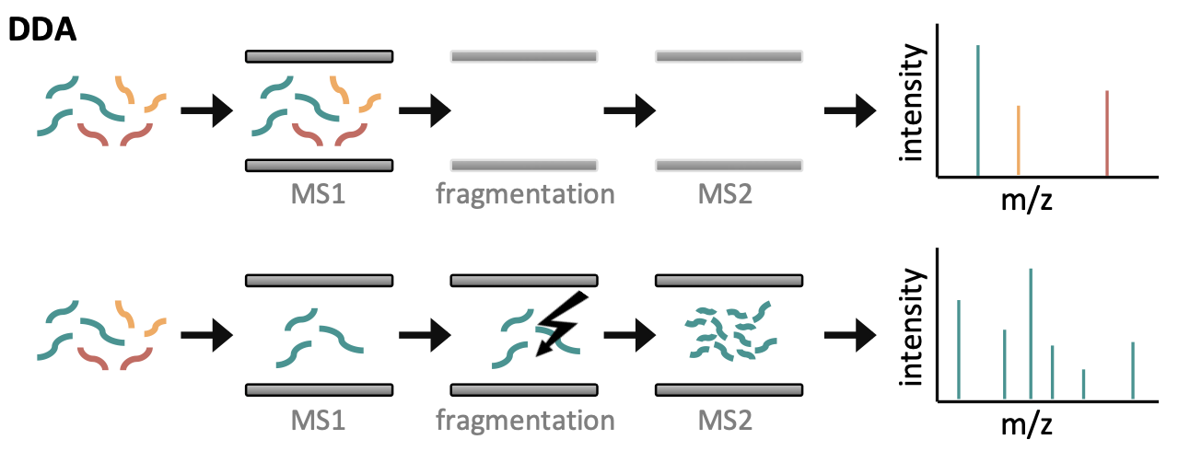
Overview
Extract proteins
from fasta file
In silico protein
digestion
Predict peptide
retention times in liquid chromatography
Simulate MS spectra
Understand the basic workings of mass spectrometry data acquisition, including MS1 spectrum acquisition, peptide fragmentation and MS2 spectrum acquisition.
MS1 spectrum
MS2 spectrum
Bludau I & Aebersold R., Nat Rev Mol Cell Biol. (2020) doi:10.1038/s41580-020-0249-5.

Slide 10
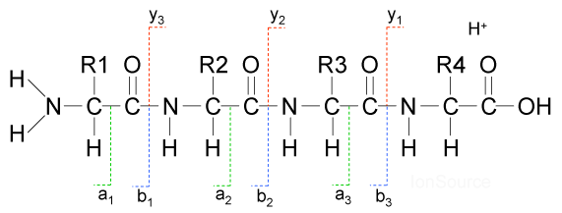
Overview
Extract proteins
from fasta file
In silico protein
digestion
Predict peptide
retention times in liquid chromatography
Simulate MS spectra
Understand the basic workings of mass spectrometry data acquisition, including MS1 spectrum acquisition, peptide fragmentation and MS2 spectrum acquisition.
Calculating peptide and fragment ion masses and mz values.
Practice basic string slicing to simulate peptide fragmentation into b- and y-ions.

Slide 11
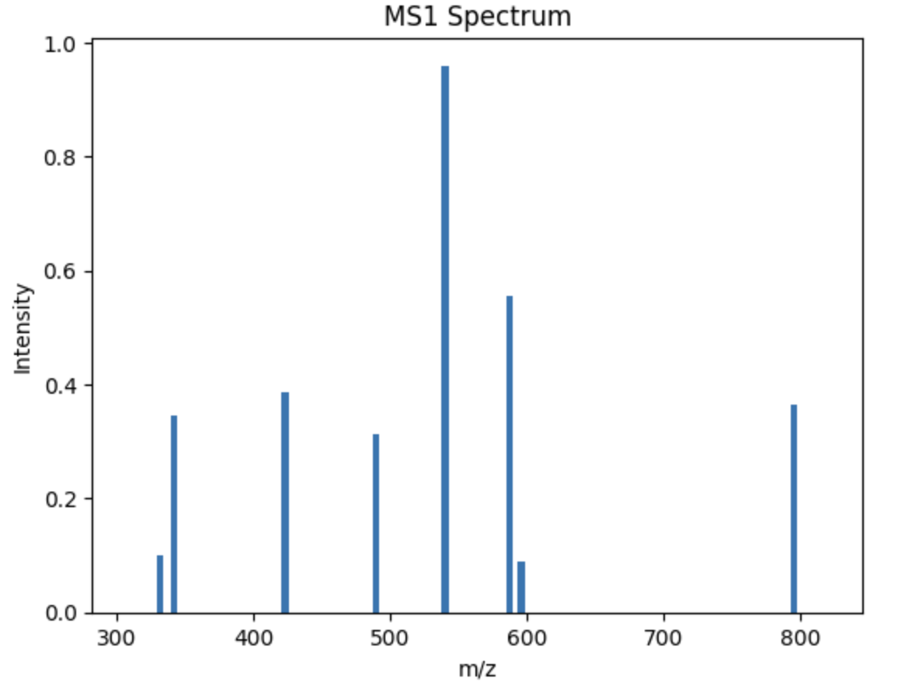
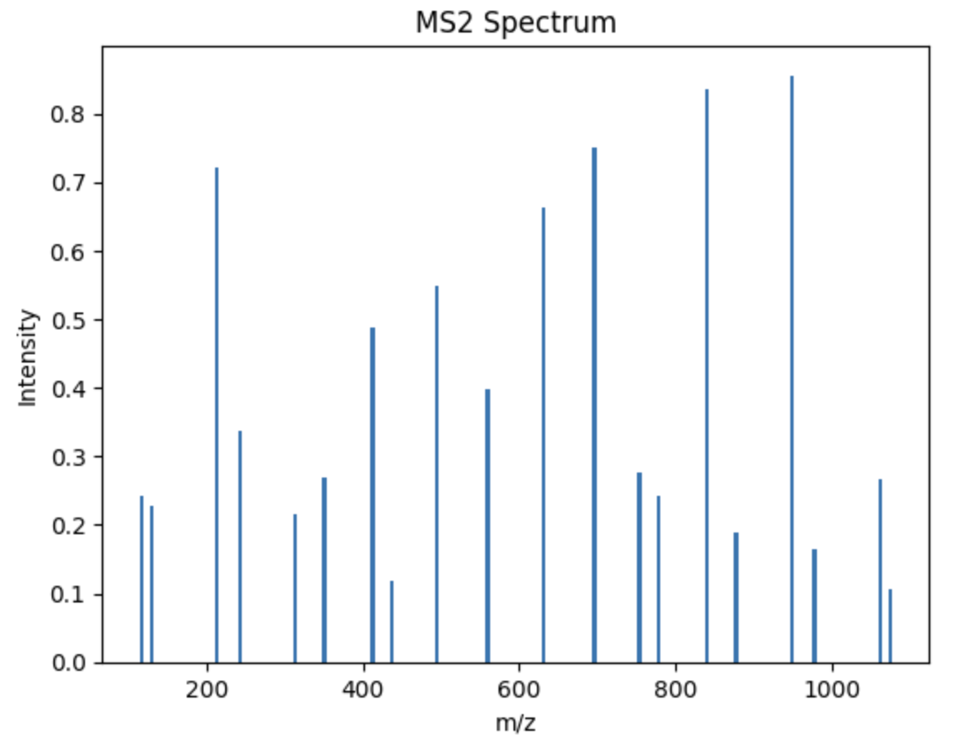
Overview
Extract proteins
from fasta file
In silico protein
digestion
Predict peptide
retention times in liquid chromatography
Simulate MS spectra
Understand the basic workings of mass spectrometry data acquisition, including MS1 spectrum acquisition, peptide fragmentation and MS2 spectrum acquisition.
Calculating peptide and fragment ion masses and mz values.
Practice basic string slicing to simulate peptide fragmentation into b- and y-ions.
Generate random intensity data for MS spectra using Python's NumPy library.
Visualize MS1 and MS2 spectra using Python's matplotlib library.
Tools: slicing, random number generation, numpy, matplotlib

